Slide 1
Welcome to our services
New Lebanon Church of Christ
We are Simply Christians.
Our Emphasis is Spiritual, Not Material or Social.
We are striving to be The Same Church as Described in The New Testament.
Please Come Back Again

Slide 2
Practicing
What We Preach
THE inspired Luke begins the book of Acts after this manner: "The former treatise have I made, O Theophilus, of all that Jesus began both to do and teach." (Acts 1:1.)

Slide 3
Practicing What We Preach Acts 1:1
Notice the order: do and teach. Too many today have reversed that order.
They begin to teach before they begin to do.
No teaching has greater weight than that which is done by doing. In other words, teaching will not be effective unless the teacher lives what he teaches.

Slide 4
Practicing What We Preach Acts 1:1
Jesus, the Master Teacher, not only taught but he lived what he taught.
On one occasion some of the disciples of John were sent to Jesus.
These two disciples of John were instructed to ask Jesus this question: ''Art thou he that should come, or do we look for another?'" (Matt. 11:3.)

Slide 5
Practicing What We Preach Acts 1:1
Christ could have made many arguments in answering this question.
He could have made an argument using (Gen.3:15). He could have shown that he was the fulfillment of the prophecy here made.
But he did not do it! He could have taken dozens of other prophecies from the Old Testament and shown how he was the fulfillment of these prophecies. But he did not do it!

Slide 6
Practicing What We Preach Acts 1:1
How did he answer this question? How did he set about to prove to John and his disciples that he was he "that should come"? He didn’t use any great arguments. He simply said:
"Go and show John again those things which you do hear and see: the blind receive their sight, and the lame walk, the lepers are cleansed, and the deaf hear, the dead are raised up, and the poor have the gospel preached to them:" (Matt. 11:4, 5.)

Slide 7
Practicing What We Preach Acts 1:1
Jesus proved his teaching by what he did. His works gave the weight to what he said.
We can teach in these two ways.
We must teach the truth,
but this teaching must be backed up by the practice.

Slide 8
Practicing What We Preach Acts 1:1
1.Jesus taught that men ought always to pray.
(Luke 18:1.) Did he practice what he taught?
Time after time we read about Jesus praying.
"And it came to pass in those days, that he went out into a mountain to pray, and continued all night in prayer to God.“ (Luke 6:12.)

Slide 9
"And he went a little farther, and fell on his face, and prayed.“
"He went away again the second time, and prayed.“
"And he left them, and went away again, and prayed the third time." (Matt. 26.)
Not one of us can imagine Jesus saying that we ought to pray, but not practicing it himself.
What gave the weight to the teaching?

Slide 10
Practicing What We Preach Acts 1:1
1.Jesus taught that men ought always to pray.

Slide 11
Practicing What We Preach Acts 1:1
2.Jesus taught men to be humble.
He even washed the feet of the disciples to impress this lesson of humility upon them. Some of our religious neighbors have entirely missed the lesson here.
The disciples did not get the full import of the lesson at the time. Jesus said:
"What I do you know not now; but you shall know hereafter." (John 13:7.)

Slide 12
Of course Peter and the other disciples knew that Jesus was washing their feet, but they missed the great lesson of humility.
They got it later.
It would seem that all would get it today.
Would the teaching of Jesus have had weight if he had not been the very embodiment of humility?

Slide 13
Practicing What We Preach Acts 1:1
1.Jesus taught that men ought always to pray.
2.Jesus taught men to be humble.

Slide 14
Practicing What We Preach Acts 1:1
3.Jesus taught us to love.
Did he practice love? (Rom. 5:6-8.) "For when we were yet without strength, in due time Christ died for the ungodly. For scarcely for a righteous man will one die: yet peradventure for a good man some would even dare to die. But God commends his love toward us. in that, while we were yet sinners, Christ died for us."
Christ sealed his love with his death.

Slide 15
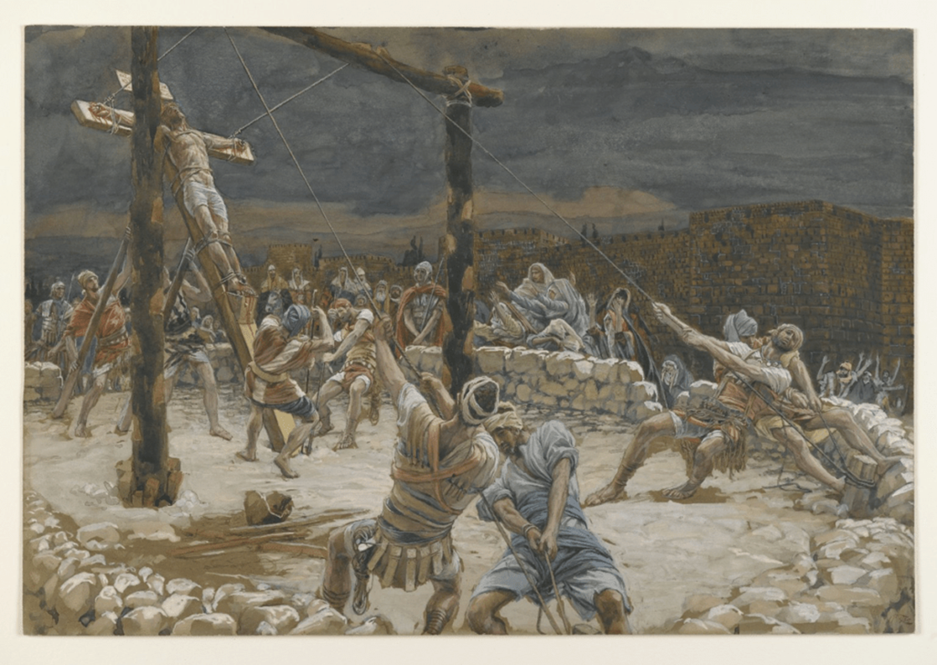

Slide 16
Practicing What We Preach Acts 1:1
1.Jesus taught that men ought always to pray.
2.Jesus taught men to be humble.
3.Jesus taught us to love.

Slide 17
Practicing What We Preach Acts 1:1
4.Jesus taught giving.
Paul told the Ephesian elders "to remember the words of the Lord Jesus, how he said, It is more blessed to give than to receive." (Acts 20:35.)
Jesus gave up the joys of heaven to save sinners. When he was here, he gave his very all that a lost and evil race might be saved. He gave his very life to redeem us from our fallen state. When Jesus taught that we ought to give, he set the example by giving everything. This gave the weight to his teaching.

Slide 18
Practicing What We Preach Acts 1:1
1.Jesus taught that men ought always to pray.
2.Jesus taught men to be humble.
3.Jesus taught us to love.
4.Jesus taught giving.

Slide 19
Practicing What We Preach Acts 1:1
5.Jesus instituted the Lord's Supper,
saying: "This do in remembrance of me." (Luke 22:19.) He set the example. He ate the Supper.
And we don’t “brown bag” the Lord’s Supper.”
We don’t get it to go.
We take it in the assembly when we come together every first day of the week.

Slide 21
A Man Made Religion 1Kings 12

Slide 22
Practicing What We Preach Acts 1:1
1.Jesus taught that men ought always to pray.
2.Jesus taught men to be humble.
3.Jesus taught us to love.
4.Jesus taught giving.
5.Jesus told us to take the Lord's Supper,

Slide 23
Practicing What We Preach Acts 1:1
6. Before Jesus went back to heaven he said: "He that believeth and is baptized shall be saved."
(Mark 16:16') But before saying this he had set the example. He had been baptized to fulfill all righteousness. (Matt. 3:15.)
His commandment is given added force by his example. Many times false doctrines are given weight because the false teachers are doing some good works. How often do we meet such an expression as this. –
"But they are doing so much good"!

Slide 24
Practicing What We Preach Acts 1:1
The doctrine may be as false as Satan himself, but it is given some credence by folks because the ones sponsoring the doctrine may be doing some good works. And, conversely, how often has truth been retarded because the one teaching it was not practicing it!
Error would not get such a hold upon men if it were not for the fact that some good works are mixed with the false teaching.
And the truth would run and be glorified much faster if the ones who teach it would live it, if they would begin to do and teach, if they would so live that others would hear and see.

Slide 25
Practicing What We Preach Acts 1:1
Paul wrote to Timothy saying: ''Take heed unto thyself, and unto the doctrine; continue in them: for in doing this thou shalt both save thyself, and them that hear thee." (1 Tim. 4:16.)
To Titus he wrote: "For the grace of God that bringeth salvation hath appeared to all men, teaching us that, denying ungodliness and worldly lusts, we should live soberly, righteously, and godly, in this present world; looking for that blessed hope, and the glorious appearing of the great God and our Saviour Jesus Christ." (Titus 2:11-13.)

Slide 26
Practicing What We Preach Acts 1:1
Paul said in (Rom. 2:21, 22) You therefore which teach another, teach thou not thyself? thou that preach a man should not steal, dost you steal? 22 You that say a man should not commit adultery, do you commit adultery? you that abhor idols, do you commit sacrilege?

Slide 27
Practicing What We Preach Acts 1:1
1.Jesus taught that men ought always to pray.
2.Jesus taught men to be humble.
3.Jesus taught us to love.
4.Jesus taught giving.
5.Jesus instituted the Lord's Supper,
6. Jesus said: "He that believeth and is baptized shall be saved."

Slide 28
Practicing What We Preach Acts 1:1
1.Jesus taught that men ought always to pray.
2.Jesus taught men to be humble.
3.Jesus taught us to love.
4.Jesus taught giving.
5.Jesus instituted the Lord's Supper,
6. Jesus said: "He that believeth and is baptized shall be saved."
Are we practicing what Jesus wants us to do?

Slide 29
The World’s Bible
Verse 1: Christ has no hands but our hands To do His work today, He has no feet but our feet To lead men in His way; He has no tongue but our tongues To tell men how He died, He has no help but our help To bring them to His side.
Verse 2: We are the only Bible The careless world will read, We are the sinner’s gospel, We are the scoffers’ creed; We are the Lord’s last message Given in deed and word, What if the type is crooked? What if the print is blurred?
Verse 3: What if our hands are busy With other things than His? What if our feet are walking Where sin’s allurement is? What if our tongues are speaking Of things His life would spurn, How can we hope to help Him And welcome His return?

Slide 30
Practicing What We Preach Acts 1:1
May the dear Lord help us not to teach anything that we are not practicing,
and help us to practice what we teach.

