Slide 1
Welcome to our services
New Lebanon Church of Christ
We are Simply Christians.
Our Emphasis is Spiritual, Not Material or Social.
We are striving to be The Same Church as Described in The New Testament.
Please Come Back Again

Slide 2
So you must also
bear witness at Rome. Acts 23:11
Acts 23:11 But the following night the Lord stood by him and said, "Be of good cheer, Paul; for as you have testified for Me in Jerusalem, so you must also bear witness at Rome."

Slide 3
5 defenses
background
characters
places

Slide 4
Acts 9:15
But the Lord said to him,
"Go, for he is a chosen vessel of Mine to bear My name before Gentiles, kings, and the children of Israel.
16 "For I will show him how many things he must suffer for My name's sake."

Slide 5
Characters
Agabus the prophet
Lysias the chief captain
Sanhedrin(Pharisees and Sadducees)
Paul’s nephew
Felix the governor and Drusila his wife
Ananias the High Priest
Tertullus - Jewish lawyer to plead case against Paul
Festus- Procurator of Judea
King Agrippa and Bernice

Slide 6
In a hurry to get to Jerusalem for Pentecost feast
Ch.20 Paul meets with elders from Ephesus.
Ch.21:10 following, Agabus the prophet.
Ch.22:16 repeats conversion story.
Ch.23 Paul preaches to the Jewish council – Sanhedrin.
Ch.24 Paul reasons with Felix. Righteousness, self-control, judgment to come.
Ch.25:10-11 before Festus. I appeal to Caesar.
Ch.26 Paul before Herod Agrippa.
Ch.27 travel by ship to Rome. Storm. Spared.
Ch.28 arrive at Rome
Ch.28:30-31 under arrest proclaiming kingdom of God.
Paul arrested in temple.

Slide 7
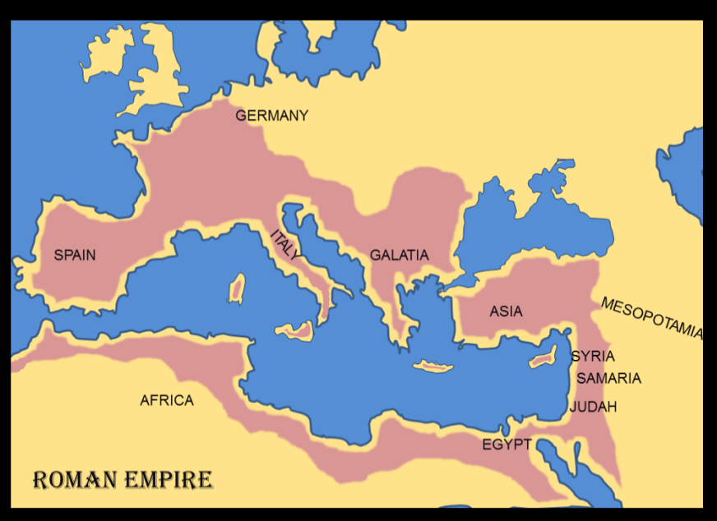
In 63 B.C. Rome
gained possession of Palestine.
HOW ROMAN RULE AFFECTED THE JEWS—
Rome brought peace to the whole world.
Jews were allowed political liberty and self government.
As much as possible, Rome worked through local rules.
They were required to pay a yearly tax.
Rome constructed roads.
THE HERODS
Rulers of Palestine (47 B.C. to A.D. 93)
Herod is a name used by several kings belonging to the Herodian Dynasty of the Roman province of Judaea.
Herod the Great, 37-4 B.C.
Herod Antipas, 4 B.C.-A.D. 39
Herod Archelaus, 4 B.C.-A.D. 6
Herod Philip, 4 B.C.-A.D. 39
Herod Agrippa I, A.D. 41-44
Herod of Chalcis, A.D. 48-53
Herod Agrippa II, A.D. 53-93

Slide 8
The Twelve Caesars
“. . . I appeal unto Caesar” Acts 25:11”
CAESAR BIRTH DEATH REIGN
“And it came to pass in those days, that there went out a decree from Caesar Augustus, that all the world should be taxed” Luke 2:3.

Slide 9
The providence of God in using the Roman government to transport Paul to proclaim the gospel to a governor, a king, and a Caesar.
Three Taverns
Appii
The Journey To Rome

Slide 10
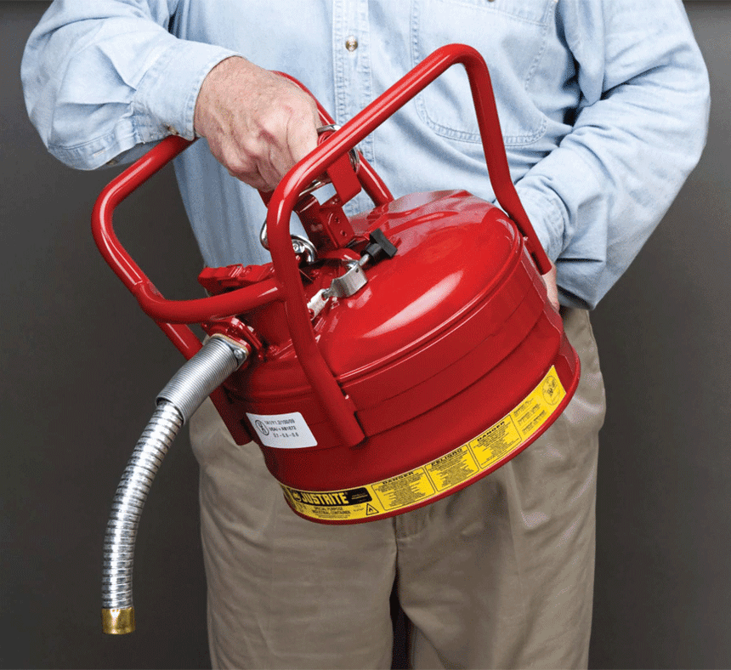
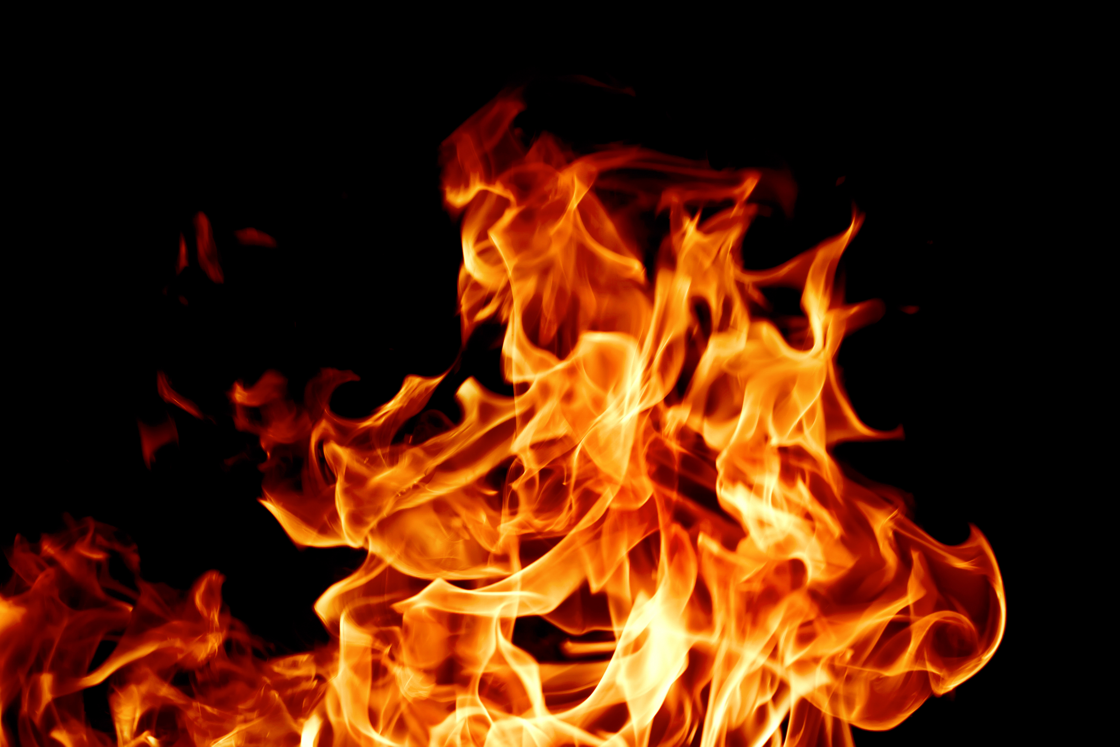
Then Paul stretched forth his hand and made his defense Acts 26:1
Trigger words:
1 Gentiles
2 Pharisees

Slide 11
Chapter 21
Paul went to Jerusalem—even though he was warned not to by the brethren and the prophet Agabus.
Paul made a vow in the Temple.
The Jews accused Paul of polluting the Temple bringing Gentiles in.

Slide 12
Then Paul stretched forth his hand and made his defense Acts 26:1
Paul’s first defense: from the steps Acts 22
Paul made a defense before the Jewish mob.
Paul was arrested and taken into the castle to be questioned.
Paul told the Chief Captain Lysias that he was a Roman.

Slide 13
Paul, standing on the stairs, beckoned with the hand to the people
Paul addresses the angry crowd in Jerusalem
21:40
Notes:
This image comes from Gustave Doré via Wikimedia Commons and is in the public domain, https://commons.wikimedia.org/wiki/File:Paul_Addresses_the_Crowd_After_His_Arrest_by_Gustave_Dor%C3%A9.jpg.
wiki101820061410

Slide 14
Then Paul stretched forth his hand and made his defense Acts 26:1
Paul’s second defense: his plea before the Sanhedrin Acts 23
Paul spoke to the Jewish Council.
The High Priest had Paul slapped in the face.
There was dissension between the Pharisees and Sadducees.
The Jews physically attacked Paul.
The Chief Captain rescued Paul by arresting him.

Slide 15
Acts 23:9 Then there arose a loud outcry. And the scribes of the Pharisees' party arose and protested, saying, "We find no evil in this man; but if a spirit or an angel has spoken to him, let us not fight against God."
10 Now when there arose a great dissension, the commander, fearing lest Paul might be pulled to pieces by them, commanded the soldiers to go down and take him by force from among them, and bring him into the barracks.
11 But the following night the Lord stood by him and said, "Be of good cheer, Paul; for as you have testified for Me in Jerusalem, so you must also bear witness at Rome."
12 And when it was day, some of the Jews banded together and bound themselves under an oath, saying that they would neither eat nor drink till they had killed Paul.
13 Now there were more than forty who had formed this conspiracy.

Slide 16
Chapter 23 continued—
Paul’s nephew warned him and the Chief Captain of the vow.
The Chief Captain got 470 men to escort Paul to Caesara.
The Chief Captain didn’t go but sent a letter addressed to Felix.

Slide 17
Acts 23:23 And he called for two centurions, saying, "Prepare two hundred soldiers,
seventy horsemen,
and two hundred spearmen
to go to Caesarea at the third hour of the night;
24 "and provide mounts to set Paul on, and bring him safely to
Felix the governor."

Slide 18
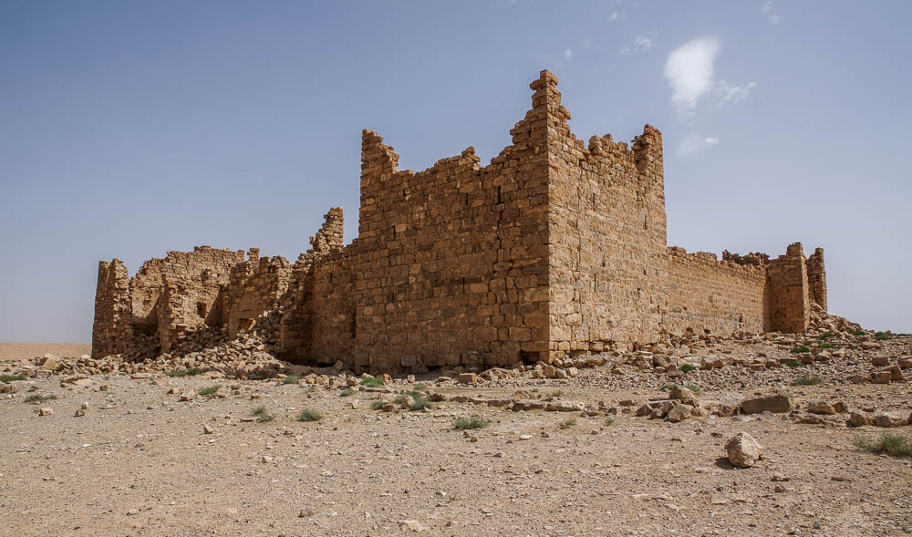
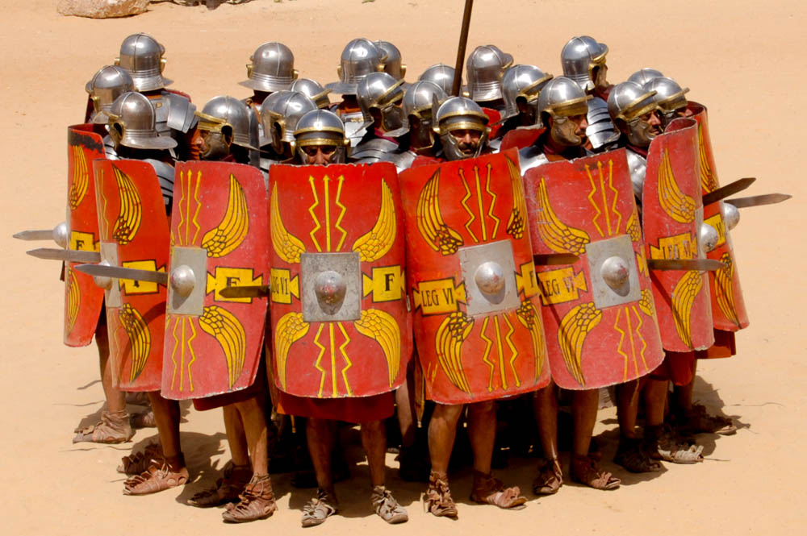
Notes:
Roman soldiers were well-trained for situations such as this. The commander must have sensed the situation was escalating and ordered the chained prisoner to be carried in order to hasten their retreat. The reenactors shown here and in the following images demonstrate some of the defensive maneuvers that could have been taken by the soldiers as they retreated from the angry crowd.
dp041108696

Slide 19
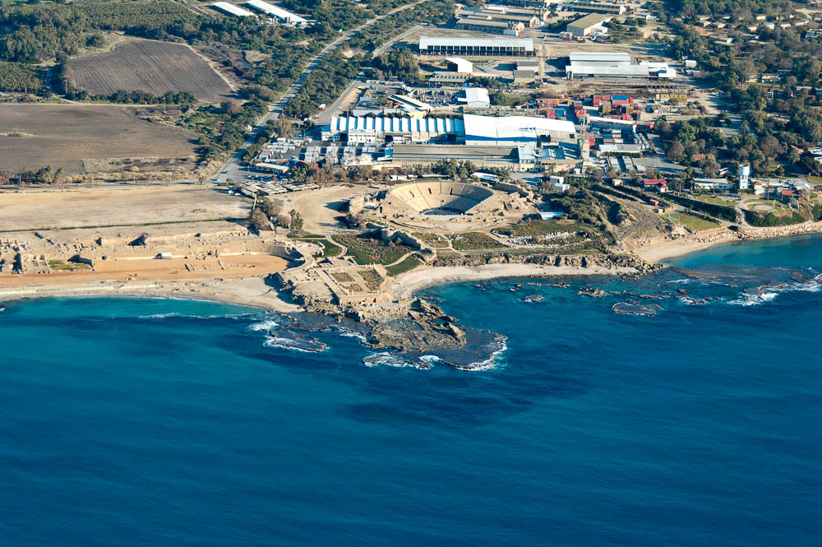
However, Festus answered that Paul was being held in Caesarea
theater
Paul’s prison?
hippodrome
Promontory Palace
Herod’s Promontory Palace at Caesarea (aerial view from the west)
25:4
Notes:
Many scholars believe that the governor’s residence in Caesarea was the old Promontory Palace of Herod the Great, located on a stone promontory that jutted out into the sea at the southern end of the city. It is also likely, then, that this palace housed both guards for the governor and a prison (much like the situation in Jerusalem where Herod’s former palace fulfilled a similar function as the praetorium in later years). The prison was likely located at the eastern end of the palace complex, as this seems to have been the more industrial end.
tb121704924

Slide 21
Then Paul stretched forth his hand and made his defense Acts 26:1
Paul’s third defense: the speech before governor Felix. Acts 24
Chapter 24
Felix the Governor held Paul 5 days until Ananias the High Priest, Jewish elders and their orator Tertullus arrived to accuse Paul.
After the Jews accusations, Felix allowed Paul to speak.
Felix decided to keep Paul under arrest until he heard personally from Chief Captain Lysias.

Slide 22
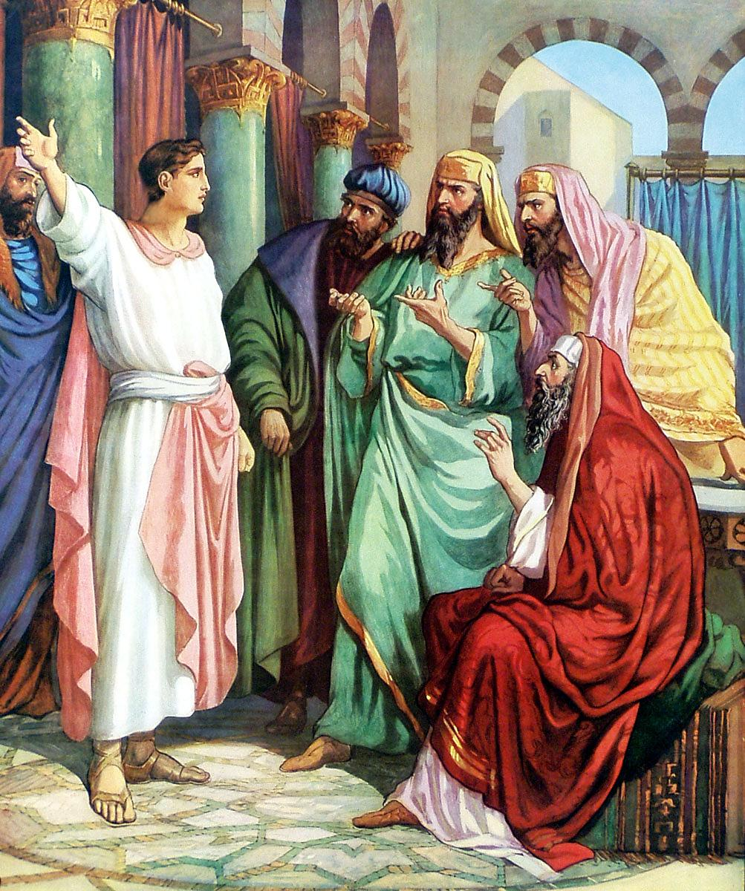
CHAPTER 24
“¹And after five days Ananias the high priest descended with the elders, and with a certain orator named Tertullus, who informed the governor against Paul.”
Tertullus was a hired lawyer by the Jews to plead their case against Paul.

Slide 23
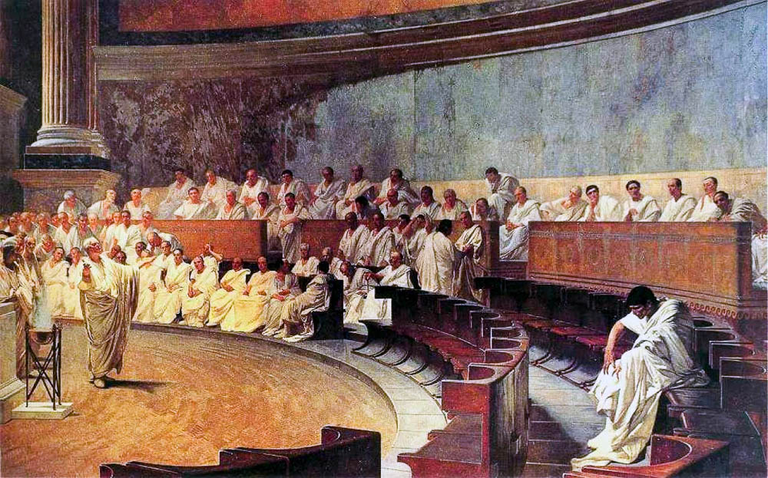
When he was summoned, Tertullus began to accuse him
Fresco of Cicero denouncing Catiline
24:2
Notes:
The above illustration depicts Cicero, one of Rome’s greatest lawyer-orators, denouncing Senator Catiline to the Roman Senate for treason in the year 63 BC. In the same manner, Tertullus now denounced Paul before Felix. This image was painted by Cesare Maccari in 1889. This photo comes from Alonso de Mendoza and is in the public domain, via Wikimedia Commons: https://commons.wikimedia.org/wiki/File:Maccari-Cicero.jpg
wiki051420160919

Slide 24
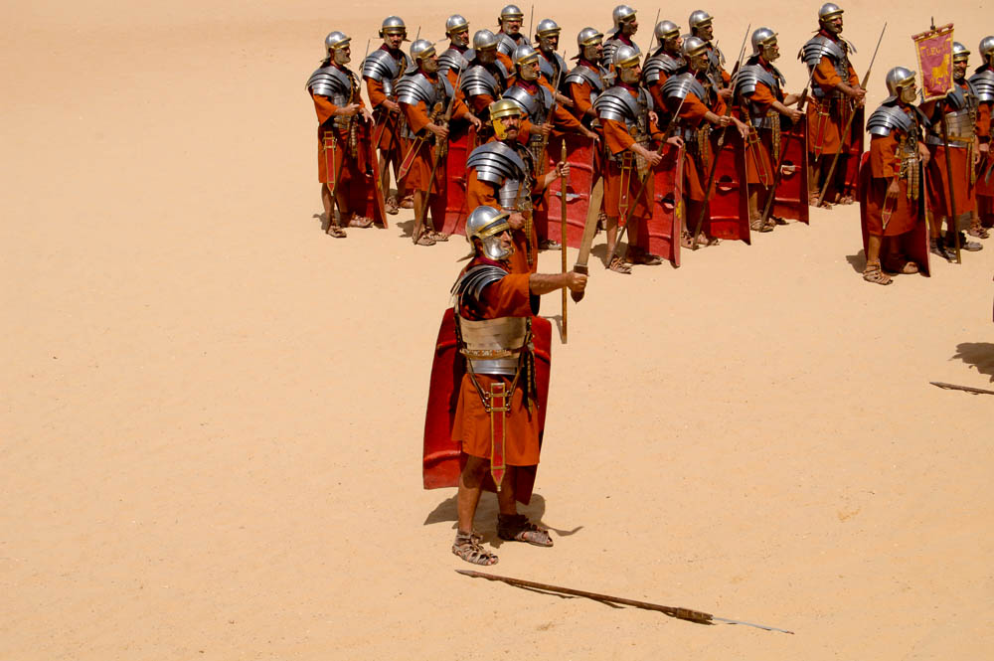
But the commander Lysias came, and with great violence took him away out of our hands
“Roman soldier” with a sword
24:7
Notes:
Soldiers dressed similarly to these (modern reenactors are Jerash, Jordan) came down to rescue Paul near the temple.
dp041108596

Slide 25
Then Paul stretched forth his hand and made his defense Acts 26:1
Paul’s third defense: the speech before governor Felix. Acts 24
Chapter 24- continued
While under arrest Paul had opportunity to speak to Felix and his wife Drusilla about righteousness, temperance, and the judgment to come. Felix trembled.
Two years passed, and Paul was still bound by Governor Felix. Hoping to get the Jew’s pleasure and money for releasing him.

Slide 26
FELIX
Felix and his brother Pallas had been slaves in the household of Agrippina, the mother of emperor Claudius. Claudius elevated Felix from the position of slave to that of ruler over the province of Judea.
DRUSILLA
Drusilla was the daughter of Herod Agrippa I who murdered James (Acts 12:1-2) and died a horrible death in A.D. 44. At that time she was six years old. At an early age she became the wife of a king of Emesa named Azizus.

Slide 27
FELIX & DRUSILLA
Josephus tells us that Drusilla “exceeded all other women in beauty” (Antiquities 20.7.2). And that when Felix was “governor” or procurator of Judea, he fell in love with her.
FELIX TREMBLED
“…how steeped in the blood of private murder and public massacre—during the eight years which he had now spent in the government, first of Samaria, then of Palestine. (Farrar, Life of Paul, p. 550 in McGarvey, p. 240).
FELIX TREMBLED
“Nothing could be more terrifying than to speak of righteousness to a man of such iniquity; of temperance in all things to a man of such unbridled lust; or to drive home what was said on these topics by depicting the judgment to come” (McGarvey, p. 240).

Slide 28
Ch.20 Paul meets with elders from Ephesus.
Ch.21:10 following, Agabus the prophet.
Ch.22:16 repeats conversion story.
Ch.23 Paul preaches to the Jewish council – Sanhedrin.
Ch.24 Paul reasons with Felix. Righteousness, self-control, judgment to come.
Ch.25:10-11 before Festus. I appeal to Caesar.
Ch.26 Paul before Herod Agrippa.
Ch.27 travel by ship to Rome. Storm. Spared.
Ch.28 arrive at Rome
Ch.28:30-31 under arrest proclaiming kingdom of God.

Slide 29
Then Paul stretched forth his hand and made his defense Acts 26:1
Paul’s fourth defense: the speech before governor Festus Acts 25:6
Festus was Procurator of Judea from about A.D. 60 to 62.
Felix was recalled by Rome due to his violent but ineffective intervention in the riots between the Jewish and Gentile inhabitants of Caesarea.
The historian Tacitus is known for his cutting epigram of Felix: “He exercised the authority of a king with the mind of a slave.”

Slide 30
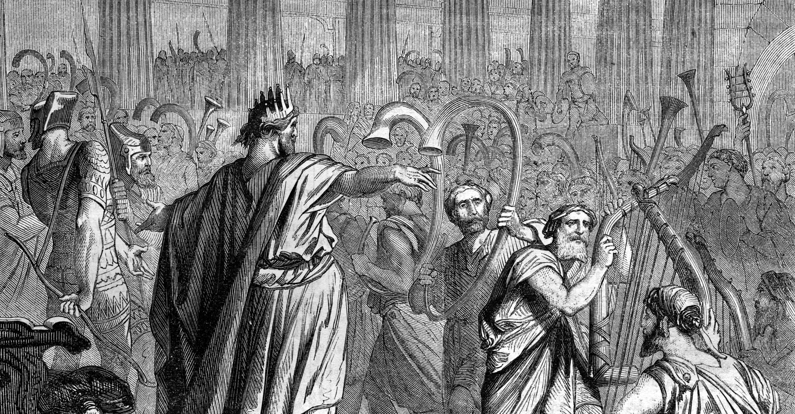
CHAPTER 25
“²³And on the morrow, when Agrippa was come, and Bernice, with great pomp, and was entered into the place of hearing, with the chief captains, and principal men of the city, at Festus’ commandment Paul was brought forth.”

Slide 31
Herod Agrippa II (son of Herod Agrippa, Acts 12) ruled over the former territory of Herod Philip, the tetrarch (Luke 3:1), which ran along the NE borders of Festus’ province. The capital was at Caesarea Philippi. Bernice was his sister.
Herod’s Promontory Palace at Caesarea (aerial view from the west)
25:4
Notes:
Many scholars believe that the governor’s residence in Caesarea was the old Promontory Palace of Herod the Great, located on a stone promontory that jutted out into the sea at the southern end of the city. It is also likely, then, that this palace housed both guards for the governor and a prison (much like the situation in Jerusalem where Herod’s former palace fulfilled a similar function as the praetorium in later years). The prison was likely located at the eastern end of the palace complex, as this seems to have been the more industrial end.
tb121704924

Slide 32
Herod Agrippa II was 17 years old when his father died in A.D. 44 back in Acts chapter 12. He was known to be expert in all matters of affecting the Jewish religion. For example, among other things he had the right of appointing and deposing the Jewish high priests.

Slide 33
CHAPTER 25
“²⁴And Festus said,
King Agrippa, and all
men which are here
present with us, ye see this man, about whom all the multitude of the Jews have dealt with me, both at Jerusalem, and also here, crying that he ought not to live any longer.”

Slide 34
CHAPTER 25
“²⁵But when I found that he had committed nothing worthy of death, and that he himself hath appealed to Augustus, I have determined to send him. ²⁶Of whom I have no certain thing to write unto my lord. Wherefore I have brought him forth
before you, and specially
before thee, O king Agrippa, that, after examination had, I might have somewhat to write. ²⁷For it seemeth to me unreasonable to send a prisoner, and not withal to signify the crimes laid against him.”

Slide 35
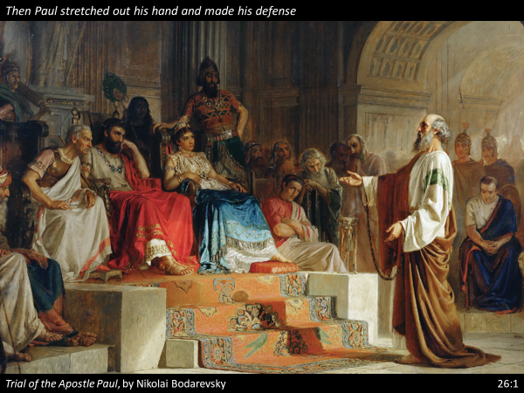
Then Paul stretched forth his hand and made his defense Acts 26:1
Paul’s fifth defense: before Agrippa and Bernice. Acts 26:1-2

Slide 36
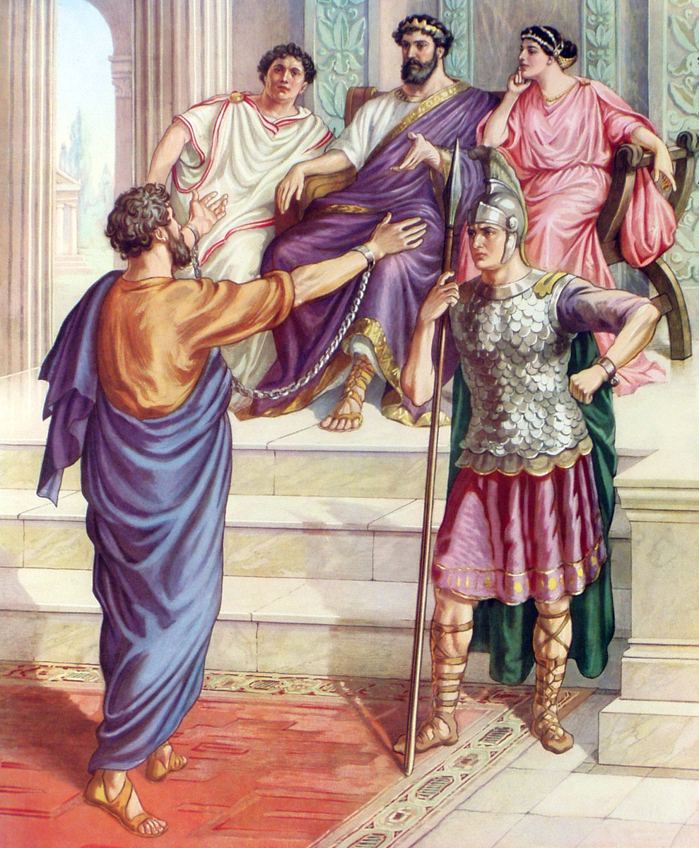
Acts 26
CHAPTER 26
“¹Then Agrippa said unto Paul, Thou art permitted to speak for thyself.”

Slide 37
New Commentary On Acts Of Apostles
By J.W. McGarvey
“Agrippa had been brought up in the Jewish faith, and on this account had been entrusted by the emperor with the oversight of religious affairs in Jerusalem, while Judea was under Roman procurators.”

Slide 38
CHAPTER 26
“¹ . . . Then Paul stretched forth the hand, and answered for himself. ²I think myself happy, king Agrippa, because I shall answer for myself this day before thee touching all the things whereof I am accused of the Jews: ³Especially because I know thee to be expert in all customs and questions which are among the Jews: wherefore I beseech thee to hear me patiently.”
CHAPTER 26
“⁴My manner of life from my youth, which was at the first among mine own nation at Jerusalem, know all the Jews; ⁵Which knew me from the beginning, if they would testify, that after the most straitest sect of our religion I lived a Pharisee.”
CHAPTER 26
“⁶And now I stand and am judged for the hope of the promise made of God, unto our fathers: ⁷Unto which promise our twelve tribes, instantly serving God day and night, hope to come. For which hope’s sake, king Agrippa, I am accused of the Jews.”

Slide 39
Festus Interrupts
CHAPTER 26
“²⁴And as he thus spake for himself, Festus said with a loud voice, Paul, thou art beside thyself; much learning doth make thee mad.”

Slide 40
Paul’s Answer—
CHAPTER 26
“²⁵But he said, I am not mad, most noble Festus; but speak forth the words of truth and soberness. ²⁶For the king knoweth of these things, before whom also I speak freely: for I am persuaded that none of these things are hidden from him; for this thing was not done in a corner.”

Slide 41
CHAPTER 26
“²⁷King Agrippa, believest thou the prophets? I know that thou believest.”

Slide 42
CHAPTER 26
“²⁸Then Agrippa said unto Paul, Almost thou persuadest me to be a Christian.”

Slide 43
CHAPTER 26
“²⁹And Paul said,
I would to God, that not only thou, but also all that hear me this day, were both almost, and altogether such as I am, except these bonds.”
CHAPTER 26
“³²Then said Agrippa unto Festus, This man might have been set at liberty, if he had not appealed unto Caesar.”
CHAPTER 26
“³⁰And when he had thus spoken, the king rose up, and the governor, and Bernice, and they that sat with them: ³¹And when they were gone aside, they talked between themselves, saying, This man doeth nothing worthy of death or of bonds.”

Slide 44
Jerusalem Council
Trials
Paul Before Caesar
Second Missionary Journey
Macedonia
Achaia
Greece
Third Missionary Journey
Asia
First Roman Imprisonment
60 - 63
Rome
Second Roman Imprisonment
67 - 68
Rome
A.D. 51 53 57 60 66 68 70
1 Thess.
Place: Corinth
Date: 51 - 52
1 Corinthians
Place: Ephesus
Date: 56 - 57
Ephesians
Place: Rome
Date: 60 - 63
1 Timothy
Place: Macedonia
Date: 63 - 66
2 Thess.
Place: Corinth
Date: 51 - 52
2 Corinthians
Place: Macedonia
Date: 56 - 57
Colossians
Place: Rome
Date: 60 - 63
Titus
Place: Macedonia
Date: 63 - 66
Galatians
Place: Antioch
Date: 57?
Philemon
Place: Rome
Date: 60 - 63
2 Timothy
Place: Rome
Date: 67 - 68
Romans
Place: Corinth
Date: 57?
Philippians
Place: Rome
Date: 60 - 63

Slide 45
Acts 9:15 But the Lord said to him, "Go, for he is a chosen vessel of Mine to bear My name before Gentiles, kings, and the children of Israel.
Three Taverns
Appii
The Journey To Rome
Acts 23:11 But the following night the Lord stood by him and said, "Be of good cheer, Paul; for as you have testified for Me in Jerusalem, so you must also bear witness at Rome."

Slide 46
Death is a departure.
2Timothy 4:6 For I am already being poured out as a drink offering, and the time of my departure is at hand. 7 I have fought the good fight, I have finished the race, I have kept the faith. 8 Finally, there is laid up for me the crown of righteousness, which the Lord, the righteous Judge, will give to me on that Day, and not to me only but also to all who have loved His appearing.

