Slide 1
Welcome to our services
New Lebanon Church of Christ
We are Simply Christians.
Our Emphasis is Spiritual, Not Material or Social.
We are striving to be The Same Church as Described in The New Testament.
Please Come Back Again

Slide 2
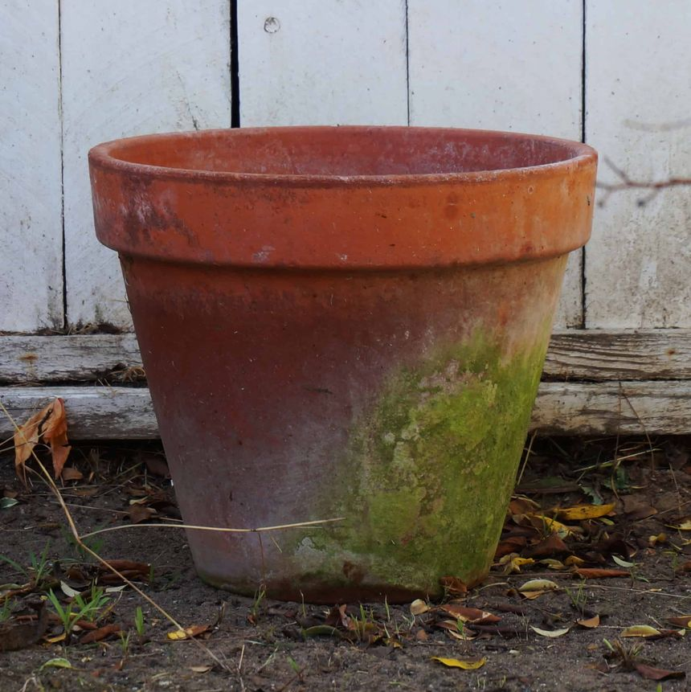
Paul as a Vessel. Acts 9:15

Slide 3
Damascus
CHAPTER 9
“³And as he journeyed, he came near Damascus: and suddenly there shined round about him a light from heaven: ⁴And he fell to the earth, and heard a voice saying unto him, Saul, Saul, why persecutest thou me?”
GALILEE
Jordan
SAMARIA
PEREA
JUDEA
Jerusalem
Dead Sea

Slide 4
Paul as a Vessel. Acts 9:15
Paul delighted to call himself “a slave of Jesus Christ.” The slave was at the disposal of his master, having no special interests of his own.
The same thought comes out in the title of “vessel” given to Paul by the Lord Himself immediately after his conversion: “Go thy way, he is a chosen vessel unto Me.” A vessel has no will of its own, but is open to be filled with anything or to be carried anywhere.

Slide 5
Paul as a Vessel. Acts 9:15
Let’s look at the history of Paul as a vessel…
And see if there are some similarities with our life.

Slide 6
An Unclean Vessel. Acts 9:15

Slide 7
Paul as a Vessel. Acts 9:15
1. An Unclean Vessel (Acts 9:1, 2).
Acts 9:1 Then Saul, still breathing threats and murder against the disciples of the Lord, went to the high priest 2 and asked letters from him to the synagogues of Damascus, so that if he found any who were of the Way, whether men or women, he might bring them bound to Jerusalem.
Full of hatred for the followers of Jesus. “A blasphemer, and a persecutor, and injurious.”
1 Cor…. “Such were some of you, but ye are washed.”

Slide 8
An Empty Vessel. Acts 9:15

Slide 9
Paul as a Vessel. Acts 9:15
2. An Empty Vessel (Acts 9:5-6). “Lord, what will you have me to do?”
Acts 9:5 And he said, "Who are You, Lord?" Then the Lord said, "I am Jesus, whom you are persecuting. It is hard for you to kick against the goads." 6 So he, trembling and astonished, said, "Lord, what do You want me to do?" Then the Lord said to him, "Arise and go into the city, and you will be told what you must do."
His own plans and purposes are now abandoned. The Lord has turned him upside down and wiped him out as a vessel. It is a serious time in our life when all our lofty thoughts and boastings have to be poured out by the wayside as filth and refuse.

Slide 10
Paul as a Vessel. Acts 9:15
What thou must do … indicates that whatever message Saul would receive would be neither unessential nor optional, but mandatory. In the sequel to this (Acts 22:16) is recorded the ONLY COMMANDMENT recorded in the New Testament as being to Saul. It reads:
And now why tarriest thou? arise, and be baptized, and wash way thy sins, calling on his name Acts 22:16.
Must … This is a big word in the New Testament.
In this passage before us it reveals baptism as one of the “musts” regarding salvation,
The false teaching setting aside this divine “must” should be rejected.

Slide 11
What is the church?
The blood bought,
Heaven sent,
Spirit filled
Body of believers that the Lord adds to when we surrender our hearts and our lives to His Word.
Acts 2:37 Now when they heard this, they were cut to the heart, and said to Peter and the rest of the apostles, "Men and brethren, what shall we do?"
38 Then Peter said to them, "Repent, and let every one of you be baptized in the name of Jesus Christ for the remission of sins; and you shall receive the gift of the Holy Spirit.
Acts 2:47 praising God and having favor with all the people. And the Lord added to the church daily those who were being saved.

Slide 12
A Chosen Vessel. Acts 9:15

Slide 13
Paul as a Vessel. Acts 9:15
3. A Chosen Vessel.
Acts 9:15 But the Lord said to him, "Go, for he is a chosen vessel of Mine to bear My name before Gentiles, kings, and the children of Israel.
Before Gentiles and kings … There is no way to separate these words from the great prophecy of Isaiah regarding the new name to be borne by God’s children.
And the Gentiles shall see thy righteousness, and all kings thy glory: and thou shalt be called by a new name, which the mouth of the Lord shall name Isa.62:2.

Slide 14
Paul as a Vessel. Acts 9:15
“It pleased God who called me by His grace” (Gal. 1:15).
This is according to His good pleasure which He hath purposed in Himself.” “By grace are ye saved” (Eph. 2:8).

Slide 15
A Filled Vessel. Acts 9:15

Slide 16
Paul as a Vessel. Acts 9:15
4. A Filled Vessel.
Gal. 1:15 But when it pleased God, who separated me from my mother's womb and called me through His grace,
16 to reveal His Son in me, that I might preach Him among the Gentiles, I did not immediately confer with flesh and blood,
What a treasure, Christ in us. What a filling up of the emptied vessel. Filled up with all the fullness of God. 2Cor. 4:7 But we have this treasure in earthen vessels, that the excellence of the power may be of God and not of us.
Chosen and filled with the treasures of the gospel that he might bear His Name before the Gentiles.

Slide 17
Paul as a Vessel. Acts 9:15
The vessel may be easily broken, but the precious contents cannot be stolen.
2Cor. 12:10 Therefore I take pleasure in infirmities, in reproaches, in needs, in persecutions, in distresses, for Christ's sake. For when I am weak, then I am strong.

Slide 18
A Separated Vessel. Acts 9:15

Slide 19
Paul as a Vessel. Acts 9:15
5. A Separated Vessel.
(Acts 13:2). As they ministered to the Lord and fasted, the Holy Spirit said, "Now separate to Me Barnabas and Saul for the work to which I have called them.“ (Acts 13:2 // 13:9)
The Holy Ghost here claims to have a share in the calling of Saul, and for the very definite purpose of being separated unto God for His specific work. He begins his letter to the Romans with: “Paul, a servant of Jesus Christ, separated unto the Gospel of God.” He reminds the Galatians that he is “an apostle, not of men, neither by man.” This is the experience of every true servant of God. Do we know anything about this divine calling, and this holy, separated, purposeful life of God
Romans 1:1-6

Slide 20
Paul as a Vessel. Acts 9:15
Eph 4:17 This I say, therefore, and testify in the Lord, that you should no longer walk as the rest of the Gentiles walk, in the futility of their mind,18 having their understanding darkened, being alienated from the life of God, because of the ignorance that is in them, because of the blindness of their heart;
19 who, being past feeling, have given themselves over to lewdness, to work all uncleanness with greediness. 20 But you have not so learned Christ,
21 if indeed you have heard Him and have been taught by Him, as the truth is in Jesus: 22 that you put off, concerning your former conduct, the old man which grows corrupt according to the deceitful lusts,
23 and be renewed in the spirit of your mind, 24 and that you put on the new man which was created according to God, in true righteousness and holiness.

Slide 21
Paul as a Vessel. Acts 9:15
Rom. 12:1, 2 I beseech you therefore, brethren, by the mercies of God, that you present your bodies a living sacrifice, holy, acceptable to God, which is your reasonable service.
2 And do not be conformed to this world, but be transformed by the renewing of your mind, that you may prove what is that good and acceptable and perfect will of God.

Slide 22
An Honored Vessel. Acts 9:15

Slide 23
Paul as a Vessel. Acts 9:15
6. An Honored Vessel.
Acts 26:16. 'But rise and stand on your feet; for I have appeared to you for this purpose, to make you a minister and a witness both of the things which you have seen and of the things which I will yet reveal to you.

Slide 24
Paul as a Vessel. Acts 9:15
Acts 26:12 Whereupon as I journeyed to Damascus with the authority and commission of the chief priests, at midday, O king, I saw on the way a light from heaven, above the brightness of the sun, shining round about me and them that journeyed with me. And when we were all fallen to the earth, I heard a voice saying to me in the Hebrew language, Saul, Saul, why persecutest thou me? It is hard for thee to kick against the goad. And I said, Who art thou, Lord? And the Lord said, I am Jesus whom thou persecutest. But arise, and stand upon thy feet: for to this end have I appeared unto thee, to appoint thee a minister and a witness both of the things wherein thou hast seen me, and of the things wherein I will appear unto thee.

Slide 25
Paul as a Vessel. Acts 9:15
It was a midday (Acts 26:13).
Both in Acts 9 and Acts 22, there were given accounts of Saul’s conversion.
A number of interesting supplemental bits of information, however, are visible in this account of it.

Slide 26
Acts 26:12 "While thus occupied, as I journeyed to Damascus with authority and commission from the chief priests, 13 "at midday, O king, along the road I saw a light from heaven, brighter than the sun, shining around me and those who journeyed with me.
14 "And when we all had fallen to the ground, I heard a voice speaking to me and saying in the Hebrew language, 'Saul, Saul, why are you persecuting Me? It is hard for you to kick against the goads.'15 "So I said, 'Who are You, Lord?' And He said, 'I am Jesus, whom you are persecuting.
16 'But rise and stand on your feet; for I have appeared to you for this purpose, to make you a minister and a witness both of the things which you have seen and of the things which I will yet reveal to you. 17 'I will deliver you from the Jewish people, as well as from the Gentiles, to whom I now send you,
18 'to open their eyes, in order to turn them from darkness to light, and from the power of Satan to God, that they may receive forgiveness of sins and an inheritance among those who are sanctified by faith in Me.'

Slide 27
Paul as a Vessel. Acts 9:15
The light was brighter than the sun (Acts 26:13).
The light enveloped the whole company (Acts 26:13).
The whole company fell to the earth (Acts 26:14).
Jesus spoke in Hebrew (Acts 26:14).
He said, “It is hard for thee to kick against the goad” (Acts 26:14).
There is a fuller account of what Jesus said (Acts 26:16, 18)

Slide 28
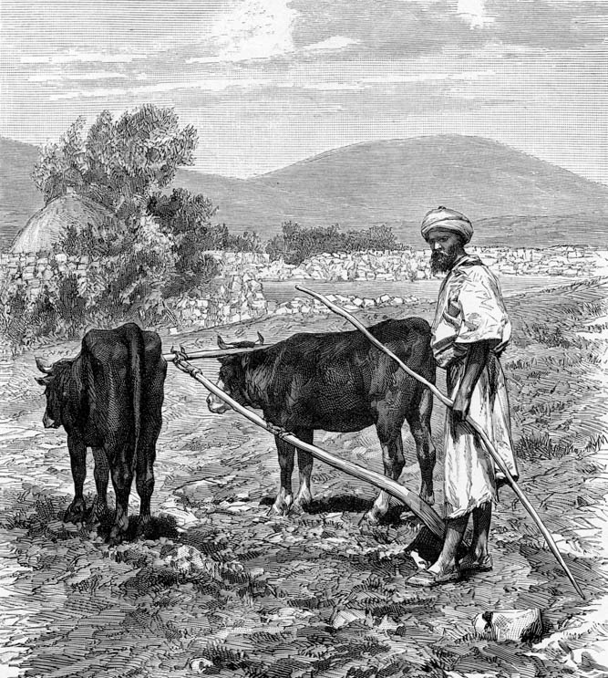
It is hard for you to kick against the goads
The metaphor of “kicking against the goad” is apt. The animal pulling the plow cannot escape the bothersome prodding of the goad except by complying with the wishes of the plowman by pulling the plow.
This seems to be exactly Jesus’s intent in the metaphor, to remind Paul that balking at the task he was given was useless.
Illustration of a man plowing in Galilee, goad in hand
26:14
Notes:
The metaphor of “kicking against the goad” is apt. The animal pulling the plow cannot escape the bothersome prodding of the goad except by complying with the wishes of the plowman by pulling the plow. This seems to be exactly Jesus’s intent in the metaphor, to remind Paul that balking at the task he was given was useless.
gj0075

Slide 29
Paul as a Vessel. Acts 9:15
It appears maybe that some of the things told Paul by Ananias were also spoken to Paul directly from heaven, by the Lord.
This would account for the full and immediate trust which Paul placed in Ananias’ words. He knew they were also the words of the Lord.

Slide 30
Paul as a Vessel. Acts 9:15
We have but to glance along the life of the apostle to see how largely he did minister the grace of God, and how faithfully he witnessed to the power and Name of his risen Lord. He was honored in opening the eyes of many, and turning them “from darkness to light, and from the power of Satan unto God”
Acts 26:18 'to open their eyes, in order to turn them from darkness to light, and from the power of Satan to God, that they may receive forgiveness of sins and an inheritance among those who are sanctified by faith in Me.'

Slide 31
Paul as a Vessel. Acts 9:15
A vessel filled with such riches is sure to be abundantly used of God in blessing poor and needy souls. An empty well has no attraction for the thirsty, there is nothing in it but disappointment.

Slide 32
A Suffering Vessel. Acts 9:15

Slide 33
Paul as a Vessel. Acts 9:15
7. A Suffering Vessel.
Although he could say, “We have this treasure in earthen vessels,” yet he adds, “We are troubled on every side, perplexed, persecuted, cast down, always bearing in the body the dying of the Lord Jesus”
2Cor. 4:7 But we have this treasure in earthen vessels, that the excellence of the power may be of God and not of us. 8 We are hard pressed on every side, yet not crushed; we are perplexed, but not in despair;
9 persecuted, but not forsaken; struck down, but not destroyed-
10 always carrying about in the body the dying of the Lord Jesus, that the life of Jesus also may be manifested in our body.

Slide 34
Paul as a Vessel. Acts 9:15
In 2 Cor. 11:21–31 he gives us a catalogue of his afflictions and perils. 2Cor. 11:21 To our shame, I say that we were too weak for that! But in whatever anyone is bold--I speak foolishly--I am bold also.22 Are they Hebrews? So am I. Are they Israelites? So am I. Are they the seed of Abraham? So am I.
23 Are they ministers of Christ? --I speak as a fool--I am more: in labors more abundant, in stripes above measure, in prisons more frequently, in deaths often. 24 From the Jews five times I received forty stripes minus one.
25 Three times I was beaten with rods; once I was stoned; three times I was shipwrecked; a night and a day I have been in the deep;

Slide 35
Paul as a Vessel. Acts 9:15
26 in journeys often, in perils of waters, in perils of robbers, in perils of my own countrymen, in perils of the Gentiles, in perils in the city, in perils in the wilderness, in perils in the sea, in perils among false brethren;
27 in weariness and toil, in sleeplessness often, in hunger and thirst, in fastings often, in cold and nakedness--
28 besides the other things, what comes upon me daily: my deep concern for all the churches.
29 Who is weak, and I am not weak? Who is made to stumble, and I do not burn with indignation?
30 If I must boast, I will boast in the things which concern my infirmity.
31 The God and Father of our Lord Jesus Christ, who is blessed forever, knows that I am not lying.

Slide 36
Paul as a Vessel. Acts 9:15
The vessels of God, bearing His Name in the midst of the rush and turmoil of this God-neglecting age, cannot expect to fare better than the Master Himself.
It is a faithful saying,… 2 Tim. 2:11, 12. This is a faithful saying: For if we died with Him, We shall also live with Him.
12 If we endure, We shall also reign with Him. If we deny Him, He also will deny us.

Slide 37
Paul as a Vessel. Acts 9:15
Just now God in grace is seeking to make known the riches of His glory in the vessels of mercy which he has prepared unto glory
Rom. 9:21–23. Does not the potter have power over the clay, from the same lump to make one vessel for honor and another for dishonor?
22 What if God, wanting to show His wrath and to make His power known, endured with much longsuffering the vessels of wrath prepared for destruction,
23 and that He might make known the riches of His glory on the vessels of mercy, which He had prepared beforehand for glory,

Slide 38
Paul as a Vessel. Acts 9:15
unclean empty chosen
filled separated honored suffering

Slide 39
Paul as a Vessel. Acts 9:15
It is hard
for you to kick against the goads.

