Slide 1
Welcome to our services
New Lebanon Church of Christ
We are Simply Christians.
Our Emphasis is Spiritual, Not Material or Social.
We are striving to be The Same Church as Described in The New Testament.
Please Come Back Again

Slide 2
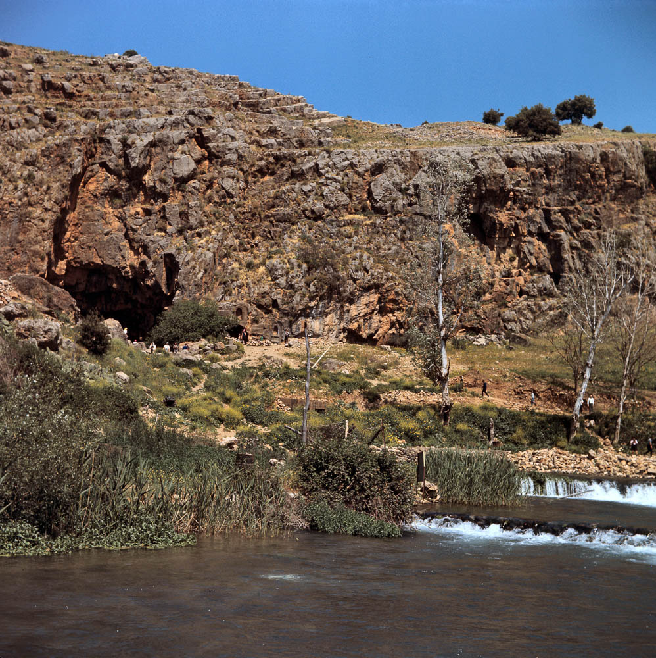
You are Peter, and on this rock I will build My church
Caesarea Philippi area and sacred cave
16:18
Notes:
Peter’s confession and Jesus’s response were made somewhere in the greater area of Caesarea Philippi. This photograph, taken in 1968 by David Bivin, shows the area prior to excavations. The large rock in this area can be used to illustrate this verse, although this dialogue may have occurred elsewhere.
db6804073606

Slide 3
PETER’S CONFESSION OF CHRIST
The account of this significant event is recorded in Matthew 16, Mark 8, and Luke 9. The introduction of each account relates different aspects of the setting—
Matthew tells us where they were.
(In the district of Caesarea Philippi)
Mark tells us what they had been doing
(teaching in many towns of the area)
Luke tells us that Jesus was praying.

Slide 4
A.D. 1
Preliminary Events – Appearances of an Angel
Birth - Childhood - 12 Years Old In The Temple
Baptism - Temptation
First Miracle, Early Galilean Ministry
The Apostles Were Chosen
Sermon On The Mount – Miracles – John In Prison
John the Baptist Imprisoned, Woe To Pharisees
John Beheaded
Fed 5,000 - Walked On Sea, Fed 4,000
Peter's Confession - Transfiguration
70 Sent – 10 Lepers Healed
Lazarus Raised
Luke 17 Discourse On Faith And Second Coming
Triumphal Entry, Cleansing Temple
Matthew 25 – Discourse on the Mount Of Olives
Last Passover Feast, Lord's Supper Instituted
Gethsemane, Betrayal, Denial
Pilate Condemned Jesus
Crucifixion Of Christ , Burial, The Resurrection
Forty Days, The Ascension
A.D. 30
A.D. 31
BASIC TIMELINE
A.D. 32
A.D. 33

Slide 5
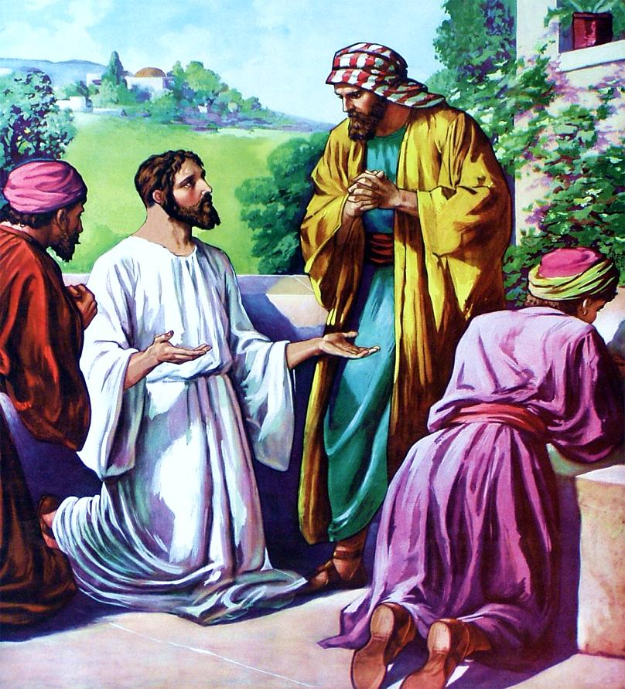
Matthew 16
“¹³When Jesus came into the coasts [district] of Caesarea Philippi . . .”
Sidon
Tyre
Caesarea
Philippi
PHOENICIA
GALILEE
Bethsaida
Nazareth
Sea of Galilee
DECAPOLIS
Jordan River
SAMARIA
PEREA
Jerusalem
Bethlehem
JUDEA
Salt Sea
ARABIA
EGYPT

Slide 6
Sidon
Luke 9
“¹⁸. . . as he was alone praying, his disciples were with him . . .”
Tyre
Caesarea
Philippi
PHOENICIA
GALILEE
Bethsaida
Nazareth
Sea of Galilee
DECAPOLIS
Jordan River
SAMARIA
PEREA
Jerusalem
Bethlehem
JUDEA
Salt Sea
ARABIA
EGYPT

Slide 7
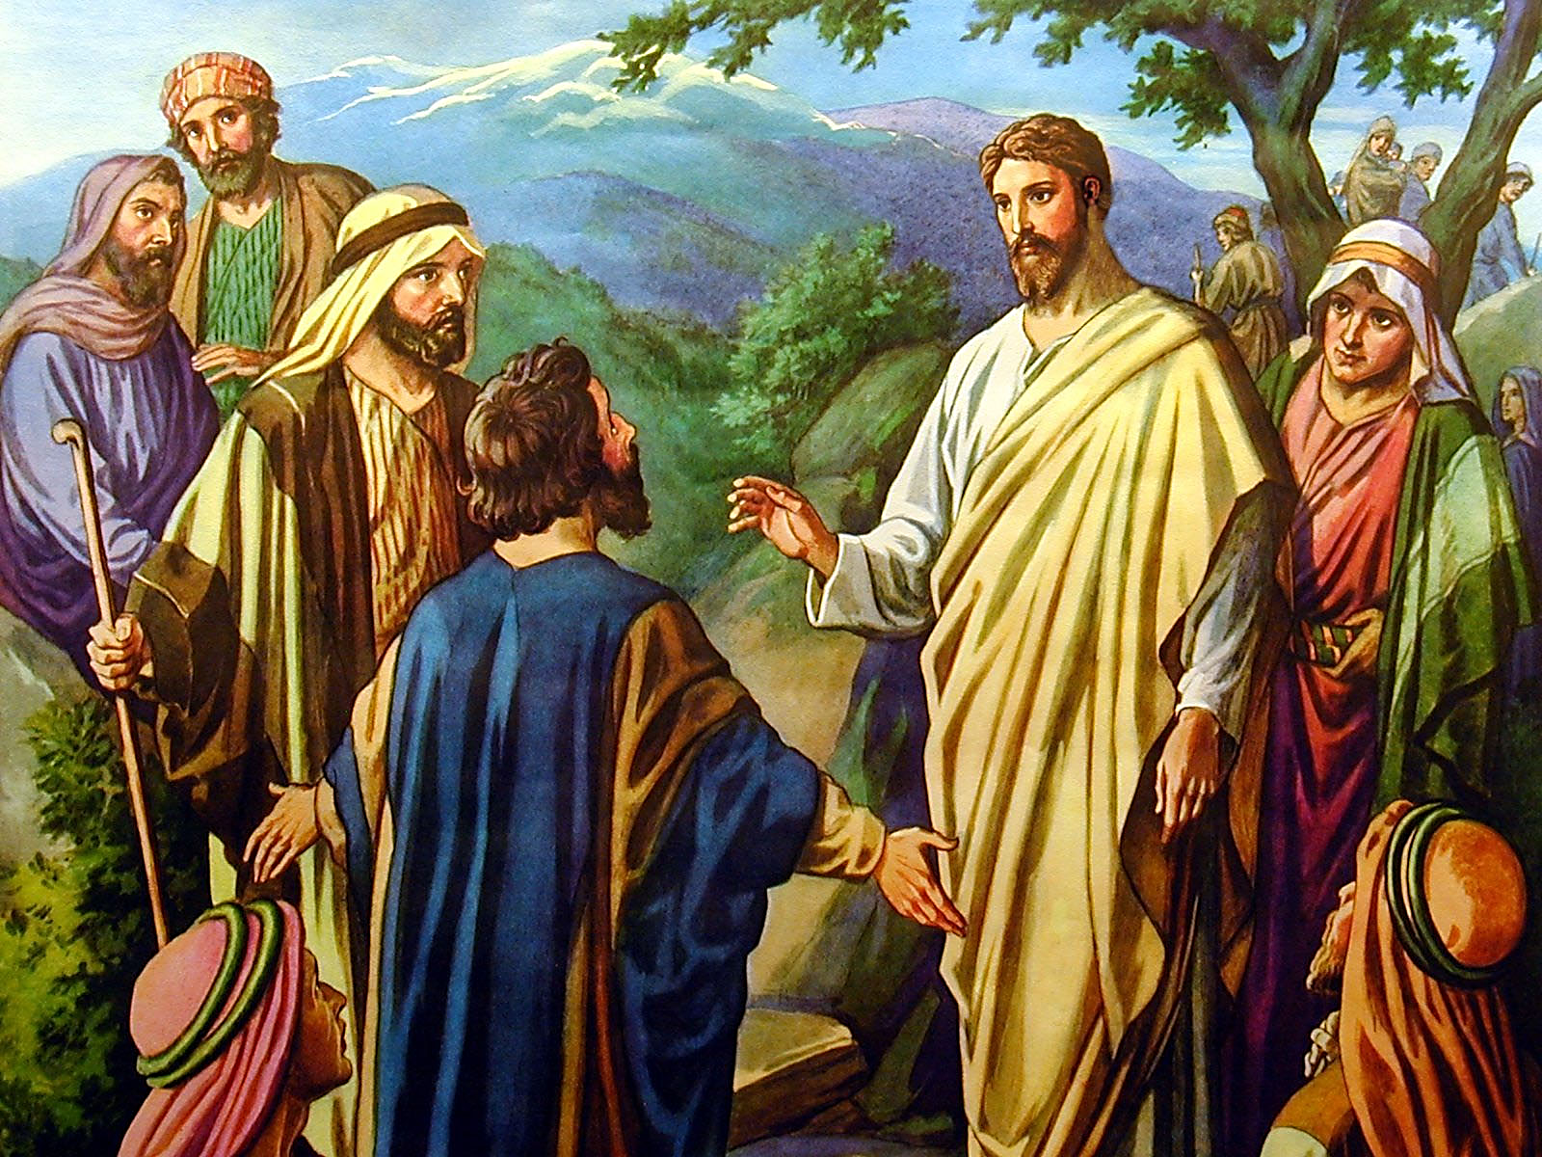
Matthew 16
“¹³. . . he asked his disciples, saying, Whom do men say that I the Son of man am?”

Slide 8
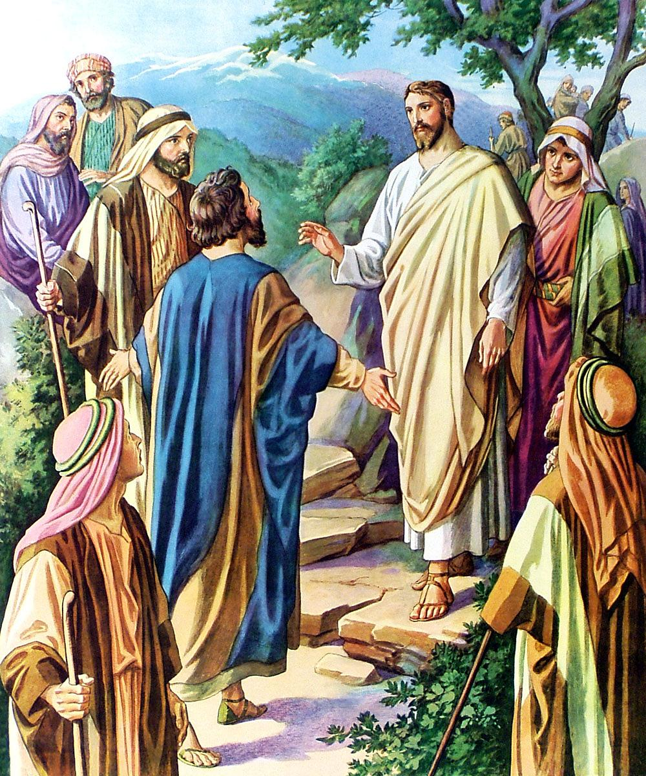
Matthew 16
“¹⁴And they said, Some say that thou art John the Baptist: some, Elias [Elijah]; and others, Jeremias [Jeremiah], or one of the prophets. ¹⁵He saith unto them, But whom say ye that I am? ¹⁶And Simon Peter answered and said, Thou art the Christ, the Son of the living God.”
Christ’s question struck down to the depths of their hearts and called for a confession of their own conviction.

Slide 9
Matthew 16
“¹⁷And Jesus answered and said unto him, Blessed art thou, Simon Barjona: for flesh and blood hath not revealed it unto thee, but my Father which is in heaven.
¹⁸And I say also unto thee, That thou art Peter, and upon this rock I will build my church; and the gates of hell shall not prevail against it.
¹⁹And I will give unto thee the keys of the kingdom of heaven: and whatsoever thou shalt bind on earth shall be bound in heaven: and whatsoever thou shalt loose on earth shall be loosed in heaven.”

Slide 10
But who do you say that I am? Matt 16:15
Four wrong religious opinions
Matt. 16:13 When Jesus came into the region of Caesarea Philippi, He asked His disciples, saying, "Who do men say that I, the Son of Man, am?" 14 So they said, "Some say John the Baptist,
some Elijah,
and others Jeremiah
or one of the prophets."
15 He said to them, "But who do you say that I am?"

Slide 11
Matt. 16:16 Simon Peter answered and said, "You are the Christ, the Son of the living God."
17 Jesus answered and said to him, "Blessed are you, Simon Bar-Jonah, for flesh and blood has not revealed this to you, but My Father who is in heaven.
18 "And I also say to you that you are Peter, and on this rock I will build My church, and the gates of Hades shall not prevail against it. (NKJV)
Fullfillment of prophecies the Pharisees could not see
singular
Not plural churches
Not plural them

Slide 12
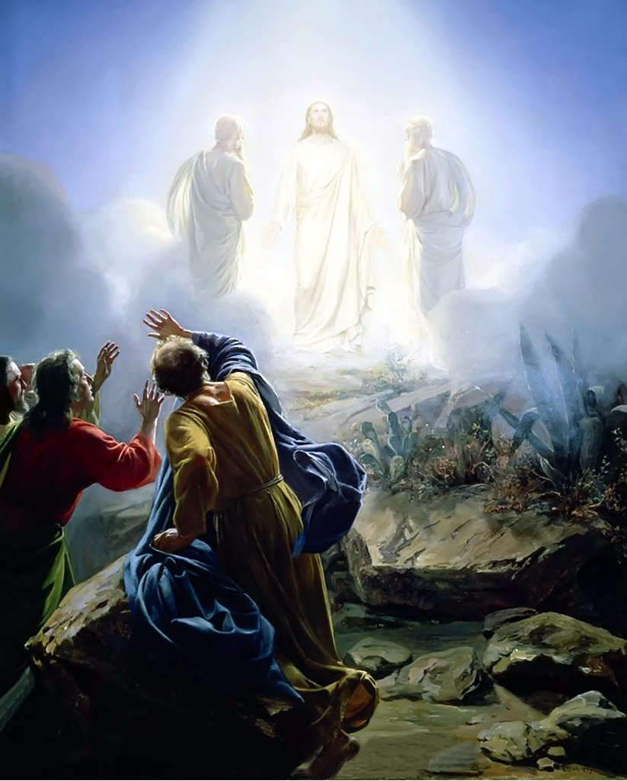
Matthew 17
“¹And after six days Jesus taketh Peter, James, and John his brother, and bringeth them up into an high mountain apart, ²And was transfigured before them: and his face did shine as the sun, and his raiment was white as the light.”
It is thought that the transfiguration occurred exactly one year before our Lord’s ascension.
A Commentary On The Gospel According To Matthew
By H. Leo Boles

Slide 13
CHRIST’S TRANSFIGURATION
His appearance changed. He appeared in his glorified state not veiled by human flesh.
Peter, James and John were chosen for their traits of character and faith which rendered them capable of perceiving this special manifestation.
Jesus revealed himself to these three disciples to teach them the mystery of his nature which he should assume after his suffering.
Such earthly splendor and glory as they beheld suggested the supernal and eternal glory with which he was clothed before the world was, and which should be after his ascension.
A Commentary On The Gospel According To Matthew
By H. Leo Boles

Slide 14
Luke 9
“³⁰And, behold, there talked with him two men, which were Moses and Elias [Elijah]: ³¹Who appeared in glory, and spake of his decease which he should accomplish at Jerusalem. ³²But Peter and they that were with him were heavy with sleep: and when they were awake, they saw his glory, and the two men that stood with him.”
“We need not ask how they knew Moses and Elijah; the records do not inform us.”
A Commentary On
The Gospel By Luke
By H. Leo Boles

Slide 15
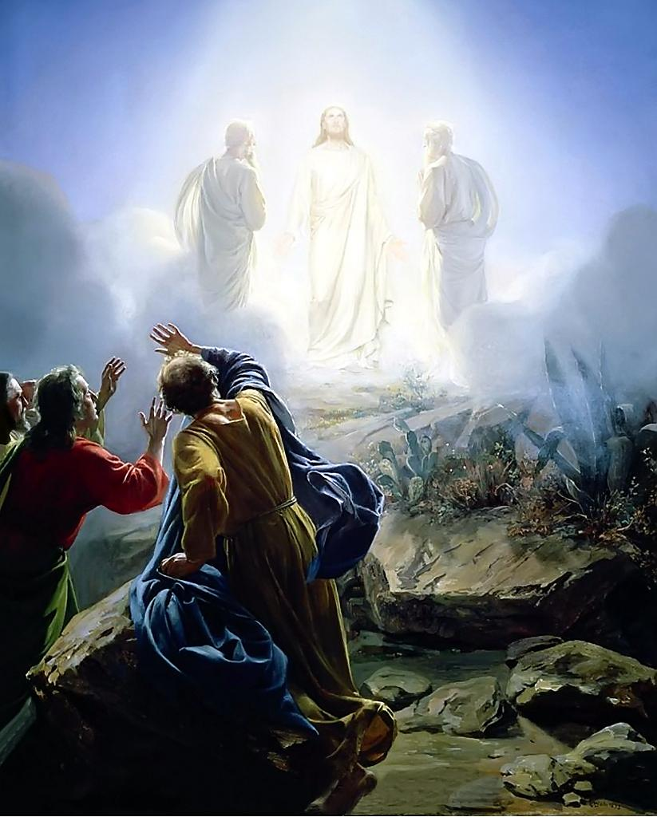
Moses was the representative of the law, and Elijah was the representative of the prophets. Moses had died more than fourteen hundred years before, and Elijah had been translated nine hundred years before.
Jesus had announced his death to his disciples six days before this, and now Moses and Elijah “spake of his decease which he should accomplish at Jerusalem.”

Slide 16
Mark 9
“⁵And Peter answered and said to Jesus, Master, it is good for us to be here: and let us make three tabernacles; one for thee, and one for Moses, and one for Elias [Elijah]. ⁶For he wist not what to say; for they were sore afraid. ⁷And there was a cloud that overshadowed them: and a voice came out of the cloud, saying, This is my beloved Son: hear him.”

Slide 17
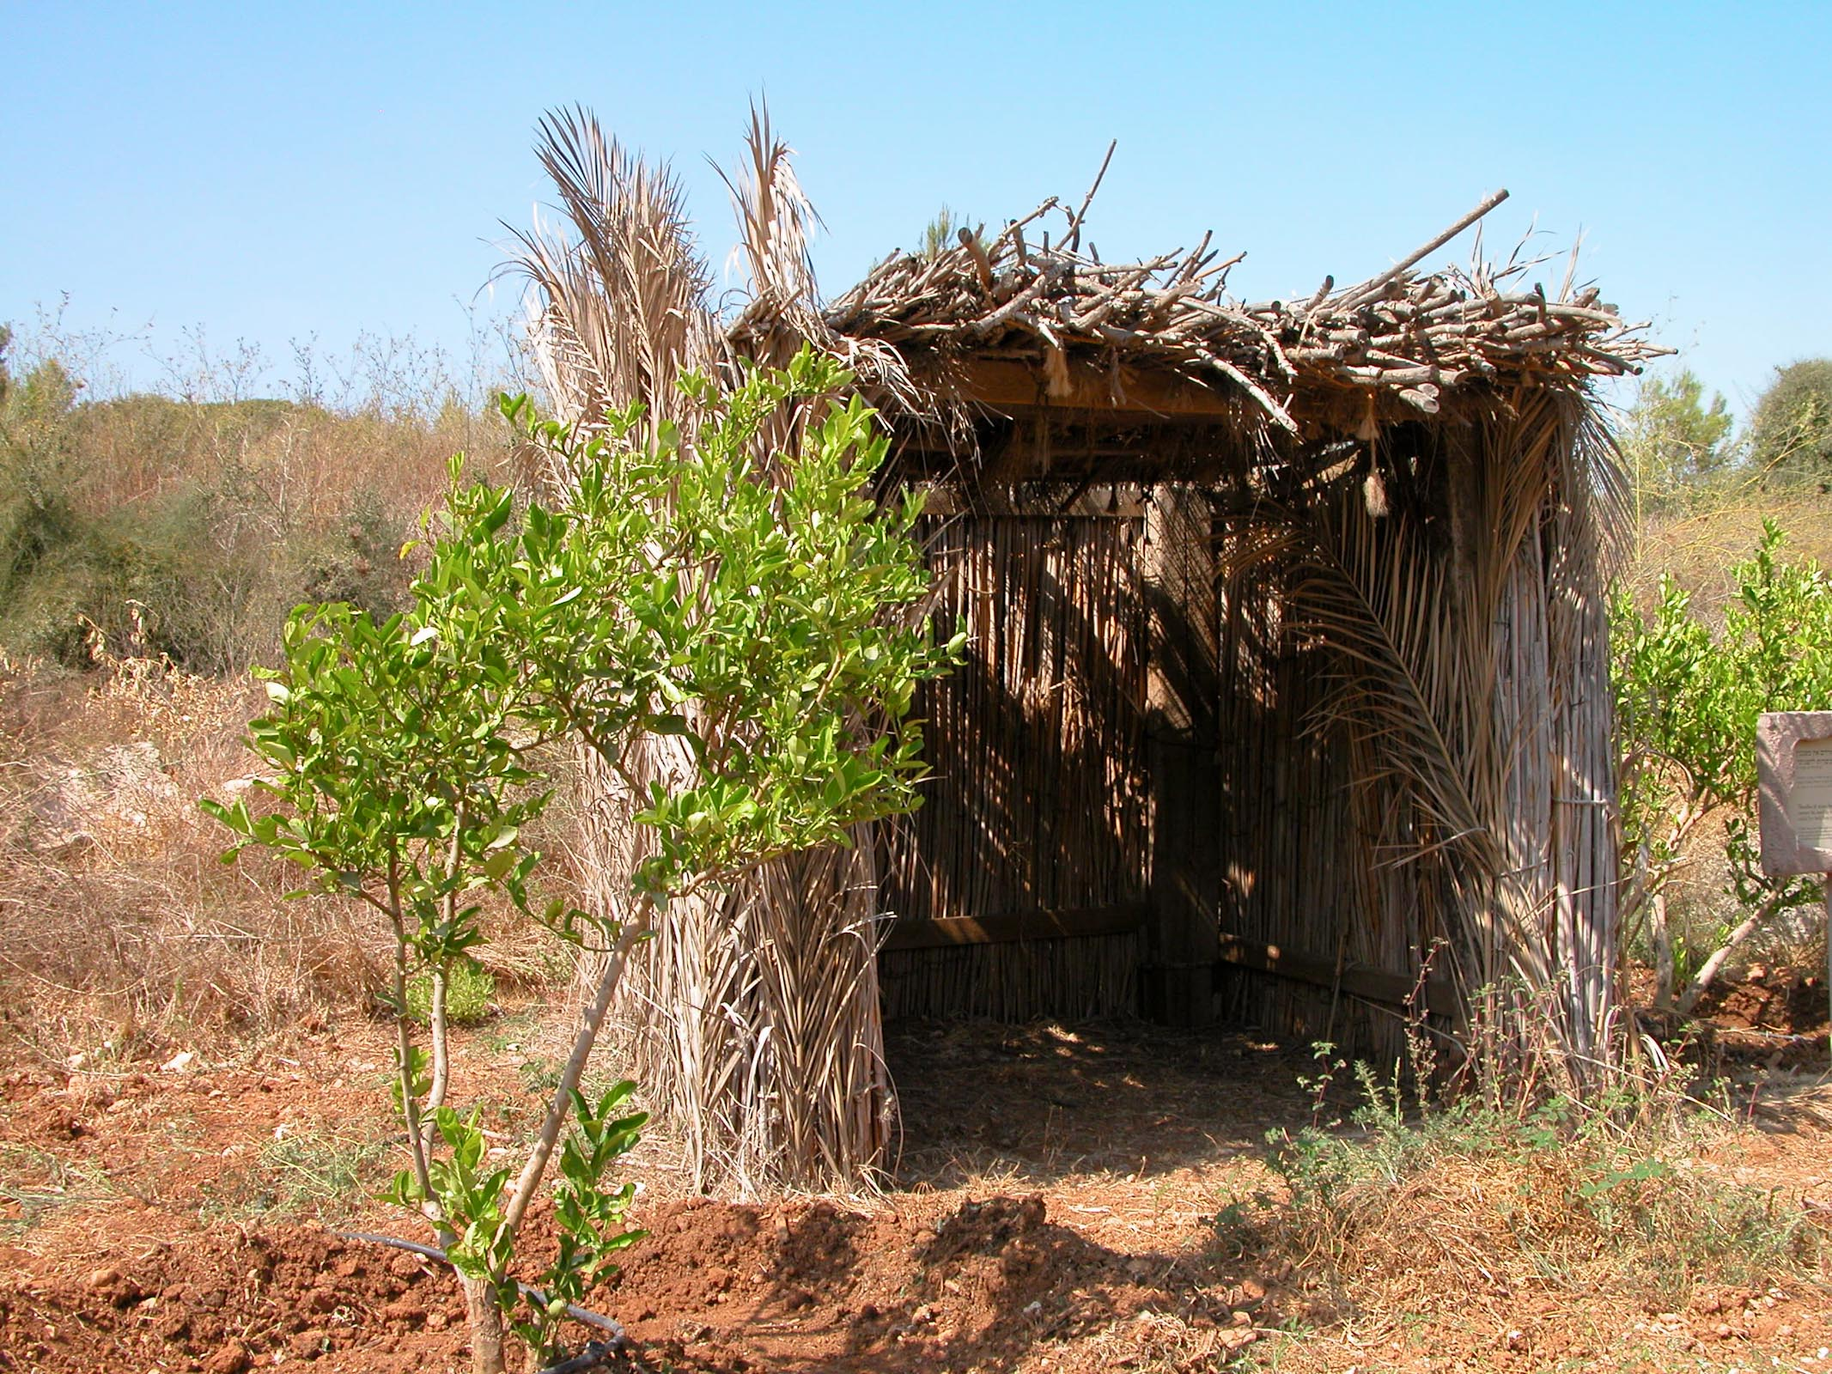
Lord . . . if you wish, I will make three booths here
Booth (sukkah) at Neot Kedumim
17:4
Notes:
The Israelites built booths (sukkot) each year during the fall feast of Tabernacles (Sukkot) to commemorate the wilderness wanderings. This festival was understood as a symbol of the future kingdom (cf. Zech 14) which may explain Peter’s request. This booth is on display at the Neot Kedumim Biblical Landscape Reserve.
tb091403241

Slide 18
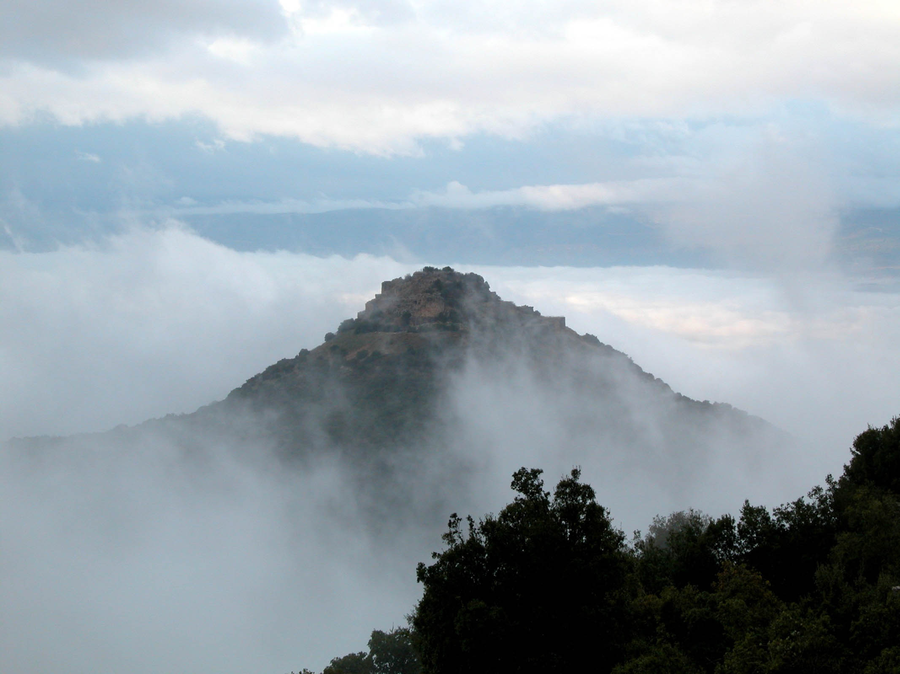
While he was still speaking, a bright cloud overshadowed them
Nimrod’s Fortress in clouds
17:5
Notes:
Nimrod’s Fortress is above Caesarea Philippi and on the slopes of Mount Hermon, probably in the vicinity of the Transfiguration.
tb121802201

Slide 19
Peter, James, and John
did not understand the resurrection of Christ.
Mark 9
“⁹And as they came down from the mountain, he charged them that they should tell no man what things they had seen, till the Son of man were risen from the dead. ¹⁰And they kept that saying with
themselves, questioning
one with another what
the rising from the
dead should
mean.”

Slide 20
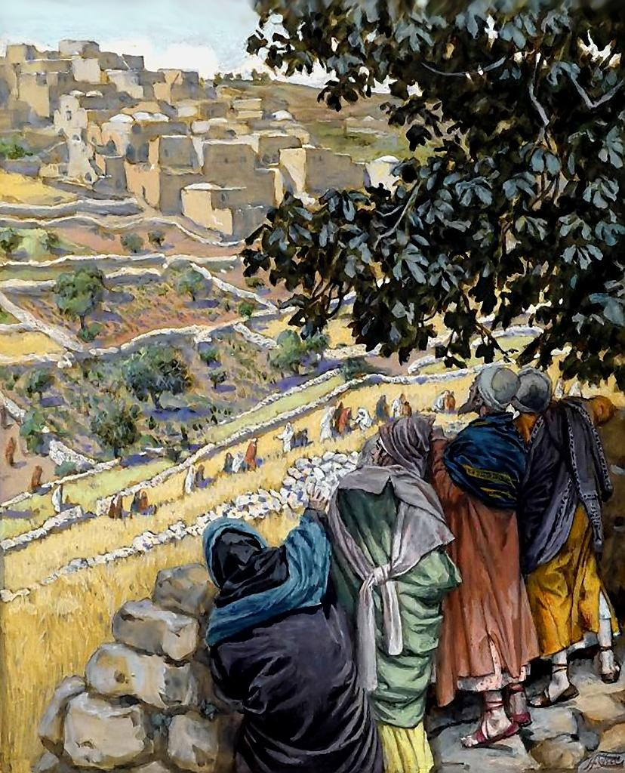
THE HEALING
OF THE DEMONIAC SON
“Parallel records of this miracle are found in Mt. 17:14-20 and Mk. 9:14-29. Jesus and the three disciples spent the night on the mount of transfiguration. . . . The miracle which followed is peculiar, as a case of failure on the part of the disciples; it gave the occasion for our Lord to rebuke their unbelief.”
A Commentary On
The Gospel By Luke
By H. Leo Boles
Luke 9
“³⁷And it came to pass, that on the next day, when they were come down from the hill, much people met him.”

Slide 21
Matthew 17
“¹⁴And when they were come to the multitude, there came to him a certain man, kneeling down to him, and saying, ¹⁵Lord, have mercy on my son: for he is lunatick, and sore vexed: for ofttimes he falleth into the fire, and oft into the water. ¹⁶And I brought him to thy disciples, and they could not cure him.”

Slide 22
Matthew 17
“¹⁷Then Jesus answered and said, O faithless and perverse generation, how long shall I be with you? how long shall I suffer you? bring him hither to me. ¹⁸And Jesus rebuked the devil; and he departed out of him: and the child was cured from that very hour. ¹⁹Then came the disciples to Jesus apart, and said, Why could not we cast him out? ²⁰And Jesus said unto them, Because of your unbelief: for verily I say unto you, If ye have faith as a grain of mustard seed, ye shall say unto this mountain,
remove hence to yonder place;
and it shall remove; and nothing
shall be impossible unto you.
²¹Howbeit this kind goeth not out
but by prayer and fasting.”

Slide 23
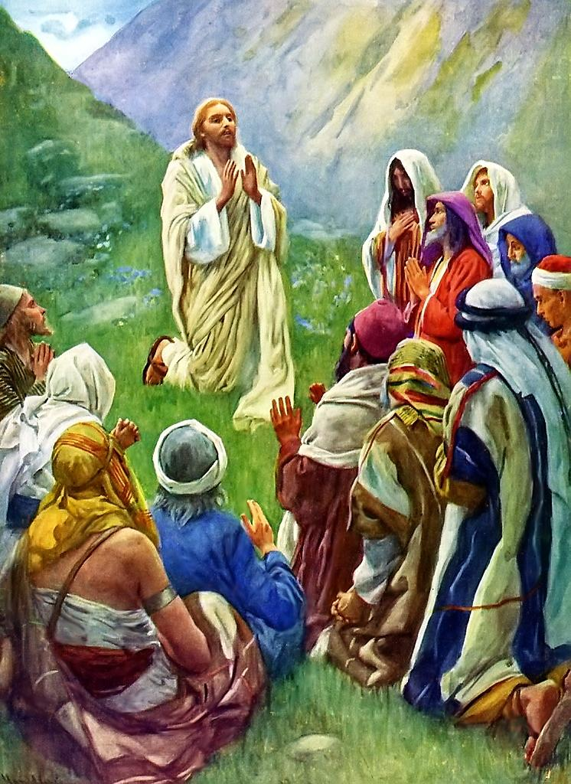
Matthew 17
“²²And while they abode in Galilee, Jesus said unto them, The Son of man shall be betrayed into the hands of men: ²³And they shall kill him, and the third day he shall be raised again. And they were exceeding sorry.”

Slide 24
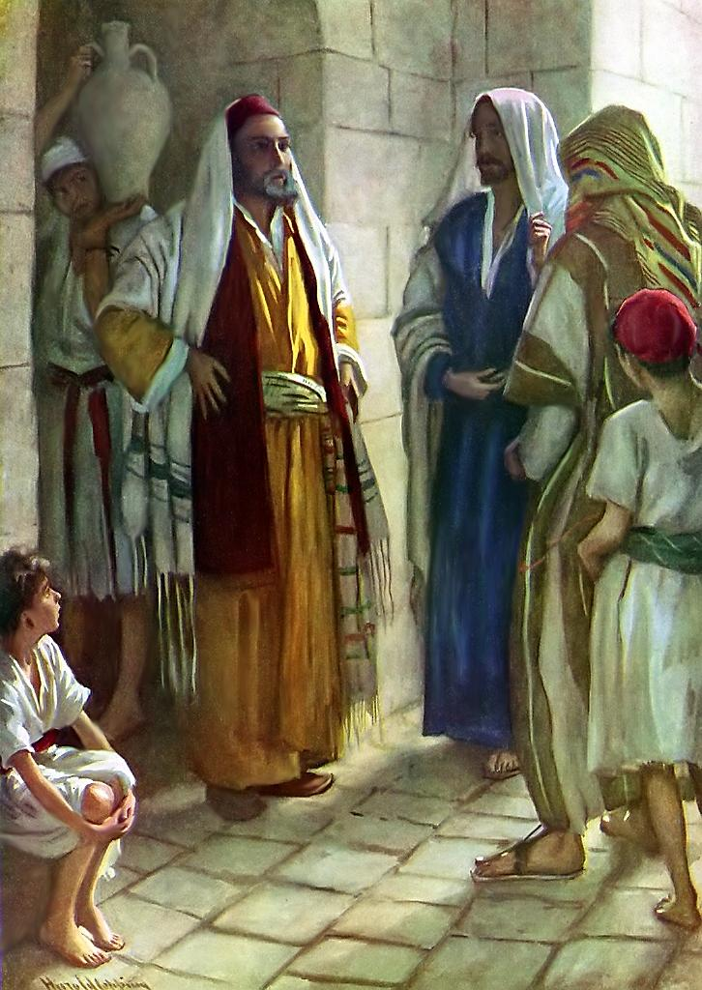
Matthew 17
“²⁴And when they were come to Capernaum, they that received tribute money came to Peter, and said, Doth not your master pay tribute? ²⁵He saith, Yes . . .”
Sidon
Tyre
Capernaum
PHOENICIA
GALILEE
Nazareth
Sea of Galilee
DECAPOLIS
“From the time that Herod Antipas killed John the Baptist, Capernaum ceased to be the ordinary residence of Jesus; only twice is it recorded that he visited it again. These visits were on his way to the third Passover (John 6:25) and now as he goes on his way to the Feast of Pentecost.”
A Commentary On
The Gospel According To Matthew
By H. Leo Boles
“These were Jews and not Roman tax gatherers, for they would not have proposed the payment as a matter of question. This “half-shekel” was the tribute money which every Jew, rich or poor, over twenty years of age, was obliged to pay yearly.”
The Gospel According To Matthew
By H. Leo Boles
Jordan River
SAMARIA
PEREA
Jerusalem
Bethlehem
JUDEA
Salt Sea
ARABIA
EGYPT

Slide 25
Matthew 17
“²⁵. . . And when he was come into the house, Jesus prevented him, saying, What thinkest thou, Simon? of whom do the kings of the earth take custom or tribute?
of their own children,
or of strangers?
²⁶Peter saith unto him,
Of strangers.
Jesus saith
unto him, Then
are the children free.”

Slide 26
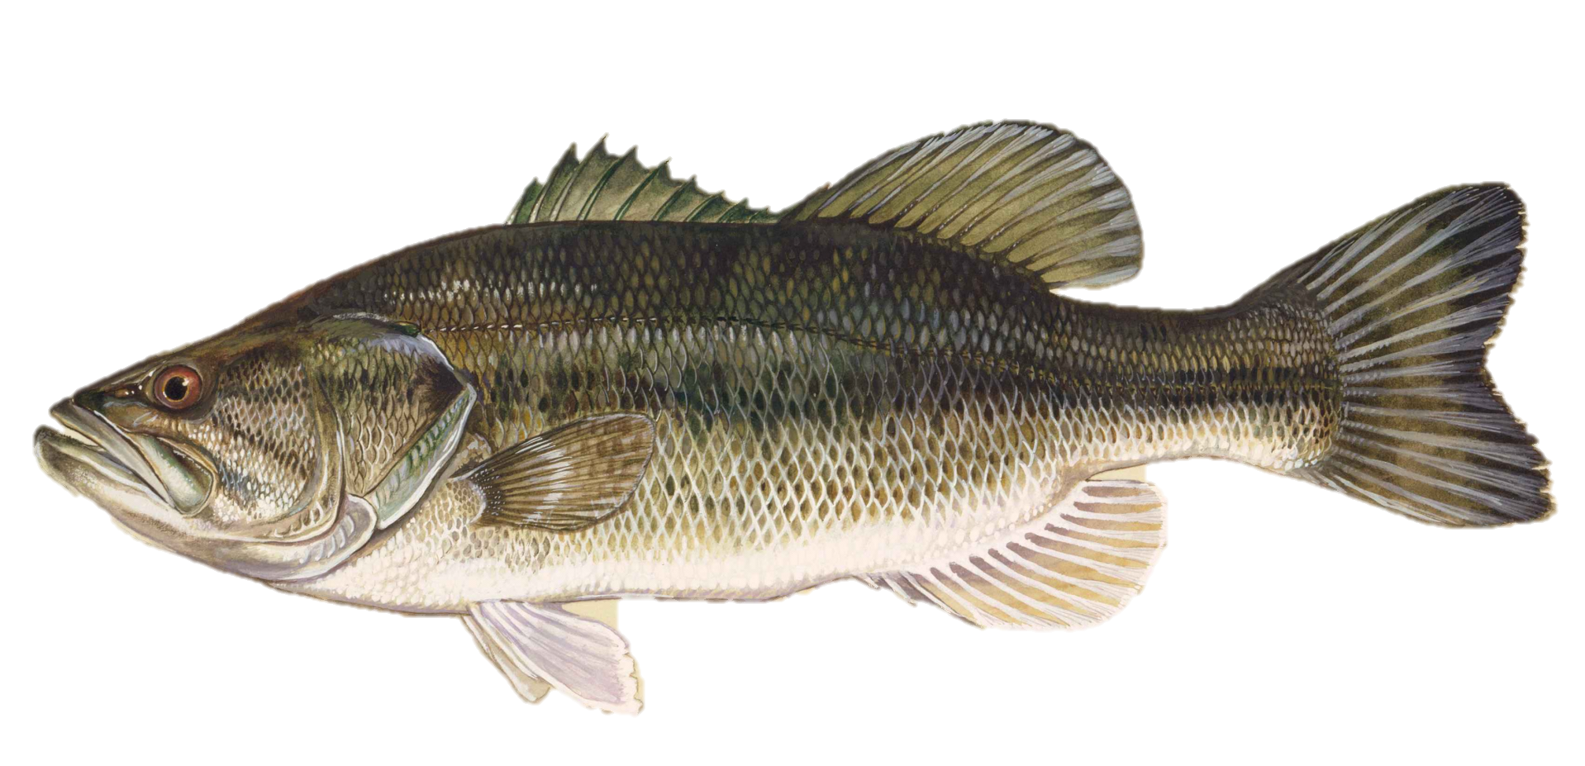
Matthew 17
“²⁷Notwithstanding, lest we should offend them, go thou to the sea, and cast an hook, and take up the fish that first cometh up; and when thou hast opened his mouth, thou shalt find a piece of money: that take, and give unto them for me and thee.”
Picture: Wikimedia / Public Domain / Author: Raver Duane

Slide 27
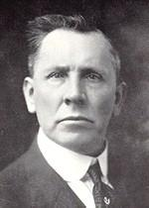
THE SOCRATIC METHOD OF TEACHING
--That Is By Questions --
“Peter is asked if kings of the earth collect taxes ‘from their sons, or from strangers’? Peter promptly answered “from strangers.’ ‘Strangers’ does not mean ‘foreigners,’ but persons out of their own family and kindred; that is, from the subjects of the kingdom. Jesus promptly answered, ‘therefore the sons are free’; that is, the sons of the king did not have to pay the tax.”
“His point is that the custom of earthly kings is to collect taxes from their own subjects, and not from their immediate family; that the sons of the king are exempt from paying the taxes that other subjects must pay. And now since God is the king and Jesus is his Son, then he is under no obligation to pay the tax. He is exempt. This is another way of declaring himself to be the Son of God.”
A Commentary On
The Gospel According To Matthew
By H. Leo Boles

Slide 28
BELIEVE HE IS THE SON OF GOD.
OBEY THE GOSPEL.
Hear the Gospel (Matthew 15:10).
Believe the Gospel (John 3:16).
Repent of Sins (Luke 13:3).
Confess Christ (Matthew 10:32).
Be Baptized Into Christ (Matthew 28:18-20).
“He Shall Save His People From Their Sins” Matthew 1:21.

Slide 29
Thank you for learning
more about
THE LIFE OF CHRIST.

Slide 30
THE BIBLE VISUALIZED
THE LIFE OF CHRIST
Produced By Ethical Media
Executive Producer
Gary McDade
Graphics
Sheila McDade
SOURCES
Ultimate Picture Collection
Wikimedia Pictures
Illustrated Life Of Jesus
A Harmony Of The Gospels – A.T. Robertson
Dickson Bible & Thompson Bible
Matthew Henry’s Commentary
Copyright 2015

