Slide 1
Welcome to our services
New Lebanon Church of Christ
We are Simply Christians.
Our Emphasis is Spiritual, Not Material or Social.
We are striving to be The Same Church as Described in The New Testament.
Please Come Back Again

Slide 2
The Way Of Liberalism In The Church Of Christ
Understanding Conservatism,
Liberalism, and Pluralism
Sunday July 2nd at 5pm.
New Lebanon Church Of Christ
1973 W. Main St.
Everyone is invited to attend.
Please join us for this important lesson.

Slide 3
The Way Of Liberalism In The Church Of Christ
Understanding Conservatism,
Liberalism, and Pluralism

Slide 4
Please open your hearts, your ears, and your Bible and follow along.
If you have any questions about anything I say, if you disagree anything I say, please say something to me after the service and I will be glad to sit down with you and God’s word and study so that we can come to know His truth

Slide 7
Definitions
Conservatism: adhering to the original word of God. Following the pattern. Not adding to or taking away from God’s word. Acting with AUTHORITY (Jesus has ALL Authority.) Accepts Verbal Plenary Inspiration.
Liberalism: NOT adhering to the original word of God. Does NOT follow the pattern. Takes liberty with interpretation. Believes in “thought” inspiration. Takes silence as permissive (doesn’t say we can’t do this). Based more on personal emotion and feelings than on the written word of God.
Pluralism: Accepting of many different views and opinions. Unity in diversity. Agree to disagree. We are told that to stand up and speak out against an individuals sin is "building fences." The fear is that we will alienate the church from the people in the world. In reality, a "fence" has already been "built" by the sinner when he chooses to do that which the New Testament prohibits. The "fence" is not between the church and the world, it is between the sinner and the Saviour. To allow this separation to remain without warning or informing the sinner is indifference and pure selfishness on our part. In a rush to be acceptable and "socially correct," we allow the sinner to remain unacceptable and "spiritually incorrect" with the Lord. Is this being a "light unto the world"?

Slide 8
Pluralism: Accepting of many different views and opinions. Unity in diversity. Agree to disagree.
“We are told that to stand up and speak out against an individuals sin is "building fences." The fear is that we will alienate the church from the people in the world. In reality, a "fence" has already been "built" by the sinner when he chooses to do that which the New Testament prohibits.
The "fence" is not between the church and the world, it is between the sinner and the Saviour. To allow this separation to remain without warning or informing the sinner is indifference and pure selfishness on our part. In a rush to be acceptable and "socially correct," we allow the sinner to remain unacceptable and "spiritually incorrect" with the Lord. Is this being a "light unto the world"? (ken Mars truth magazine)

Slide 9
I went to school with Nadab and Abihu.

Slide 11
Col.3:17 ¹⁷ And whatever you do in word or deed, do all in the name of the Lord Jesus, giving thanks to God the Father through Him.

Slide 15
Newton's First Law of Motion
Newton's First Law of Motion states that an object in motion tends to stay in motion unless an external force acts upon it. Similarly, if the object is at rest, it will remain at rest unless an unbalanced force acts upon it. Newton's First Law of Motion is also known as the Law of Inertia.
Basically, what Newton's First Law is saying is that objects behave predictably. If a ball is sitting on your table, it isn't going to start rolling or fall off the table unless a force acts upon it to cause it to do so. Moving objects don't change their direction unless a force causes them to move from their path.

Slide 17
Understanding Conservatism, Liberalism, and Pluralism
Objects behave predictably.
People behave predictably.

Slide 18
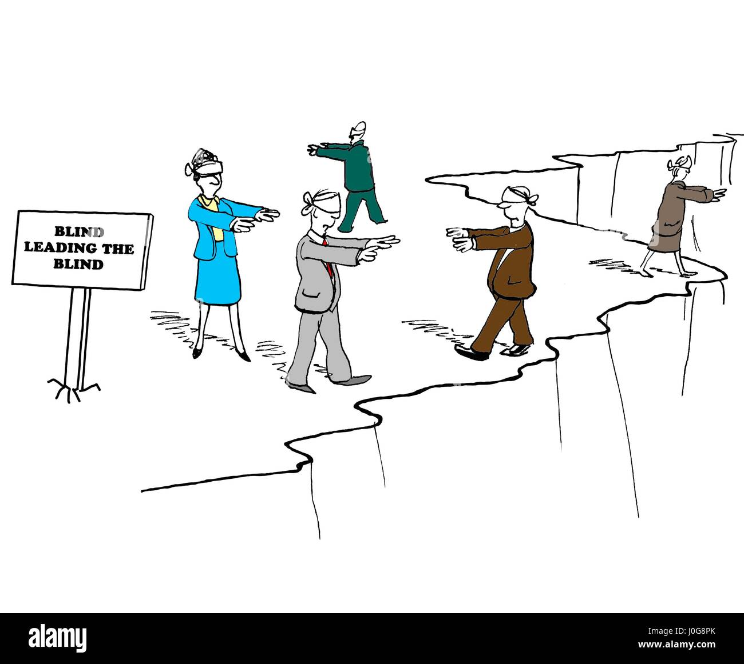

Slide 19
Understanding Conservatism, Liberalism, and Pluralism
Psalm 119:105
Your word is a lamp to my feet And a light to my path.
Matt. 15:14
Let them alone. They are blind leaders of the blind. And if the blind leads the blind, both will fall into a ditch.”

Slide 20
Understanding Conservatism, Liberalism, and Pluralism
1
Liberal
1. Have missionary, benevolent and educational organizations to execute the work of the church.
Conservative
1. Have no missionary, benevolent and educational organizations to execute the work of the church. They believe the local church is God's only organization to do his work (Phil. 1:1; Acts 14:23).

Slide 21
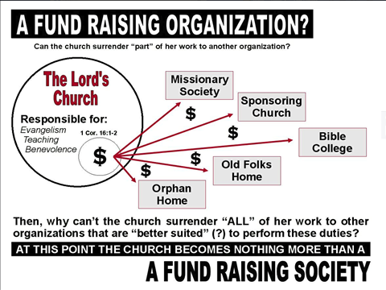

Slide 23
Brethren have apostatized because they tried to activate the
Universal church
To carry out the lord’s work.
A.C.M.S, Herald of Truth, etc.
The work of the church is regulated
to the local congregation.

Slide 24
The issue is not whether an individual or institution is worthy of receiving money.
The issue is - can we take
the $ from the Lord’s treasury?
The issue is - are we following
the Lord’s pattern?
Is it a responsibility
of the church or individual?

Slide 25
Home
Govt.
church
All separate and individual institutions.
Liberal mind does not recognize distinction

Slide 26
Carried by this.
Not this.
What does the church have in its treasury?
ONLY MONEY. The church did not have a food pantry, a clothes pantry, a disaster pantry, a “Christmas shoebox pantry”………

Slide 27
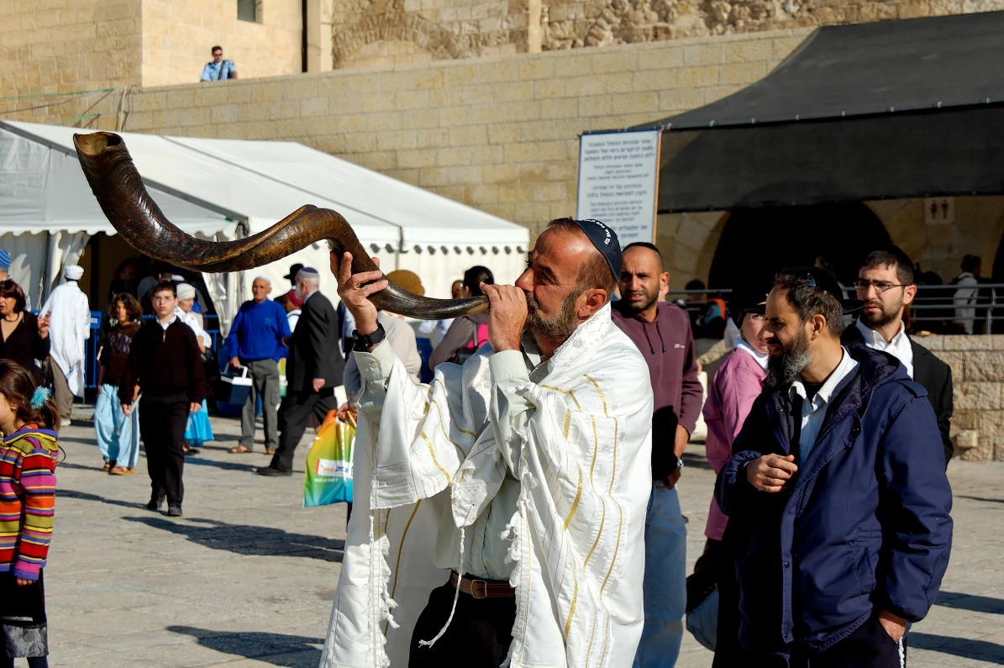
Matt. 6:2
"Therefore, when you do a charitable deed, do not sound a trumpet before you as the hypocrites do in the synagogues and in the streets, that they may have glory from men. Assuredly, I say to you, they have their reward.
Notes:
This man was blowing the shofar (ram’s horn; trumpet) as part of a celebration at the Western Wall prayer plaza in Jerusalem.
tb042605429

Slide 28
Departures in the church in America
2021-2022 | Anything you | WANT
1952 | Herald of Truth
1950s-1960s | Another major split in America | Institutional Non-institutional
 |  | Liberal conservative
Early 1900s- Late 1800s | Social Gospel | Benevolence
 |  | Orphans homes Widows homes
1849 | A.C.M.S. | Evangelism

Slide 29
1850 – 1950
1950 – 2050 ?

Slide 30
Understanding Conservatism, Liberalism, and Pluralism
2
Liberal
2. Have "educational directors," "associate ministers," "youth directors," and "superintendents" over their human organizations.
Conservative
2. Have evangelists, elders (pastors) and teachers (Eph. 4:11).

Slide 31
Understanding Conservatism, Liberalism, and Pluralism
3
Liberal
3. Seek to get crowds with "youth meetings," "rallies," carnal rewards such as trips to Opryland and all kinds of promotions (such as the "bus ministry").
Conservative
3. Engage in none of these things, but seek to draw men to Christ with the preaching of the gospel (Jn. 6:45; Rom. 1:16).

Slide 32
3. Seek to get crowds with "youth meetings," "rallies," carnal rewards such as trips to Opryland and all kinds of promotions (such as the "bus ministry").

Slide 33
3. Seek to get crowds with "youth meetings," "rallies," carnal rewards such as trips to Opryland and all kinds of promotions (such as the "bus ministry").
BIBLE?
I wonder why the apostles didn’t think of this???
Matt.7
Fun – Food – Fellowship - Free

Slide 34
Understanding Conservatism, Liberalism, and Pluralism
4
Liberal
4. Emphasize society and the physical man by appealing to the carnal nature with "church banquets," "church kitchens," "church camps," "fellowship halls," and all kinds of parties.
Conservative
4. Do not believe the church is to provide the social needs of man (Rom. 14:17; 1 Cor. 11:22, 34; Jn. 18:36).

Slide 35
Understanding Conservatism, Liberalism, and Pluralism
1 Cor. 11:22
²² What! Do you not have houses to eat and drink in? Or do you despise the church of God and shame those who have nothing? What shall I say to you? Shall I praise you in this? I do not praise you.

Slide 36
Understanding Conservatism, Liberalism, and Pluralism
Christian family v._ ?
Christian school v. _ ?
Christian camp v.__ ?
Christian college v._ ?

Slide 37
Home
Govt.
church
All separate and individual institutions.
Liberal mind does not recognize distinction

Slide 38
Understanding Conservatism, Liberalism, and Pluralism
1 Cor. 11:22
²² What! Do you not have houses to eat and drink in? Or do you despise the church of God and shame those who have nothing? What shall I say to you? Shall I praise you in this? I do not praise you.

Slide 39
A Battle For The Mind
2 Different churches of Christ
Book Chapter Verse
Emotional
church of Christ
church of Christ
Looks forward.
Progressive,
Inclusive,
Diverse,
Cutting edge,
Extended fellowship.
Looks back to the first century.
Which one honors the Father and His word?
How far is too far?
Why did Paul warn about so many false teachers in the church?

Slide 40
Nehemiah 13:23 In those days I also saw Jews who had married women of Ashdod, Ammon, and Moab.
24 And half of their children spoke the language of Ashdod, and could not speak the language of Judah, but spoke according to the language of one or the other people.
25 So I contended with them and cursed them, struck some of them and pulled out their hair, and made them swear by God, saying, "You shall not give your daughters as wives to their sons, nor take their daughters for your sons or yourselves.

Slide 41
“You people from the church of Christ are too legalistic…
you just don’t care.”

Slide 42
Understanding Conservatism, Liberalism, and Pluralism
5
Liberal
5. Elevate their preachers above the rest of the members by using such titles as "doctor."
Conservative
5. Reject all such titles as unscriptural (Matt. 23:7-12).

Slide 43
Understanding Conservatism, Liberalism, and Pluralism
6
Liberal
6. Support and operate schools for secular education, beginning with kindergarten and going through schools of higher education.
Conservative
6. Do not support or operate any schools. They believe that the church is the pillar and ground of the truth (1 Tim. 3:15)

Slide 44
Understanding Conservatism, Liberalism, and Pluralism

Slide 45
Col. 3:17? 1st Peter 4:11? 1Cor.16
Where is the authority for this?
What is the motivation?
Why would a congregation want to raise money this way?

Slide 46
Understanding Conservatism, Liberalism, and Pluralism
7
Liberal
7. Do much of their work through what they call the "sponsoring church" arrangement - many churches pooling their funds under one eldership to do a general work all churches are equally related to.
Conservative
7. Reject this arrangement as a violation of the New Testament pattern of congregational cooperation. In New Testament times one church only helped another church when the receiving church was in want (or need) - unable to do its own work (Acts 11:27-30). (Cooperation in such work does not require the centralized "sponsoring church").

Slide 47
Understanding Conservatism, Liberalism, and Pluralism
8
Liberal
8. Do much of their work through what they call the "sponsoring church" arrangement - many churches pooling their funds under one eldership to do a general work all churches are equally related to.
Conservative
8. Reject this arrangement as a violation of the New Testament pattern of congregational cooperation. In New Testament times one church only helped another church when the receiving church was in want (or need) - unable to do its own work (Acts 11:27-30). (Cooperation in such work does not require the centralized "sponsoring church").

Slide 48
Understanding Conservatism, Liberalism, and Pluralism
9
Liberal
9. Expect their preachers to be modern-day "pastors," running after the members and visiting the hospitals on a regular basis and to be the "head planner" of all their projects and promotions.
Conservative
9. Do not expect their preachers to leave the work of God to serve tables (Acts 6:20). They have deacons and godly women to take care of the "physical needs" of the congregation and elders to do the planning (Acts 20:28). The preacher is left free to study, meditate, pray and carry on the work of preaching the gospel to the lost (2 Tim. 2:15; 1 Tim. 4:12-16). The preacher is to visit the sick because he is a Christian (Matt. 25:36), not as a "preacher duty."

Slide 49
Understanding Conservatism, Liberalism, and Pluralism

Slide 50
Understanding Conservatism, Liberalism, and Pluralism
10
Liberal
10. Have "special singing" in the assembly - different choral groups are invited in to sing.
Conservative
10. Have nothing but congregational singing (Eph. 5:19; Col. 3:16).

Slide 51
Way’s God does not authorize.
1.God's word does not authorize upon the basis of our personal likes and dislikes. 2.God's word does not authorize upon the basis of our opinions or the opinions of others. 3.God's word does not authorize upon the basis of what is popular. 4.God's word does not authorize upon the basis of what some well-known preacher teaches or may have taught. 5.God's word does not authorize upon the basis of human traditions. 6.God's word does not authorize upon the basis of silence of the scriptures.

Slide 52
Departing from the pattern is often based on emotion,
not scripture.

Slide 53
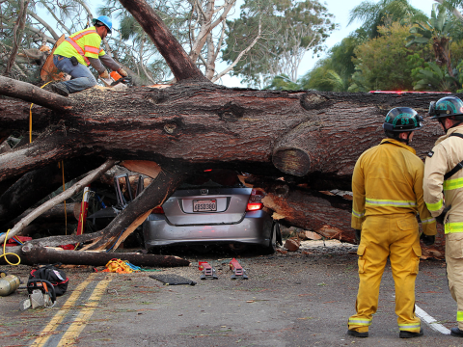
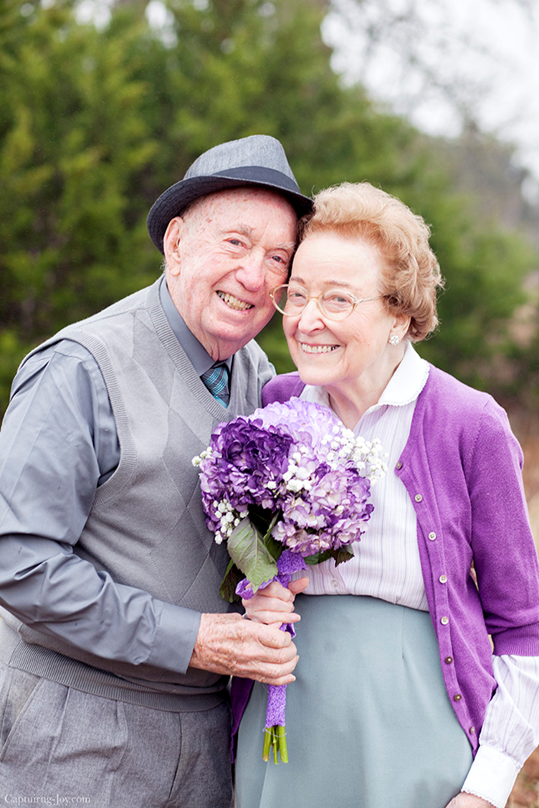
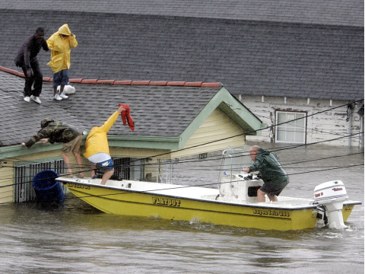
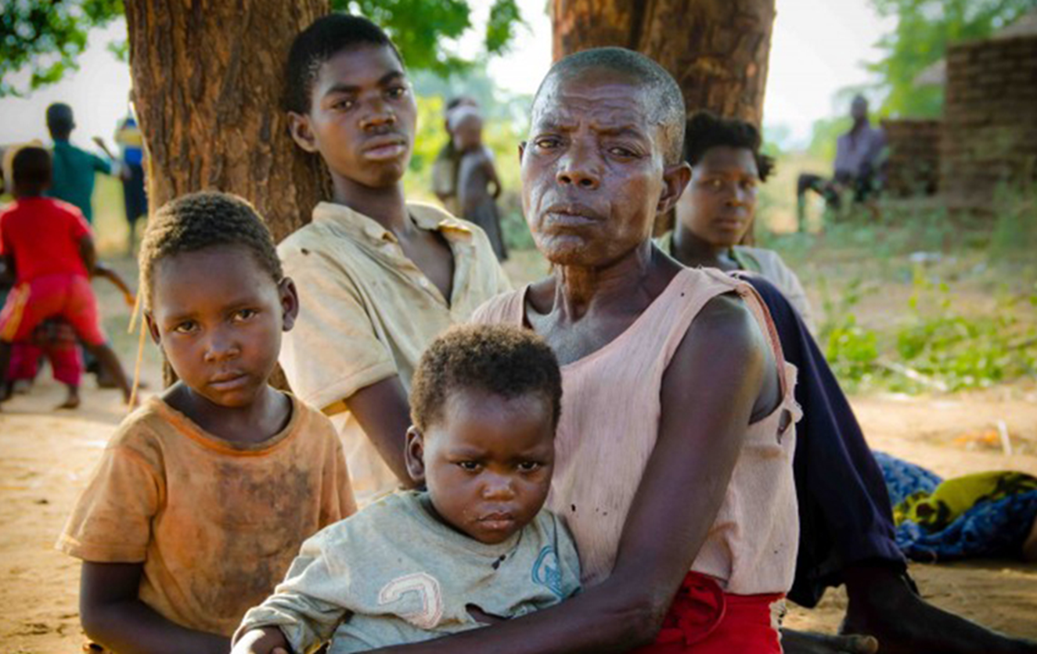
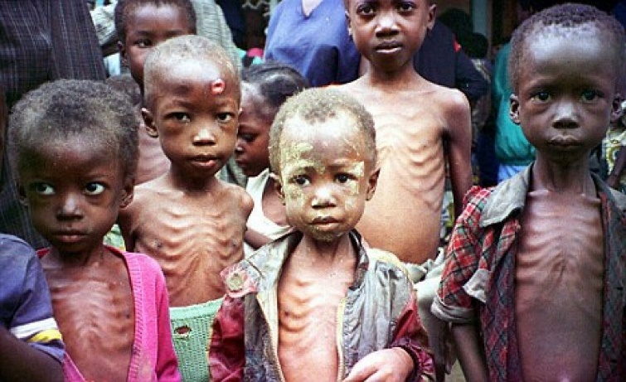

Slide 54
The Authority of God and
The Silence Of God
Malachi 1:6 "A son honors his father, And a servant his master. If then I am the Father, Where is My honor? And if I am a Master, Where is My reverence? Says the LORD of hosts To you priests who despise My name.

Slide 55
What is the answer?
Agree to disagree? No.
Repent and turn to God.
Ezekiel 33:6–7
⁶ But if the watchman sees the sword coming and does not blow the trumpet, and the people are not warned, and the sword comes and takes any person from among them, he is taken away in his iniquity; but his blood I will require at the watchman’s hand.’
⁷ “So you, son of man: I have made you a watchman for the house of Israel; therefore you shall hear a word from My mouth and warn them for Me.

