Slide 1
Welcome to our services
New Lebanon Church of Christ
We are Simply Christians.
Our Emphasis is Spiritual, Not Material or Social.
We are striving to be The Same Church as Described in The New Testament.
Please Come Back Again

Slide 2
How do We Answer When God Calls Us?
Eph 4:1 I, therefore, the prisoner of the Lord, beseech you to walk worthy of the calling with which you were called,
b hastings newlebanoncoc.com

Slide 3
Illustrated
Bible verses
by Ethical Media

Slide 4
How do We Answer When God Calls Us? Eph.4:1
Intro.
God has always sent men to do His work here on earth,
The purpose of this lesson is to remind us of some things we already know, lest we forget. To Equip us. To Encourage us.
To Energize us. To give us something to think about,. Something to feel. And most important, something to do.
Consider three men who God called & sent on missions to accomplish His will.
Their reactions to God’s call to go can be applied to how we react when God has called us to action.
Going to consider three different Attitudes!
b hastings newlebanoncoc.com

Slide 5
How do We Answer When God Calls Us? Eph.4:1
Three Men Called By God.
Jonah: “Here am I, I’m not going”
Jonah 1:1-3. Now the word of the LORD came to Jonah the son of Amittai, saying,
2 "Arise, go to Nineveh, that great city, and cry out against it; for their wickedness has come up before Me."
b hastings newlebanoncoc.com

Slide 6
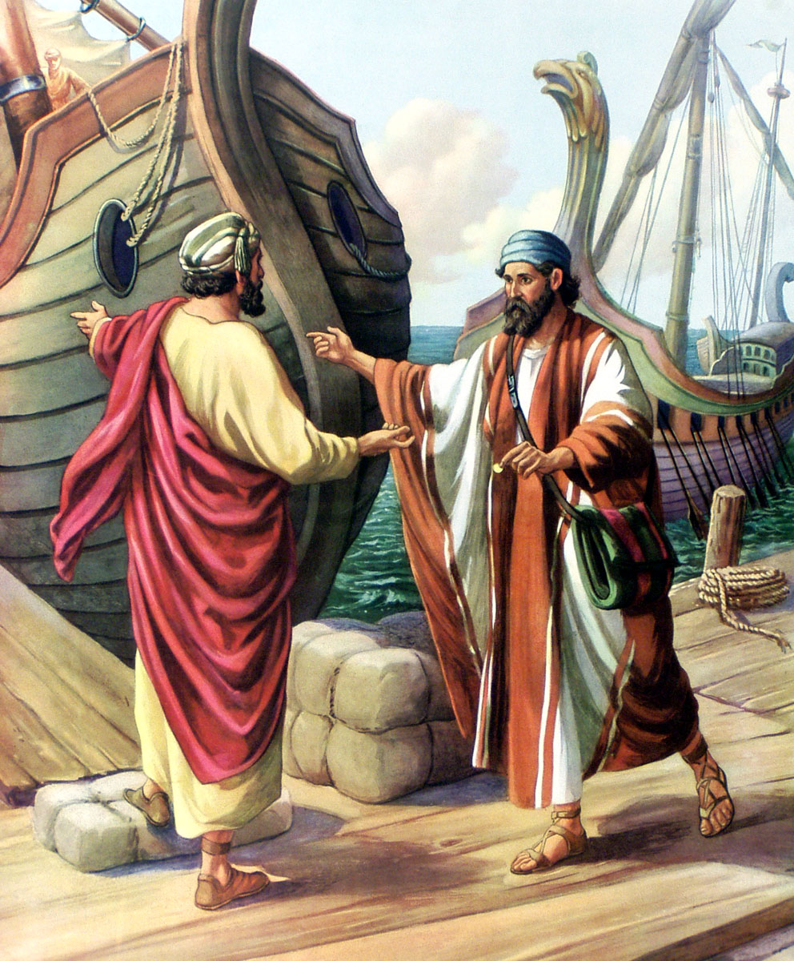
Jonah 1
“³But Jonah rose up to flee unto Tarshish from the presence of the LORD, and went down to Joppa; and he found a ship going to Tarshish: so he paid the fare thereof, and went down into it, to go with them unto Tarshish from the presence of the LORD.”

Slide 7
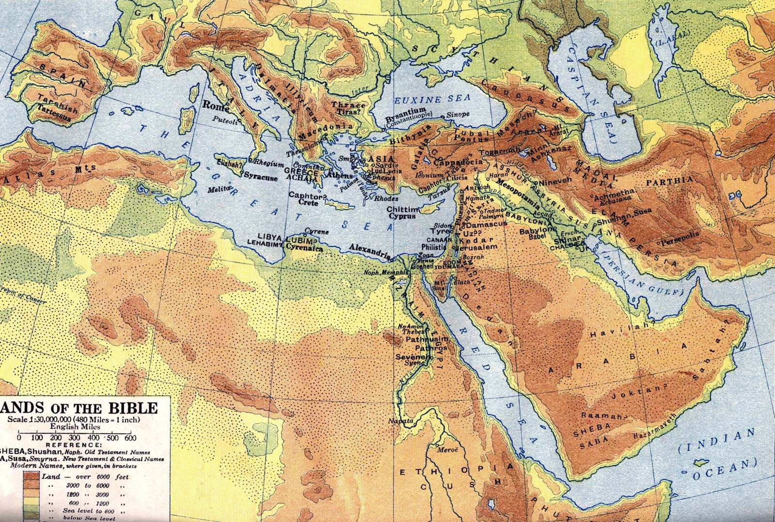
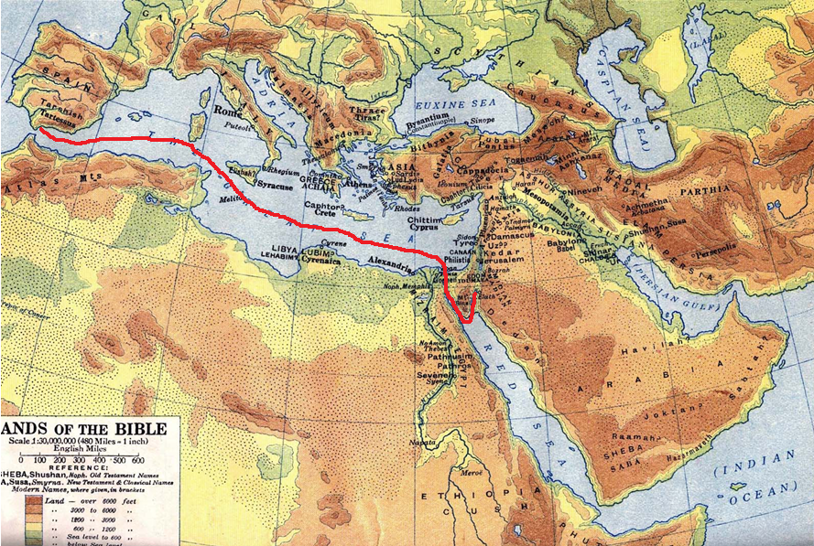
Nineveh
Tarshish—
Possibly in southern Spain near Gibraltar. Because of mineral wealth the Phoenicians established a colony there.
Joppa
Jonah was going as far from Nineveh as he could get!

Slide 8
How do We Answer When God Calls Us? Eph.4:1
God called him to a work –
Preach against Nineveh.
His reaction showed lack of faith
(in God) & lack of love (for souls),
b hastings newlebanoncoc.com

Slide 9
How do We Answer When God Calls Us? Eph.4:1
Jonah 4:1-5.
Today: Are we like Jonah - Running from spiritual obligations, believing we have good reasons which clear us from responsibility?
b hastings newlebanoncoc.com

Slide 10
How do We Answer When God Calls Us? Eph.4:1
2. Moses: “Here am I, send Aaron” –
Exodus. 3:10. "Come now, therefore, and I will send you to Pharaoh that you may bring My people, the children of Israel, out of Egypt."
11 But Moses said to God, "Who am I that I should go to Pharaoh, and that I should bring the children of Israel out of Egypt?"
Moses knew the need which existed, he just couldn’t see himself being used by God to meet the need.
b hastings newlebanoncoc.com

Slide 11
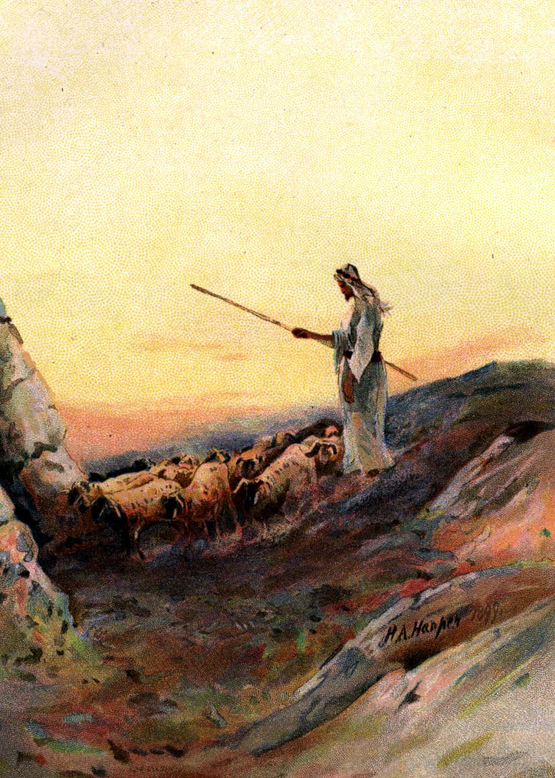
Exodus 3
“¹Now Moses kept the flock of Jethro his father in law, the priest of Midian . . .”

Slide 12
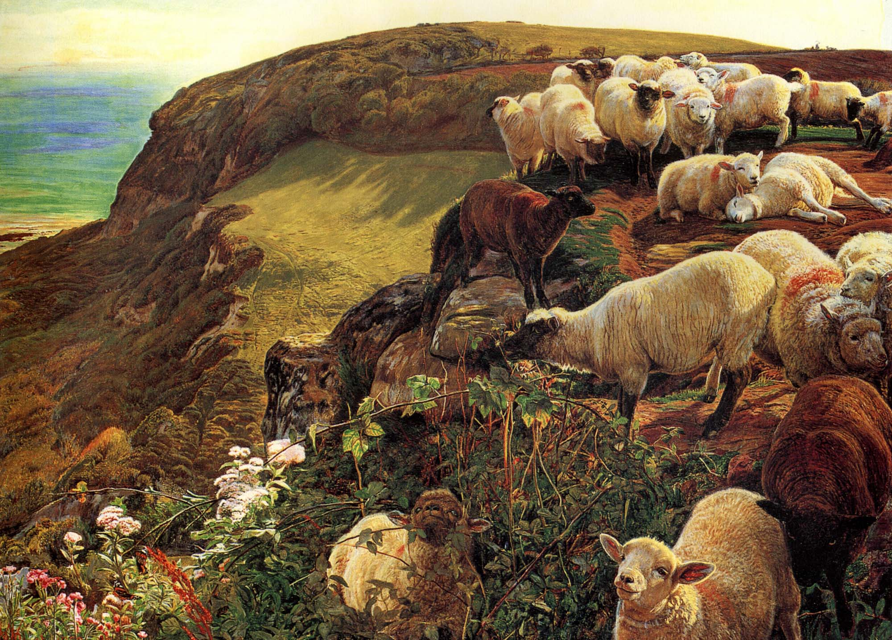
Exodus 3
“¹ . . . and he led the flock to the backside of the desert, and came to the mountain of God, even to Horeb.”

Slide 13
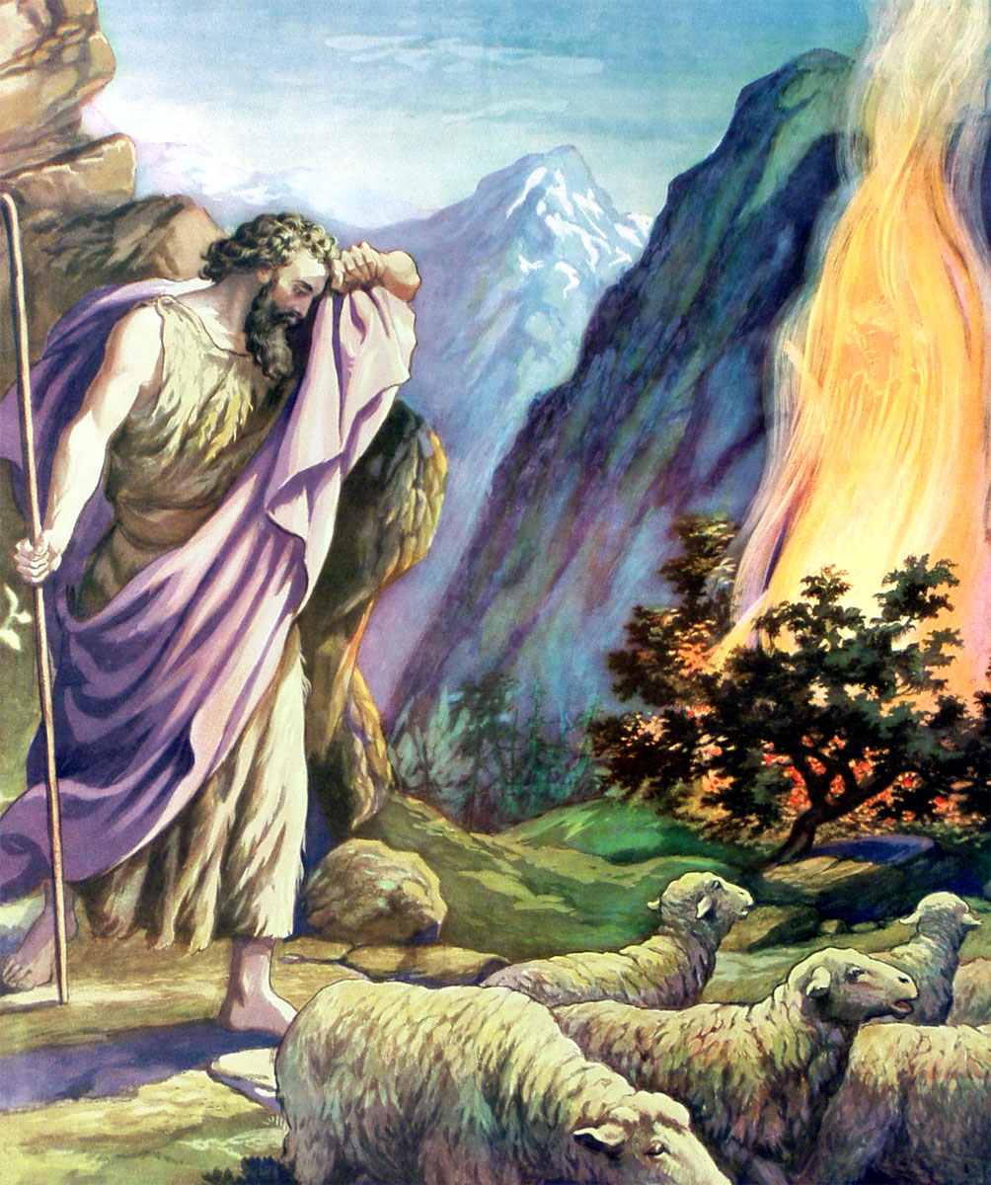
Exodus 3
“²And the angel of the LORD appeared unto him in a flame of fire out of the midst of a bush: and he looked, and, behold, the bush burned with fire, and the bush was not consumed. ³And Moses said, I will now turn aside, and see this great sight, why the bush is not burnt.”

Slide 14
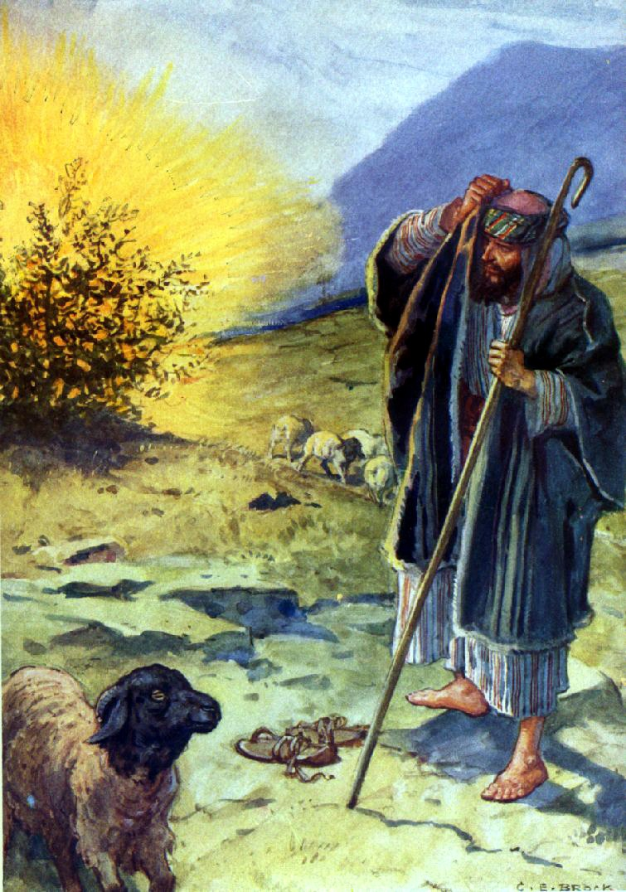
Exodus 3
“⁵And he said, Draw not nigh hither: put off thy shoes from off thy feet, for the place whereon thou standest is holy ground.”
Exodus 3
“⁴And when the LORD saw that he turned aside to see, God called unto him out of the midst of the bush, and said, Moses, Moses. And he said, Here am I.”

Slide 15
Exodus 3
“⁶Moreover he said, I am the God of thy father, the God of Abraham, the God of Isaac, and the God of Jacob. And Moses hid his face; for he was afraid to look upon God.”

Slide 16
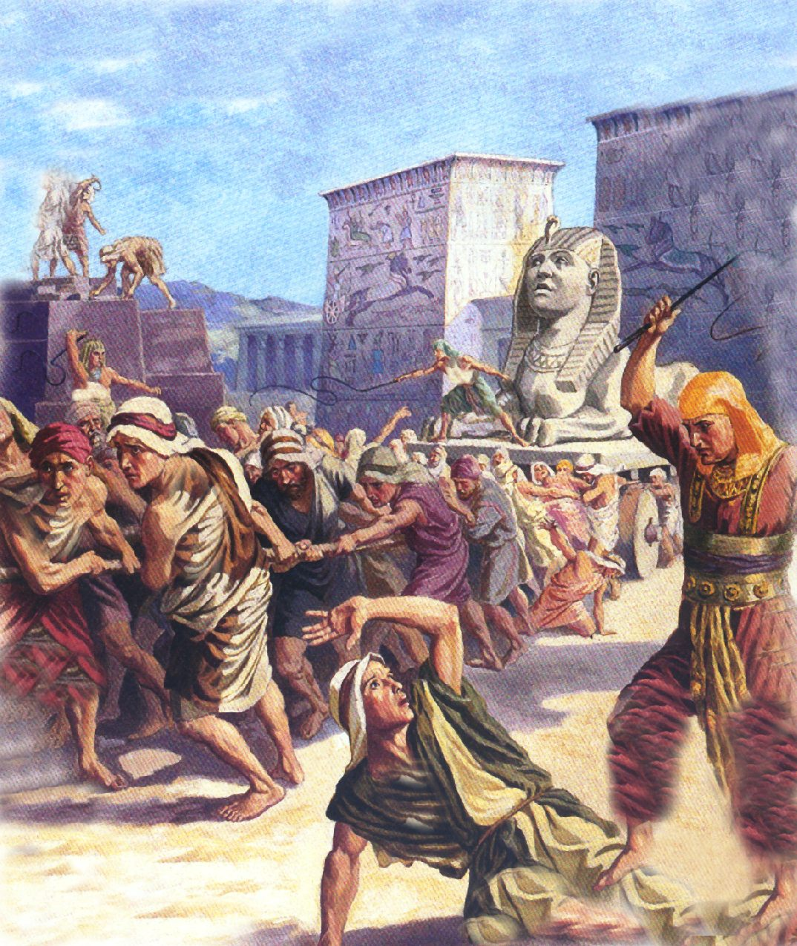
Exodus 3
“⁷And the LORD said, I have surely seen the affliction of my people which are in Egypt, and have heard their cry by reason of their taskmasters; for I know their sorrows.”

Slide 17
Exodus 3
“⁸And I am come down to deliver them out of the hand of the Egyptians, and to bring them up out of that land unto a good land and a large, unto a land flowing with milk and honey; unto the place of the Canaanites, and the Hittites, and the Amorites, and the Perizzites, and the Hivites, and the Jebusites.”

Slide 18
Exodus 3
“⁹Now therefore, behold, the cry of the children of Israel is come unto me: and I have also seen the oppression wherewith the Egyptians oppress them.”

Slide 19
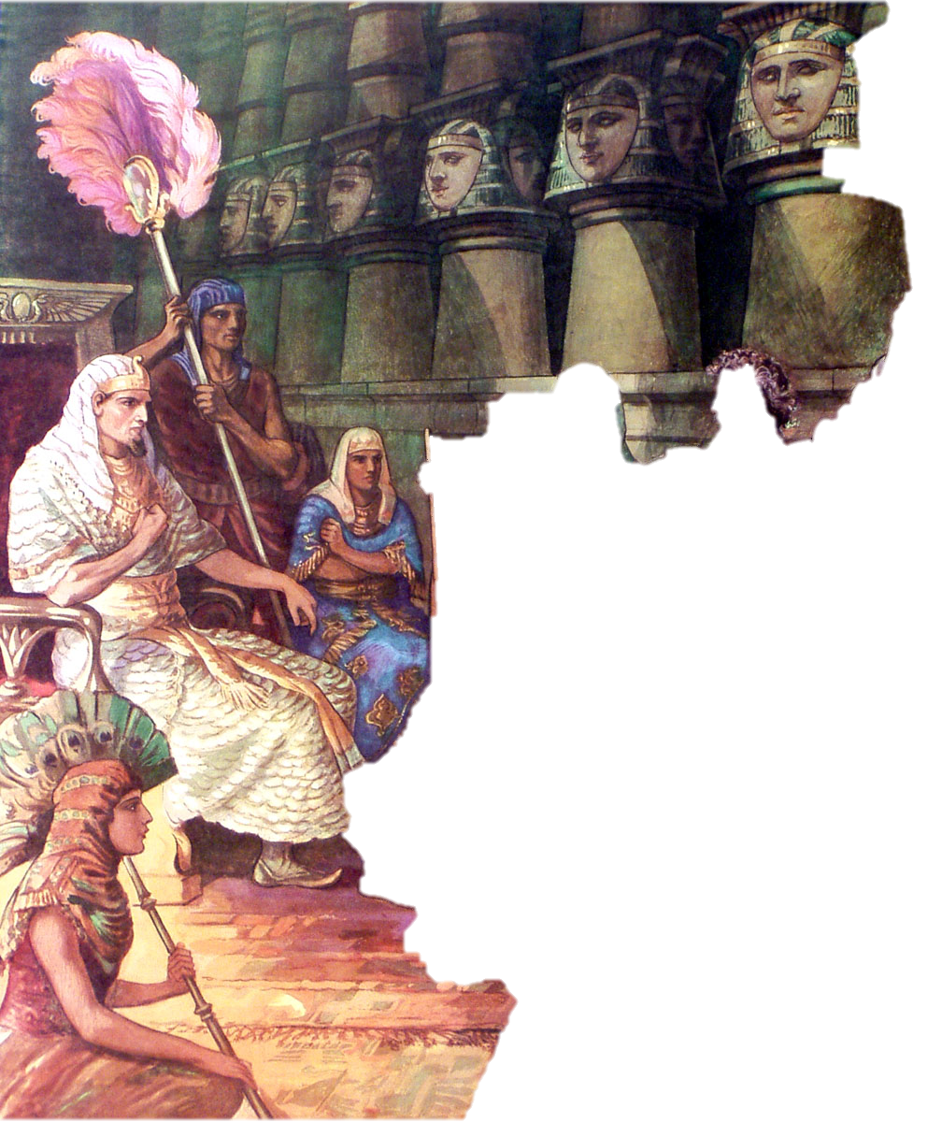
Exodus 3
“¹⁰Come now therefore, and I will send thee unto Pharaoh, that thou mayest bring forth my people the children of Israel out of Egypt.”

Slide 20
How do We Answer When God Calls Us? Eph.4:1
He offered multiple excuses aimed at removing himself from God’s consideration as deliverer of Israel (3:11-4:17).
Today: Do we not often rationalize why we are not best suited for some spiritual work - That surely God could find someone other than me to do what needs to be done?
b hastings newlebanoncoc.com

Slide 21
How do We Answer When God Calls Us? Eph.4:1
3. Isaiah:“Here am I, send me”
Isa. 6:8. Also I heard the voice of the Lord, saying: "Whom shall I send, And who will go for Us?" Then I said, "Here am I! Send me."
1. What motives prompted Isaiah’s response:
a. Majesty / glory of God, 6:1-4.
b. Sinfulness of man, 6:5.
c. Forgiveness from God, 6:6-7.
b hastings newlebanoncoc.com

Slide 22
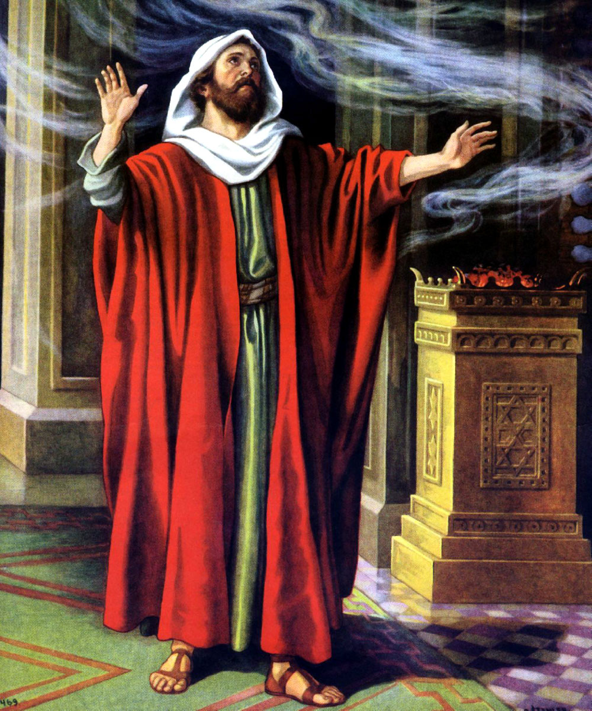
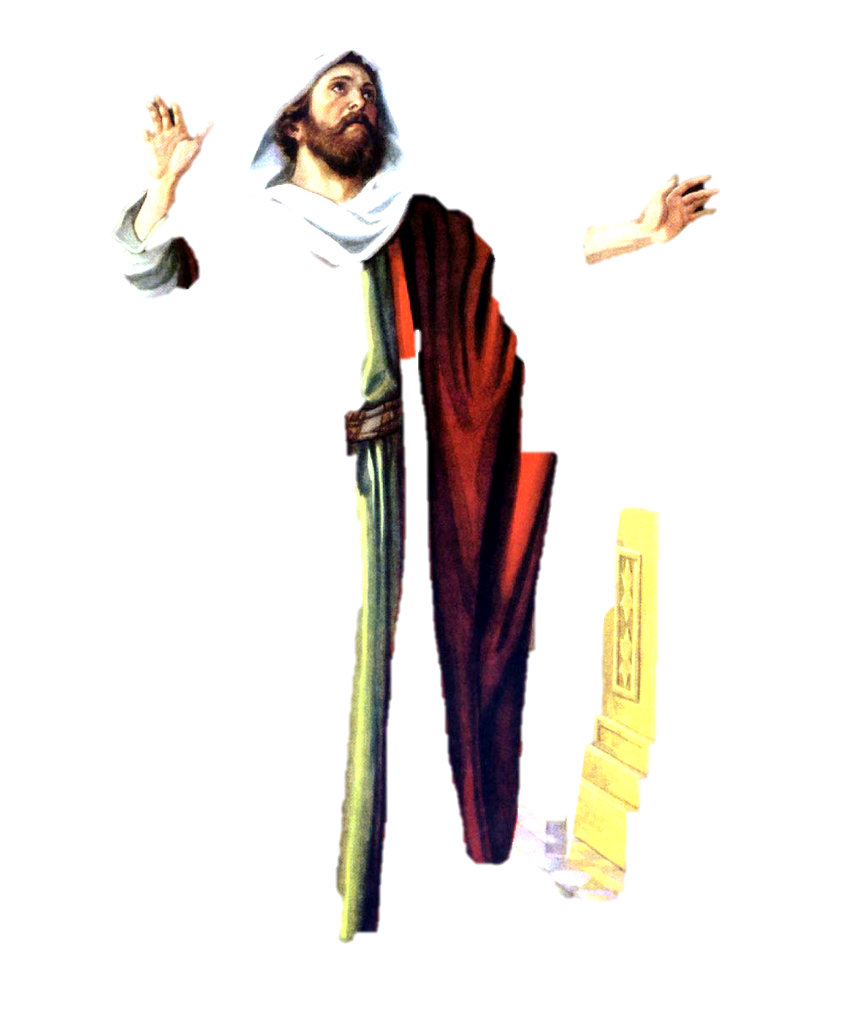
THE CALL
Chapter 6
In the year that King Uzziah died, Isaiah,
apparently while worshipping in the temple,
received a call to the prophetic office.

Slide 23
Having been reared in Jerusalem, he was well fitted to become the political and religious counselor of the nation, but the experience which prepared him most for his important work was the vision of the
majestic and holy God whom he saw in the temple.
He responded with noteworthy zeal, and accepted his commission, though he knew from the outset that his task was to be one of
fruitless warning and exhortation.

Slide 24
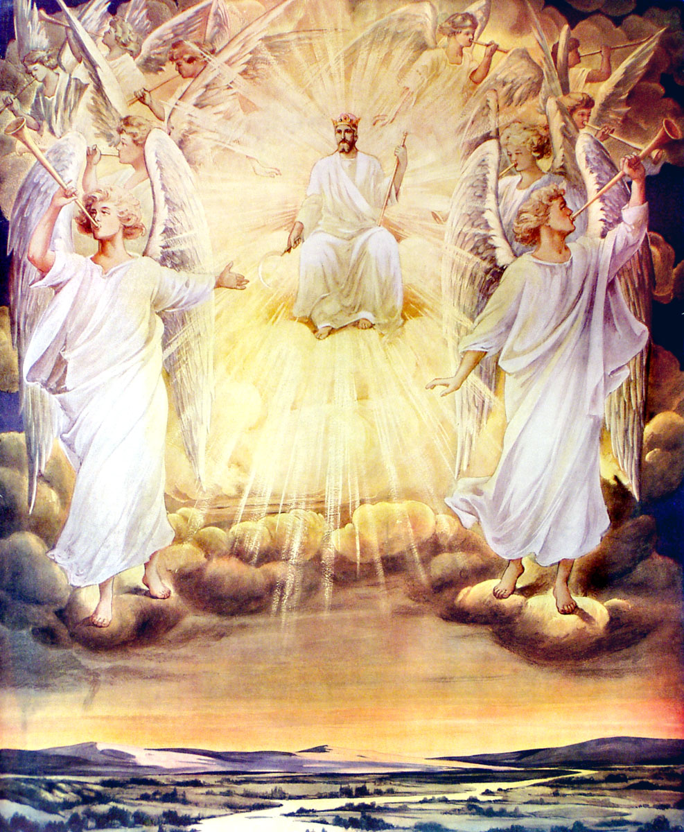
Isaiah 6
“¹In the year that king Uzziah died I saw also the Lord sitting upon a throne, high and lifted up, and his train filled the temple.”
Isaiah’s vision in the temple . . .

Slide 25
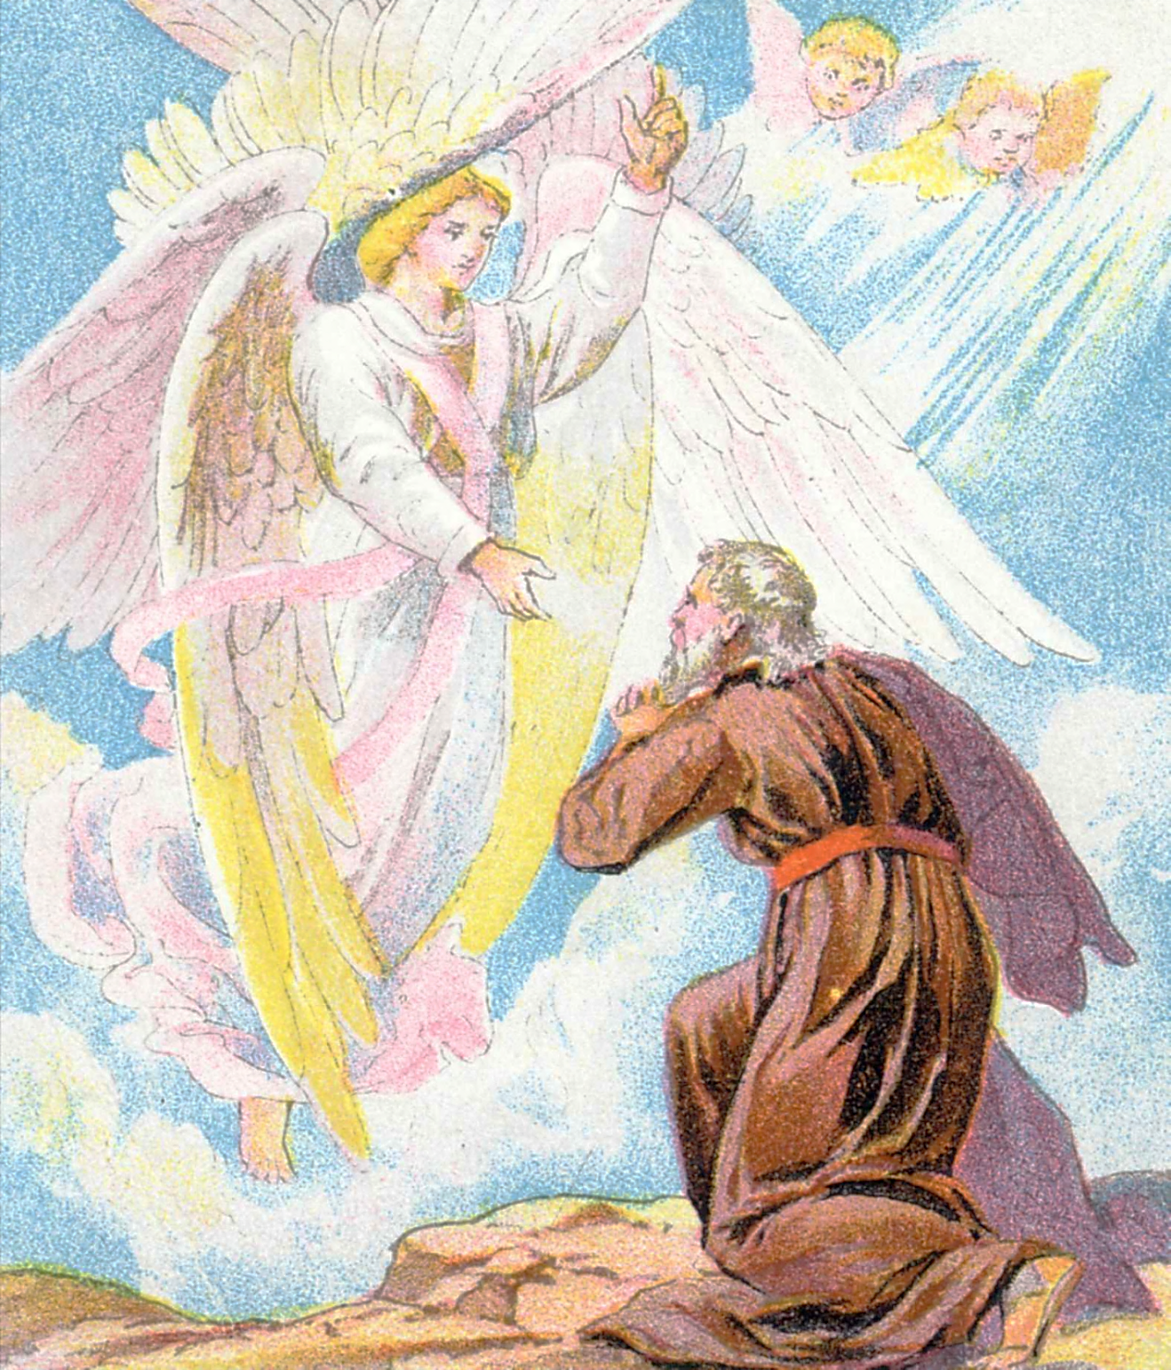
Isaiah 6
“²Above it stood the seraphims: each one had six wings; with twain he covered his face, and with twain he covered his feet, and with twain he did fly. ³And one cried unto another, and said, Holy, holy, holy, is the LORD of hosts: the whole earth is full of his glory.”

Slide 26
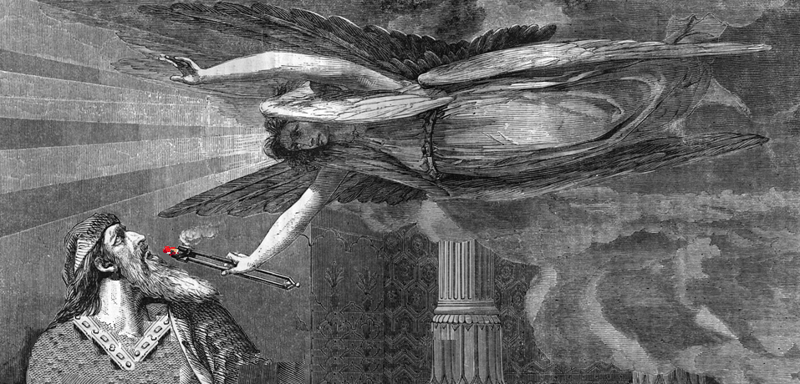
Isaiah 6
“⁶Then flew one of the seraphims unto me, having a live coal in his hand, which he had taken with the tongs from off the altar: ⁷And he laid it upon my mouth, and said, Lo, this hath touched thy lips; and thine iniquity is taken away, and thy sin purged. ⁸Also I heard the voice of the Lord, saying, Whom shall I send, and who will go for us? Then said I,
Here am I; send me.”
Isaiah 6
“⁴And the posts of the door moved at the voice of him that cried, and the house was filled with smoke. ⁵Then said I, Woe is me! for I am undone; because I am a man of unclean lips, and I dwell in the midst of a people of unclean lips: for mine eyes have seen the King, the LORD of hosts.”

Slide 27
How do We Answer When God Calls Us? Eph.4:1
Ready eagerness, 2 Cor. 8:3-5, 11-12.
This should be the consistent attitude & action of God’s people today!
When was the last time you remember having & acting with such readiness/eagerness in serving the Lord?
b hastings newlebanoncoc.com

Slide 28
How do We Answer When God Calls Us? Eph.4:1
God is STILL Calling today. How do we respond?
How do we respond to ?
The Call to be Saints­,
1 Cor. 1:2 To the church of God which is at Corinth, to those who are sanctified in Christ Jesus, called to be saints, with all who in every place call on the name of Jesus Christ our Lord, both theirs and ours:
b hastings newlebanoncoc.com

Slide 29
How do We Answer When God Calls Us? Eph.4:1
God calls us with a holy calling (gospel),
2 Tim. 1:9.who has saved us and called us with a holy calling, not according to our works, but according to His own purpose and grace which was given to us in Christ Jesus before time began,
God called us in sanctification, 1 Thes. 4:7 (Jno. 17:17)
Be holy because God is holy, 1 Peter. 1:15-16.
b hastings newlebanoncoc.com

Slide 30
How do We Answer When God Calls Us? Eph.4:1
Some Christians refuse to be sent as saints into the world of sin – they Compromise with, participate in, blend in with the world. (1 John. 2:15)
Or do WE say…“Hear am I, send me…”
To be the salt of the earth, Matt. 5:13-15.
To be a light in the world, Matt. 5:14-16
b hastings newlebanoncoc.com

Slide 31
How do We Answer When God Calls Us? Eph.4:1
Called to be a sojourner,
1 Peter. 2:11-12. Beloved, I beg you as sojourners and pilgrims, abstain from fleshly lusts which war against the soul,12 having your conduct honorable among the Gentiles, that when they speak against you as evildoers, they may, by your good works which they observe, glorify God in the day of visitation.
How do we respond ? Here am I send me…….
Or will we say: “I’m not going...send someone else.”
b hastings newlebanoncoc.com

Slide 32
How do We Answer When God Calls Us? Eph.4:1
How do we respond to ?
The Call to Service in the Church, Rom. 12:3-8.
Some still view themselves as spectators rather than participants in the work of the church.
Spectators: Speculate, criticize & seek personal pleasure.
Participant: Working, improving, growing.
b hastings newlebanoncoc.com

Slide 33
How do We Answer When God Calls Us? Eph.4:1
Many things to do in the church:
-“Here am I, send me…”
To teach classes, worship services; bldg. Upkeep…
To visit & help those in need; to edify, to restore
b hastings newlebanoncoc.com

Slide 34
How do We Answer When God Calls Us? Eph.4:1
Use your gifts to serve the church,
1 Pet. 4:10-11.10 As each one has received a gift, minister it to one another, as good stewards of the manifold grace of God. 11 If anyone speaks, let him speak as the oracles of God. If anyone ministers, let him do it as with the ability which God supplies, that in all things God may be glorified through Jesus Christ, to whom belong the glory and the dominion forever and ever. Amen.
Or will we say: “I’m not going...send someone else.”
b hastings newlebanoncoc.com

Slide 35
How do We Answer When God Calls Us? Eph.4:1
The New Testament pattern of things evidences that the individual Christian should be a part of a local church of Christ. Paul "assayed to join himself to the disciples" when he came up to Jerusalem from three years of preaching in Arabia. This is essential to fellowship with the saints, for fellowship is a congregational matter.
b hastings newlebanoncoc.com

Slide 36
How do We Answer When God Calls Us? Eph.4:1
And when an individual is not a member of a local church,
he is not subject to an eldership (Heb.13:17);
he cannot discharge his duty toward other disciples of the Lord Gal. 6:1-2; Heb. 10:23-25);
he cannot have fellowship in the work of the church for he is not in a position to participate in it and do his part. 2 Tim.2:21-26;
1 Cor.16:1-2; Eph.4:14-16)
All of this failure means disobedience to the Lord and eventually condemnation in eternity.
b hastings newlebanoncoc.com

Slide 37
How do We Answer When God Calls Us? Eph.4:1
There are a good many professed Christians throughout the country that have no place in the local church. They are members of none.
1) They are not a part of the church where they worship.
2) They are not subject to its discipline and accept no part of its work as an obligation.
3) They have no church home and are a part of no church family.
4) They are religious strays or tramps, responsible for nothing and worth nothing to any congregation of God's people.
b hastings newlebanoncoc.com

Slide 38
How do We Answer When God Calls Us? Eph.4:1
How do we respond to ?
The Call of Evangelism,
Mk. 16:15; And He said to them, "Go into all the world and preach the gospel to every creature.
16 "He who believes and is baptized will be saved; but he who does not believe will be condemned.
b hastings newlebanoncoc.com

Slide 39
How do We Answer When God Calls Us? Eph.4:1
People will not be saved unless we go and preach the gospel to them, Rom. 10:12-15.
Ability + Opportunity = Responsibility: Matt. 25:15, 19.
True of the church and of THE INDIVIDUAL..
b hastings newlebanoncoc.com

Slide 40
How do We Answer When God Calls Us? Eph.4:1
Evangelism goes beyond the “preacher” & “pulpit” preaching,
Acts 8:4. Therefore those who were scattered went everywhere preaching the word.
“Here am I, send me…”
To teach my family, friends & neighbors, John. 1:40-42.
To teach our community, Acts 5:28.
To teach the world, Acts 17:6; Rom. 1:15.
Or will we say: I’m not going...send someone else.”
b hastings newlebanoncoc.com

Slide 41
How do We Answer When God Calls Us? Eph.4:1
Friends, we can’t just "Go To Church", and think we can go to heaven. If someone has not been to church services for a number of years asked, "What have they done wrong besides missing the services?
They had robbed God of thousands of dollars (1 Cor. 16:1,2);
they had forsaken the Lord's own memorial supper (1 Cor. 11:23-26); for years
their voices were unheard in the praises of the saints, >>>>
b hastings newlebanoncoc.com

Slide 42
How do We Answer When God Calls Us? Eph.4:1
their petitions and thanksgivings absent from the prayers of the saints,
and their knowledge of God's word stifled and fading, while their spiritual growth was completely neglected –
to say nothing of the bad example set and the
wrong influence exerted upon others around them!
Indeed, their souls had become dead to God, and yet they ask: "What have we done wrong besides not going to church?"
b hastings newlebanoncoc.com

Slide 43
How do We Answer When God Calls Us? Eph.4:1
Question…..If It Was Up To You, Would The Church Close Its Doors?
Every year many new businesses are started. Unfortunately many
businesses close their doors each year.
Whether we realize it or not, we're giving our vote as to whether these businesses succeed or fail. We do it when we make the choice to patronize a particular business or to trade elsewhere.
I wonder if certain church members realize that a similar situation exists in local congregations.
b hastings newlebanoncoc.com

Slide 44
How do We Answer When God Calls Us? Eph.4:1
Some folks show an apparent apathy towards the continued existence of the church. They may attend occasionally - perhaps even most Sunday mornings. However, it is just 'too hard' for them to make the Bible study hour and they never return on Sunday evening. Wednesday night assemblies are absolutely out of the question - they're entirely too busy, too tired, etc.
b hastings newlebanoncoc.com

Slide 45
How do We Answer When God Calls Us? Eph.4:1
What these folks are doing, whether they know it or not, is giving their vote to "close the doors". If it was left up to them, no one would assemble and no work would be done. Are you one of these people who are trying to put the church out of business? Think about it!
b hastings newlebanoncoc.com

Slide 46
How do We Answer When God Calls Us? Eph.4:1
How do we react knowing that God has called us to action?
Eph. 4:1: I, therefore, the prisoner of the Lord, beseech you to walk worthy of the calling with which you were called,
Worthily, or do we disappoint our God?
b hastings newlebanoncoc.com

Slide 47
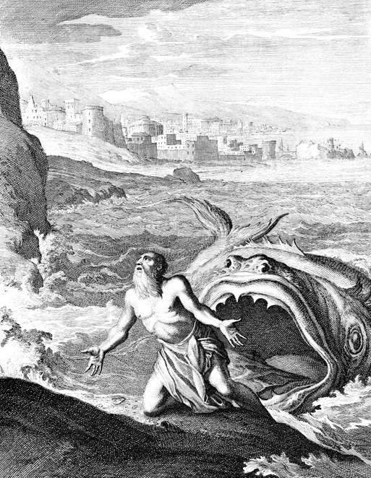
How do YOU Answer When God Calls YOU?
Send
SOMEBODY
ELSE
Don’t send ME
Send
ME
b hastings newlebanoncoc.com
b hastings newlebanoncoc.com
b hastings newlebanoncoc.com

