Slide 1
Welcome to our services
New Lebanon Church of Christ
We are Simply Christians.
Our Emphasis is Spiritual, Not Material or Social.
We are striving to be The Same Church as Described in The New Testament.
Please Come Back Again

Slide 2
Developing A Life Of Faith Heb. 10:22
Heb 10:22
let us draw near with a true heart in full assurance of faith, having our hearts sprinkled from an evil conscience and our bodies washed with pure water.

Slide 3
Developing A Life Of Faith Heb. 10:22
Without faith it is impossible to please God. (Heb.11:6)
Faith is the element that helps us put our trust in God and do the impossible (faith’s hall of fame)
In this lesson we will look at some steps to help us develop the faith we need.

Slide 4
Developing A Life Of Faith Heb. 10:22
Let Us
(1) Draw near.
(Heb 10:22) let us draw near with a true heart in full assurance of faith, having our hearts sprinkled from an evil conscience and our bodies washed with pure water.
Draw near to what? Evidently to God and to the throne of his grace, as we are exhorted to do in 4:16.
The priests of the Old Covenant drew near to God symbolically, whenever they approached the golden altar to burn incense, and between this altar and the Ark of the Covenant, on which God's presence was manifested, there was just a little space. The veil stood between the worshiped and the worshipers,

Slide 6
Developing A Life Of Faith Heb. 10:22
But now, having a joyful confidence in regards to the entrance into the Holiest of all,
and having a great sympathetic high priest over the house of God we may all now draw near to God as his redeemed children, and find grace and mercy.
But this approach into the presence of our heavenly Father should always be made with reverence and with proper preparation of both head and heart. "I will be treated as Holy" says God, "in them that come near me." (Lev. 10:3.)
And accordingly the children of Israel were required to wash their clothes and to purify themselves for three days, before they were allowed to approach God at Mount Sinai. (Ex. 19:10.)
(some people don’t take 5 minutes to prepare today)

Slide 7
Developing A Life Of Faith Heb. 10:22
What is a true heart?
That is, a heart that is free from all guile, deceit, and hypocrisy.

Slide 8
Developing A Life Of Faith Heb. 10:22
>In full assurance of faith,—That is, with a faith that dispels all doubt with regard to God and his promises; a faith which enables us to "take God at his word," and to do just what he commands, feeling perfectly sure that all things work together for good to them that love and serve him.
If we have sin in our life we cannot approach God with that confidence. But when we repent of the sin, confess the wrong, we can be fully assured that the fault is forgiven, then what a change comes over us.
And so it is with every child of God. So long as we feel conscious of guilt, we feel that there is a veil, a barrier between us and our God.
(Heb 10:22) but when we have our hearts sprinkled from an evil conscience and our bodies washed with pure water…then we can draw near with a true heart in full assurance of faith,

Slide 9
Developing A Life Of Faith Heb. 10:22
(2) Hold fast.
(Heb 10:23) Let us hold fast the confession of our hope without wavering, for He who promised is faithful.
Hold fast the confession of our faith all the way unto the end of life, or even if it causes the loss of our life.

Slide 10
Developing A Life Of Faith Heb. 10:22
(3) Consider One Another.
(Heb 10:24) And let us consider one another in order to stir up love and good works,
And let us consider one another—That is, Let us not be selfish, caring merely for ourselves; but let us have constantly in mind each other's wants and circumstances as members of the one family of God…
and that, also, for the purpose of exciting and encouraging one another to love and good works.

Slide 11
Developing A Life Of Faith Heb. 10:22
(4) Persevere.
(Heb 10:25) not forsaking the assembling of ourselves together, as is the manner of some, but exhorting one another, and so much the more as you see the Day approaching.
Provoke / exhort, one another unto love and good works – (Heb. 10:24)
Provoke -- to stimulate; to stir up – (2 Cor. 9:2)
We need to stir up one another to work more -- (1 Cor.15:58)

Slide 12
Developing A Life Of Faith Heb. 10:22
We need to stir up one another to greater love for:
God and Christ – (Matt. 22: 37) (John 14:15)
The church
The lost
For our family
For one another

Slide 13
Developing A Life Of Faith Heb. 10:22
(5) Lay Aside every weight.
(Heb 12:1) Therefore we also, since we are surrounded by so great a cloud of witnesses, let us lay aside every weight, and the sin which so easily ensnares us, and let us run with endurance the race that is set before us,
In this verse there is an allusion to the games of the ancient Greeks; or perhaps to those which Herod the Great had introduced into Palestine in imitation of the Grecian games.

Slide 14
Developing A Life Of Faith Heb. 10:22
Corresponding with these assembled multitudes of anxious spectators, is the "cloud of witnesses" ……by whom the Hebrew Christians are said to be surrounded while running their race for the crown of life.
These crowned victors are here represented as a cloud on account of their immense numbers (Ezek. 38:9, 16) as well perhaps as on account of their elevated position.

Slide 15
Developing A Life Of Faith Heb. 10:22
let us lay aside every weight,—In this clause the writer makes allusion particularly to those who run foot-races in the amphitheatre. These contestants laid aside everything that might in any way serve to impede their progress.
The original word (on-kos) means a weight, a burden, a swelling, an encumbrance, and it is evidently used here.

Slide 16
Developing A Life Of Faith Heb. 10:22
…weights - To denote whatever has a tendency to interrupt or retard our progress in the way of holiness; such as "the lusts of the flesh, the lusts of the eye, and the pride of life." All such hindrances the Apostle exhorts his brethren to lay aside, so that like the contestants in the Grecian games, they might be able to run with patient endurance the race that was set before them.

Slide 17
Developing A Life Of Faith Heb. 10:22
(6) Run with Patience.
(Heb 12:1) Therefore we also, since we are surrounded by so great a cloud of witnesses, let us lay aside every weight, and the sin which so easily ensnares us, and let us run with endurance the race that is set before us,
endurance or perseverance diligence

Slide 18
Developing A Life Of Faith Heb. 10:22
(7) Continue Looking Unto Jesus.
(Heb 12:2) looking unto Jesus, the author and finisher of our faith, who for the joy that was set before Him endured the cross, despising the shame, and has sat down at the right hand of the throne of God.

Slide 19
Developing A Life Of Faith Heb. 10:22
(8) Consider Jesus.
(Heb 12:3) For consider Him who endured such hostility from sinners against Himself, lest you become weary and discouraged in your souls.

Slide 20
Developing A Life Of Faith Heb. 10:22
(9) Despise Not Chastening.
(Heb 12:5) And you have forgotten the exhortation which speaks to you as to sons: "My son, do not despise the chastening of the LORD, Nor be discouraged when you are rebuked by Him;
6 For whom the LORD loves He chastens, And scourges every son whom He receives."
7 If you endure chastening, God deals with you as with sons; for what son is there whom a father does not chasten?
8 But if you are without chastening, of which all have become partakers, then you are illegitimate and not sons.>>>

Slide 21
Developing A Life Of Faith Heb. 10:22
9 Furthermore, we have had human fathers who corrected us, and we paid them respect. Shall we not much more readily be in subjection to the Father of spirits and live?
10 For they indeed for a few days chastened us as seemed best to them, but He for our profit, that we may be partakers of His holiness.
11 Now no chastening seems to be joyful for the present, but painful; nevertheless, afterward it yields the peaceable fruit of righteousness to those who have been trained by it.
12 Therefore strengthen the hands which hang down, and the feeble knees,
13 and make straight paths for your feet, so that what is lame may not be dislocated, but rather be healed.

Slide 22
Developing A Life Of Faith Heb. 10:22
(10) Follow Peace With All Men.
(Heb 12:14) Pursue peace with all people, and holiness, without which no one will see the Lord:

Slide 23
Developing A Life Of Faith Heb. 10:22
(11) Avoid Bitterness.
(Heb 12:15) looking carefully lest anyone fall short of the grace of God; lest any root of bitterness springing up cause trouble, and by this many become defiled;

Slide 24
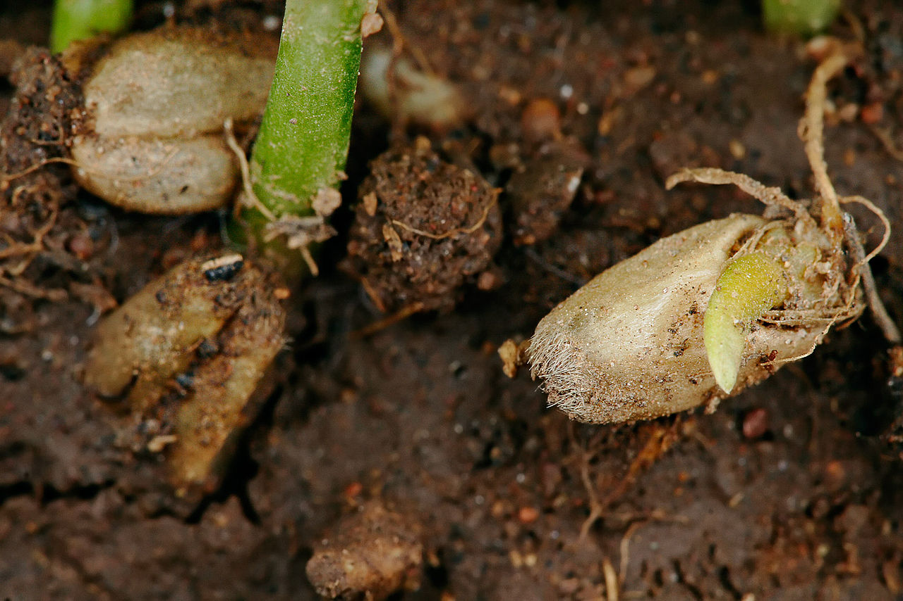
And that no root of bitterness springs up to trouble you
Wheat seeds sprouting into plants
12:15
Notes:
This photo shows the initial stages of wheat seeds as they begin to sprout. The tiny roots and shoots will quickly become a full-fledged plant that bears fruit like the original seed. This image comes from Fir0002/Flagstaffotos and is licensed under GFDL v1.2, via Wikimedia Commons: https://commons.wikimedia.org/wiki/File:Sprouting_wheat.jpg. The terms of this license can be found at: https://www.gnu.org/licenses/old-licenses/fdl-1.2.en.html.
wiki1007200707171067

Slide 25
Developing A Life Of Faith Heb. 10:22
(12) Be Loveable and Hospitable.
(Heb 13:1) Let brotherly love continue.
2 Do not forget to entertain strangers, for by so doing some have unwittingly entertained angels.
3 Remember the prisoners as if chained with them--those who are mistreated--since you yourselves are in the body also.
4 Marriage is honorable among all, and the bed undefiled; but fornicators and adulterers God will judge.

Slide 26
Developing A Life Of Faith Heb. 10:22
(13) Be Established In doctrine.
(Heb 13:9) Do not be carried about with various and strange doctrines. For it is good that the heart be established by grace, not with foods which have not profited those who have been occupied with them.

Slide 27
Developing A Life Of Faith Heb. 10:22
(14) Go Forth.
(Heb 13:13) Therefore let us go forth to Him, outside the camp, bearing His reproach.

Slide 28
Developing A Life Of Faith Heb. 10:22
(15) Offer The sacrifice Of Praise.
(Heb 13:15) Therefore by Him let us continually offer the sacrifice of praise to God, that is, the fruit of our lips, giving thanks to His name.

Slide 29
Developing A Life Of Faith Heb. 10:22
Heb 10:22
let us draw near with a true heart in full assurance of faith, having our hearts sprinkled from an evil conscience and our bodies washed with pure water.

