Slide 1
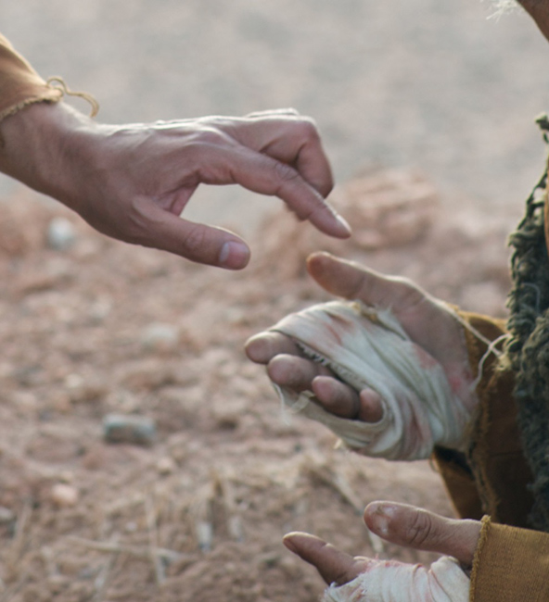
He put out His hand and touched him. Luke 5:13

Slide 2
Shackled by a heavy burden, 'Neath a load of guilt and shame.
Then the hand of Jesus touched me, And now I am no longer the same.
He touched me, Oh He touched me, And oh the joy that floods my soul!
Something happened and now I know, He touched me and made me whole.
Since I met this blessed Savior, Since He cleansed and made me whole,
I will never cease to praise Him, I'll shout it while eternity rolls.
He touched me, Oh He touched me, And oh the joy that floods my soul!
Something happened and now I know He touched me and made me whole.

Slide 3
Are You A New Testament Christian?
Hear the Gospel (Rom.10:14).
Believe the Gospel (Heb. 11:6).
Repent of Sins (Acts 3:19).
Confess Christ (Rom.10:9).
Be Baptized Into Christ (1 Cor.12:13).
1 Timothy 4:16
“Take heed unto thyself, and unto the doctrine; continue in them: for in doing this thou shalt both save thyself, and them that hear thee.”

Slide 4
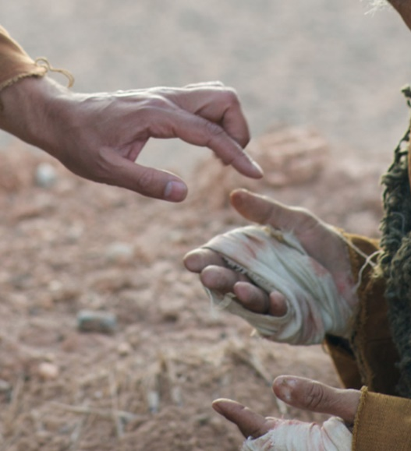
He put out His hand and touched him. Luke 5:13
¹² And it happened when He was in a certain city, that behold, a man who was full of leprosy saw Jesus; and he fell on his face and implored Him, saying, “Lord, if You are willing, You can make me clean.”
¹³ Then He put out His hand and touched him, saying, “I am willing; be cleansed.” Immediately the leprosy left him. ¹⁴ And He charged him to tell no one, “But go and show yourself to the priest, and make an offering for your cleansing, as a testimony to them, just as Moses commanded.”
¹⁵ However, the report went around concerning Him all the more; and great multitudes came together to hear, and to be healed by Him of their infirmities.

Slide 5
He put out His hand and touched him. Luke 5:13
Matt 8:2 And behold, a leper came to Him, and bowed down to Him, ---Bowed down. This is the word for “worship.” This leper knew enough about Jesus to know He was worthy of worship.
If you are willing. We can almost feel the pain, the loneliness, the rejection and the isolation of this man. He knows Jesus has the power to heal him, but does not know if He is willing to do so. In reading the pitiful plea of the leper, we can almost see him reach out to Jesus. Would Jesus also reject him?

Slide 6
He put out His hand and touched him. Luke 5:13
He touched him. How long it had been since the leper had been touched? Lepers were not people privileged to experience the joy of human touch. To have Jesus reach out and touch him was a demonstration of love and
compassion he had never seen
before or at least for a very long
time.

Slide 7
He put out His hand and touched him. Luke 5:13
“Leper” is derived from “Lepis,” which means “a scale”; it is so called because the disease shows itself in dry, thick scales, or scabs, which are white in common leprosy. (Ex. 4:6; Num. 12:10; 2 Kings 5:27.) The spots are usually about the size of a dollar. This man was “full of leprosy”; his body was thoroughly infected with the disease; the disease was in its worst form.

Slide 8
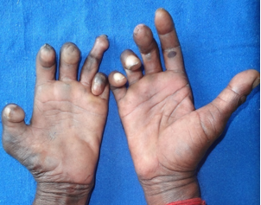
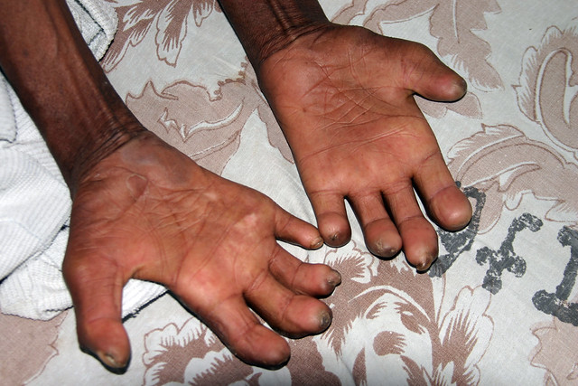
He put out His and and touched him. Luke 5:13

Slide 9
He put out His hand and touched him. Luke 5:13
1. Miserable Condition

Slide 10
He put out His hand and touched him. Luke 5:13
1. Miserable Condition
2. Inspiring Revelation

Slide 11
He put out His hand and touched him. Luke 5:13
1. Miserable Condition
2. Inspiring Revelation
3. Humble Position

Slide 12
He put out His hand and touched him. Luke 5:13
1. Miserable Condition
2. Inspiring Revelation
3. Humble Position
4. Sincere Petition

Slide 13
He put out His hand and touched him. Luke 5:13
1. Miserable Condition
2. Inspiring Revelation
3. Humble Position
4. Sincere Petition
5. Instant and Perfect Salvation

Slide 14
He put out His hand and touched him. Luke 5:13
1. Miserable Condition
2. Inspiring Revelation
3. Humble Position
4. Sincere Petition
5. Instant and Perfect Salvation
6. Special Commission

Slide 15
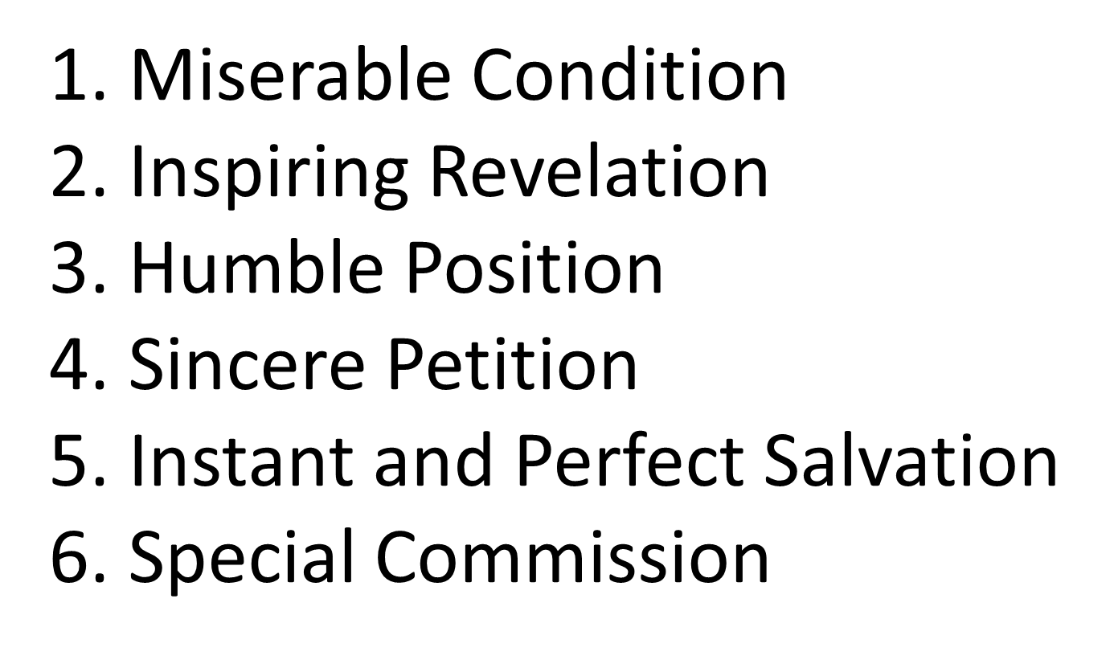
He put out His hand and touched him. Luke 5:13
Then Now
Why do you wait?
Come to the Lord TODAY.

