Slide 1
Welcome to our services
New Lebanon Church of Christ
We are Simply Christians.
Our Emphasis is Spiritual, Not Material or Social.
We are striving to be The Same Church as Described in The New Testament.
Please Come Back Again

Slide 2
Godliness With Contentment 1Tim.6:6-12
1 Timothy 6:6–14
⁶ Now godliness with contentment is great gain. ⁷ For we brought nothing into this world, and it is certain we can carry nothing out. ⁸ And having food and clothing, with these we shall be content. ⁹ But those who desire to be rich fall into temptation and a snare, and into many foolish and harmful lusts which drown men in destruction and perdition. ¹⁰ For the love of money is a root of all kinds of evil, for which some have strayed from the faith in their greediness, and pierced themselves through with many sorrows.

Slide 3
Jerusalem Council
Trials
Paul Before Caesar
Second Missionary Journey
Macedonia
Achaia
Greece
Third Missionary Journey
Asia
First Roman Imprisonment
60 - 63
Rome
Second Roman Imprisonment
67 - 68
Rome
A.D. 51 53 57 60 66 68 70
1 Thess.
Place: Corinth
Date: 51 - 52
1 Corinthians
Place: Ephesus
Date: 56 - 57
Ephesians
Place: Rome
Date: 60 - 63
1 Timothy
Place: Macedonia
Date: 63 - 66
A.D. 70
Destruction of Jerusalem, continued scattering, and growth of the church
Date: 70
2 Thess.
Place: Corinth
Date: 51 - 52
2 Corinthians
Place: Macedonia
Date: 56 - 57
Colossians
Place: Rome
Date: 60 - 63
Titus
Place: Macedonia
Date: 63 - 66
Galatians
Place: Antioch
Date: 57?
Philemon
Place: Rome
Date: 60 - 63
2 Timothy
Place: Rome
Date: 67 - 68
Romans
Place: Corinth
Date: 57?
Philippians
Place: Rome
Date: 60 - 63

Slide 4
Godliness With Contentment 1Timothy 6:6
Life is not about the stuff you have, but about the stuff you are made of. It’s about the stuff we put in our heart and fill our mind with. Life is about the things God wants us to fill our heart and mind with. And what does God want us to fill our heart and mind with??? Jesus Christ.
6 But godliness with contentment is great gain:—

Slide 5
Godliness With Contentment 1Timothy 6:6
Contentment pertains not to the place or condition, but to the heart.
Being contented in our lot is great gain. It is a precious treasure that brings much joy in this world, and then an unfailing treasure in the world to come. It is great gain to learn to be content without riches or earthly treasures. In this sentence Paul expresses both these main ideas that godliness makes us content, and to be content is the highest good.

Slide 6
Godliness With Contentment 1Timothy 6:6
Godliness with contentment
Godliness IS contentment
Becoming godly
Protect the MIND.
Flee
Follow
Fight

Slide 7
Godliness With Contentment 1Timothy 6:6
Protect our MIND.
God wants us to recognize that our hearts are his temple. It is the sacred ground on which God himself walks amongst us because our hearts are God's dwelling place…
it is imperative that we separate them from the ordinary ground of the world… this does not mean that we are to go off and live by ourselves never interacting with the world… rather it is a call to recognize that our lives are God’s home and to disentangle ourselves from the snares that might pull us into compromising the place of God's dwelling… they are places where we feel safe, loved, and relaxing…

Slide 8
Godliness With Contentment 1Timothy 6:6
While we go to great lengths to protect our physical homes from invasion it is amazing how little we do to protect our hearts are being violated by the world…

Slide 9
Godliness With Contentment 1Timothy 6:6
v7 for we brought nothing into the world, for neither can we carry anything out;—
Every earthly possession is only meant for this life—for the period between the hour of birth and death—then we should only be concerned about what we can wisely use in our journey through life. To burden ourselves with more is to hinder our usefulness and our true enjoyment of life and our opportunities for doing good for others and for improving ourselves.
v8 but having food and covering we shall be therewith content.— 9 But they that are minded to be rich fall into a temptation and a snare and many foolish and hurtful lusts,

Slide 10
Godliness With Contentment 1Timothy 6:6
—The eagerness for riches brings temptation to sin. They are led into a snare of Satan. The effort to gain riches and enjoy them excites many hurtful lusts, which burden the heart, destroys the desires of the spirit, and makes one a selfish being.
such as drown men in destruction and perdition.—There is no truth more plainly taught on the pages of inspiration than all unjust means—or means gained when we make anxiety for money the chief end of our labors—bring ruin, poverty, and shame upon men and their families.

Slide 11
Godliness With Contentment 1Timothy 6:6
Paul used metaphors in this verse to describe the people whose minds are set upon becoming rich. They are caught in a “snare,” in the sense of a trapped animal, which once captured is unable to recover itself.
The other is that of an exhausted swimmer who is drowned in the flood.

Slide 13
Godliness With Contentment 1Timothy 6:6
10 For the love of money is a root of all kinds of evil:
—An inordinate desire of earthly things or of what belongs to our neighbor. which some reaching after have been led astray from the faith,—
Some had been so deceived as to depart from the faith or living according to the requirements of God. [The one who covets gold longs for opportunities in which his love of money finds a field for exercise.]
and have pierced themselves through with many sorrows.—

Slide 14
Fruit: all sorts of evil
Love of money

Slide 15
Godliness With Contentment 1Timothy 6:6
A tree. The love of money – the root. Temptations, lusts, unbelief, sorrow, destructions, perdition – spring up from the root.
compare- (James 1:21) Therefore lay aside all filthiness and overflow of wickedness, and receive with meekness the implanted word, which is able to save your souls. - Word needs to be planted in our heart

Slide 16
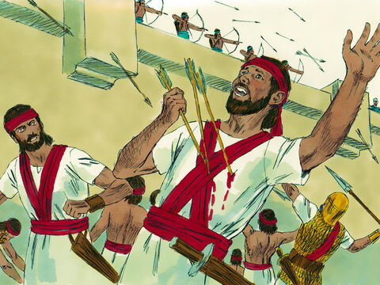
and have pierced themselves through with many sorrows.—

Slide 17
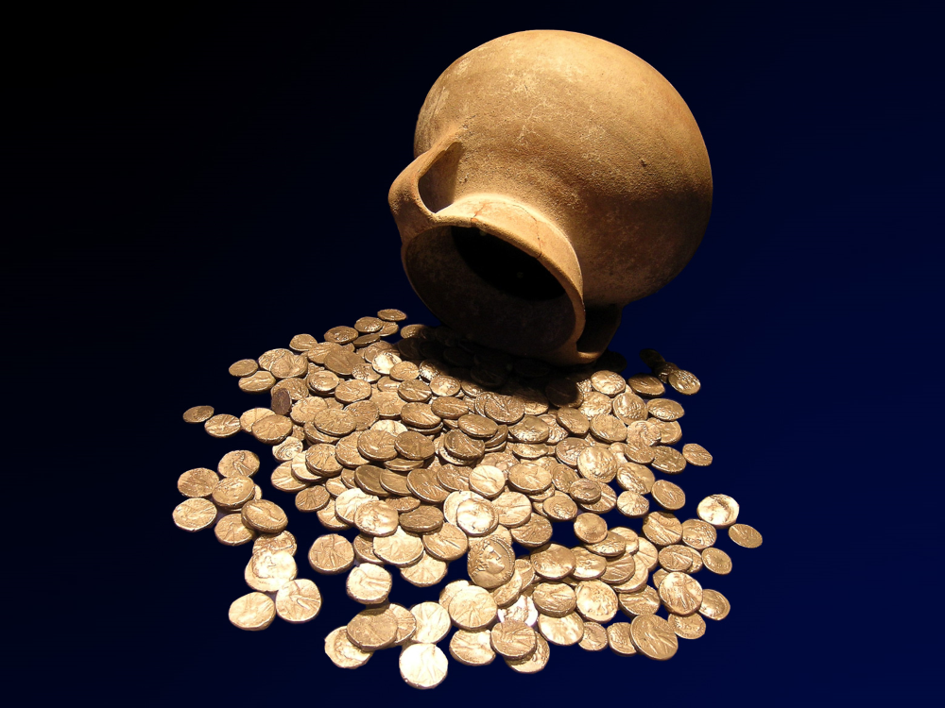
But those who want to get rich fall into temptation and a trap
Tyrian shekel hoard from Isfiya, possibly collected for the Temple tax, 1st century AD
6:9
Notes:
Paul does not criticize those who have wealth, but those who desire wealth. This hoard of silver coins comes from Isfiya, a site along the Carmel Mountains in northern Israel. It was photographed at the Eretz Israel Museum in Tel Aviv.
tb061804589gr

Slide 18
Godliness With Contentment 1Timothy 6:6
Destruction and perdition … “The two words taken together imply the utter ruin and destruction of body and soul,” being the double disaster brought on by the foolish and hurtful lusts by which the seekers of riches destroy themselves.
1 Tim 6:10 For the love of money is a root of all kinds of evil: which some reaching after have been led astray from the faith, and have pierced themselves through with many sorrows.
Pierced themselves through with many sorrows … This is the same thought of being drowned in destruction and perdition, mentioned in 1 Tim. 6:9.

Slide 19
Godliness With Contentment 1Timothy 6:6
They have overwhelmed themselves with many sorrows and afflictions.
The reference here is most likely to the many pains, agonies, troubles attending money seeking, the pangs of conscience, the miseries of unsatisfied greed, and the conscious failure of attaining life’s best end.

Slide 20
Godliness With Contentment 1Timothy 6:6
They that are minded … is also translated “they that desire to be.” The people here condemned are not merely the rich, specifically, but those whose desire and intention are focused upon that one thing. This does not decry lawful ambition and application in one’s work.
What is condemned here is not ambition to excel in some lawful department of human activity, which indeed may bring an increase in riches … but the having of a single eye to the accumulation of money by any means.

Slide 21
Godliness With Contentment 1Timothy 6:6
1.Flee – from sin and wrath to come
Sin is our most deadly and dangerous enemy.
Our surest safety is to FLEE.
We should flee it as we would run from a rattlesnake, or run from a lion.
So In v. 9 and 10, we are warned to flee from the love of money and its associated evils.

Slide 22
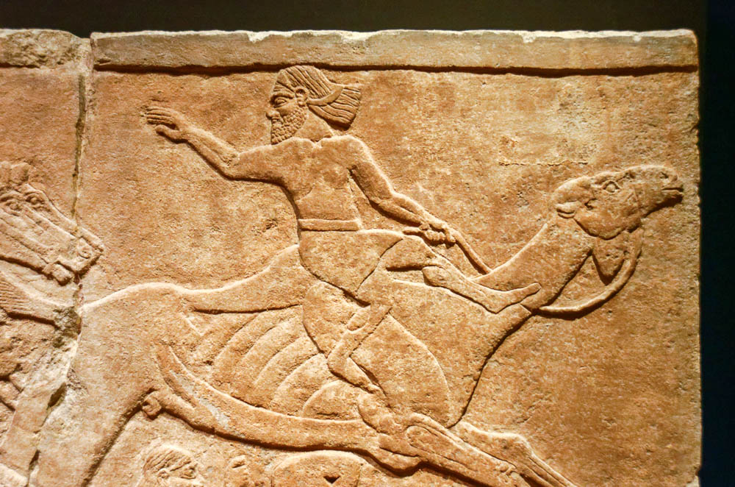
But you, O man of God, flee these things
Relief of a fleeing camel rider in battle, from the central palace at Nimrud, 728 BC
6:11
Notes:
This relief, which is part of the British Museum collection, was photographed while on loan to the Getty Villa in southern California.
tb100919331

Slide 23
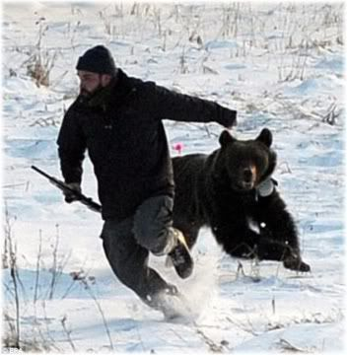

Slide 24
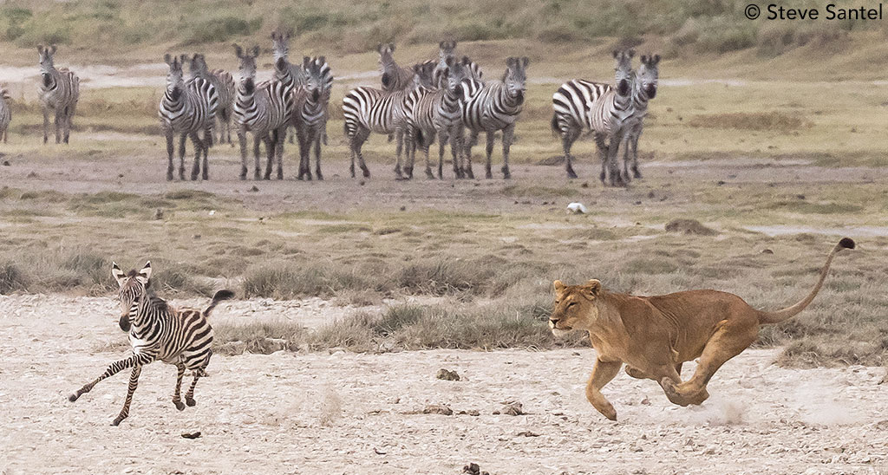

Slide 25
Godliness With Contentment 1Timothy 6:6
A trapped animal:
Fall into a snare –
pierced through with many sorrows.

Slide 26
Godliness With Contentment 1Timothy 6:6
Fight the Good Fight of Faith (6:11–16)
(but – contrast)
11 But thou, O man of God,—“Man of God” is one devoted to the service of God. It frequently in the Old Testament means the prophets inspired of God and sent to teach the people, but under the new covenant the name is extended to all faithful men in the Lord Jesus Christ. (2 Tim. 3:17.)
flee these things;—Paul gives Timothy and all teachers of the Lord Jesus Christ the warning to flee from the love of money, and get far away from such desires and all the evils and dangers it brings.

Slide 27
Godliness With Contentment 1Timothy 6:6
Godliness with contentment
Godliness IS contentment
Becoming godly
Protect the MIND.
Flee
Follow
Fight

Slide 28
Godliness With Contentment 1Timothy 6:6
“Flee … “(1Tim.6:11). One of the best influences is a pair of heels.
“Follow …” To flee is not enough, being only negative; the positive counterpart of flight is following the Lord.
“Fight … “(1Tim.6:12). Whatever metaphor Paul had in mind, whether athletic or military, one phase of Christian living is certainly that of … active resistance to evil.

Slide 29
Godliness With Contentment 1Timothy 6:6
(v11) and follow after righteousness,—The apostle says: “Be not overcome of evil, but overcome evil with good. (Rom. 12:21.) The “man of God” fleeing from all covetous longings for money must follow after righteousness, shape his inner life after “the law of the Spirit of life in Christ Jesus,” which makes “free from the law of sin and of death.” (Rom. 8:2.)
It is fear on the one hand; eagerness of desire is on the other.
We are to pursue the good things of life in an effort to attain them.
Life’s best prizes are those that come as a result of hard, honest work.

Slide 30
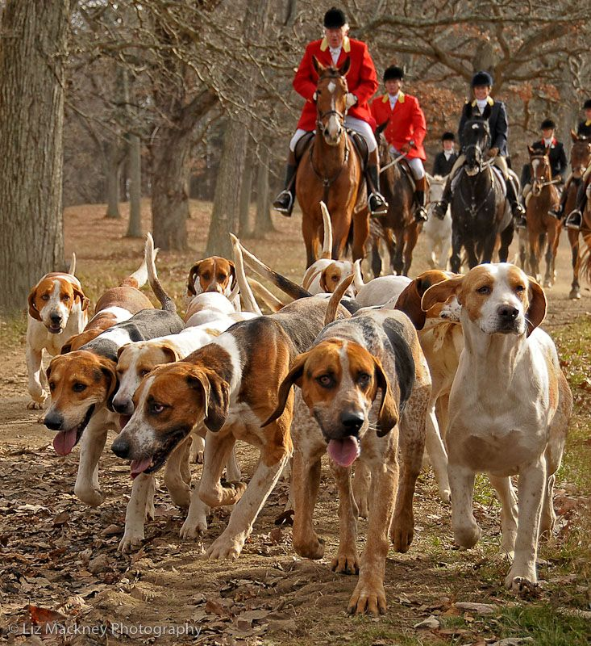
Godliness With Contentment 1Timothy 6:6
Let us follow /pursue them. PURSUE
(hunter going after his catch)

Slide 31
Godliness With Contentment 1Timothy 6:6
Righteousness – just dealings with God and our fellowman.
(Prov.14:34) Righteousness exalts a nation, But sin is a reproach to any
godliness,—Godliness gives contentment with food, raiment, and what at present we enjoy.
faith,—Faith in God and Christ assures of a better and more abiding substance reserved in heaven for us. (1 Pet. 1:3–12.)
love,—Love is manifested in doing good to our fellow men, and the divine law tells us that it is the only way we can do it, hence “love therefore is the fulfillment of the law.” (Rom. 13:10.)
patience,—[Patience is that state of mind and heart that enables one to face difficulties and obstacles that make him willing to toil and suffer adversity in order to maintain his loyalty to God.]
meekness.—Meekness suppresses our wrath and indignation against those who are injurious to us and takes away from us that which is our own—submission to the divine will

Slide 32
Godliness With Contentment 1Timothy 6:6
“Flee … “(1Tim.6:11). One of the best influences is a pair of feet.
“Follow …” To flee is not enough, being only negative; the positive counterpart of flight is following the Lord.
“Fight … “(1Tim.6:12). Whatever metaphor Paul had in mind, whether athletic or military, one phase of Christian living is certainly that of … active resistance to evil.

Slide 33
Godliness With Contentment 1Timothy 6:6
“Lay hold … “(1Tim.6:12). Salvation is freely offered, but it must be grasped. This is a term which means “take hold once for all.”
“Keep …” Excavations at Pompeii found the body of a soldier buried alive because no one came to relieve him at his post of duty.
A similar faithful endurance to death is indicated by this

Slide 34
Godliness With Contentment 1Timothy 6:6
3. Fight. The sword of the spirit.
The figure changes from that of a runner to that external – the world.
(1 John 2:15-16) Do not love the world or the things in the world. If anyone loves the world, the love of the Father is not in him. 16 For all that is in the world--the lust of the flesh, the lust of the eyes, and the pride of life--is not of the Father but is of the world.
The time come when we are forced to face them.

Slide 35
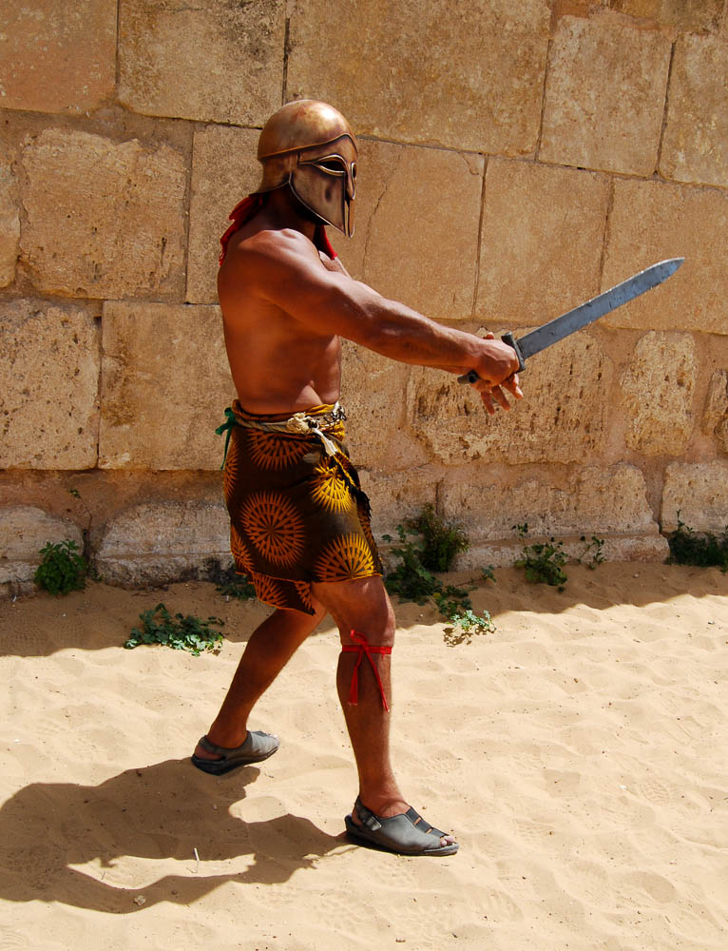
Fight the good fight of the faith
“Gladiator” in the hippodrome at Gerasa
6:12
Notes:
The Roman Army and Chariot Experience, pictured here, takes place daily during most of the year at Jerash (Gerasa).
fj0411080310

Slide 36
Godliness With Contentment 1Timothy 6:6
Our enemy is
External – the world. (James 4:4), Adulterers and adulteresses! Do you not know that friendship with the world is enmity with God? Whoever therefore wants to be a friend of the world makes himself an enemy of God.
Internal – the flesh – lust of eyes, lust of flesh, pride of life
Because our enemy is strong, we must arm ourselves with
The divine armor. (Eph. 6:10-17)
Can you list the pieces?
How do you know if you have them on?

Slide 37
Godliness With Contentment 1Timothy 6:6
The object of the battle :
Eternal life.

Slide 38
Godliness With Contentment 1Timothy 6:6
12 Fight the good fight of the faith,—Faith in God calls man to a vigorous fight with evil in his own soul that he against the influences of the flesh may keep the faith, and then it summons him to maintain the faith in the world. - The Christian teacher especially had to maintain that truth against the fierce opposition of the world, and before the world both in precept and example of what faith in Christ will make of a man.
lay hold on the life eternal,—He was to do the things required to gain eternal life.

Slide 39
Godliness With Contentment 1Timothy 6:6
Godliness with contentment
Godliness IS contentment
Becoming godly
Protect the MIND.
Flee
Follow
Fight

Slide 40
Godliness With Contentment 1Timothy 6:6
Do you have
godliness with contentment?

