Slide 1
Welcome to our services
New Lebanon Church of Christ
We are Simply Christians.
Our Emphasis is Spiritual, Not Material or Social.
We are striving to be The Same Church as Described in The New Testament.
Please Come Back Again

Slide 2
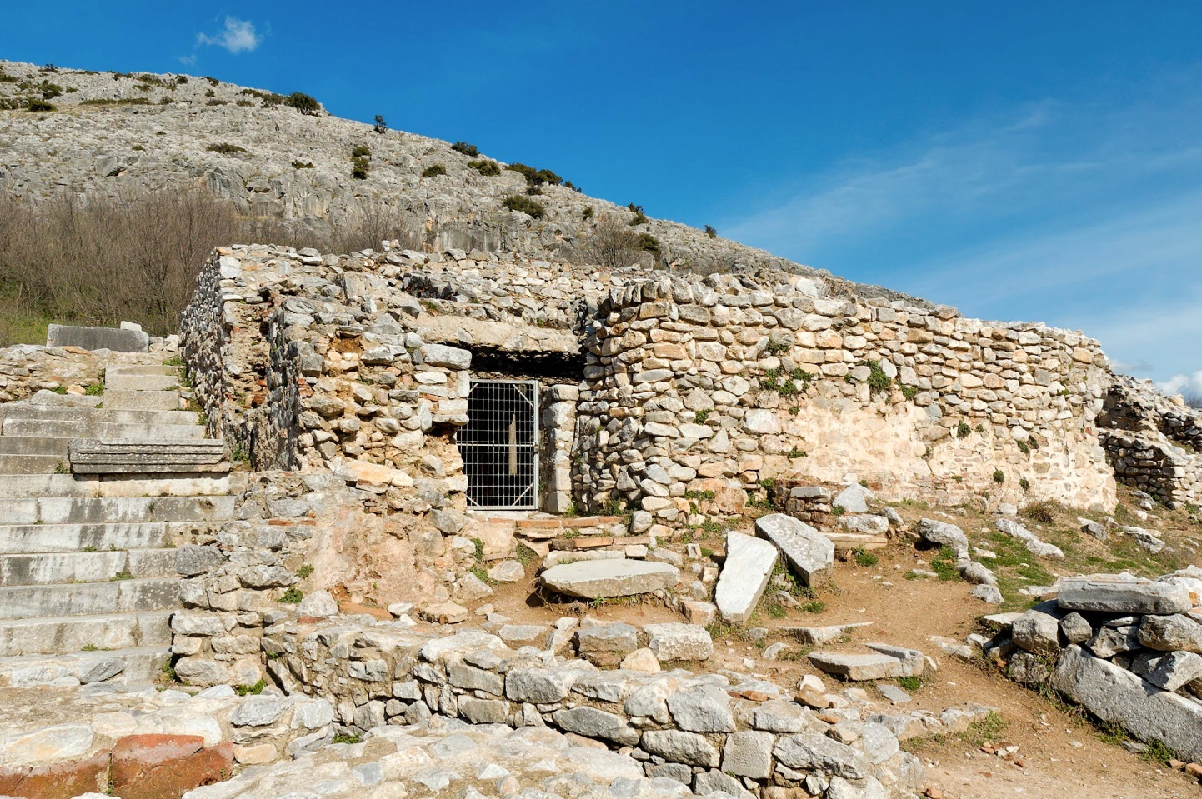
Forgiveness, Sin, And Jesus.
³⁸ Therefore let it be known to you, brethren, that through this Man is preached to you the forgiveness of sins; Acts 13:38
Forgiveness sets us free from our debt of sin.

Slide 3
Forgiveness, Sin, And Jesus.
Matt. 6:9–12
⁹ In this manner, therefore, pray:
Our Father in heaven,
Hallowed be Your name.
¹⁰ Your kingdom come.
Your will be done
On earth as it is in heaven.
¹¹ Give us this day our daily bread.
¹² And forgive us our debts,
As we forgive our debtors.

Slide 4
FORGIVE, FORGAVE, FORGIVENESS
A. Verbs.
aphiemi (ἀφίημι, 863), primarily, “to send forth, send away” (apo, “from,” hiemi, “to send”), denotes, besides its other meanings, “to remit or forgive”
debts, Matt. 6:12; 18:27, 32, these being completely cancelled;
sins, e.g., Matt. 9:2, 5, 6; 12:31, 32; Acts 8:22 (“the thought of thine heart”); Rom. 4:7; Jas. 5:15; 1 John 1:9; 2:12.
In this latter respect the verb, like its corresponding noun (below), firstly signifies the remission of the punishment due to sinful conduct, the deliverance of the sinner from the penalty divinely, and therefore righteously, imposed; secondly, it involves the complete removal of the cause of offense; such remission is based upon the vicarious and propitiatory sacrifice of Christ.

Slide 6
Forgiveness, Sin, And Jesus.
Why Forgive?
1. Forgiveness Frees the Forgiver
“Forgiveness is unlocking the door to set someone free and realizing you were the prisoner!”—Author Unknown
“Resentment is like a glass of poison that a man drinks; then he sits down and waits for his enemy to die.”—Author Unknown

Slide 8
Some areas forgiveness might be difficult.

Slide 9
Forgiveness, Sin, And Jesus.
Heb.12:14–15
¹⁴ Pursue peace with all people, and holiness, without which no one will see the Lord: ¹⁵ looking carefully lest anyone fall short of the grace of God; lest any root of bitterness springing up cause trouble, and by this many become defiled;

Slide 10
Forgiveness, Sin, And Jesus.
1 Peter 3:8–9
Finally, all of you be of one mind, having compassion for one another; love as brothers, be tenderhearted, be courteous; ⁹ not returning evil for evil or reviling for reviling, but on the contrary blessing, knowing that you were called to this, that you may inherit a blessing.
SO, If we want to be forgiven ourselves, we must extend that same forgiveness to others, allowing forgiveness to triumph over the desire to take retribution.

Slide 11
Forgiveness, Sin, And Jesus.
Matt. 6:14–15 ¹⁴ “For if you forgive men their trespasses, your heavenly Father will also forgive you. ¹⁵ But if you do not forgive men their trespasses, neither will your Father forgive your trespasses.
Mark 11:25 ²⁵ “And whenever you stand praying, if you have anything against anyone, forgive him, that your Father in heaven may also forgive you your trespasses.
Luke 6:37 ³⁷ “Judge not, and you shall not be judged. Condemn not, and you shall not be condemned. Forgive, and you will be forgiven.

Slide 12
Forgiveness, Sin, And Jesus.
James 2:12–13
¹² So speak and so do as those who will be judged by the law of liberty. ¹³ For judgment is without mercy to the one who has shown no mercy. Mercy triumphs over judgment.

Slide 13
Forgiveness, Sin, And Jesus.
2 Extremes –
Some people live feeling they have never been forgiven (do not feel worthy).
Some people live God has forgiven them and they are dead wrong (Denominational friends).

Slide 14
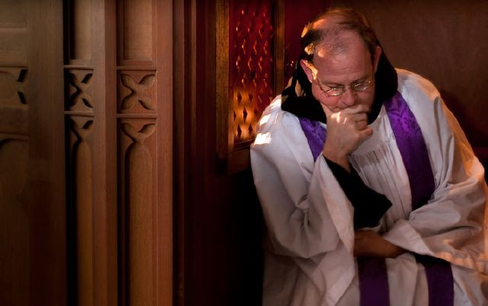
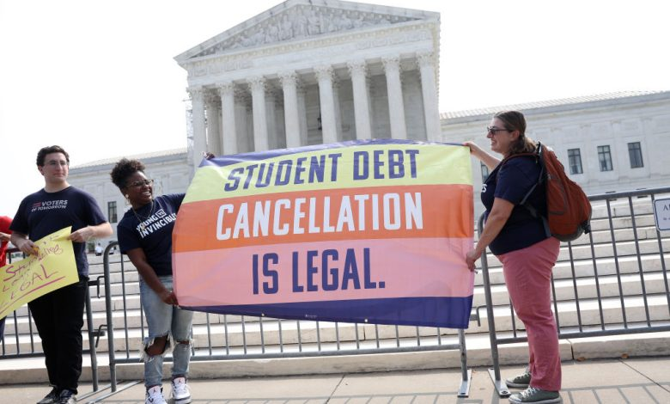
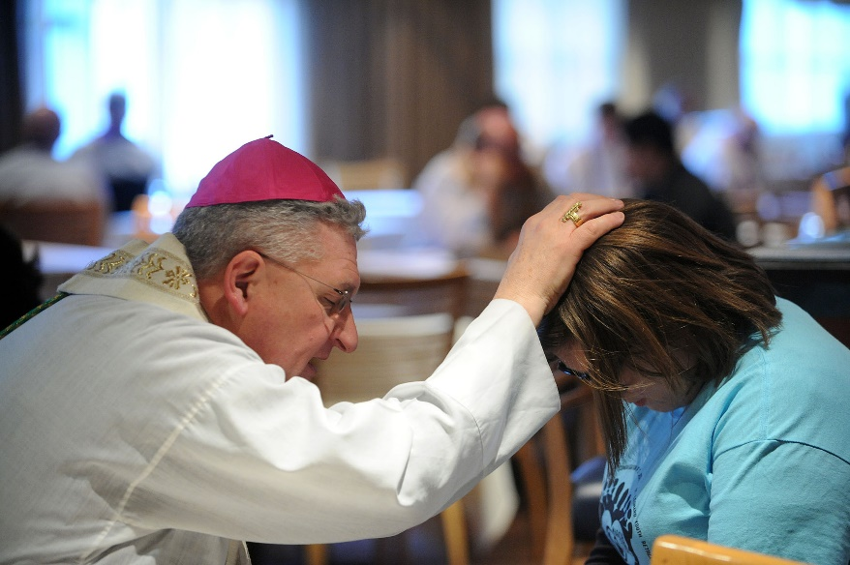
Just because someone says they can cancel a debt does not mean they have AUTHORITY to do so.

Slide 15
Forgiveness, Sin, And Jesus.
2. So Forgiveness Is Needed
Forgiveness exists because sin exists. Forgiveness is necessary because sin powerfully affects all areas of our lives. Forgiveness is not about ignoring evil, excusing it, or making light of it. On the contrary, forgiveness faces sin and evil. Forgiveness acknowledges that a terrible wrong has been done and seeks to do something about it.

Slide 16
Forgiveness, Sin, And Jesus.
Sin Is Real
No one needs to look far to see that there is sin in the world. We are born into a world where harmful patterns of sin persist in societies, communities, churches, and families. We may not even be aware of our own contribution to the cycles of sin. Because sin is in the world and in us, we need forgiveness even more.
⁸ If we say that we have no sin, we deceive ourselves, and the truth is not in us. ⁹ If we confess our sins, He is faithful and just to forgive us our sins and to cleanse us from all unrighteousness. ¹⁰ If we say that we have not sinned, we make Him a liar, and His word is not in us. 1 John 1:8–10

Slide 17
Forgiveness, Sin, And Jesus.
Sin Is Destructive
Sin breaks our communion with God and destroys our relationships with others. The first sin brought death into the world for all to suffer the consequences. - When someone hurts us, our pain and our sin begin a cycle of anger, violence, resentment, and revenge that increases over time. Only forgiveness can allow us to break this cycle.

Slide 18
Forgiveness, Sin, And Jesus.
¹² Therefore, just as through one man sin entered the world, and death through sin, and thus death spread to all men, because all sinned— Rom. 5:12
²¹ And you, who once were alienated and enemies in your mind by wicked works, yet now He has reconciled. Col. 1:21
(Pride Promotes Strife) 4 Where do wars and fights come from among you? Do they not come from your desires for pleasure that war in your members? ² You lust and do not have. You murder and covet and cannot obtain. You fight and war. Yet you do not have because you do not ask. James 4:1–2

Slide 19
Forgiveness, Sin, And Jesus.
Sin Is Real
No one needs to look far to see that there is sin in the world. We are born into a world where harmful patterns of sin persist in societies, communities, churches, and families. We may not even be aware of our own contribution to the cycles of sin. Because sin is in the world and in us, we need forgiveness even more.
⁸ If we say that we have no sin, we deceive ourselves, and the truth is not in us. ⁹ If we confess our sins, He is faithful and just to forgive us our sins and to cleanse us from all unrighteousness. ¹⁰ If we say that we have not sinned, we make Him a liar, and His word is not in us. 1 John 1:8–10

Slide 20
Forgiveness, Sin, And Jesus.
3. God Cannot Tolerate Sin.
Scripture tells us that God is merciful and forgiving, but it also makes clear that God does not tolerate sin. Because sin is so harmful, it demands divine judgment, not mere dismissal.
⁶ And the Lord passed before him and proclaimed, “The Lord, the Lord God, merciful and gracious, longsuffering, and abounding in goodness and truth, ⁷ keeping mercy for thousands, forgiving iniquity and transgression and sin, by no means clearing the guilty, visiting the iniquity of the fathers upon the children and the children’s children to the third and the fourth generation.” Ex. 34:6–7

Slide 21
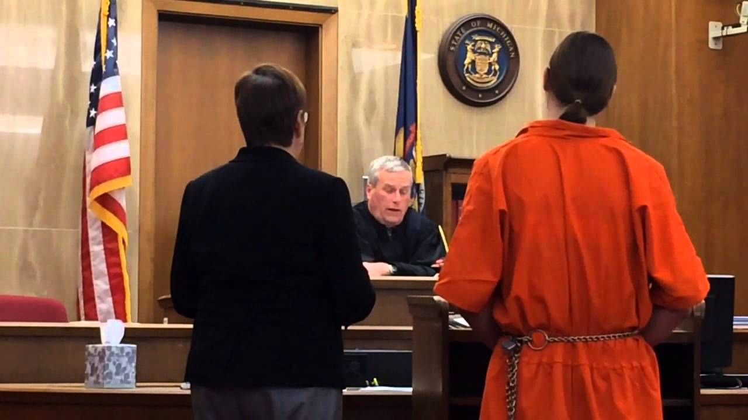

Slide 22
Forgiveness, Sin, And Jesus.
4. Forgiveness Is Possible
If judgment of sin were the last word on the matter, we would all stay trapped in our guilt and brokenness.
If vengeance for every offense were the only option, we would forever remain separated from our Creator.
But thank God he has provided another way—the way of forgiveness. Forgiveness does not erase the past, but it gives us a chance for a better future.

Slide 23
He Paid A Debt He Did Not Owe, I Owed A Debt I Could Not Pay, I Needed Someone To Wash My Sins Away; And Now I Sing A Brand New Song, Amazing Grace All Day Long, Christ Jesus Paid A Debt That I Could Never Pay.
He paid A Debt
#376
He Paid A Debt At Calvary, He Cleansed My Soul And Set Me Free, I’m Glad That Jesus Did All My Sins Erase. I Now Can Sing A Brand New Song, Amazing Grace All Day Long, Christ Jesus Paid A Debt That I Could Never Pay.
One Day He’s Coming Back For Me, To Live With Him Eternally, Won’t It Be Glory To See Him On That Day! I Then Will Sing A Brand New Song, Amazing Grace All Day Long Christ Jesus Paid A Debt That I Could Never Pay.

Slide 24
For the wages of sin is death,
but the gift of God is eternal life
in Christ Jesus our Lord.
Romans 6:23

Slide 25
Forgiveness, Sin, And Jesus.
5. God Desires to Forgive
The Old Testament contains many examples of God sending punishment for sinful acts.
However, his withholding of judgment was for the purpose of bringing the people back to God so he could forgive them and restore the broken relationship.

Slide 26
Forgiveness, Sin, And Jesus.
Though our actions deserve judgment, God desires to be merciful.
¹⁴ if My people who are called by My name will humble themselves, and pray and seek My face, and turn from their wicked ways, then I will hear from heaven, and will forgive their sin and heal their land. 2 Chron. 7:14
³ It may be that the house of Judah will hear all the adversities which I purpose to bring upon them, that everyone may turn from his evil way, that I may forgive their iniquity and their sin.” Jer. 36:3

Slide 27
Forgiveness, Sin, And Jesus.
⁸ The Lord is merciful and gracious,
Slow to anger, and abounding in mercy.
⁹ He will not always strive with us,
Nor will He keep His anger forever.
¹⁰ He has not dealt with us according to our sins,
Nor punished us according to our iniquities.
¹¹ For as the heavens are high above the earth,
So great is His mercy toward those who fear Him;
¹² As far as the east is from the west,
So far has He removed our transgressions from us. Psalm 103:8–12

Slide 28
Forgiveness, Sin, And Jesus.
6. Jesus Made Forgiveness Possible
In the New Testament, we see God’s desire to forgive expressed most clearly in the life and death of his Son. Jesus’ sinless life and voluntary death atoned for the world’s sins. He bore the ultimate judgment of sin so we don’t have to. God forgives us because he loves us.
³⁸ Therefore let it be known to you, brethren, that through this Man is preached to you the forgiveness of sins; Acts 13:38
⁸ But God demonstrates His own love toward us, in that while we were still sinners, Christ died for us. Rom. 5:8
⁷ In Him we have redemption through His blood, the forgiveness of sins, according to the riches of His grace. Eph.1:7

Slide 29
Forgiveness, Sin, And Jesus.
¹³ He has delivered us from the power of darkness and conveyed us into the kingdom of the Son of His love, ¹⁴ in whom we have redemption through His blood, the forgiveness of sins. Col.1:13–14

Slide 30
Forgiveness, Sin, And Jesus.
²⁵“I, even I, am He who blots out your transgressions for My own sake; And I will not remember your sins. Isaiah 43:25
1 There is therefore now no condemnation to those who are in Christ Jesus, who do not walk according to the flesh, but according to the Spirit. ² For the law of the Spirit of life in Christ Jesus has made me free from the law of sin and death. Rom. 8:1–2
³⁸ Then Peter said to them, “Repent, and let every one of you be baptized in the name of Jesus Christ for the remission of sins; and you shall receive the gift of the Holy Spirit. Acts 2:38

Slide 31
Forgiveness, Sin, And Jesus.
⁴³ To Him all the prophets witness that, through His name, whoever believes in Him will receive remission of sins.” Acts 10:43
As believers, we are made right with God through Jesus, yet old patterns of sin may still resurface. Sinful habits in our lives hurt others and impede a growing, vibrant relationship with God. We continue to be in need of God’s forgiveness daily, and are instructed to ask forgiveness from anyone whom we have wronged.

Slide 32
Forgiveness, Sin, And Jesus.
2 My little children, these things I write to you, so that you may not sin. And if anyone sins, we have an Advocate with the Father, Jesus Christ the righteous. ² And He Himself is the propitiation for our sins, and not for ours only but also for the whole world. 1 John 2:1–2
²³ Therefore if you bring your gift to the altar, and there remember that your brother has something against you, ²⁴ leave your gift there before the altar, and go your way. First be reconciled to your brother, and then come and offer your gift. Matt. 5:23–24
¹⁶ Confess your trespasses to one another, and pray for one another, that you may be healed. The effective, fervent prayer of a righteous man avails much. James 5:16

Slide 33
Forgiveness, Sin, And Jesus.
7. Forgive Others As Often As Needed
God forgives us time and time again, and he calls us to do the same. There is no limit to how often or how many times we are to forgive others. God wants his forgiven people to be forgivers.
³ Take heed to yourselves. If your brother sins against you, rebuke him; and if he repents, forgive him. ⁴ And if he sins against you seven times in a day, and seven times in a day returns to you, saying, ‘I repent,’ you shall forgive him.” Luke 17:3–4
¹³ bearing with one another, and forgiving one another, if anyone has a complaint against another; even as Christ forgave you, so you also must do. ¹⁴ But above all these things put on love, which is the bond of perfection. Col.3:13–14

Slide 34
Forgiveness, Sin, And Jesus.
8. Give Up on getting Revenge
Anger is a natural response when we are harmed. But God’s Word says to be careful that our anger does not result in taking revenge. We should not add sin upon sin, but leave the situation where it belongs—in God’s hands. (See also 1 Thess. 5:15)
Prov.20:22
²² Do not say, “I will recompense evil”;
Wait for the Lord, and He will save you.

Slide 35
Forgiveness, Sin, And Jesus.
Bless those who persecute you; bless and do not curse.… Do not repay anyone evil for evil. Be careful to do what is right in the eyes of everyone. If it is possible, as far as it depends on you, live at peace with everyone.
Do not take revenge, my friends, but leave room for God’s wrath, for it is written: “It is mine to avenge; I will repay,” says the Lord.
On the contrary: “If your enemy is hungry, feed him; if he is thirsty, give him something to drink. In doing this, you will heap burning coals on his head.” Do not be overcome by evil, but overcome evil with good.— Rom. 12:14–21

Slide 36
Forgiveness, Sin, And Jesus.
Forgiveness Frees the Forgiver
2. So Forgiveness Is Needed
3. God Cannot Tolerate Sin
4. Forgiveness Is Possible
5. God Desires to Forgive
6. Jesus Made Forgiveness Possible
7. Forgive Others As Often As Needed
8. Give Up on getting Revenge

Slide 38
10 Stories of Forgiveness
1. Esau forgave his brother Jacob after years of estrangement.
2. Joseph forgave his brothers who betrayed him.
3. David asked for God’s forgiveness for his adultery with Bathsheba.
4. Out of love, a forgiven woman anointed Jesus’ feet.
5. The Parable of the Prodigal Son
6. A tax collector begged for mercy while a Pharisee failed to see his own need for forgiveness.
7. Jesus did not condemn woman caught in adultery.
8. Jesus asked the Father to forgive those who crucified him.
9. Jesus restored Peter who had denied him three times.
10. Stephen asked God to forgive those who were stoning him.

Slide 39
Forgiveness, Sin, And Jesus.
1 John 1:9
⁹ If we confess our sins, He is faithful and just to forgive us our sins
and to cleanse us
from all unrighteousness.

Slide 40
Forgiveness, Sin, And Jesus.
³⁸ Therefore let it be known to you, brethren, that through this Man is preached to you the forgiveness of sins; Acts 13:38
Forgiveness sets us free from our debt of sin.

Slide 41
How will the judge rule when YOU stand before Him?
Will He find you guilty or forgiven?

