Slide 1
Welcome to our services
New Lebanon Church of Christ
We are Simply Christians.
Our Emphasis is Spiritual, Not Material or Social.
We are striving to be The Same Church as Described in The New Testament.
Please Come Back Again

Slide 2
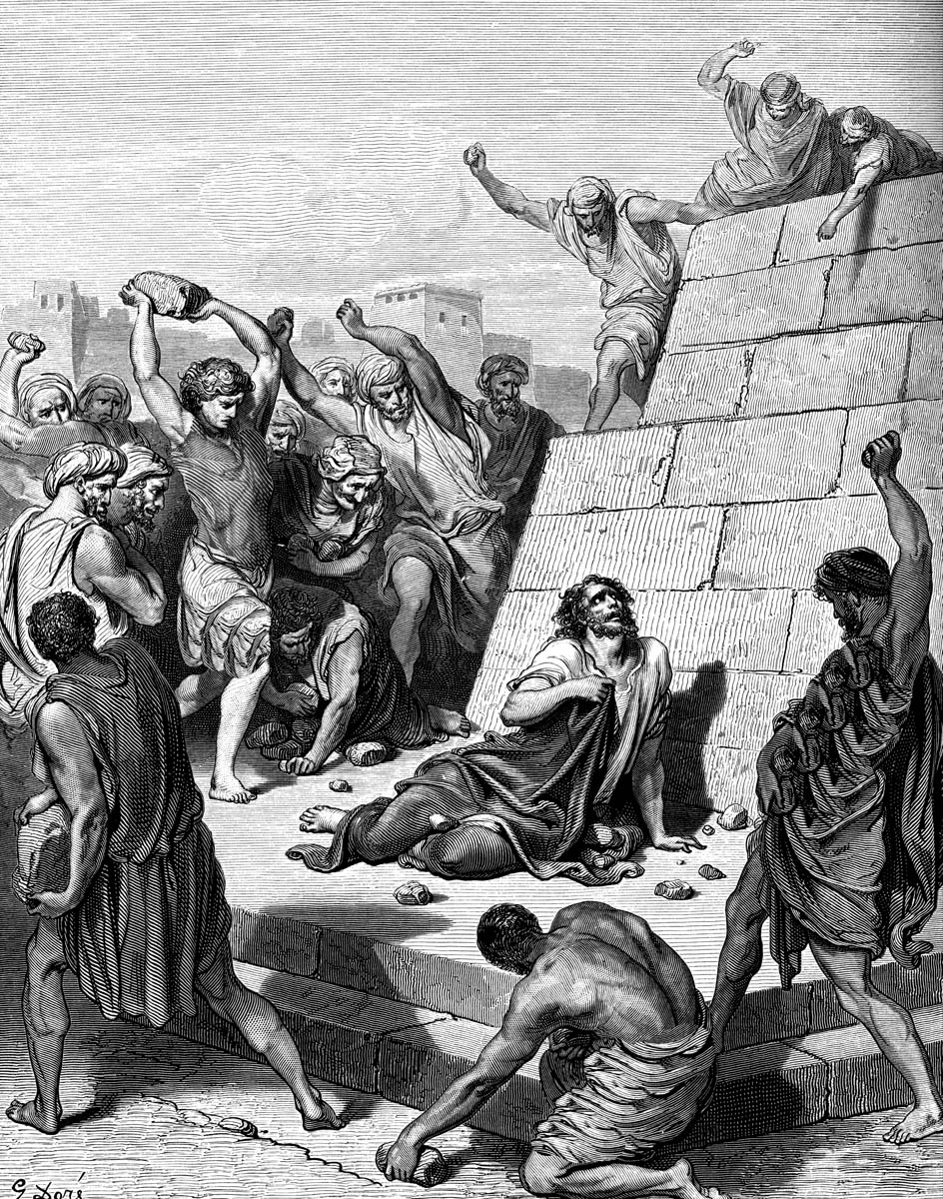
Forgiveness Part 2 - Examples
Acts 7:57–60
⁵⁷ Then they cried out with a loud voice, stopped their ears, and ran at him with one accord; ⁵⁸ and they cast him out of the city and stoned him. And the witnesses laid down their clothes at the feet of a young man named Saul. ⁵⁹ And they stoned Stephen as he was calling on God and saying, “Lord Jesus, receive my spirit.” ⁶⁰ Then he knelt down and cried out with a loud voice, “Lord, do not charge them with this sin.” And when he had said this, he fell asleep.

Slide 3
Forgiveness Part 2 - Examples
Acts 7:57–60
⁶⁰ Then he knelt down and cried out with a loud voice, “Lord, do not charge them with this sin.” And when he had said this, he fell asleep.
If you were being put to death, would this be your last words?

Slide 4
Forgiveness, Part 1
Forgiveness Frees the Forgiver
2. So Forgiveness Is Needed
3. God Cannot Tolerate Sin
4. Forgiveness Is Possible
5. God Desires to Forgive
6. Jesus Made Forgiveness Possible
7. Forgive Others As Often As Needed
8. Give Up on getting Revenge

Slide 6
Some areas forgiveness might be difficult.
Emotional
Physical
Spiritual
Financial
Social

Slide 7
Forgiveness Part 2 - Examples
1. Esau forgave his brother Jacob after years of estrangement.
Abraham
(Ishmael) Isaac
Esau Jacob
12 sons
12 tribes of Israel

Slide 8
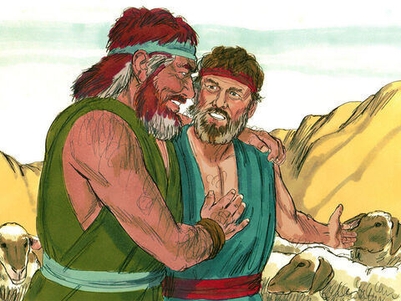
Forgiveness Part 2 - Examples
1. Esau forgave his brother Jacob after years of estrangement.
Genesis 25:27–34
GEN 27 OVERVIEW - READ
Genesis 32:3–12
Gen 33:4 But Esau ran to meet him, and embraced him, and fell on his neck and kissed him, and they wept.

Slide 9
Forgiveness Part 2 - Examples
2. Joseph forgave his brothers who betrayed him.
Gen. 37–50 (Joseph – son of Jacob)
Joseph has dreams of greatness – his brothers want to kill him.
Gen 37:8 They Hated him
Gen 37:11 they envied him.
37:18 they conspired to kill him.
37:21 Reuben intervenes – they do not kill him
37:25 They sell Joseph to some Ishmaelite traders heading to Egypt.

Slide 10
Forgiveness Part 2 - Examples
2. Joseph forgave his brothers who betrayed him.
Gen. 37–50
37:36- The traders sold Joseph to Potiphar an officer of Pharoah and captain of the guard.
ch 39 Joseph becomes a slave in Egypt
ch 39 Joseph is thrown into prison because of refusing sexual advances made to him by Potiphar’s wife.
He is forgotten in prison
ch 41Later he interperts dream of Pharoah and is released
Joseph rises to power in Egypt and is put in charge of food storage because of a coming famine.
The famine comes – EVERYBODY comes to Egypt for food to keep from starving - So do his brothers

Slide 11
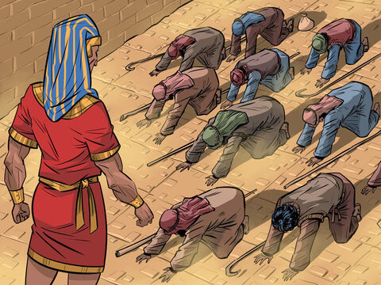
Forgiveness Part 2 - Examples
2. Joseph forgave his brothers who betrayed him.
Gen. 37–50
Gen.50:20 But as for you, you meant evil against me; but God meant it for good, in order to bring it about as it is this day, to save many people alive.

Slide 12
Forgiveness Part 2 - Examples
3. David asked for God’s forgiveness for his adultery with Bathsheba.
Nathan’s Parable and David’s Confession 2 Samuel 11
Then the Lord sent Nathan to David. And he came to him, and said to him: “There were two men in one city, one rich and the other poor. ² The rich man had exceedingly many flocks and herds. ³ But the poor man had nothing, except one little ewe lamb which he had bought and nourished; and it grew up together with him and with his children. It ate of his own food and drank from his own cup and lay in his bosom; and it was like a daughter to him. ⁴ And a traveler came to the rich man, who refused to take from his own flock and from his own herd to prepare one for the wayfaring man who had come to him; but he took the poor man’s lamb and prepared it for the man who had come to him.”

Slide 13
Forgiveness Part 2 - Examples
3. David asked for God’s forgiveness for his adultery with Bathsheba.
⁵ So David’s anger was greatly aroused against the man, and he said to Nathan, “As the Lord lives, the man who has done this shall surely die! ⁶ And he shall restore fourfold for the lamb, because he did this thing and because he had no pity.”
⁷ Then Nathan said to David, “You are the man! Thus says the Lord God of Israel: ‘I anointed you king over Israel, and I delivered you from the hand of Saul. ⁸ I gave you your master’s house and your master’s wives into your keeping, and gave you the house of Israel and Judah. And if that had been too little, I also would have given you much more! ⁹ Why have you despised the commandment of the Lord, to do evil in His sight? You have killed Uriah the Hittite with the sword; you have taken his wife to be your wife, and have killed him with the sword of the people of Ammon. ¹⁰ Now therefore, the sword shall never depart from your house, because you have despised Me, and have taken the wife of Uriah the Hittite to be your wife.’

Slide 14
Forgiveness Part 2 - Examples
3. David asked for God’s forgiveness for his adultery with Bathsheba.
¹⁰ Now therefore, the sword shall never depart from your house, because you have despised Me, and have taken the wife of Uriah the Hittite to be your wife.’ ’ ¹¹ Thus says the Lord: ‘Behold, I will raise up adversity against you from your own house; and I will take your wives before your eyes and give them to your neighbor, and he shall lie with your wives in the sight of this sun. ¹² For you did it secretly, but I will do this thing before all Israel, before the sun.’ ”
¹³ So David said to Nathan, “I have sinned against the Lord.”
And Nathan said to David, “The Lord also has put away your sin; you shall not die. ¹⁴ However, because by this deed you have given great occasion to the enemies of the Lord to blaspheme, the child also who is born to you shall surely die.” ¹⁵ Then Nathan departed to his house.

Slide 15
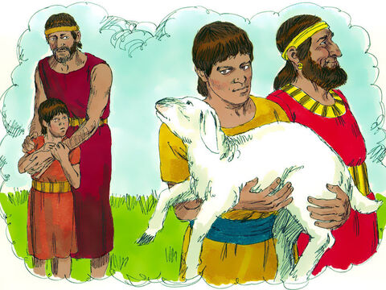
Forgiveness Part 2 - Examples
3. David asked for God’s forgiveness for his adultery with Bathsheba.
2 Samuel 11
Psalm 51
Psalm 51:2–3 Wash me thoroughly from my iniquity, And cleanse me from my sin. 3 For I acknowledge my transgressions, And my sin is always before me.

Slide 16
Forgiveness Part 2 - Examples
4. Out of love, a forgiven woman anointed Jesus’ feet.
^{Luke 7:36} Then one of the Pharisees asked Him to eat with him. And He went to the Pharisee’s house, and sat down to eat. ³⁷ And behold, a woman in the city who was a sinner, when she knew that Jesus sat at the table in the Pharisee’s house, brought an alabaster flask of fragrant oil, ³⁸ and stood at His feet behind Him weeping; and she began to wash His feet with her tears, and wiped them with the hair of her head; and she kissed His feet and anointed them with the fragrant oil. ³⁹ Now when the Pharisee who had invited Him saw this, he spoke to himself, saying, “This Man, if He were a prophet, would know who and what manner of woman this is who is touching Him, for she is a sinner.”

Slide 17
Forgiveness Part 2 - Examples
4. Out of love, a forgiven woman anointed Jesus’ feet.
⁴⁰ And Jesus answered and said to him, “Simon, I have something to say to you.” So he said, “Teacher, say it.”
⁴¹ “There was a certain creditor who had two debtors. One owed five hundred denarii, and the other fifty. ⁴² And when they had nothing with which to repay, he freely forgave them both. Tell Me, therefore, which of them will love him more?”
⁴³ Simon answered and said, “I suppose the one whom he forgave more.”
And He said to him, “You have rightly judged.” ⁴⁴ Then He turned to the woman and said to Simon,

Slide 18
Forgiveness Part 2 - Examples
4. Out of love, a forgiven woman anointed Jesus’ feet.
⁴⁰ And Jesus answered and said to him, “Simon, I have something to say to you.” So he said, “Teacher, say it.”
⁴¹ “There was a certain creditor who had two debtors. One owed five hundred denarii, and the other fifty. ⁴² And when they had nothing with which to repay, he freely forgave them both. Tell Me, therefore, which of them will love him more?”
⁴³ Simon answered and said, “I suppose the one whom he forgave more.”
And He said to him, “You have rightly judged.” ⁴⁴ Then He turned to the woman and said to Simon,

Slide 19
Forgiveness Part 2 - Examples
4. Out of love, a forgiven woman anointed Jesus’ feet.
“Do you see this woman? I entered your house; you gave Me no water for My feet, but she has washed My feet with her tears and wiped them with the hair of her head. ⁴⁵ You gave Me no kiss, but this woman has not ceased to kiss My feet since the time I came in. ⁴⁶ You did not anoint My head with oil, but this woman has anointed My feet with fragrant oil. ⁴⁷ Therefore I say to you, her sins, which are many, are forgiven, for she loved much. But to whom little is forgiven, the same loves little.”
⁴⁸ Then He said to her, “Your sins are forgiven.”
⁴⁹ And those who sat at the table with Him began to say to themselves, “Who is this who even forgives sins?”
⁵⁰ Then He said to the woman, “Your faith has saved you. Go in peace.”

Slide 20
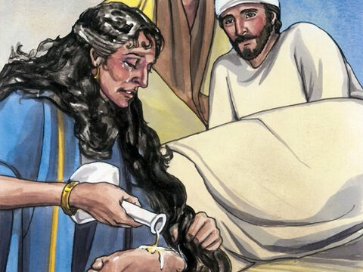
Forgiveness Part 2 - Examples
4. Out of love, a forgiven woman anointed Jesus’ feet.
Luke 7:36–50
Luke 7:47 Therefore I say to you, her sins, which are many, are forgiven, for she loved much. But to whom little is forgiven, the same loves little."

Slide 21
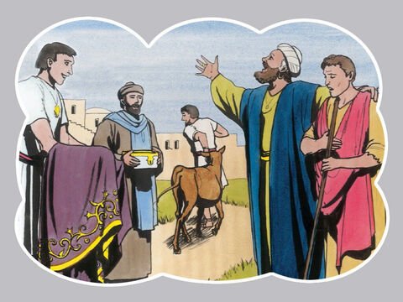
Forgiveness Part 2 - Examples
5. The Parable of the Prodigal Son
Luke 15:11–32
Luke 15:20 And he arose and came to his father. But when he was still a great way off, his father saw him and had compassion, and ran and fell on his neck and kissed him.

Slide 22
Forgiveness Part 2 - Examples
6. A tax collector begged for mercy while a Pharisee failed to see his own need for forgiveness. Luke 18:9–14
⁹ Also He spoke this parable to some who trusted in themselves that they were righteous, and despised others: ¹⁰ “Two men went up to the temple to pray, one a Pharisee and the other a tax collector. ¹¹ The Pharisee stood and prayed thus with himself, ‘God, I thank You that I am not like other men—extortioners, unjust, adulterers, or even as this tax collector. ¹² I fast twice a week; I give tithes of all that I possess.’ ¹³ And the tax collector, standing afar off, would not so much as raise his eyes to heaven, but beat his breast, saying, ‘God, be merciful to me a sinner!’ ¹⁴ I tell you, this man went down to his house justified rather than the other; for everyone who exalts himself will be humbled, and he who humbles himself will be exalted.”

Slide 23
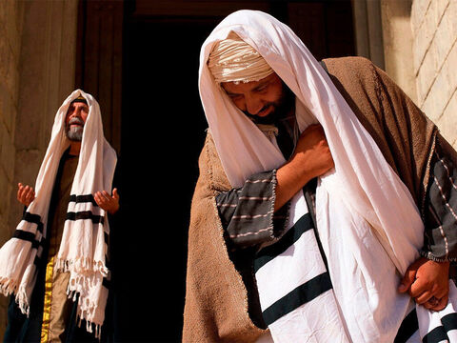
Forgiveness Part 2 - Examples
6. A tax collector begged for mercy while a Pharisee failed to see his own need for forgiveness.
Luke 18:9–14
Luke 18:13 And the tax collector, standing afar off, would not so much as raise his eyes to heaven, but beat his breast, saying, 'God, be merciful to me a sinner!'

Slide 24
Forgiveness Part 2 - Examples
7. Jesus did not condemn woman caught in adultery. John 8:1-11 8 But Jesus went to the Mount of Olives. ² Now early in the morning He came again into the temple, and all the people came to Him; and He sat down and taught them. ³ Then the scribes and Pharisees brought to Him a woman caught in adultery. And when they had set her in the midst, ⁴ they said to Him, “Teacher, this woman was caught in adultery, in the very act. ⁵ Now Moses, in the law, commanded us that such should be stoned. But what do You say?” ⁶ This they said, testing Him, that they might have something of which to accuse Him. But Jesus stooped down and wrote on the ground with His finger, as though He did not hear.
⁷ So when they continued asking Him, He raised Himself up and said to them, “He who is without sin among you, let him throw a stone at her first.” ⁸ And again He stooped down and wrote on the ground. ⁹ Then those who heard it, being convicted by their conscience, went out one by one, beginning with the oldest even to the last. And Jesus was left alone, and the woman standing in the midst. ¹⁰ When Jesus had raised Himself up and saw no one but the woman, He said to her, “Woman, where are those accusers of yours? Has no one condemned you?”
¹¹ She said, “No one, Lord.” And Jesus said to her, “Neither do I condemn you; go and sin no more.”

Slide 25
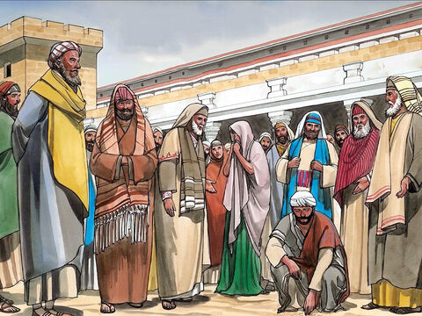
Forgiveness Part 2 - Examples
7. Jesus did not condemn woman caught in adultery.
John 8:1–11
John 8:11 She said, "No one, Lord." And Jesus said to her, "Neither do I condemn you; go and sin no more."

Slide 26
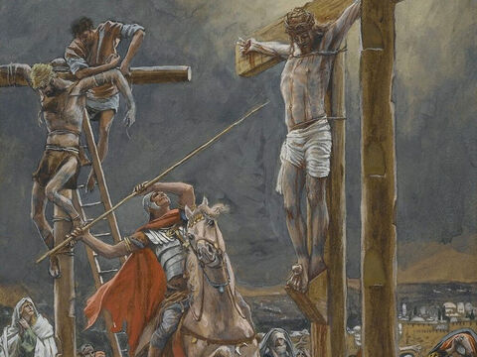
Forgiveness Part 2 - Examples
8. Jesus asked the Father to forgive those who crucified him.
Luke 23:32–43
Luke 23:34 Then Jesus said, "Father, forgive them, for they do not know what they do." And they divided His garments and cast lots.

Slide 27
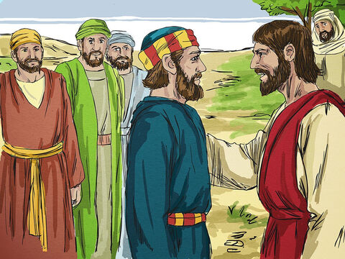
Forgiveness Part 2 - Examples
9. Jesus restored Peter who had denied him three times.
John 13:31–38
John 18:15–27
John 21:15–19
John 21:17 He said to him the third time, "Simon, son of Jonah, do you love Me?" Peter was grieved because He said to him the third time, "Do you love Me?" And he said to Him, "Lord, You know all things; You know that I love You." Jesus said to him, "Feed My sheep. (7x7 – 3xs)

Slide 28
10 Stories of Forgiveness
1. Esau forgave his brother Jacob after years of estrangement.
2. Joseph forgave his brothers who betrayed him.
3. David asked for God’s forgiveness for his adultery with Bathsheba.
4. Out of love, a forgiven woman anointed Jesus’ feet.
5. The Parable of the Prodigal Son
6. A tax collector begged for mercy while a Pharisee failed to see his own need for forgiveness.
7. Jesus did not condemn woman caught in adultery.
8. Jesus asked the Father to forgive those who crucified him.
9. Jesus restored Peter who had denied him three times.
10. Stephen asked God to forgive those who were stoning him.

Slide 29
Forgiveness Part 2 - Examples
10. Stephen asked God to forgive those who were stoning him.
Acts 7:54–60
Acts 7:60 Then he knelt down and cried out with a loud voice, "Lord, do not charge them with this sin." And when he had said this, he fell asleep.

Slide 30
Forgiveness Part 2 - Examples
Acts 7:57–60
⁶⁰ Then he knelt down and cried out with a loud voice, “Lord, do not charge them with this sin.” And when he had said this, he fell asleep.
If you were being put to death, would this be your last words?

Slide 31
Forgiveness
³⁸ Therefore let it be known to you, brethren, that through this Man is preached to you the forgiveness of sins; Acts 13:38
¹⁴ “For if you forgive men their trespasses, your heavenly Father will also forgive you. ¹⁵ But if you do not forgive men their trespasses, neither will your Father forgive your trespasses. Matt. 6:14–15

