Slide 1
Welcome to our services
New Lebanon Church of Christ
We are Simply Christians.
Our Emphasis is Spiritual, Not Material or Social.
We are striving to be The Same Church as Described in The New Testament.
Please Come Back Again

Slide 2
—Matthew 5:43–48
⁴³ “You have heard that it was said, ‘You shall love your neighbor and hate your enemy.’ ⁴⁴ But I say to you, love your enemies, bless those who curse you, do good to those who hate you, and pray for those who spitefully use you and persecute you, ⁴⁵ that you may be sons of your Father in heaven; for He makes His sun rise on the evil and on the good, and sends rain on the just and on the unjust.
⁴⁶ For if you love those who love you, what reward have you? Do not even the tax collectors do the same? ⁴⁷ And if you greet your brethren only, what do you do more than others? Do not even the tax collectors do so? ⁴⁸ Therefore you shall be perfect, just as your Father in heaven is perfect.
—Matthew 5:43–48
⁴³ “You have heard that it was said, ‘You shall love your neighbor and hate your enemy.’ ⁴⁴ But I say to you, love your enemies, bless those who curse you, do good to those who hate you, and pray for those who spitefully use you and persecute you, ⁴⁵ that you may be sons of your Father in heaven; for He makes His sun rise on the evil and on the good, and sends rain on the just and on the unjust.
⁴⁶ For if you love those who love you, what reward have you? Do not even the tax collectors do the same? ⁴⁷ And if you greet your brethren only, what do you do more than others? Do not even the tax collectors do so? ⁴⁸ Therefore you shall be perfect, just as your Father in heaven is perfect.

Slide 3
Some areas forgiveness might be difficult.
Emotional
Physical
Spiritual
Financial
Social

Slide 4
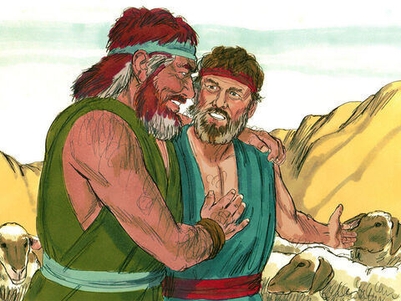
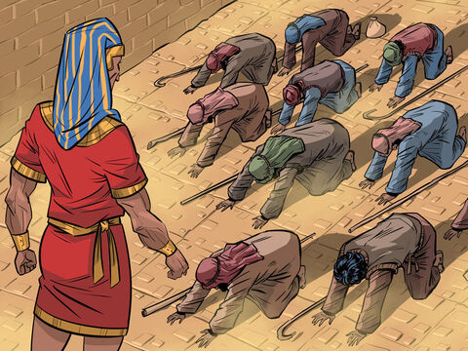
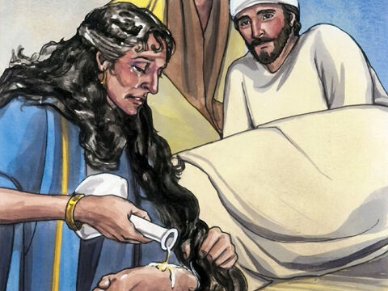
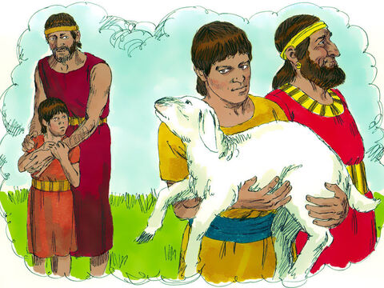
Forgiveness 3

Slide 5
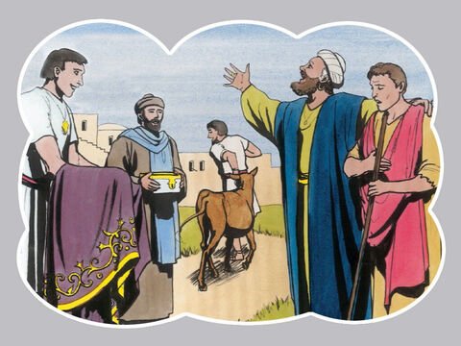
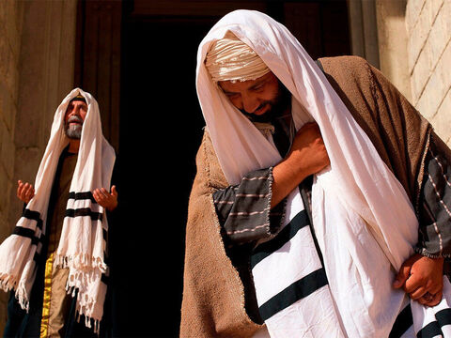
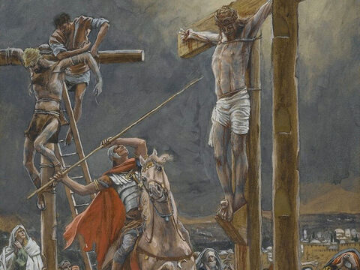
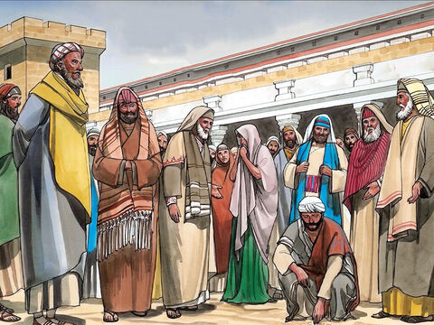

Slide 6
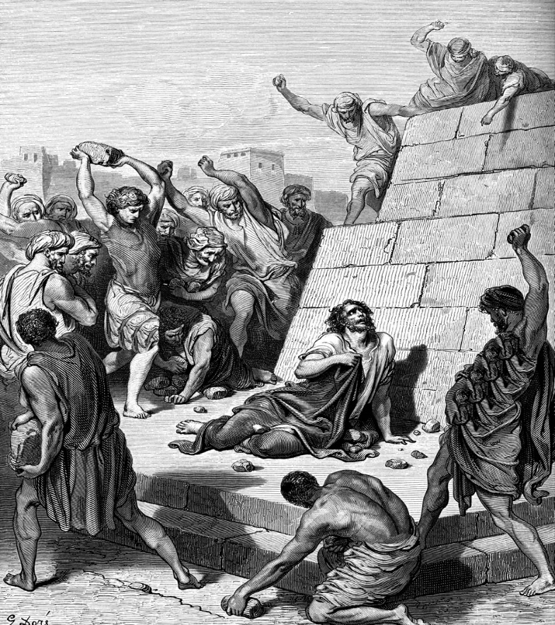
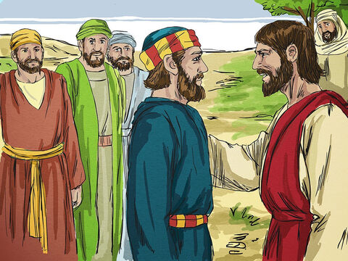

Slide 7
Leviticus 19:18 is the Old Testament passage which says, “Love thy neighbor.” It does not, however, say, “Hate thine enemy.” THAT was an addition to God’s word by the scribes and Pharisees.
So, the people of Jesus’ day had fallen into the old habit of linking a truth with a error. To use an Old Testament figure of speech - thus
“yoking the ox with the ass,”-they were told not to do that. (2Cor 6:14 do not be unequally yoked together with unbelievers…)

Slide 8
Underlying these verses is the challenge that men should be “like their Father who is in heaven.” That is what it is really all about, that men should be like the pure and holy God whom they are taught to worship through Christ.
God loves sinners, even dying for them while they were yet in sin; so Christians should love all men, sinners included, even their own personal enemies! To live the other way is to be no better than a publican (the gatherer of the Roman taxes); and, to the Jews, that was about as low as a man could get!

Slide 9
Matt. 5:47 And if ye salute your brethren only, what do ye more than others? do not even the Gentiles the same?
-An interesting statement. “What do ye more than others?” The implications of this are positively profound. Implicit in these words is the proclamation that
Christians are different;
we love more than others,
We will do more than others,
Our righteousness is a matter of going beyond,
giving the cloak also,
going the second mile,
turning the other cheek,
loving enemies, praying for those who persecute them, and, in short, being “sons of your Father who is in heaven” (Matt. 5:45).

Slide 10
Anyone who has been wronged knows that forgiveness is not easy. However, resentment and bitterness are damaging.
If anger is allowed to fester it will spill over into other areas of life, destroying relationships and leading to a path of revenge.
Make every effort to live in peace with everyone and to be holy; without holiness no one will see the Lord.
(Jacob / Esau Joseph / brothers Stephen / mob)

Slide 11
(1) Forgive so That You Will Be Forgiven
If we want to be forgiven ourselves, we must extend that same forgiveness to others, allowing forgiveness to triumph over the desire to extract retribution.
Matt.6:14–15
¹⁴ “For if you forgive men their trespasses, your heavenly Father will also forgive you. ¹⁵ But if you do not forgive men their trespasses, neither will your Father forgive your trespasses.

Slide 12
Often the key to healing relationships begins with forgiveness. God is working in the world to reconcile sinful man to himself through Christ, and he calls us to be ministers of reconciliation in this broken world.
2 Cor. 5:18–20
¹⁸ Now all things are of God, who has reconciled us to Himself through Jesus Christ, and has given us the ministry of reconciliation, ¹⁹ that is, that God was in Christ reconciling the world to Himself, not imputing their trespasses to them, and has committed to us the word of reconciliation.
²⁰ Now then, we are ambassadors for Christ, as though God were pleading through us: we implore you on Christ’s behalf, be reconciled to God.

Slide 13
Col.1:21–23
²¹ And you, who once were alienated and enemies in your mind by wicked works, yet now He has reconciled ²² in the body of His flesh through death, to present you holy, and blameless, and above reproach in His sight—
²³ if indeed you continue in the faith, grounded and steadfast, and are not moved away from the hope of the gospel which you heard, which was preached to every creature under heaven, of which I, Paul, became a minister.

Slide 14
(2) Give Up our thoughts of Revenge
Anger is a natural response when we are harmed. But God’s Word says to be careful that our anger does not result in taking revenge. We should not add sin upon sin, but leave the situation where it belongs—in God’s hands.

Slide 15
1 Thess. 5:15 ¹⁵ See that no one renders evil for evil to anyone, but always pursue what is good both for yourselves and for all.
Prov. 20:22 Do not say, “I will recompense evil”; Wait for the Lord, and He will save you.
Eph.4:26-27 “Be angry, and do not sin”: do not let the sun go down on your wrath, ²⁷ nor give place to the devil. …29

Slide 16
Rom.12:14–21
¹⁴ Bless those who persecute you; bless and do not curse. ¹⁵ Rejoice with those who rejoice, and weep with those who weep. ¹⁶ Be of the same mind toward one another. Do not set your mind on high things, but associate with the humble. Do not be wise in your own opinion.
¹⁷ Repay no one evil for evil. Have regard for good things in the sight of all men. ¹⁸ If it is possible, as much as depends on you, live peaceably with all men. ¹⁹ Beloved, do not avenge yourselves, but rather give place to wrath; for it is written, “Vengeance is Mine, I will repay,” says the Lord. ²⁰ Therefore
“If your enemy is hungry, feed him;
If he is thirsty, give him a drink;
For in so doing you will heap coals of fire on his head.”
²¹ Do not be overcome by evil, but overcome evil with good.

Slide 17
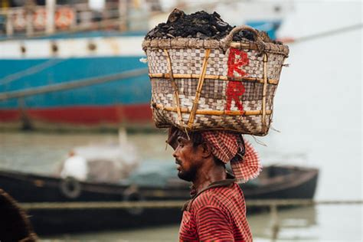

Slide 18
(3) Dealing with Anger
Sometimes anger and bitterness prevent us from experiencing the freedom of forgiveness.
Be willing to confess your bitterness and resentment to God Ps. 51:10–12
Eph. 4:31–32
³¹ Let all bitterness, wrath, anger, clamor, and evil speaking be put away from you, with all malice. ³² And be kind to one another, tenderhearted, forgiving one another, even as God in Christ forgave you.
1 Peter 4:8
⁸ And above all things have fervent love for one another, for “love will cover a multitude of sins.”

Slide 22
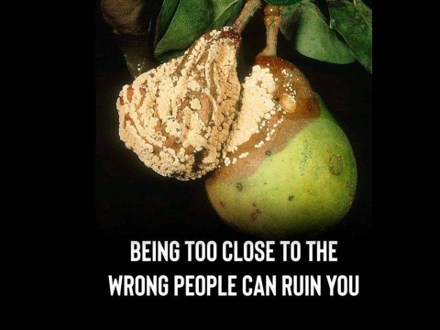

Slide 23
(4) Remember our Own Sin and need for forgiveness.
Recognizing our own need for God’s forgiveness enables us to see our offender’s need for mercy.
The practice of the Lord’s Supper (Communion) reminds us that we are all flawed and sinful people in need of forgiveness.
Self-righteousness will breed an unforgiving heart, but through humility we can learn to extend mercy to others. (God be merciful to me a sinner)
The Pharisee and the tax collector – Luke 18

Slide 24
(5) Forgiveness and loving our enemy Is a Testimony of God’s Love
The world tells us to “get even” or “make them sorry!” God says something quite different. God’s love for all people motivates us to love others as well—even the most unlovable! When we forgive, we demonstrate God’s love for a sinful world.
“We forgive with no strings attached; that may require us to forgive repeatedly. When we do, we shock the world with God’s power at work within us

Slide 25
—Matt. 5:44–48
⁴⁴ But I say to you, love your enemies, bless those who curse you, do good to those who hate you, and pray for those who spitefully use you and persecute you, ⁴⁵ that you may be sons of your Father in heaven; for He makes His sun rise on the evil and on the good, and sends rain on the just and on the unjust. ⁴⁶ For if you love those who love you, what reward have you? Do not even the tax collectors do the same? ⁴⁷ And if you greet your brethren only, what do you do more than others? Do not even the tax collectors do so? ⁴⁸ Therefore you shall be perfect, just as your Father in heaven is perfect.

Slide 26
(6) Forget The Past - Phil.3:12–16
¹² Not that I have already attained, or am already perfected; but I press on, that I may lay hold of that for which Christ Jesus has also laid hold of me. ¹³ Brethren, I do not count myself to have apprehended; but one thing I do, forgetting those things which are behind and reaching forward to those things which are ahead, ¹⁴ I press toward the goal for the prize of the upward call of God in Christ Jesus.
¹⁵ Therefore let us, as many as are mature, have this mind; and if in anything you think otherwise, God will reveal even this to you. ¹⁶ Nevertheless, to the degree that we have already attained, let us walk by the same rule, let us be of the same mind.

Slide 27
(7) We need to Love our Enemies. Pray For our Enemies
Loving your “enemies” is to see them as fellow human beings who are loved by God and in need of his grace; but it is not to tolerate their abuse or invite them to hurt you again. The so-called “love” that ignores or allows such damaging sins is not really love at all.

Slide 28
Matt.5:44–45
⁴⁴ But I say to you, love your enemies, bless those who curse you, do good to those who hate you, and pray for those who spitefully use you and persecute you, ⁴⁵ that you may be sons of your Father in heaven; for He makes His sun rise on the evil and on the good, and sends rain on the just and on the unjust.

Slide 29
But I tell you: Love your enemies and pray for those who persecute you, that you may be children of your Father in heaven.
—Matthew 5:44–45

