Slide 1

Welcome to our services
New Lebanon Church of Christ
We are Simply Christians.
Our Emphasis is Spiritual, Not Material or Social.
We are striving to be The Same Church as Described in The New Testament.
Please Come Back Again

Slide 2
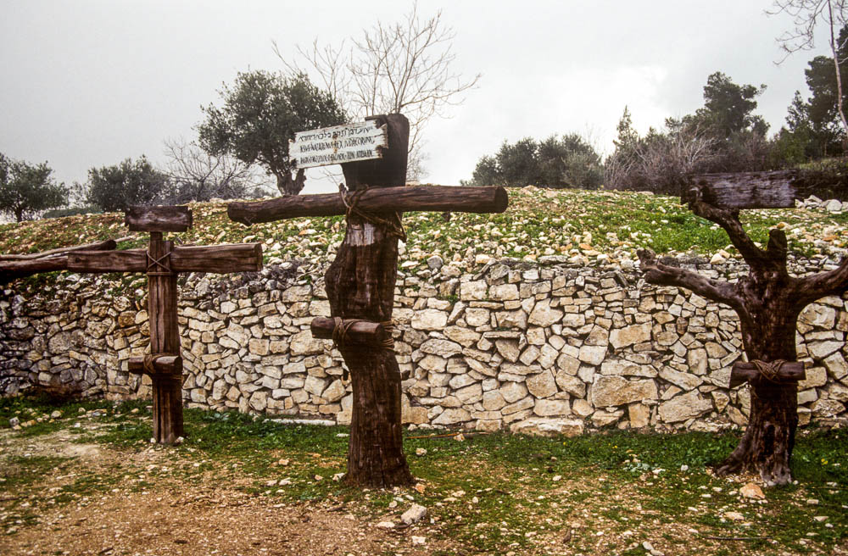
Three Pictures of the Cross
Luke 9:23 And he said to them all, If any man will come after me, let him deny himself, and take up his cross daily, and follow me.
b hastings newlebanoncoc.com
b hastings newlebanoncoc.com

Slide 3

Please open your hearts, your ears, and your Bible and follow along.
If you have any questions about anything I say, if you disagree anything I say, please say something to me after the service and I will be glad to sit down with you and God’s word and study so that we can come to know His truth

Slide 4
Two bandits were crucified with Him, one on the right and one on the left
Three crosses at Tantur
27:38
Notes:
These crosses are a more historically accurate representation of ancient crosses than what is typically found in medieval and modern art. They were on display at the Biblical Gardens at Tantur.
tbs80019402e

Slide 5
Three Pictures of the Cross. Luke 9:23
Words cannot sufficiently describe and adequately portray the full picture of Jesus on Calvary's cross. The great need of the masses is to catch a glimpse of the old rugged cross.
Tillit S. Teddlie wrote the beautiful words that touch the hearts of all who sing:
Oh the depth and the riches of God's saving grace
Flowing down from the cross for me!
There the debt for my sins by the Savior was paid
In His suffering on Calvary!
b hastings newlebanoncoc.com

Slide 6
Three Pictures of the Cross. Luke 9:23
The Old Rugged Cross 313
Beneath The Cross Of Jesus 314
When I Survey The Wondrous Cross 315
Jesus Paid It All 316
Alas And Did My savior Bleed? 324
Blessed Redeemer 331
Lead Me To Calvary 332
On The Cross Of Calvary 338
b hastings newlebanoncoc.com

Slide 7
Three Pictures of the. Cross Luke 9:23
To the world, to those who perish, the cross is foolishness, but to those who are saved, it is the power of God and the wisdom of God 1 Cor. 1:18,24.
With Paul we can say, "God forbid that I should glory, save in the cross of our Lord Jesus Christ" Gal. 6:14.
b hastings newlebanoncoc.com

Slide 8
Three Pictures of the Cross. Luke 9:23
But, Jesus says there is a cross for you and a cross for me. "if all man will come after me, let him deny himself, and take up his cross, and follow me" Matt. 16:24.
b hastings newlebanoncoc.com

Slide 9
Three Pictures of the Cross. Luke 9:23
Must Jesus Bear The Cross Alone?
Must Jesus bear the cross alone,
And all the world go free?
No, there’s a cross for everyone,
And there’s a cross for me.
How happy are the saints above,
Who once went sorrowing here!
But now they taste unmingled love,
And joy without a tear.
The consecrated cross I’ll bear
Till death shall set me free;
And then go home my crown to wear,
For there’s a crown for me.
4.Upon the crystal pavement down
At Jesus’ pierced feet,
Joyful I’ll cast my golden crown
And His dear Name repeat.
5.O precious cross! O glorious crown!
O resurrection day!
When Christ the Lord from heav’n comes down
And bears my soul away.
b hastings newlebanoncoc.com

Slide 10
Three Pictures of the Cross. Luke 9:23
So, when we consider the cross, there are three pictures or portraits of the cross. They are
(1) the historical cross,
(2) the religious cross and
(3) the figurative cross.
b hastings newlebanoncoc.com

Slide 11
Three Pictures of the Cross. Luke 9:23
The historical cross
All four gospels mention the physical cross on which Jesus was executed
Matt. 27:32
Mk. 15:21
Lk. 23:26
John 19:17 as well as other New Testament letters.
Crucifixion was the most barbaric mode of execution known of man.
b hastings newlebanoncoc.com

Slide 12
Three Pictures of the Cross. Luke 9:23
Roman citizens were excluded from crucifixion. It was reserved for the slaves, particularly those guilty of treason, sedition, assassination, robbery and other horrible acts.
It was practiced until Constantine the Great outlawed it as an insult to Christianity.
Crucifixion was also familiar to the Egyptians, Greeks, Persians, Babylonians and others.
It is said that Alexander the Great crucified 2000 people of Tyre after the fall of Tyre.
b hastings newlebanoncoc.com

Slide 13
Three Pictures of the Cross. Luke 9:23
There were different forms of crosses. One was shaped like our letter T.
Another was like our letter X.
The one on which Jesus was put to death was, evidently, the dagger-type, where the upright beam projected above the crosspiece.
The fact that inscriptions were placed above his head indicate this.
b hastings newlebanoncoc.com

Slide 14
The International Standard Bible Encyclopedia gives the following gruesome description of crucifixion:
The suffering of death by crucifixion was intense. Severe local inflammation, coupled with bleeding of the wounds, produced traumatic fever, which was aggravated by the exposure to the heat of the sun, the strained position of the body and insufferable thirst. The wounds swelled about the rough nails and the torn and lacerated tendons and nerves cause excruciating agony. The arteries of the head and stomach were surcharged with blood and a terrific throbbing headache ensued. The mind was confused and filled with anxiety and dread foreboding. The victim of crucifixion literally died a thousand deaths . . . . The sufferings were so frightful that "even among the raging passions of war pity was sometimes excited" (Vol. 2, p. 761).

Slide 15
Three Pictures of the Cross. Luke 9:23
The Religious Cross
The word "cross" is also used in a religious or theological sense.
Paul wrote, "For the preaching of the cross is to them that perish foolishness" 1 Cor. 1:18
Gal. 5:11
Gal. 6:12,14
1 Cor. 1:17
b hastings newlebanoncoc.com

Slide 16
Three Pictures of the Cross. Luke 9:23
The cross to Paul was the gospel. By the death, burial and resurrection of Christ, God's saving power is manifested.
The cross symbolized all of this. Therefore, by the cross the following was and is accomplished:
b hastings newlebanoncoc.com

Slide 17
Three Pictures of the Cross. Luke 9:23
Redemption
Paul wrote, "Christ hath redeemed us from the curse of the law, being made a curse for us: for it is written, Cursed is every one that hangeth on a tree" (Gal. 3:13).
The Greek word translated "redeemed" (exagorazo) in this text suggests the "price paid" for redemption.
By the cross Jesus paid the price or debt for our sins. "Jesus paid it all, All to Him I owe; Sin had left a crimson stain, He washed it white as snow."
b hastings newlebanoncoc.com
Notes:
Redemption was accomplished by the cross

Slide 18
Three Pictures of the Cross. Luke 9:23
Another word for redemption is lutroo. This word means "actual deliverance." Paul uses the word both in Eph.1:7 and Col.1:14.
Through the cross, or by Jesus' shed blood, we are delivered from the spiritual bondage of sorrow and night into the freedom of gladness and light.
b hastings newlebanoncoc.com

Slide 19
Three Pictures of the Cross. Luke 9:23
Reconciliation
Man, alienated from God by sin, is brought back to God, yes, reconciled to God, by the cross. "And you, that were sometime alienated and enemies in your mind by wicked works, yet now hath he reconciled in the body of his flesh through death" Col.1:21-22.
Both Jew and Gentile are reconciled in one body by the cross Eph.2:16.
b hastings newlebanoncoc.com
Notes:
Reconciliation was accomplished by the cross

Slide 20
Three Pictures of the Cross. Luke 9:23
Peace
Sin makes man an enemy of God. Friendship of this world is enmity with God James 4:4. There is estrangement, terror, fear and distance. But all of these disappear when we come to God by the way of the cross.
We read, "And, having made peace through the blood of his cross" Col. 1:20. To have peace with God is to have a right relationship with him. This we have through Christ.
b hastings newlebanoncoc.com
Notes:
Peace was accomplished by the cross

Slide 21
Three Pictures of the Cross. Luke 9:23
Purchase of the church
It was through the cross that the church was purchased. Paul told the Ephesian elders to "feed the church of God which he hath purchased with his own blood" Acts 20:28. The same apostle wrote Titus, "Who gave himself for us, that he might redeem us from all iniquity" Titus 2:14.
From heaven he came and sought her
To be His holy bride;
With his own blood he bought her,
And for her life he died.
b hastings newlebanoncoc.com
Notes:
The purchase of the church was accomplished by the cross

Slide 22
Three Pictures of the Cross. Luke 9:23
Abolished law of Moses
At Calvary the Mosaical law was abolished. No man could be saved by that law Acts 13:39, Rom. 3:20, Gal. 2:16. It was given to magnify sin and act as a tutor to the Jews until Jesus came Gal.3:24. In order to inaugurate a better system, Jesus did away with the law of Moses and instituted the New Covenant. The handwriting of ordinances that was against the Jews and contrary to them was nailed to the cross Col. 2:14.
b hastings newlebanoncoc.com
Notes:
Abolishing the law of Moses was accomplished by the cross

Slide 23
Three Pictures of the Cross. Luke 9:23
Access to heaven
"Having therefore, brethren, boldness to enter into the holiest by the blood of Jesus, by a new and living way, which he hath consecrated for us, through the veil, that is to say, his flesh" Heb. 10:19-20. Indeed, we must go home by the way of the cross, because, as the song says, "There's no other way but this."
b hastings newlebanoncoc.com

Slide 24
Three Pictures of the Cross. Luke 9:23
The Figurative Cross
Finally, the word "cross" is used in a metaphorical or figurative sense. Listen to Jesus: "If any man will come after me, let him deny himself, and take up his cross and follow me"
Lk. 9:23;
Matt. 16:24;
Lk. 14:27.
Jesus chose this figure, perhaps, because he was to be crucified
b hastings newlebanoncoc.com

Slide 25
Three Pictures of the Cross. Luke 9:23
Jesus bore his cross. No one else could bear it for him. Each disciple of Jesus must bear his own cross, and that day by day.
Must Jesus bear the cross alone.
And all the world go free?
No, there's a cross for every one,
And there's a cross for me.
b hastings newlebanoncoc.com

Slide 26
Three Pictures of the Cross. Luke 9:23
Analyzing this passage in Luke, let us notice -
The cross is voluntary
Jesus said, "if any man will come." The Lord does not force us or coerce us, but we follow Jesus by our own free will. When the burdens become heavy and the way grows weary, let us not fret and complain. We made the decision to follow. Let us ask for strength to persevere and carry on.
b hastings newlebanoncoc.com

Slide 27
Three Pictures of the Cross. Luke 9:23
The cross makes self-denial.
As the text states he who follows is to "deny himself, and take up his cross." This entails a disowning and complete denial of oneself. This is not just giving up some of the bad habits or outward practices, but it is a turning off altogether of self, i.e., sinful self. When Christ's will becomes the disciple's will, then he is ready for cross-bearing.
b hastings newlebanoncoc.com

Slide 28
Three Pictures of the Cross. Luke 9:23
The cross must be bourne
A disciple must take up his cross and this is to be done daily. The responsibility of being a disciple of Jesus is a constant thing, regardless of the hardships that may be encountered. Cross-bearing is a readiness and willingness to bear and endure all things for Jesus' sake.
b hastings newlebanoncoc.com

Slide 29
Three Pictures of the Cross. Luke 9:23
The cross is a test of discipleship
Jesus exhorts any would be disciple to follow him. This denotes faithfulness and fidelity. But prerequisites to following Jesus are cross-bearing and self-denial. In Luke 14:27 Jesus said that a man cannot be his disciple unless he bears his cross and comes after him.
b hastings newlebanoncoc.com

Slide 30
Three Pictures of the Cross. Luke 9:23
"He who desires to become his disciple and servant will every day have to be willing to put his own interests and wishes into the background and to accept voluntarily and whole-heartedly - the sacrifice and suffering that will have to be endured in his service.
The 'cross' is not the ordinary, human troubles and sorrows such as disappointments, disease, death, poverty and the like, but the things which have to be suffered, endured and lost in the service of Christ" (Commentary on the Gospel of Luke, p. 276).
b hastings newlebanoncoc.com

Slide 31

1Cor. 1:17 For Christ did not send me to baptize, but to preach the gospel, not with wisdom of words, lest the cross of Christ should be made of no effect. 18 For the message of the cross is foolishness to those who are perishing, but to us who are being saved it is the power of God.
Gal. 6:14 But God forbid that I should boast except in the cross of our Lord Jesus Christ, by whom the world has been crucified to me, and I to the world.

Slide 32
Three Pictures of the Cross. Luke 9:23
In view of what Jesus did for us at Calvary, and all that we have received through the cross of Christ, let us take up our cross daily in his service.
Friend, we ask loving and kindly,….
b hastings newlebanoncoc.com

