Slide 1
Welcome to our services
New Lebanon Church of Christ
We are Simply Christians.
Our Emphasis is Spiritual, Not Material or Social.
We are striving to be The Same Church as Described in The New Testament.
Please Come Back Again

Slide 2
Consecration
1 Take my life and let it be consecrated, Lord, to thee. Take my moments and my days; let them flow in endless praise, let them flow in endless praise.
Take My Life And Let It Be

Slide 3
Consecration
Leviticus 11:44 (NKJV)
⁴⁴ For I am the Lord your God. You shall therefore consecrate yourselves, and you shall be holy; for I am holy. Neither shall you defile yourselves with any creeping thing that creeps on the earth.
Leviticus 11:44
⁴⁴ For I am the Lord your God. You shall therefore consecrate yourselves, and you shall be holy; for I am holy. Neither shall you defile yourselves with any creeping thing that creeps on the earth.

Slide 4
Consecration
Consecrate; Consecration:
kon'-se-krat, kon-se-kra'-shun.
1. In the Old Testament:
In the Old Testament for several Hebrew words of different meanings:
(1) charam: "I will consecrate (the Revised Version (British and American) "devote") their gain unto the Lord," i.e. the spoil of the nations shall be dedicated to the service of Yahweh (Mic 4:13).
See BAN; CURSE.
(2) nazar, nezer (Nu 6:7,9,12; the Revised Version (British and American) "separate").
See NAZIRITE.

Slide 5
"consecrate" occurs 35 times in 34 verses in the NKJV.
"consecration" occurs 11 times in 11 verses in the NKJV.

Slide 6
Rom. 12:1–2
1 I beseech you therefore, brethren, by the mercies of God, that you present your bodies a living sacrifice, holy, acceptable to God, which is your reasonable service. 2 And do not be conformed to this world, but be transformed by the renewing of your mind, that you may prove what is that good and acceptable and perfect will of God.
1 Cor. 6:11
And such were some of you. But you were washed, but you were sanctified, but you were justified in the name of the Lord Jesus and by the Spirit of our God.
1 Thess 4:3–8
3 For this is the will of God, your sanctification: that you should abstain from sexual immorality; 4 that each of you should know how to possess his own vessel in sanctification and honor, 5 not in passion of lust, like the Gentiles who do not know God; 6 that no one should take advantage of and defraud his brother in this matter, because the Lord is the avenger of all such, as we also forewarned you and testified. 7 For God did not call us to uncleanness, but in holiness. 8 Therefore he who rejects this does not reject man, but God, who has also given us His Holy Spirit.

Slide 7
1 Chronicles 29:10–14 (NKJV)
¹⁰ Therefore David blessed the Lord before all the assembly; and David said:
“Blessed are You, Lord God of Israel, our Father, forever and ever.
¹¹ Yours, O Lord, is the greatness,
The power and the glory,
The victory and the majesty;
For all that is in heaven and in earth is Yours;
Yours is the kingdom, O Lord,
And You are exalted as head over all.
¹² Both riches and honor come from You,
And You reign over all.
In Your hand is power and might;
In Your hand it is to make great
And to give strength to all.
¹³ “Now therefore, our God, We thank You
And praise Your glorious name.
¹⁴ But who am I, and who are my people,
That we should be able to offer so willingly as this?
For all things come from You,
And of Your own we have given You.

Slide 8
Consecration
V 14 For all things come from You, And of Your own we have given You. In these words there are four very precious thoughts I want to try and make clear to you: -
1. God is the Owner of all, and gives all to us.
2. We have nothing but what we receive—but everything we need we may receive from God.
3. It is our privilege and honor to give back to God what we receive from Him.
4. God has a double joy in His possessions when he receives back from us what He gave.

Slide 9
Consecration
And when I apply this to my life—to my body, to my wealth, property, to my whole being with all its powers—then I understand what Consecration ought to be.

Slide 10
Consecration
I It is the glory of God, and His very nature, to be always GIVING. God is the owner of all. There is no power, no riches, no goodness, no love, outside of God.
I must see that everything I have is given by Him;
I must learn to believe in God as the great Owner and Giver of all.

Slide 11
James 1:17
¹⁷ Every good gift and every perfect gift is from above, and comes down from the Father of lights, with whom there is no variation or shadow of turning.

Slide 12
Matthew 7:7–11 (NKJV)
⁷ “Ask, and it will be given to you; seek, and you will find; knock, and it will be opened to you. ⁸ For everyone who asks receives, and he who seeks finds, and to him who knocks it will be opened.
⁹ Or what man is there among you who, if his son asks for bread, will give him a stone? ¹⁰ Or if he asks for a fish, will he give him a serpent? ¹¹ If you then, being evil, know how to give good gifts to your children, how much more will your Father who is in heaven give good things to those who ask Him!

Slide 13
Consecration
2 Take my hands and let them move at the impulse of thy love. Take my feet and let them be swift and beautiful for thee, swift and beautiful for thee.
Take My Life And Let It Be

Slide 14
Consecration
Never be afraid whatever God asks; for God only asks what is His own; what He asks you to give
He will first Himself give you.

Slide 15
Consecration
II. Just as it is the nature and glory of God to be always giving, it is the nature and glory of man to be always receiving.

Slide 16
What can be more simple?
Come as a VESSEL—cleansed, emptied and humble. Come, and then
God will delight to give.

Slide 17
Consecration
1Ch 29:14
But who am I, and who are my people, That we should be able to offer so willingly as this? For all things come from You, And of Your own we have given You

Slide 18
Consecration
3 Take my voice and let me sing always, only, for my King. Take my lips and let them be filled with messages from thee, filled with messages from thee.
Take My Life And Let It Be

Slide 19
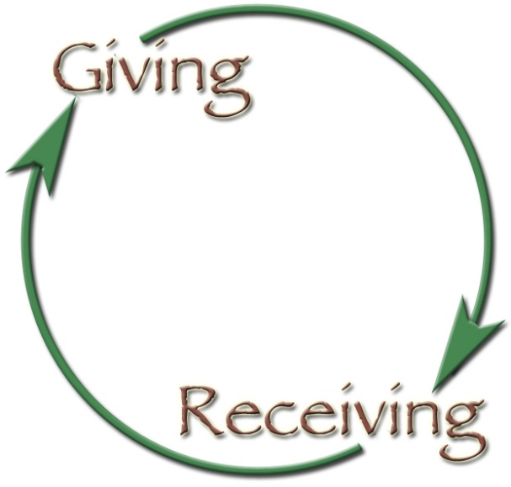
Consecration
III. If God gives all and I receive all, then the third thought is very simple—
I must give all back again.

Slide 20
Consecration
1Ch 16:29
Give to the LORD the glory due His name; Bring an offering, and come before Him. Oh, worship the LORD in the beauty of holiness!
Psa 96:8
Give to the LORD the glory due His name; Bring an offering, and come into His courts.

Slide 21
David felt it.
He said: “Lord, what an unspeakable privilege it is to be allowed to give that back to You which is Your own!”
Just to receive and then to give back in love to Him as God, what He gives.

Slide 22
Consecration
We have now had the three thoughts:
1. God gives all;
2. I receive all;
3. I give up all.
Will you do this now? Will not every heart say, “My God, teach me to give up everything?”

Slide 23
Consecration
IV. God gives all, I receive all, I give all.
Now comes the fourth thought: God rejoices in what we give to Him.

Slide 24
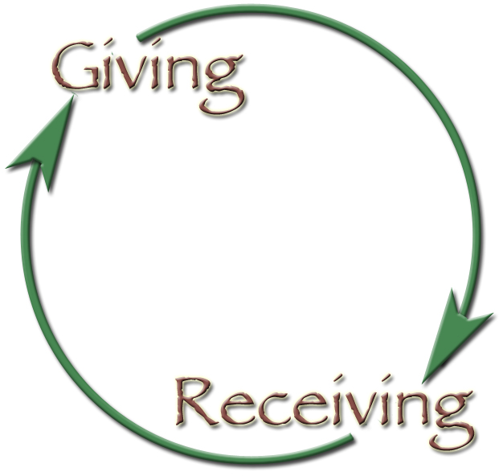
Consecration

Slide 25
Consecration
Have you not seen a mother give a piece of food, and the child comes and offers her a piece to share it with her? How she values the gift!
And your God, loves and longs to have you give Him everything. It is not a demand… it is the call of a loving Father, who knows that every gift you bring to God will bind you closer to Himself, and every surrender you make will open your heart wider to get more of his spiritual gifts.

Slide 26
Consecration
4 Take my silver and my gold; not a mite would I withhold. Take my intellect and use every power as thou shalt choose, every power as thou shalt choose.
Take My Life And Let It Be

Slide 27
Consecration
Consecration is to be and abide in continual dependence upon God.

Slide 28
Consecration
What are we
going to
consecrate?

Slide 29
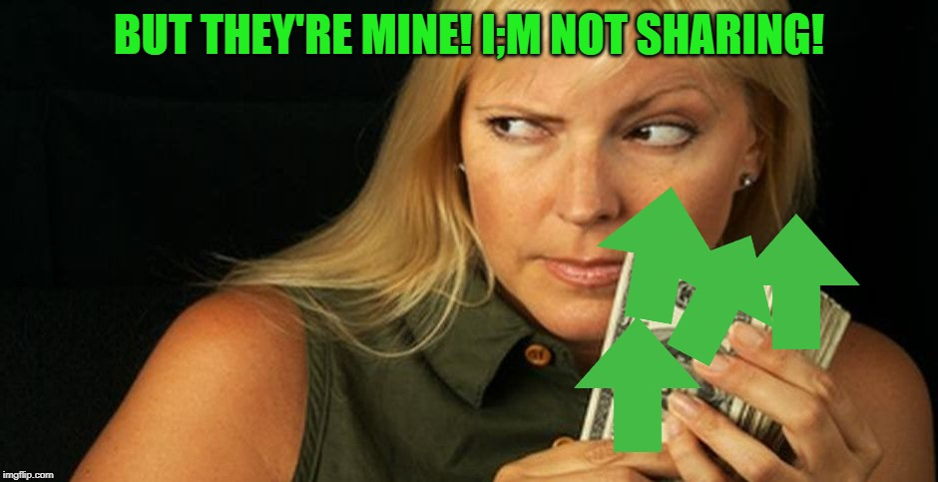

Slide 30
Consecration
Our lives
Our children
Our money
Everything

Slide 32
Consecration
Our giving must be in proportion to God’s giving. He gives you all. Let us take it up in our prayer: “Lord, take it all, every penny I possess. It is all Thine.” Let us often say “It is all His.”
You may not know how much you ought to give. Give up all, put everything in His hands, and He will teach you if you will wait.

Slide 33
Malachi 3:8–12 (NKJV)
⁸ “Will a man rob God? Yet you have robbed Me!
But you say, ‘In what way have we robbed You?’
In tithes and offerings.
⁹ You are cursed with a curse, For you have robbed Me,
Even this whole nation.
¹⁰ Bring all the tithes into the storehouse, That there may be food in My house,
And try Me now in this,” Says the Lord of hosts,
“If I will not open for you the windows of heaven
And pour out for you such blessing
That there will not be room enough to receive it.
¹¹ “And I will rebuke the devourer for your sakes, So that he will not destroy the fruit of your ground,
Nor shall the vine fail to bear fruit for you in the field,”
Says the Lord of hosts;
¹² And all nations will call you blessed, For you will be a delightful land,”
Says the Lord of hosts.

Slide 34
Consecration
5 Take my will and make it thine; it shall be no longer mine. Take my heart it is thine own; it shall be thy royal throne, it shall be thy royal throne.
Take My Life And Let It Be

Slide 35
Consecration
6 Take my love; my Lord, I pour at thy feet its treasure store. Take myself, and I will be ever, only, all for thee, ever, only, all for thee.
Take My Life And Let It Be

Slide 36
Consecration
V 14 For all things come from You, And of Your own we have given You. In these words there are four very precious thoughts I want to try and make clear to you: -
1. God is the Owner of all, and gives all to us.
2. We have nothing but what we receive—but everything we need we may receive from God.
3. It is our privilege and honor to give back to God what we receive from Him.
4. God has a double joy in His possessions when he receives back from us what He gave.

