Slide 1
Welcome to our services
New Lebanon Church of Christ
We are Simply Christians.
Our Emphasis is Spiritual, Not Material or Social.
We are striving to be The Same Church as Described in The New Testament.
Please Come Back Again

Slide 2
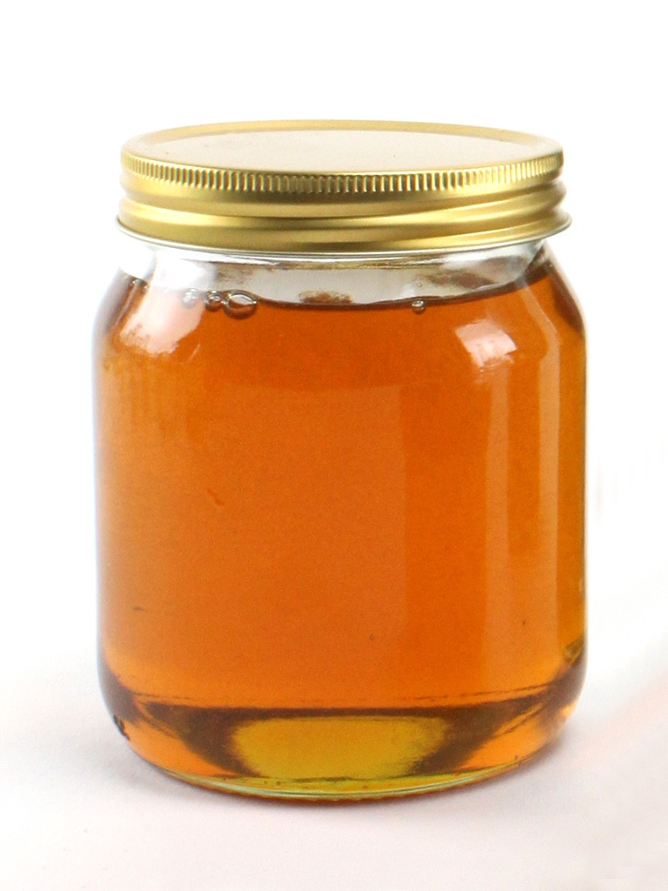
Gen. 43:11 And their father Israel said to them, "If it must be so, then do this: Take some of the best fruits of the land in your vessels and carry down a present for the man-a little balm and a little honey, spices, and myrrh, nuts, and almonds:
Gen. 43:11 At sinabi sa kanila ng kanilang amang si Israel, Kung gayon, ngayo'y gawin ninyo ito: magdala kayo sa inyong bayong ng mga piling bunga ng lupain, at dalhan ninyo ang lalaking yaon ng kaloob, ng kaunting balsamo at kaunting pulot, pabango, at mirra, mga pile at almendras.

Slide 3
Carry A Little Honey
Genesis 43:1-10

Slide 4
Please open your hearts, your ears, and your Bible and follow along.
If you have any questions about anything I say, if you disagree anything I say, please say something to me after the service and I will be glad to sit down with you and God’s word and study so that we can come to know His truth

Slide 5
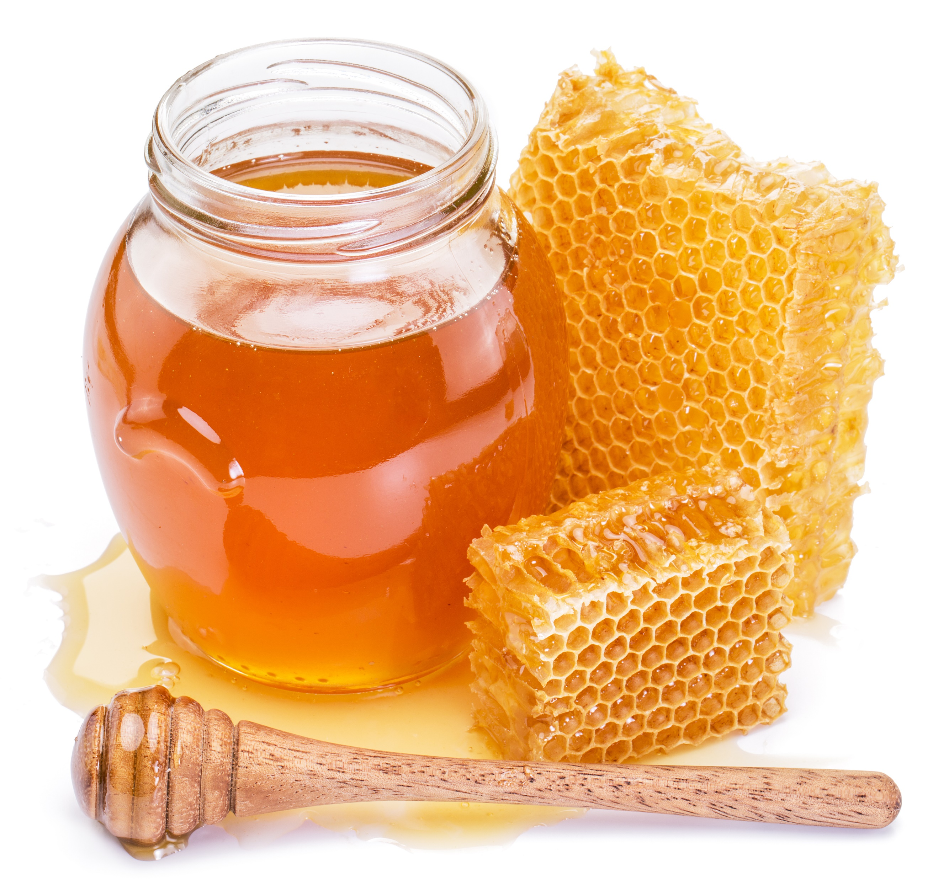
Carry A Little Honey Genesis 43:11
Gen. 43:1 And the famine was sore in the land.
2 And it came to pass, when they had eaten up the corn which they had brought out of Egypt, their father said unto them, Go again, buy us a little food.
3 And Judah spake unto him, saying, The man did solemnly protest unto us, saying, Ye shall not see my face, except your brother be with you.
4 If thou wilt send our brother with us, we will go down and buy thee food:
5 But if thou wilt not send him, we will not go down: for the man said unto us, Ye shall not see my face, except your brother be with you.

Slide 6
Commentary -
“Ye shall not see my face …” This expression meant that the sons of Jacob would not be permitted in Joseph’s presence at all without Benjamin. “To see Joseph’s face, in court language, meant to get an audience with him or to be permitted in his presence.”
Only ministers of the very highest rank were permitted to be in the ruler’s presence, except by special permission. Jesus declared of the angels of little children, “Their angels, do always behold the face of my Father who is in heaven” (Matt. 18:10), the same being a recognition of the fact that “angels of the face,” were the highest-ranking ministers in ancient kingdoms.

Slide 7
Carry A Little Honey Genesis 43:11
6 And Israel said, Wherefore dealt ye so ill with me, as to tell the man whether ye had yet a brother?
7 And they said, The man asked us straitly of our state, and of our kindred, saying, Is your father yet alive? have ye another brother? and we told him according to the tenor of these words: could we certainly know that he would say, Bring your brother down?
8 And Judah said unto Israel his father, Send the lad with me, and we will arise and go; that we may live, and not die, both we, and thou, and also our little ones.
9 I will be surety for him; of my hand shalt thou require him: if I bring him not unto thee, and set him before thee, then let me bear the blame for ever:
10 For except we had lingered, surely now we had returned this second time.
11 And their father Israel said unto them, If it must be so now, do this; take of the best fruits in the land in your vessels, and carry down the man a present, a little balm, and a little honey, spices, and myrrh, nuts, and almonds:

Slide 8
Carry A Little Honey Genesis 43:11
Introduction
Jacob said, "Carry a little honey."
I would suggest brethren, that is good advice for us today.
Not literally, but figuratively.
Jacob had been through enough troubles in his life that he learned some lessons about dealing with people.

Slide 9
Carry A Little Honey Genesis 43:11
Where can we get some honey?
1). Psalm 19:7 The law of the LORD is perfect, converting the soul; The testimony of the LORD is sure, making wise the simple;
8 The statutes of the LORD are right, rejoicing the heart; The commandment of the LORD is pure, enlightening the eyes;
9 The fear of the LORD is clean, enduring forever; The judgments of the LORD are true and righteous altogether.
10 More to be desired are they than gold, Yea, than much fine gold; Sweeter also than honey and the honeycomb.

Slide 10
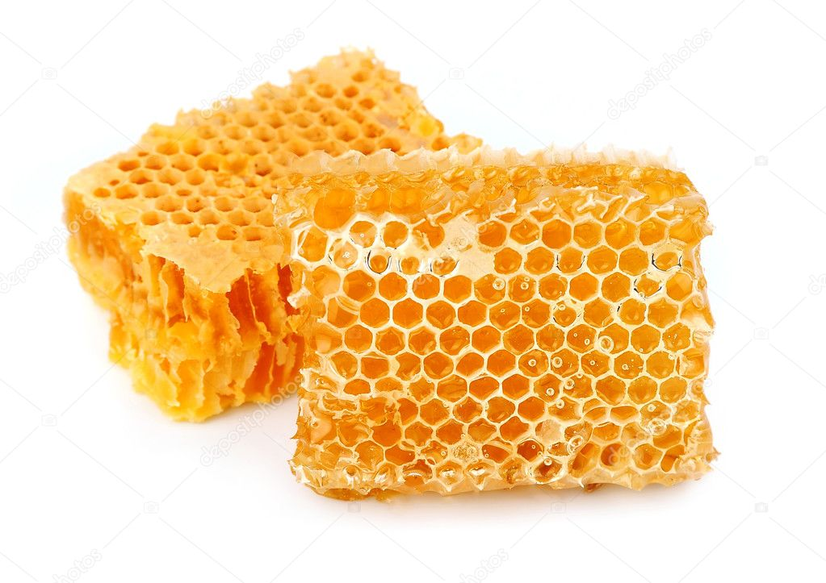
Carry A Little Honey Genesis 43:11
Psalm 119:103 How sweet are Your words to my taste, Sweeter than honey to my mouth!
3).We get our “honey” from the word of God.
We should have and keep an abundant supply of honey.
Col. 3:16 Let the word of Christ dwell in you richly in all wisdom, teaching and admonishing one another in psalms and hymns and spiritual songs, singing with grace in your hearts to the Lord.

Slide 11
Carry A Little Honey Genesis 43:11
Honey strengthens us.
1Samuel 14:29 Then said Jonathan, My father hath troubled the land: see, I pray you, how mine eyes have been enlightened, because I tasted a little of this honey.
Sarcasm, ridicule, bitterness, should not be uttered by one professing to follow God.
Knowing his sons as Jacob did, he could well have meant, "Not only take a little honey in your jars. Take a little sweetness in your soul. Do not be your usual angry, bitter unpleasant self."

Slide 12
Carry A Little Honey Genesis 43:11
Why should we carry a little honey?
First, do it for your own sake.
It is not enough to be good. Most of us know those who are morally good, but very disagreeable.
They have strength of character, but not beauty of soul.
They are religious, but lack attractiveness and cheerfulness.
We should demonstrate the joy, peace and tranquility of a Christian

Slide 13
Carry A Little Honey Genesis 43:11
Our peace and tranquility should come from the honey of God. Not from the medicine cabinet in the bathroom.
Maybe if some people opened their bible more often than their pill bottle, they would need fewer pills. (God -1000s years – medicine)
But a person who is a chronic complainer, disillusioned, pessimistic, needs to seriously examine his or her life.
We admit that there is enough to make a person sour, somber, cynical, bitter and sad if we dwell on the ingratitude, misunderstanding, misrepresentation, failure and hypocrisy of many people in the brotherhood.

Slide 14
Carry A Little Honey Genesis 43:11
Yet often, the greatest problem is our own attitude, not the objective situation.
The two shoe salesmen who went to Africa to see if they could sell shoes is an illustration of that.
The first one said, "Bring me home. Nobody wears shoes where I am."
The other sent the urgent message, "Send me 2,000 pair of shoes immediately. Nobody wears shoes where I am."

Slide 15
Carry A Little Honey Genesis 43:11
Jesus knows better than any of us the dark clouds and shadows of life.
He was a "Man of sorrows and acquainted with grief."
He felt loneliness that none of us have yet felt, deserted by men and forsaken of God.
He was misunderstood, mocked, mistreated and murdered by His enemies.
Yet he said, "My peace I leave with you."
James said, "Count it all joy when ye fall into divers trials" James 1:2.
This is not only a command, but gives encouragement to "carry a little honey."

Slide 16
Carry A Little Honey Genesis 43:11
We need to do it not only for our own sakes, but for the sake of others.
Since there are so many things in life that bring disappointment, discouragement and despair, many need our help and encouragement.
You need the "honey" of encouragement. Heb. 12:12 Therefore strengthen the hands which hang down, and the feeble knees,

Slide 17
Carry A Little Honey Genesis 43:11
Paul says in Gal.6:2, "Bear ye one another's burdens and so fulfill the law of Christ."
Does anybody here have burdens today? Would you rather I help you carry your burdens with a little honey, or a little vinegar?

Slide 18
Carry A Little Honey Genesis 43:11
2Cor. 1:3 Blessed be the God and Father of our Lord Jesus Christ, the Father of mercies and God of all comfort,4 who comforts us in all our tribulation, that we may be able to comfort those who are in any trouble, with the comfort with which we ourselves are comforted by God.
5 For as the sufferings of Christ abound in us, so our consolation also abounds through Christ.

Slide 19
Carry A Little Honey Genesis 43:11
WE need to try to carry a little honey of encouragement and appreciation.
I’m not talking about dealing with sin right now. I am not talking about compromise. I am talking about our brothers and sisters that need our help (all of us) and talking about the outsider.
Where have our manners gone???
Please, thank you, I appreciate you,
Neg. thank you- (“no problem”) (It’s my pleasure)

Slide 20
“It is not so much the greatness of our troubles as the littleness of our spirit which makes us complain”

Slide 21
Carry A Little Honey Genesis 43:11
We need to carry a little honey in the home.
There would be a great deal more wonderful things done and fewer problems of all kinds if we could carry a little honey in the home.
By some strange quirk, many of us show less appreciation, courtesy in the home than we do anywhere in life.
Husbands - wives
Parents- children

Slide 22
Carry A Little Honey Genesis 43:11
Some do carry a little honey in the home, in church and social relationships as they recognize good, encourage any effort that is right, show appreciation and praise for even small things.
How does one learn to do this? Acts 4:13 gives a clue. "They took knowledge of them that they had been with Jesus."
Those who are born with a sunny disposition may not need to have credit for being sweet, but those of us who may have a tendency to gripe, complain and find fault may have to work at it harder.

Slide 23
Carry A Little Honey Genesis 43:11
But we can do it as we live closer to the Lord.
The more we really let the life of Christ be manifest in our mortal flesh 2Cor. 4:11 the more we will carry a little honey.( For we who live are always delivered to death for Jesus' sake, that the life of Jesus also may be manifested in our mortal flesh.)

Slide 24
Carry A Little Honey Genesis 43:11
1Peter 3:5 For in this manner, in former times, the holy women who trusted in God also adorned themselves, being submissive to their own husbands,
6 as Sarah obeyed Abraham, calling him lord, whose daughters you are if you do good and are not afraid with any terror…
7 Husbands, likewise, dwell with them with understanding, giving honor to the wife, as to the weaker vessel, and as being heirs together of the grace of life, that your prayers may not be hindered. 8 Finally, all of you be of one mind, having compassion for one another; love as brothers, be tenderhearted, be courteous;

Slide 25
Carry A Little Honey Genesis 43:11
We need to carry a little honey in the church
Eph 4:31 Let all bitterness, wrath, anger, clamor, and evil speaking be put away from you, with all malice.
32 And be kind to one another, tenderhearted, forgiving one another, just as God in Christ forgave you.
5:1 Therefore be imitators of God as dear children.
2 And walk in love, as Christ also has loved us and given Himself for us, an offering and a sacrifice to God for a sweet-smelling aroma.

Slide 26
Carry A Little Honey Genesis 43:11
Heb.12:15 looking carefully lest anyone fall short of the grace of God; lest any root of bitterness springing up cause trouble, and by this many become defiled;
"Bitter envying" -- James 3:14 But if you have bitter envy and self-seeking in your hearts, do not boast and lie against the truth.15 This wisdom does not descend from above, but is earthly, sensual, demonic. 16 For where envy and self-seeking exist, confusion and every evil thing are there.17 But the wisdom that is from above is first pure, then peaceable, gentle, willing to yield, full of mercy and good fruits, without partiality and without hypocrisy.

Slide 27
Carry A Little Honey Genesis 43:11
1John 4:20–21 If someone says, "I love God," and hates his brother, he is a liar; for he who does not love his brother whom he has seen, how can he love God whom he has not seen? 21 And this commandment we have from Him: that he who loves God must love his brother also.

Slide 28
Carry A Little Honey Genesis 43:11
We need to carry a little honey in the world.
There are some people that just aren’t fun to be around.
We want to make sure we are not one of those people.
How are we going to be a POSITIVE influence in the world if our countenance, our speech, and our behavior is anything less than Christ-like.

Slide 29
Carry A Little Honey Genesis 43:11
Jacob’s advice to his sons to carry a little honey was good advice.
It’s good advice for us also, to carry a little honey.
What is honey? The word of God.
We don’t carry it like we carry our bible.
We carry it in our life:
Our attitude
Our speech
Our countenance
Our actions

Slide 30
Carry A Little Honey Genesis 43:11
We need to carry it for ourselves.
We need to carry some for others.
We need to carry it in our home.
We need to carry it in the church.
We need to carry it in the world.

Slide 31
Jesus is coming.
Are you ready?
Have you been carrying honey?
Have you been sharing honey (the Word of God)?
Do you want to see the face of Jesus?
Isaiah 59:2 But your iniquities have separated you from your God; And your sins have hidden His face from you, So that He will not hear.

