Slide 1
Welcome to our services
New Lebanon Church of Christ
We are Simply Christians.
Our Emphasis is Spiritual, Not Material or Social.
We are striving to be The Same Church as Described in The New Testament.
Please Come Back Again

Slide 2
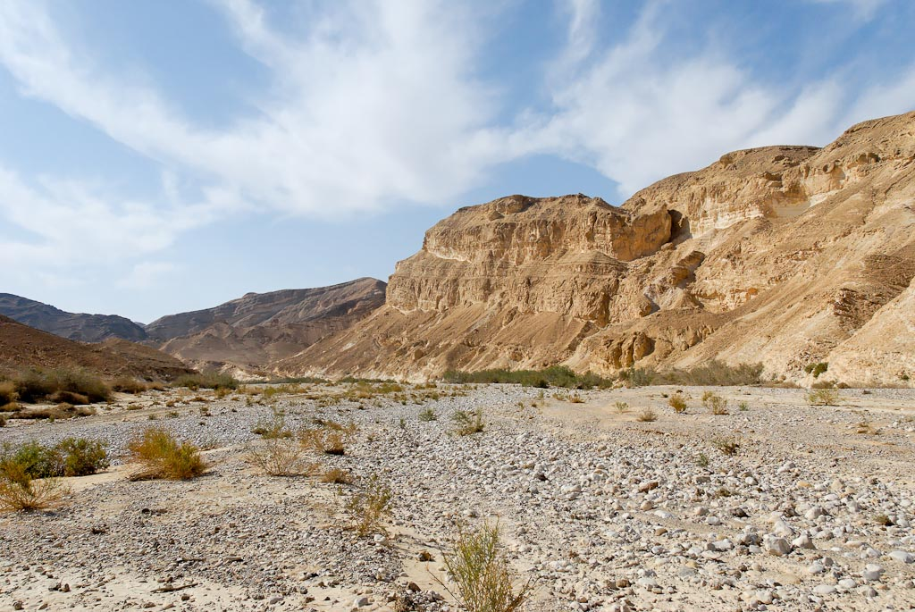
Are You Ready To Leave The Wilderness?
Heb.3:12–19 (NKJV)
¹² Beware, brethren, lest there be in any of you an evil heart of unbelief in departing from the living God; ¹³ but exhort one another daily, while it is called “Today,” lest any of you be hardened through the deceitfulness of sin. ¹⁴ For we have become partakers of Christ if we hold the beginning of our confidence steadfast to the end, ¹⁵ while it is said:
“Today, if you will hear His voice,
Do not harden your hearts as in the rebellion.”
¹⁶ For who, having heard, rebelled? Indeed, was it not all who came out of Egypt, led by Moses? ¹⁷ Now with whom was He angry forty years? Was it not with those who sinned, whose corpses fell in the wilderness? ¹⁸ And to whom did He swear that they would
not enter His rest, but to those who did not obey? ¹⁹ So we
see that they could not enter in because of unbelief.

Slide 3
Are You Ready To Leave
The Wilderness?
Heb.3:12–19

Slide 4
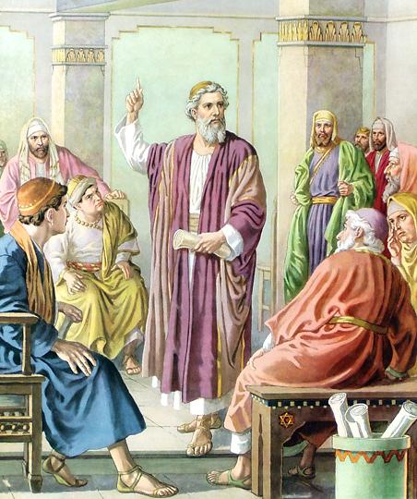
HEBREWS
Chapter 3
these verses teach
the possibility of apostasy
n
The Baptist Faith And Message contradicts the Bible by claiming that it is impossible for a true believer to depart from God. Their stance regarding this passage is that those addressed had never been true believers. But look at the passage, and notice that they are referred to as “brethren” and “partakers of Christ” who at the beginning had “confidence” or assurance. Also, we put forth the question: How can you depart from God if you were never with him?
12 Take heed, brethren, lest there be in any of you an evil heart of unbelief, in departing from the living God.
13 But exhort one another daily, while it is called To day; lest any of you be hardened through the deceitfulness of sin.
14 For we are made partakers of Christ, if we hold the beginning of our confidence [assurance] stedfast unto the end;

Slide 5
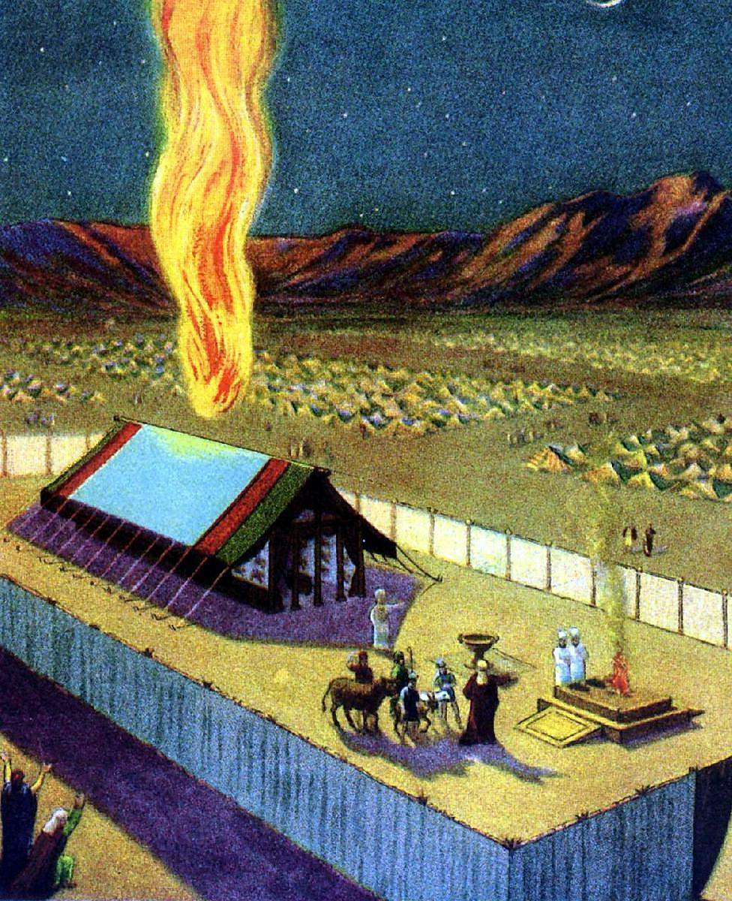
HEBREWS
Chapter 3
15 While it is said, To day if ye will hear his voice, harden not your hearts, as in the provocation.
16 For some, when they had heard, did provoke: howbeit not all that came out of Egypt by Moses.
17 But with whom was he grieved forty years? was it not with them that had sinned, whose carcases fell in the wilderness?
18 And to whom sware he that they should not enter into his rest, but to them that believed not?
19 So we see that they could not enter in because of unbelief.
The history of Israel’s provocations and of God’s dealings with them was so fully recorded in the Old Testament and so generally believed by the Hebrew Christians, that it was unnecessary to formally recount them. Hence, without further argument the writer simply concludes that owing to the sins of the Hebrews a whole generation of God’s chosen people were excluded from the promised rest.
n
This is given as a warning to all Christians to beware, lest they too fall after the same example of unbelief.

Slide 6
Are You Ready To Leave The Wilderness?
We know the cause of Israel’s life in the wilderness—the cause of all their troubles there—was unbelief.
They did not believe that God could take them into the promised land. And then followed many sins and failures—lusting, idolatry, murmuring, etc.

Slide 7
Are You Ready To Leave The Wilderness?
Are you willing to leave that wilderness life?
Sometimes you are, perhaps, enjoying fellowship with God, and sometimes you are separated from Him;
Sometimes you have nearness to Him,
and at other times great distance from Him;
Sometimes you have a willingness to walk closely with Him but sometimes there is
even unwillingness

Slide 8
Are you willing to give up your sins, to walk with God continually,
to submit yourself wholly to the will of God, and have no will of your own apart from His will?
Are you going to live a perfect life?
the perfection spoken of in the Old Testament as practiced by some of God’s saints, who are said to have “served the Lord with a perfect heart?
(perfect, not sinless)

Slide 9
Are You Ready To Leave The Wilderness?
PERFECT
Adjectives.
tamim (תָּמִים, 8549), “perfect; blameless; sincerity; entire; whole; complete; full.”
Tamim means “complete,” in the sense of the entire or whole thing: “And he shall offer of the sacrifice of the peace offering an offering made by fire unto the Lord; the fat thereof, and the whole rump, it shall he take off hard by the backbone …” (Lev. 3:9). The sun stood still for the “whole” day while Joshua fought the Gibeonites (Josh. 10:13). In Lev. 23:15 God commands that there be seven “complete” sabbaths after the first fruit feast plus fifty days and then that the new grain offering be presented. A house within a walled city must be purchased back within a
“full” year if it is to remain the permanent property of the
seller (Lev. 25:30).

Slide 11
JOSHUA Chapter 1
1 Now after the death of Moses the servant of the LORD it came to pass, that the LORD spake unto Joshua the son of Nun, Moses’ minister, saying,
2 Moses my servant is dead; now therefore arise, go over this Jordan, thou, and all this people, unto the land which I do give to them, even to the children of Israel.
Every place that the sole of your foot shall tread upon, that
have I given unto you, as I said unto Moses.
4 From the wilderness and this Lebanon even unto the great river, the river Euphrates, all the land of the Hittites, and unto the great sea toward the going down of the sun, shall be your coast.
5 There shall not any man be able to stand before thee all the days of thy life: as I was with Moses, so I will be with thee: I will not fail thee, nor forsake thee.
6 Be strong and of a good courage: for unto this people shalt thou divide for an inheritance the land, which I sware unto their fathers to give them.
7 Only be thou strong and very courageous, that thou mayest observe to do according to all the law, which Moses my servant commanded thee: turn not from it to the right hand or to the left, that thou mayest prosper whithersoever thou goest.
8 This book of the law shall not depart out of thy mouth; but thou shalt meditate therein day and night, that thou mayest observe to do according to all that is written therein: for then thou shalt make thy way prosperous, and then thou shalt have good success.
9 Have not I commanded thee? Be strong and of a good courage; be not afraid, neither be thou dismayed: for the LORD thy God is with thee whithersoever thou goest.
10 Then Joshua commanded the officers of the people, saying,
11 Pass through the host, and command the people, saying, Prepare you victuals; for within three days ye shall pass over this Jordan, to go in to possess the land, which the LORD your God giveth you to possess it.
12 And to the Reubenites, and to the Gadites, and to half the tribe of Manasseh, spake Joshua, saying,
13 Remember the word which Moses the servant of the LORD commanded you, saying, The LORD your God hath given you rest, and hath given you this land.
14 Your wives, your little ones, and your cattle, shall remain in the land which Moses gave you on this side Jordan; but ye shall pass before your brethren armed, all the mighty men of valour, and help them;
15 Until the LORD have given your brethren rest, as he hath given you, and they also have possessed the land which the LORD your God giveth them: then ye shall return unto the land of your possession, and enjoy it, which Moses the LORD’S servant gave you on this side Jordan toward the sunrising.
16 And they answered Joshua, saying, All that thou commandest us we will do, and whithersoever thou sendest us, we will go.
17 According as we hearkened unto Moses in all things, so will we hearken unto thee: only the LORD thy God be with thee, as he was with Moses.
18 Whosoever he be that doth rebel against thy commandment, and will not hearken unto thy words in all that thou commandest him, he shall be put to death: only be strong and of a good courage.

Slide 12
JOSHUA Chapter 1
1 Now after the death of Moses the servant of the LORD it came to pass, that the LORD spake unto Joshua the son of Nun, Moses’ minister, saying,
2 Moses my servant is dead; now therefore arise, go over this Jordan, thou, and all this people, unto the land which I do give to them, even to the children of Israel.
Every place that the sole of your foot shall tread upon, that
have I given unto you, as I said unto Moses.
4 From the wilderness and this Lebanon even unto the great river, the river Euphrates, all the land of the Hittites, and unto the great sea toward the going down of the sun, shall be your coast.
5 There shall not any man be able to stand before thee all the days of thy life: as I was with Moses, so I will be with thee: I will not fail thee, nor forsake thee.
6 Be strong and of a good courage: for unto this people shalt thou divide for an inheritance the land, which I sware unto their fathers to give them.
7 Only be thou strong and very courageous, that thou mayest observe to do according to all the law, which Moses my servant commanded thee: turn not from it to the right hand or to the left, that thou mayest prosper whithersoever thou goest.
8 This book of the law shall not depart out of thy mouth; but thou shalt meditate therein day and night, that thou mayest observe to do according to all that is written therein: for then thou shalt make thy way prosperous, and then thou shalt have good success.
9 Have not I commanded thee? Be strong and of a good courage; be not afraid, neither be thou dismayed: for the LORD thy God is with thee whithersoever thou goest.
10 Then Joshua commanded the officers of the people, saying,
11 Pass through the host, and command the people, saying, Prepare you victuals; for within three days ye shall pass over this Jordan, to go in to possess the land, which the LORD your God giveth you to possess it.
12 And to the Reubenites, and to the Gadites, and to half the tribe of Manasseh, spake Joshua, saying,
13 Remember the word which Moses the servant of the LORD commanded you, saying, The LORD your God hath given you rest, and hath given you this land.
14 Your wives, your little ones, and your cattle, shall remain in the land which Moses gave you on this side Jordan; but ye shall pass before your brethren armed, all the mighty men of valour, and help them;
15 Until the LORD have given your brethren rest, as he hath given you, and they also have possessed the land which the LORD your God giveth them: then ye shall return unto the land of your possession, and enjoy it, which Moses the LORD’S servant gave you on this side Jordan toward the sunrising.
16 And they answered Joshua, saying, All that thou commandest us we will do, and whithersoever thou sendest us, we will go.
17 According as we hearkened unto Moses in all things, so will we hearken unto thee: only the LORD thy God be with thee, as he was with Moses.
18 Whosoever he be that doth rebel against thy commandment, and will not hearken unto thy words in all that thou commandest him, he shall be put to death: only be strong and of a good courage.

Slide 13
Are You Ready To Leave The Wilderness?
Rom. 13:12–14
¹² The night is far spent, the day is at hand. Therefore let us cast off the works of darkness, and let us put on the armor of light. ¹³ Let us walk properly, as in the day, not in revelry and drunkenness, not in lewdness and lust, not in strife and envy. ¹⁴ But put on the Lord Jesus Christ, and make no provision for the flesh, to fulfill its lusts.
Let us believe in the love and power of God to keep us day by day, and put “no confidence in the flesh.”

Slide 14
Are You Ready To Leave The Wilderness?
Then comes the second step:—
“I must believe that such a life in the land of Canaan is a possible life.”

Slide 15
Are You Ready To Leave The Wilderness?
Num. 32:10–13
¹⁰ So the Lord’s anger was aroused on that day, and He swore an oath, saying, ¹¹ ‘Surely none of the men who came up from Egypt, from twenty years old and above, shall see the land of which I swore to Abraham, Isaac, and Jacob, because they have not wholly followed Me, ¹² except Caleb the son of Jephunneh, the Kenizzite, and Joshua the son of Nun, for they have wholly followed the Lord.’ ¹³ So the Lord’s anger was aroused against Israel, and He made them wander in the wilderness forty years, until all the generation that had done evil in the sight of the Lord was gone.

Slide 16
Are You Ready To Leave The Wilderness?
1 Peter 1:13–21 (NKJV)
¹³ Therefore gird up the loins of your mind, be sober, and rest your hope fully upon the grace that is to be brought to you at the revelation of Jesus Christ; ¹⁴ as obedient children, not conforming yourselves to the former lusts, as in your ignorance; ¹⁵ but as He who called you is holy, you also be holy in all your conduct, ¹⁶ because it is written, “Be holy, for I am holy.”
¹⁷ And if you call on the Father, who without partiality judges according to each one’s work, conduct yourselves throughout the time of your stay here in fear; ¹⁸ knowing that you were not redeemed with corruptible things, like silver or gold, from your aimless conduct received by tradition from your fathers, ¹⁹ but with the precious blood of Christ, as of a lamb without blemish and without spot. ²⁰ He indeed was foreordained before the foundation of the world, but was manifest in these last times for you ²¹ who through Him believe in God, who raised Him from the dead and gave Him glory, so that your faith and hope are in God.

Slide 17
Are You Ready To Leave The Wilderness?
1st God brought us out of Egypt;
2nd He brings us into Canaan.
Then comes— 3rd, the question……….
How does God bring us in?

Slide 18
Are You Ready To Leave The Wilderness?
Joshua 3:14–17
¹⁴ So it was, when the people set out from their camp to cross over the Jordan, with the priests bearing the ark of the covenant before the people, ¹⁵ and as those who bore the ark came to the Jordan, and the feet of the priests who bore the ark dipped in the edge of the water (for the Jordan overflows all its banks during the whole time of harvest), ¹⁶ that the waters which came down from upstream stood still, and rose in a heap very far away at Adam, the city that is beside Zaretan. So the waters that went down into the Sea of the Arabah, the Salt Sea, failed, and were cut off; and the people crossed over opposite Jericho. ¹⁷ Then the priests who bore the ark of the covenant of the Lord stood firm on dry ground in the midst of the Jordan; and all Israel crossed over on dry ground, until all the people had crossed completely over the Jordan.

Slide 19
Are You Ready To Leave The Wilderness?
After Israel had crossed the river, the Captain of the Lord’s host had to come and encourage Joshua, promising to take charge of the army and remain with them.
You need the power of God’s Spirit to enable you to overcome sin and temptation.
You need to live in His fellowship—in His unbroken fellowship, without which you cannot stand or conquer

Slide 20
Joshua 5:13–15 (NKJV)
The Commander of the Army of the Lord
¹³ And it came to pass, when Joshua was by Jericho, that he lifted his eyes and looked, and behold, a Man stood opposite him with His sword drawn in His hand. And Joshua went to Him and said to Him, “Are You for us or for our adversaries?”
¹⁴ So He said, “No, but as Commander of the army of the Lord I have now come.”
And Joshua fell on his face to the earth and worshiped, and said to Him, “What does my Lord say to His servant?”
¹⁵ Then the Commander of the Lord’s army said to Joshua, “Take your sandal off your foot, for the place where you stand is holy.” And Joshua did so.

Slide 21
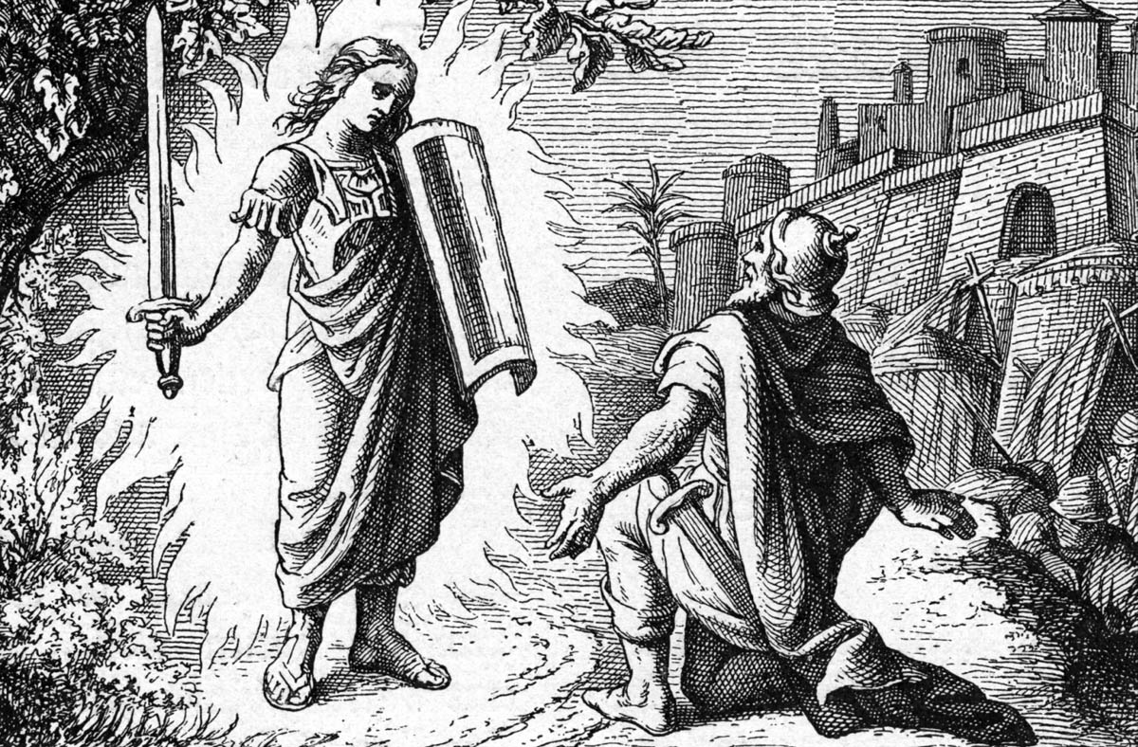
God provided Joshua
and all Israel an infallible captain

Slide 22
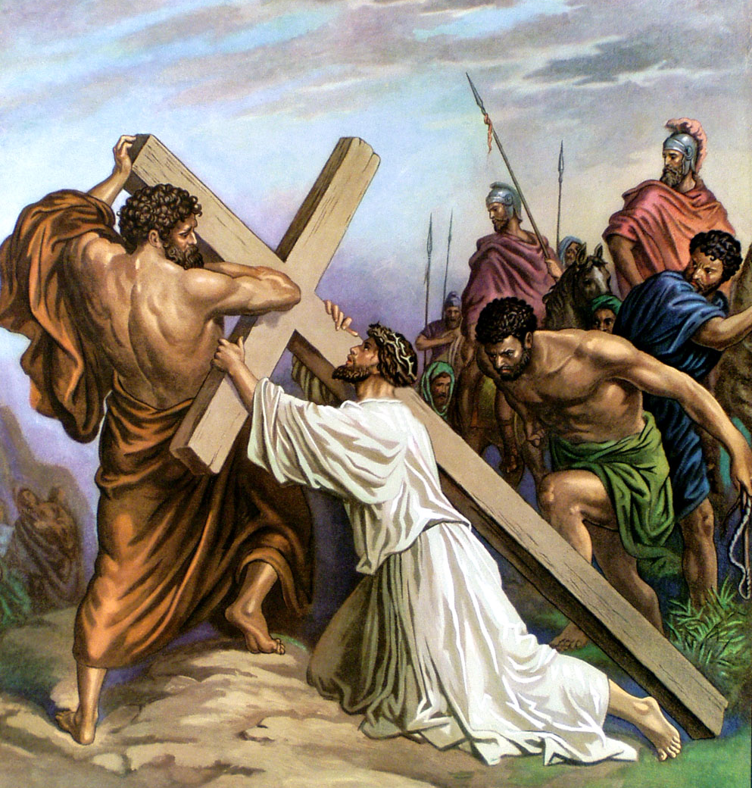
JESUS, THE CAPTAIN OF OUR SALVATION
Hebrews 2
“⁹But we see Jesus, who was made a little lower than the angels for the suffering of death, crowned with glory and honour; that he by the grace of God should taste death for every man. ¹⁰For it became him, for whom are all things, and by whom are all things, in bringing many sons unto glory, to make the captain of their salvation perfect through sufferings.”

Slide 23
Are You Ready To Leave The Wilderness?
Heb. 2:10
¹⁰ For it was fitting for Him, for whom are all things and by whom are all things, in bringing many sons to glory, to make the captain of their salvation perfect through sufferings.

Slide 24
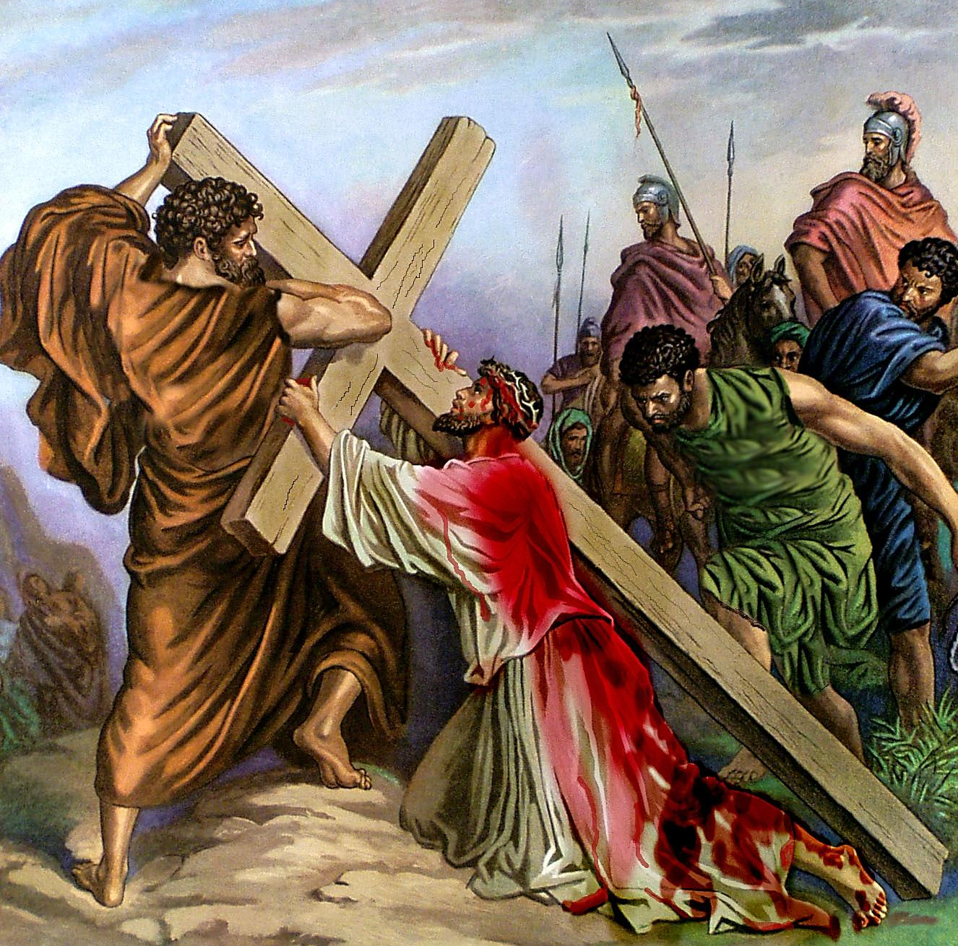
HEBREWS
Chapter 2
9 But we see Jesus, who was made a little lower than the angels for the suffering of death, crowned with glory and honour; that he by the grace of God should taste death for every man.
10 For it became him, for whom are all things, and by whom are all things, in bringing many sons unto glory, to make the captain of their salvation perfect through sufferings.
There were Jews who saw the humble life of Christ as inconsistent with a Messiah whose kingdom was powerful and everlasting.
To remove their objection the Hebrew writer made the point that the humiliation, sufferings, and death of Christ are an essential part of the scheme of redemption. In order to “bring many sons to glory” it was necessary that he should be incarnated, suffer, die, and be resurrected.

Slide 25
Are You Ready To Leave
The Wilderness?
Why Not Leave It Today?

