Slide 1
Welcome to our services
New Lebanon Church of Christ
We are Simply Christians.
Our Emphasis is Spiritual, Not Material or Social.
We are striving to be The Same Church as Described in The New Testament.
Please Come Back Again

Slide 2
Are YOU
Ready?
But he said to Him, "Lord, I am ready to go with You, both to prison and to death."Luke 22:33

Slide 3
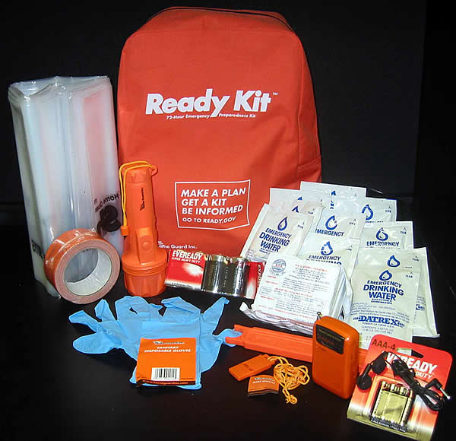

Slide 4
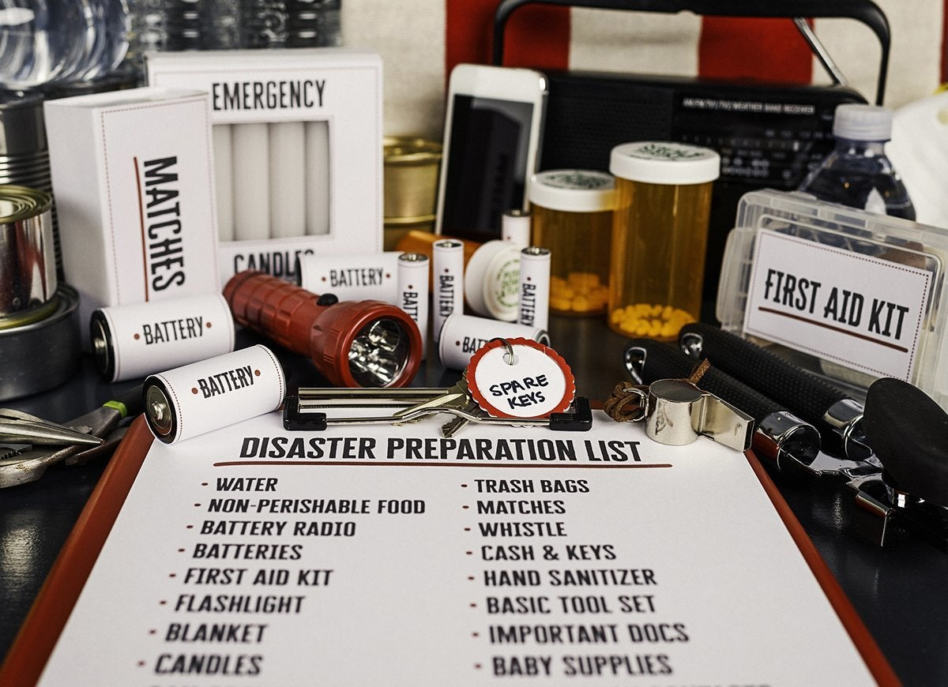

Slide 6
Are You Ready?
Luke 22:33 And the Lord said, "Simon, Simon! Indeed, Satan has asked for you, that he may sift you as wheat. 32 "But I have prayed for you, that your faith should not fail; and when you have returned to Me, strengthen your brethren." 33 But he said to Him, "Lord, I am ready to go with You, both to prison and to death."

Slide 7
Are You Ready? Luke 22:33
ARE YOU READY?
Peter said, "Lord, I am ready to go with thee, both into prison, and. to death" Luke 22:33 - wherever he led him.
But he was not ready. He just thought he was. He later denied the Lord Luke 22:54-62.

Slide 8
Luke 22:54 Having arrested Him, they led Him and brought Him into the high priest's house. But Peter followed at a distance. 55 Now when they had kindled a fire in the midst of the courtyard and sat down together, Peter sat among them.
56 And a certain servant girl, seeing him as he sat by the fire, looked intently at him and said, "This man was also with Him.“ 57 But he denied Him, saying, "Woman, I do not know Him.“
58 And after a little while another saw him and said, "You also are of them." But Peter said, "Man, I am not!"

Slide 9
59 Then after about an hour had passed, another confidently affirmed, saying, "Surely this fellow also was with Him, for he is a Galilean."
60 But Peter said, "Man, I do not know what you are saying!" Immediately, while he was still speaking, the rooster crowed.
61 And the Lord turned and looked at Peter. And Peter remembered the word of the Lord, how He had said to him, "Before the rooster crows, you will deny Me three times.“
62 So Peter went out and wept bitterly.

Slide 10
Are You Ready? Luke 22:33
We should follow Jesus, for he is; our example 1 Pet. 2:21.
1Peter 2:21 For to this you were called, because Christ also suffered for us, leaving us an example, that you should follow His steps:
(song – Who will follow Jesus)

Slide 11
Are You Ready? Luke 22:33
Our following him necessitates self-denial.
Matt. 16:24. Then Jesus said to His disciples, "If anyone desires to come after Me, let him deny himself, and take up his cross, and follow Me. 25 "For whoever desires to save his life will lose it, but whoever loses his life for My sake will find it.
26 "For what profit is it to a man if he gains the whole world, and loses his own soul? Or what will a man give in exchange for his soul?

Slide 12
Are You Ready? Luke 22:33
Following in and of itself is not proof of anything special. Even a dog will follow his master.
Following Jesus is different. Our following Jesus is like a sailor sailing under sealed orders. The question of obedience has been settled before the orders are read. We will do whatever He says.

Slide 14
Are You Ready? Luke 22:33
1. "Be ready always to give an answer to every man
1Peter 3:13. And who is he who will harm you if you become followers of what is good? 14 But even if you should suffer for righteousness' sake, you are blessed. "And do not be afraid of their threats, nor be troubled."
15 But sanctify the Lord God in your hearts, and always be ready to give a defense to everyone who asks you a reason for the hope that is in you, with meekness and fear; 16 having a good conscience, that when they defame you as evildoers, those who revile your good conduct in Christ may be ashamed.

Slide 15
Are You Ready? Luke 22:33
It takes study to do this
2Tim. 2:15 Study to show thyself approved unto God, a workman that needs not to be ashamed, rightly dividing the word of truth.
Be diligent NKJV
2Tim. 3:15 and that from childhood you have known the Holy Scriptures, which are able to make you wise for salvation through faith which is in Christ Jesus.
16 All Scripture is given by inspiration of God, and is profitable for doctrine, for reproof, for correction, for instruction in righteousness,17 that the man of God may be complete, thoroughly equipped for every good work.

Slide 16
Are You Ready? Luke 22:33
John 5:39 Search the scriptures; for in them ye think ye have eternal life: and they are they which testify of me.
It also takes the right disposition of heart to do it in the manner commanded.
One might win a discussion and lose a soul. Let us win the soul as well as the discussion
"He that wins souls is wise" Prov. 11:30.

Slide 18
Are You Ready? Luke 22:33
2. Paul said. "I am ready to preach the gospel"
Romans. 1:15 So, as much as in me is, I am ready to preach the gospel to you that are at Rome also.

Slide 19
Are You Ready? Luke 22:33
Why? Rom. 1:16 For I am not ashamed of the gospel of Christ: for it is the power of God unto salvation to everyone that believeth; to the Jew first, and also to the Greek.
He was not ashamed of the gospel Rom. 1:16.
He recognized that he was a debtor Rom. 1:14. I am a debtor both to Greeks and to barbarians, both to wise and to unwise.

Slide 20
Are You Ready? Luke 22:33
These same reasons will also motivate us to preach the gospel.
Debtor to preach it.
Ready to preach it.
Not ashamed to preach it.

Slide 22
Are You Ready? Luke 22:33
3. Be ready to distribute
1Tim. 6:18. Let them do good, that they be rich in good works, ready to give, willing to share, (takes some planning, budgeting)
(1) Sharing' with others is a Christian principle of life. God even shared his Son with us.
(2) This indicates unselfishness and kindness. It was a mark of the early church.

Slide 23
Are You Ready? Luke 22:33
Acts 2:44 Now all who believed were together, and had all things in common, 45 and sold their possessions and goods, and divided them among all, as anyone had need.
46 So continuing daily with one accord in the temple, and breaking bread from house to house, they ate their food with gladness and simplicity of heart,
Acts 4 :34,35. Nor was there anyone among them who lacked; for all who were possessors of lands or houses sold them, and brought the proceeds of the things that were sold, 35 and laid them at the apostles' feet; and they distributed to each as anyone had need.
A religion without a heart is worthless.

Slide 25
Are You Ready? Luke 22:33
4. We should "be ready to every good work"
Titus 3:1. Remind them to be subject to rulers and authorities, to obey, to be ready for every good work,
(1) Be ready to do it yourself. Do not wish it off on somebody else.
(2) Works are the fruits of faith, for we show our faith by our works

Slide 26
Are You Ready? Luke 22:33
James 2:18. But someone will say, "You have faith, and I have works." Show me your faith without your works, and I will show you my faith by my works.
This kind of religion is known, for a tree is known by its fruits
Luke 6:44 "For every tree is known by its own fruit. For men do not gather figs from thorns, nor do they gather grapes from a bramble bush. 45 "A good man out of the good treasure of his heart brings forth good; and an evil man out of the evil treasure of his heart brings forth evil. For out of the abundance of the heart his mouth speaks.46 "But why do you call Me 'Lord, Lord,' and do not do the things which I say?

Slide 28
Are You Ready? Luke 22:33
5. Paul said, "I am ready ... to die
Acts 21:13. Then Paul answered, "What do you mean by weeping and breaking my heart? For I am ready not only to be bound, but also to die at Jerusalem for the name of the Lord Jesus."

Slide 29
Are You Ready? Luke 22:33
The statement was correct, for later he did die for Jesus. Just prior to his death he wrote some very dramatic words which are found in 2 Tim. 4:6-8.
For I am already being poured out as a drink offering, and the time of my departure is at hand. 7 I have fought the good fight, I have finished the race, I have kept the faith.8 Finally, there is laid up for me the crown of righteousness, which the Lord, the righteous Judge, will give to me on that Day, and not to me only but also to all who have loved His appearing.

Slide 30
Are You Ready? Luke 22:33
Does the Lord mean that much to us? We are not called upon to die for him, but we are asked to live for him
Romans 12:1. I beseech you therefore, brethren, by the mercies of God, that you present your bodies a living sacrifice, holy, acceptable to God, which is your reasonable service.

Slide 32
Are You Ready? Luke 22:33
6. Be ready for his return
Matt. 24:42-44. "Watch therefore, for you do not know what hour your Lord is coming. 43 "But know this, that if the master of the house had known what hour the thief would come, he would have watched and not allowed his house to be broken into.
44 "Therefore you also be ready, for the Son of Man is coming at an hour you do not expect.

Slide 33
Are You Ready? Luke 22:33
The tragedy of the foolish virgins was that they were not ready to meet the bridegroom Matt. 25:1-13.
To be ready one must be in the kingdom and make preparation as did the wise virgins.
This preparation does not come accidentally. You have to make it on purpose

Slide 35
Are You Ready? Luke 22:33
7. Conclusion. - Victories are won by being ready.
An old Greek officer counseled the generals on the eve of an engagement: "The secret of victory is in getting a good ready." In keeping with this, General Foch said, "Battles are won the day before." We need the "day-before" preparation that we may be ready.

Slide 36
Are You Ready? Luke 22:33
1. Ready to give an answer to every man
2. Ready to preach the gospel
3. Ready to distribute
4. Ready to every good work
5. Ready ... to die
6. Ready for his return
7. Conclusion. Victories are won by being ready.

Slide 37
Are You Ready? Luke 22:33
God is ready for us to come to Him.
Luke 14:17 And sent his servant at supper time to say to them that were bidden, Come; for all things are now ready.

Slide 38
Are You Ready? Luke 22:33
“All things are ready,” come to the feast! Come for the table now is spread; Ye famishing, ye weary, come, And thou shalt be richly fed.
Hear the invitation, Come, whosoever will; Praise God for full salvation For whosoever will.

Slide 39
Are You Ready? Luke 22:33
“All things are ready,” come to the feast! Come, for the door is open wide; A place of honor is reserved For you at the Master’s side.
“All things are ready,” come to the feast! Come, while He waits to welcome thee; Delay not while this day is thine, Tomorrow may never be.

Slide 40
Are You Ready? Luke 22:33
“All things are ready,” come to the feast! Leave every care and worldly strife; Come, feast upon the Christ of God And drink everlasting life.

