Slide 1
Welcome to our services
New Lebanon Church of Christ
We are Simply Christians.
Our Emphasis is Spiritual, Not Material or Social.
We are striving to be The Same Church as Described in The New Testament.
Please Come Back Again

Slide 2
Acts 2:16
But this is that which was spoken by the prophet Joel:

Slide 3
1. The establishment of the Church.
2. The descent of the Holy Spirit, and the gospel that came with it.
3. The beginning of the reign of Christ on David's spiritual throne, the only throne he will occupy.
4. The first complete divine answer to the question, "What must I do to be saved?"

Slide 4
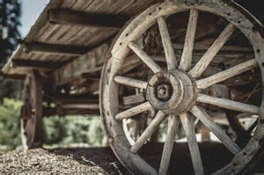
Psalm 2:1-12
Daniel 2:31-35
Isaiah 2:1-4
Acts 2. Hub of the Bible
Joel 2:28-32
Col. 1:13

Slide 5
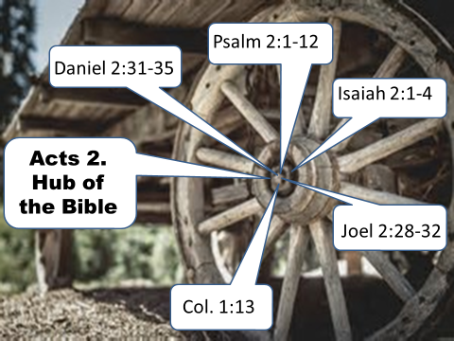
(Daniel 2:31-35) "You, O king, were watching; and behold, a great image! This great image, whose splendor was excellent, stood before you; and its form was awesome. 32 "This image's head was of fine gold, its chest and arms of silver, its belly and thighs of bronze,
33 "its legs of iron, its feet partly of iron and partly of clay. 34 "You watched while a stone was cut out without hands, which struck the image on its feet of iron and clay, and broke them in pieces.
35 "Then the iron, the clay, the bronze, the silver, and the gold were crushed together, and became like chaff from the summer threshing floors; the wind carried them away so that no trace of them was found. And the stone that struck the image became a great mountain and filled the whole earth.

Slide 6
Psalm 2:1-12 Why do the nations rage, And the people plot a vain thing? 2 The kings of the earth set themselves, And the rulers take counsel together, Against the LORD and against His Anointed, saying, 3 "Let us break Their bonds in pieces And cast away Their cords from us."
4 He who sits in the heavens shall laugh; The Lord shall hold them in derision.5 Then He shall speak to them in His wrath, And distress them in His deep displeasure:6 "Yet I have set My King On My holy hill of Zion."
7 "I will declare the decree: The LORD has said to Me, 'You are My Son, Today I have begotten You. 8 Ask of Me, and I will give You The nations for Your inheritance, And the ends of the earth for Your possession.9 You shall break them with a rod of iron; You shall dash them to pieces like a potter's vessel.'"
10 Now therefore, be wise, O kings; Be instructed, you judges of the earth.11 Serve the LORD with fear, And rejoice with trembling. 12 Kiss the Son, lest He be angry, And you perish in the way, When His wrath is kindled but a little. Blessed are all those who put their trust in Him.

Slide 7
Isaiah 2:1-4 The word that Isaiah the son of Amoz saw concerning Judah and Jerusalem. 2 Now it shall come to pass in the latter days That the mountain of the LORD'S house Shall be established on the top of the mountains, And shall be exalted above the hills; And all nations shall flow to it.
3 Many people shall come and say, "Come, and let us go up to the mountain of the LORD, To the house of the God of Jacob; He will teach us His ways, And we shall walk in His paths." For out of Zion shall go forth the law, And the word of the LORD from Jerusalem. 4 He shall judge between the nations, And rebuke many people; They shall beat their swords into plowshares, And their spears into pruning hooks; Nation shall not lift up sword against nation, Neither shall they learn war anymore.

Slide 8
Joel 2:28-32 "And it shall come to pass afterward That I will pour out My Spirit on all flesh; Your sons and your daughters shall prophesy, Your old men shall dream dreams, Your young men shall see visions.
29 And also on My menservants and on My maidservants I will pour out My Spirit in those days.30 "And I will show wonders in the heavens and in the earth: Blood and fire and pillars of smoke.
31 The sun shall be turned into darkness, And the moon into blood, Before the coming of the great and awesome day of the LORD. 32 And it shall come to pass That whoever calls on the name of the LORD Shall be saved. For in Mount Zion and in Jerusalem there shall be deliverance, As the LORD has said, Among the remnant whom the LORD calls.

Slide 9
Col. 1:13 He has delivered us from the power of darkness and
conveyed us into
the kingdom of the Son of His love,

Slide 10
Daniel 2:44 "And in the days of these kings the God of heaven will set up
a kingdom which shall never be destroyed; and the kingdom shall not be left to other people; it shall break in pieces and consume all these kingdoms, and it shall stand forever.
Mark 9:1 And He said to them, "Assuredly, I say to you that there are
some standing here who will not taste death till they see the kingdom of God present with power."

Slide 11
Matt. 16:16 Simon Peter answered and said, "You are the Christ, the Son of the living God." 17 Jesus answered and said to him, "Blessed are you, Simon Bar-Jonah, for flesh and blood has not revealed this to you, but My Father who is in heaven.
18 "And I also say to you that you are Peter, and on this rock I will build My church, and the gates of Hades shall not prevail against it.
19 "And I will give you the keys of the kingdom of heaven, and whatever you bind on earth will be bound in heaven, and whatever you loose on earth will be loosed in heaven."

Slide 12
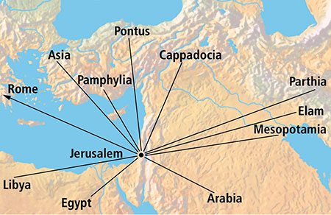
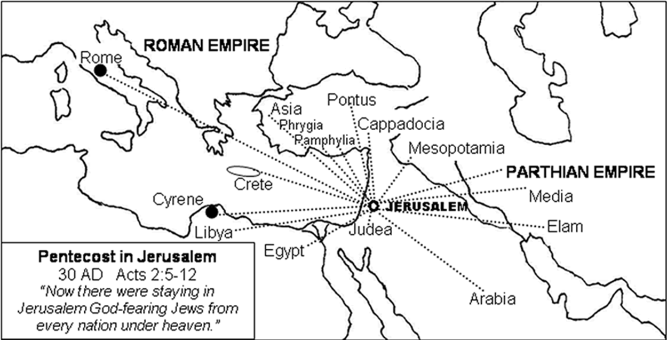
From every nation under heaven.

Slide 13
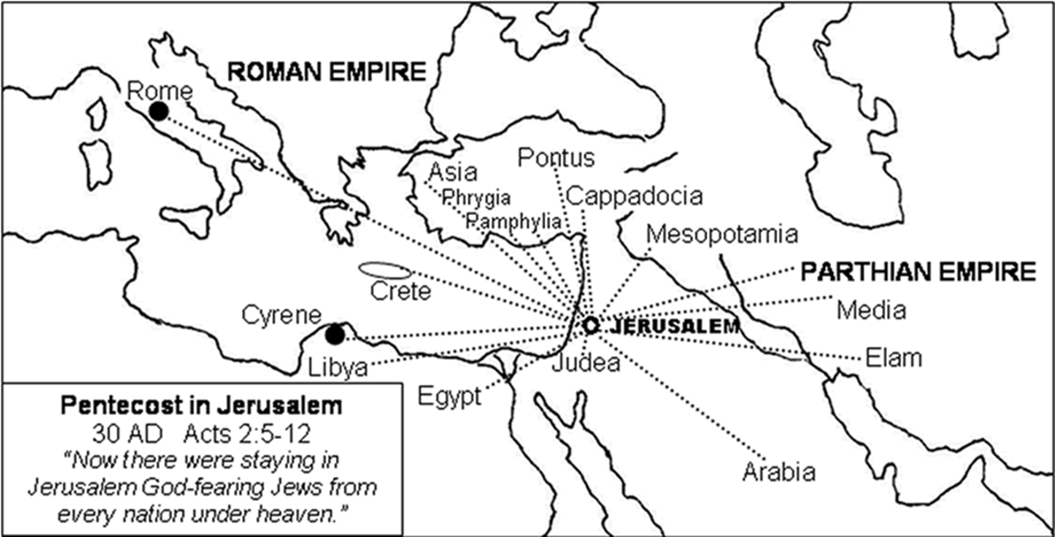
1. Jesus said “Go and make disciples of all nations.” Matt28:19
2. Men came from every nation under heaven to Jerusalem.
Acts 2:5-12
3. They were all scattered from Jerusalem, except the apostles.
Acts 8:1
4. Gospel was preached to every creature under heaven.
Col. 1:23

Slide 14
Pentecost … This was one of the three principal feasts of the Jews (2 Chr. 8:12, 13), the others being Passover and Tabernacles. This feast was known by several names: “Firstfruits,” “Harvest Festival,” “Feast of Weeks” (Lev. 23:15f), and “Pentecost,” as here.
The last two of these names derived from the time it was held, which was fifty days after the first sabbath after the beginning of Passover, “Pentecost” meaning “fiftieth.”
Also, since fifty days were exactly seven weeks, counting the first and last Sundays inclusively, this led to the name “Feast of Weeks.”

Slide 15
With the giving of the law on Sinai, three thousand souls through disobedience died on the day the Law came.
In contrast of three thousand souls were saved through obedience at Pentecost.
Ex. 32:26 Then Moses stood in the gate of the camp, and said, Who is on the LORD'S side? let him come unto me. And all the sons of Levi gathered themselves together unto him.
27 And he said unto them, Thus saith the LORD God of Israel, Put every man his sword by his side, and go in and out from gate to gate throughout the camp, and slay every man his brother, and every man his companion, and every man his neighbour.
28 And the children of Levi did according to the word of Moses: and there fell of the people that day about three thousand men.
Acts 2:41 Then they that gladly received his word were baptized: and the same day there were added unto them about three thousand souls.

Slide 16
A few things to note…
God’s choice of this day for the beginning of the church:
As Jesus was crucified at a great Jewish festival, it was appropriate that he should have been glorified at another;
Pentecost was the next after the Passover;
It was the anniversary of the giving of the Law;
The firstfruits were offered on Pentecost, and it was proper that the firstfruits of the gospel should come unto God on that occasion;
Millions of people were in Jerusalem for that occasion; and
Most importantly of all, perhaps, by its falling upon the first day of the week, it coincided in that particular with the resurrection of Christ, and was thus of major importance in certifying The first day of the week as the day of the Christian assemblies.

Slide 17
The spectacular events here are suggestive of the wonders that attended the giving of the Law (Exo. 19:16f), such as the loud trumpet, the smoking mountain, the terrible earthquake, the thick cloud, and Jehovah descending upon Sinai in fire.
Wind … fire … There was no wind, but the sound of a mighty wind; and no fire, but tongues as of fire, at Pentecost.
Despite this, wind and fire are both typical and suggestive of the Holy Spirit.

Slide 18
The Spirit is typified by the wind in that:
it is gentle;
it is powerful;
it is invisible (John 3:8);
it is the “breath” of life itself.
Fire typifies the Holy Spirit in that:
it gives light;
it provides warmth;
it purifies; and
it is an emblem of God himself (Heb. 12:29), and in this latter quality standing for the judgment of God against wickedness.

Slide 19
Note
The classical evaluation of any public address must take account of:
the occasion,
the speaker,
the subject matter, and
the results; and by any or all of these criteria,

Slide 20
Peter’s address recorded here must be hailed as the most wonderful ever given.
It was the birthday of the New Covenant, the official emergence of the kingdom of God among men.
That occasion was the precise moment toward which all the prophecies for thousands of years had pointed. The “new creation” was wrought that day.

Slide 21
And…Never did mortal lips announce in so brief a space so many facts of import to the hearers. We might challenge the world to find a parallel to it in the speeches of orators, or songs of poets.
There is not such a thunderbolt in all the burdens of the prophets of Israel, or among the voices which thunder in the Revelation.

Slide 22
In the last days … This refers to the Christian dispensation then beginning. The same thought occurs often in the New Testament. Note such passages as Hebrews 1:2; 1 Peter 1:20, and 1 John 2:18. The day of Pentecost, therefore, ushered in the “last days”; but the meaning is compound.
Those were the last days in the sense of this being the final dispensation of God’s grace to men, the same thought appearing in Mark 12:6.
Those were the last days in the sense that Israel’s day of grace was running short. Their long and repeated rebellions against God were soon to culminate and become final in their rejection of Christ.

Slide 23
(3)Those were last days in the sense that Jerusalem, the temple, and the Jewish state would be utterly destroyed before that generation died (in 70 A.D.).
(4) Those were the last days in the sense that the prophecies of Jeremiah (Jer. 31:31–35) and others of a new covenant were fulfilled in the preaching of the gospel.

Slide 24
So…The last days” began with Christ’s first advent and will end with the second advent. They are the days during which the age to come overlaps the present age; hence the assurance with which Peter could quote the words of Joel and declare, “This is that.”

Slide 25
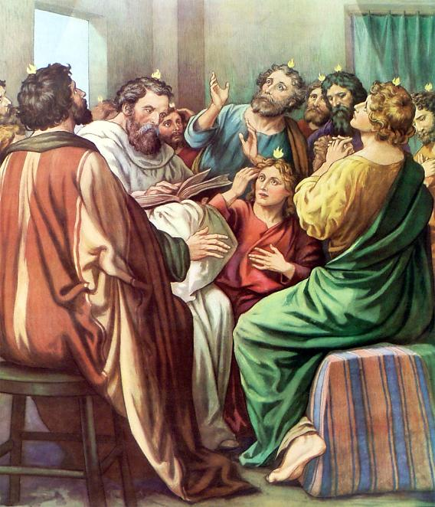
CHAPTER 2
¹And when the day of Pentecost was fully come, they were all with one accord in one place.
² And suddenly there came a sound from heaven as of a rushing mighty wind, and it filled all the house where they were sitting.
The day of Pentecost was the fiftieth day after the Sabbath of the Passover week. All male Jews were required to be present at the temple where offerings were made of the first fruits of the wheat harvest.
They refers to the apostles only not to the 120 disciples.

Slide 26
Those assembled and filled with the Holy Spirit were not the one hundred and twenty
disciples mentioned in a parenthesis in the previous chapter, but the twelve apostles. This is made certain by following the rules of grammar (a pronoun must agree with its nearest antecedent). Notice the connection between the first verse of this chapter and the last of the preceding. Taken together they read as follows:
“And they gave lots for them, and the lot fell upon Matthias; and he was numbered with the eleven apostles. And when the day of Pentecost was fully come, they were all together in one place.”

Slide 27
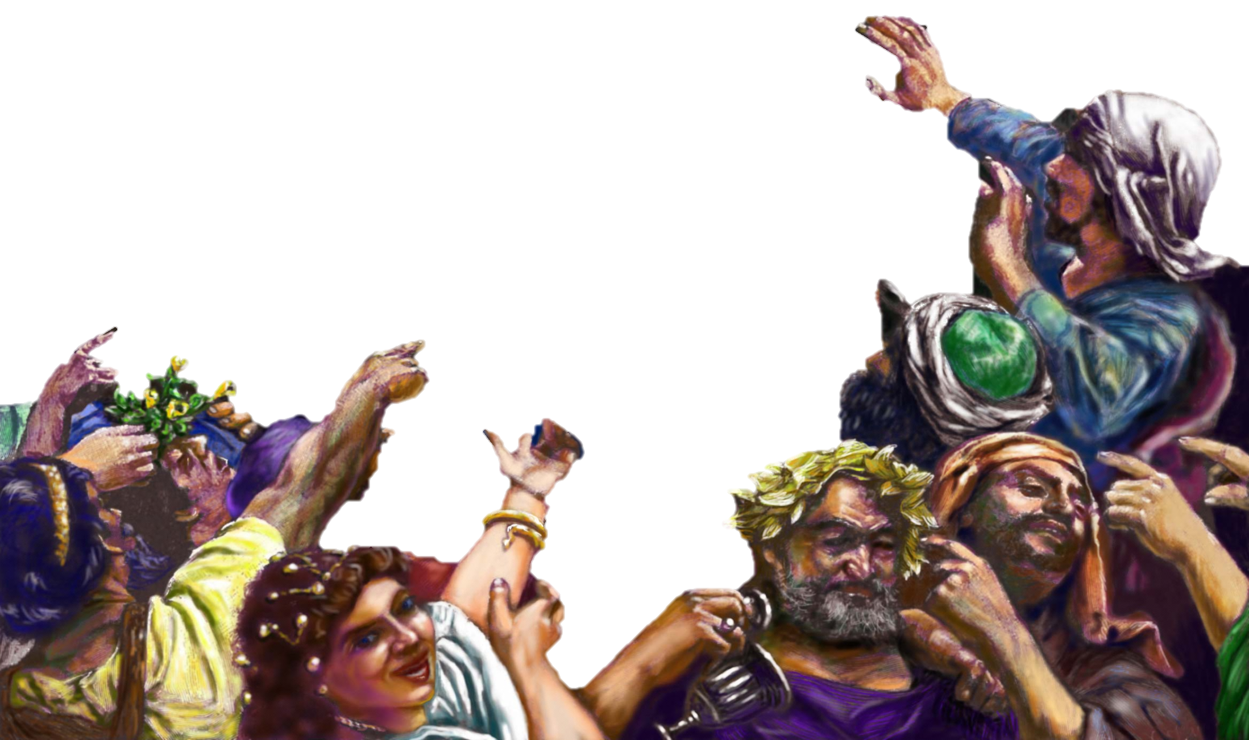
CHAPTER 2
“¹²And they were all amazed, and were in doubt, saying one to another, What meaneth this? ¹³Others mocking said, These men are full of new wine.”

Slide 28
The KINGDOM would come with POWER. The POWER would come when the HOLY SPIRIT came. Therefore, the KINGDOM came when the HOLY SPIRIT came.
HOW WE KNOW WHEN
THE KINGDOM CAME
Mark 9:1
“And he said unto them, Verily I say unto you, That there be some of them that stand here, which shall not taste of death, till they have seen the kingdom of God come with power. “
Mark 9:1
“And he said unto them, Verily I say unto you, That there be some of them that stand here, which shall not taste of death, till they have seen the kingdom of God come with power. “
Acts 1:8
“But ye shall receive power, after that the Holy Ghost is come upon you: and ye shall be witnesses unto me both in Jerusalem, and in all Judaea, and in Samaria, and unto the uttermost part of the earth.”
Acts 2:1-4
“¹And when the day of Pentecost was fully come, they were all with one accord in one place. ² And suddenly there came a sound from heaven as of a rushing mighty wind, and it filled all the house where they were sitting. ³ And there appeared unto them cloven tongues like as of fire, and it sat upon each of them. ⁴And they were all filled with the Holy Ghost, and began to speak with other tongues, as the Spirit gave them utterance.”

Slide 29
The KINGDOM would come with POWER. The POWER would come when the HOLY SPIRIT came. Therefore, the KINGDOM came when the HOLY SPIRIT came.
HOW WE KNOW WHEN
THE KINGDOM CAME
Acts 1:8
“But ye shall receive power, after that the Holy Ghost is come upon you: and ye shall be witnesses unto me both in Jerusalem, and in all Judaea, and in Samaria, and unto the uttermost part of the earth.”
Mark 9:1
“And he said unto them, Verily I say unto you, That there be some of them that stand here, which shall not taste of death, till they have seen the kingdom of God come with power. “
Acts 1:8
“But ye shall receive power, after that the Holy Ghost is come upon you: and ye shall be witnesses unto me both in Jerusalem, and in all Judaea, and in Samaria, and unto the uttermost part of the earth.”
Acts 2:1-4
“¹And when the day of Pentecost was fully come, they were all with one accord in one place. ² And suddenly there came a sound from heaven as of a rushing mighty wind, and it filled all the house where they were sitting. ³ And there appeared unto them cloven tongues like as of fire, and it sat upon each of them. ⁴And they were all filled with the Holy Ghost, and began to speak with other tongues, as the Spirit gave them utterance.”

Slide 30
The KINGDOM would come with POWER. The POWER would come when the HOLY SPIRIT came. Therefore, the KINGDOM came when the HOLY SPIRIT came.
Acts 2:1-4
“¹And when the day of Pentecost was fully come, they were all with one accord in one place. ²And suddenly there came a sound from heaven as of a rushing mighty wind, and it filled all the house where they were sitting. ³And there appeared unto them cloven tongues like as of fire, and it sat upon each of them. ⁴And they were all filled with the Holy Ghost, and began to speak with other tongues, as the Spirit gave them utterance.”
HOW WE KNOW WHEN
THE KINGDOM CAME
Mark 9:1
“And he said unto them, Verily I say unto you, That there be some of them that stand here, which shall not taste of death, till they have seen the kingdom of God come with power. “
Acts 1:8
“But ye shall receive power, after that the Holy Ghost is come upon you: and ye shall be witnesses unto me both in Jerusalem, and in all Judaea, and in Samaria, and unto the uttermost part of the earth.”
Acts 2:1-4
“¹And when the day of Pentecost was fully come, they were all with one accord in one place. ² And suddenly there came a sound from heaven as of a rushing mighty wind, and it filled all the house where they were sitting. ³ And there appeared unto them cloven tongues like as of fire, and it sat upon each of them. ⁴And they were all filled with the Holy Ghost, and began to speak with other tongues, as the Spirit gave them utterance.”

Slide 31
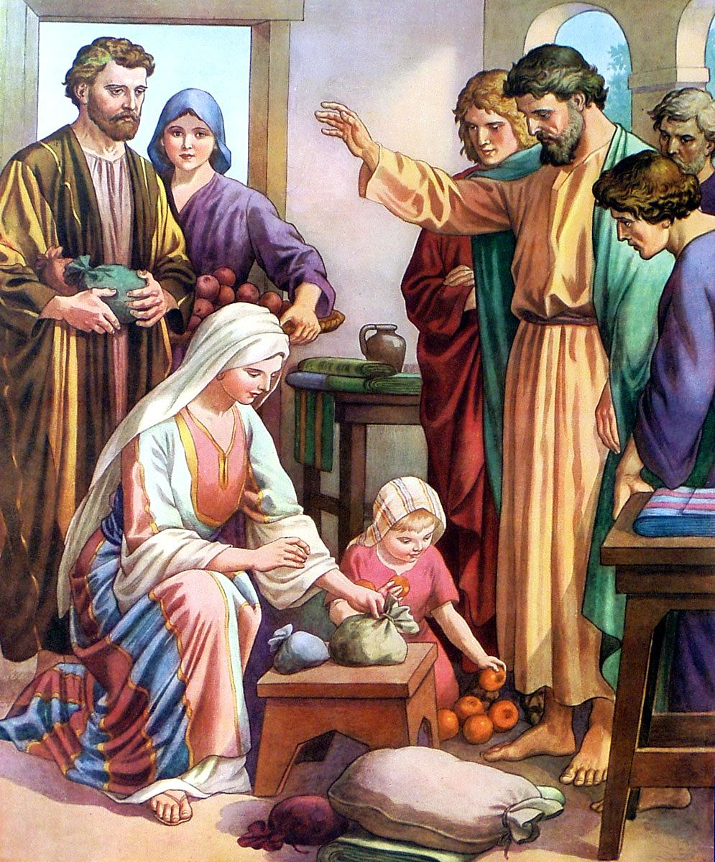
CHAPTER 2
“⁴⁴And all that believed were together, and had all things common; ⁴⁵And sold their possessions and goods, and parted them to all men, as every man had need. ⁴⁶And they, continuing daily with one accord in the temple, and breaking bread from house to house, did eat their meat with gladness and singleness of heart, ⁴⁷Praising God, and having favour with all the people. And the Lord added to the church daily such as should be saved.”

Slide 32
1. The establishment of the Church.
2. The descent of the Holy Spirit, and the gospel that came with it.
3. The beginning of the reign of Christ on David's spiritual throne, the only throne he will occupy.
4. The first complete divine answer to the question, "What must I do to be saved?"

Slide 33
Acts 2. A three point sermon.
The Sermon
1.Jesus is the messiah
2.You killed Him.
3.God raised Him up. (not stolen)
The Evidence:
1.David. (respected prophet and king)
2.We are witnesses. (Happened right here in Jerusalem)
3.The Holy Spirit (you both see and hear)
4.God made Jesus both Lord and Christ.
The Results
Those that gladly received the word were baptized.
Matt.27:50-53

Slide 34
CASE STUDIES OF CONVERSION
Acts | Preaching | Believed | Repented | Confessed | Baptized | Saved
2:22-41 | Pentecost |  | vv. 37-38 |  | vv. 38-41 | Remission Of Sins
8:12 | Samaritans | v. 12 |  |  | v. 12 | Believed
8:13 | Simon | v. 13 |  |  | v. 13
8:35-39 | Eunuch | vv. 36-37 |  | v. 37 | v. 38 | Rejoiced
9:17-18 | Saul |  |  |  | v. 18 | Sins Washed Away
10:34-48 | Cornelius | v. 43 |  |  | v. 48 | Remission Of Sins
16:13 | Lydia | v. 14 |  |  | v. 15
16:31-34 | The Jailer | v. 31 |  |  | v. 33 | Rejoiced
18:8 | Corinthians | v. 8 |  |  | v. 8
19:5 | Ephesians |  |  |  | v. 5
Baptized

Slide 35
Are You A New Testament Christian?
Hear the Gospel (Rom.10:14).
Believe the Gospel (Heb. 11:6).
Repent of Sins (Acts 3:19).
Confess Christ (Rom.10:9).
Be Baptized Into Christ (1 Cor.12:13).
1 Timothy 4:16
“Take heed unto thyself, and unto the doctrine; continue in them: for in doing this thou shalt both save thyself, and them that hear thee.”

Slide 36
Are you willing to do what is right?
Are you willing to do what is right, right now?
Are you willing to let the Bible determine what is right?

