Slide 1
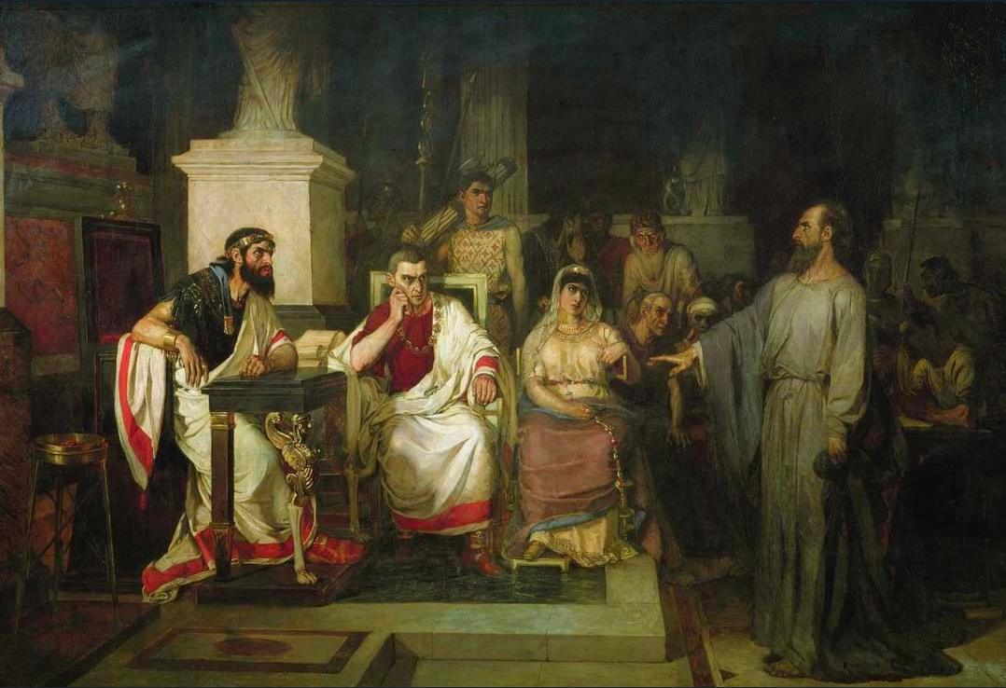
Almost And All Together Such As I Am Acts 26:29

Slide 2
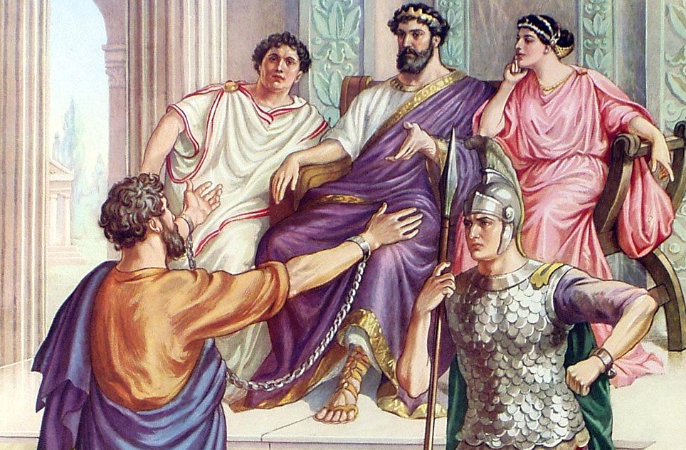
CHAPTER 26
“²⁸Then Agrippa said unto Paul, Almost thou persuadest me to be a Christian.”

Slide 3
CHAPTER 26
“²⁹And Paul said,
I would to God, that not only thou, but also all that hear me this day, were both almost, and altogether such as I am, except these bonds.”
CHAPTER 26
“³²Then said Agrippa unto Festus, This man might have been set at liberty, if he had not appealed unto Caesar.”
CHAPTER 26
“³⁰And when he had thus spoken, the king rose up, and the governor, and Bernice, and they that sat with them: ³¹And when they were gone aside, they talked between themselves, saying, This man doeth nothing worthy of death or of bonds.”

Slide 4
Almost And All Together Such As I Am Acts 26:29
Acts 26:28 Then Agrippa said to Paul, "You almost persuade me to become a Christian." 29 And Paul said, "I would to God that not only you, but also all who hear me today, might become both almost and altogether such as I am, except for these chains."

Slide 5
Almost And All Together Such As I Am Acts 26:29
1.We should be a Christian like Paul - In name
Acts 11:26 And when he had found him, he brought him to Antioch. So it was that for a whole year they assembled with the church and taught a great many people. And the disciples were first called Christians in Antioch.
Paul and Barnabas present on that occasion (Luke writes). Enemies did not come up with this name. Apostles did not. God prophesied this new name in Isaiah 62:2.
Friends, One name is not as good as another.
It does make a difference what name we wear.
Paul Persuaded people to become Christians
(Paul to Agrippa Acts 26:28)

Slide 6
Almost And All Together Such As I Am Acts 26:29
Christianity has never been a religion of force but of persuasion.
Paul was in the persuading business. We need to be in that business.
Some people like to argue about the Bible and they don’t even read it or study it.
We need to read God’s word
We need to study God’s word
We need to share God’s word
We need to persuade people to become Christians

Slide 7
Almost And All Together Such As I Am Acts 26:29
The Name Christian……
James 2:5-7 Listen, my beloved brethren: Has God not chosen the poor of this world to be rich in faith and heirs of the kingdom which He promised to those who love Him? 6 But you have dishonored the poor man. Do not the rich oppress you and drag you into the courts? 7 Do they not blaspheme that noble name by which you are called?
1 Peter 4:16 Yet if anyone suffers as a Christian, let him not be ashamed, but let him glorify God in this matter.

Slide 8
Almost And All Together Such As I Am Acts 26:29
When Paul wrote the Corinthian brethren, it bothered him that they were calling themselves after men…
1 Cor. 1:11 For it has been declared to me concerning you, my brethren, by those of Chloe's household, that there are contentions among you. 12 Now I say this, that each of you says, "I am of Paul," or "I am of Apollos," or "I am of Cephas," or "I am of Christ." 13 Is Christ divided? Was Paul crucified for you? Or were you baptized in the name of Paul?
Don’t have a right to wear the name unless that person was crucified for you.
They had been baptized by the authority of Christ and should wear the name of Christ.

Slide 9
Almost And All Together Such As I Am Acts 26:29
2. We should be a Christian like Paul - In FACT
He obeyed the same gospel as other people did
He was not saved because he saw Christ on the road. He had to obey words – facts. H B R C B
Paul did all of these. Acts 9:18 Immediately there fell from his eyes something like scales, and he received his sight at once; and he arose and was baptized.

Slide 10
Almost And All Together Such As I Am Acts 26:29
Rom. 6:3 Or do you not know that as many of us as were baptized into Christ Jesus were baptized into His death?
as many of US as were baptized
We need to Obey the same gospel.
(One of the reasons people aren’t obeying the gospel today is because they are not hearing the gospel. They are hearing everything except the gospel.)

Slide 11
Almost And All Together Such As I Am Acts 26:29
Paul Did not become a Christian by raising his hand, saying the sinner’s prayer, or by Jesus appearing to him.
We need to be a Christian in Fact – just like Paul.
John 3:3 Jesus answered and said to him, "Most assuredly, I say to you, unless one is born again, he cannot see the kingdom of God.“
Rom. 6:17-18 But God be thanked that though you were slaves of sin, yet you obeyed from the heart that form of doctrine to which you were delivered. 18 And having been set free from sin, you became slaves of righteousness.

Slide 12
Almost And All Together Such As I Am Acts 26:29
Not by grace only, faith only, prayer only, but by obedience to the gospel.
Did we become Christians the same way Paul did. By hearing the same facts. By obeying the same gospel. WE need to be a Christian like Paul in that manner.

Slide 13
Almost And All Together Such As I Am Acts 26:29
3. We should be a Christian like Paul - In LOCATION
Locations
Damascus Antioch Salamis Perga
Iconium Lystra Derbe Syria
Troas Samothrace Philippi Thessalonica Berea Athens Corinth
Ephesus Caesarea Miletus Tyre
Jerusalem

Slide 14
Almost And All Together Such As I Am Acts 26:29
Paul was A Christian at home – away from home. We should be too.
A Christian on the job – off the job
(Business / trips)
Campus
Military service
On Vacation!!!!
If a person is not going to be a Christian Everywhere, it is doubtful he will be a Christian anywhere. (24/7)
Paul took his Christianity with him where ever he went.
Are we a Christian like Paul anywhere and everywhere. Do we act the same wherever we are and the same way no matter who we are with?

Slide 15
Almost And All Together Such As I Am Acts 26:29
4. We should be a Christian like Paul - In Suffering
In trial, in tribulation
Damascus –they tried to kill him. Disciples had to let him down by the walls of the city to escape. People he knew from Jerusalem tried to kill him. they followed him on his trips – seeking to kill him.
Stoned and left for dead at Lystra.
Gal.6:17 From now on let no one trouble me, for I bear in my body the marks of the Lord Jesus.

Slide 16
Almost And All Together Such As I Am Acts 26:29
2 Tim. 2:10 Therefore I endure all things for the sake of the elect, that they also may obtain the salvation which is in Christ Jesus with eternal glory.
2Tim 3:6 For I am already being poured out as a drink offering, and the time of my departure is at hand.

Slide 17
Almost And All Together Such As I Am Acts 26:29
2 Cor. 11:24-28 From the Jews five times I received forty stripes minus one. 25 Three times I was beaten with rods; once I was stoned; three times I was shipwrecked; a night and a day I have been in the deep; 26 in journeys often, in perils of waters, in perils of robbers, in perils of my own countrymen, in perils of the Gentiles, in perils in the city, in perils in the wilderness, in perils in the sea, in perils among false brethren; 27 in weariness and toil, in sleeplessness often, in hunger and thirst, in fastings often, in cold and nakedness--28 besides the other things, what comes upon me daily: my deep concern for all the churches.
Are we willing to suffer as a Christian like Paul? Are we willing to carry the cross like Paul? Do we have the same attitude as Paul had when trials and tribulation comes our way?

Slide 18
Almost And All Together Such As I Am Acts 26:29
5. We should be a Christian like Paul - In ZEAL
Preached in Damascus shortly after his conversion.
Paul was Never lukewarm, never a coward, never apathetic. How about us?
A man of great zeal
Acts 9:20 Immediately he preached the Christ in the synagogues, that He is the Son of God.

Slide 19
Almost And All Together Such As I Am Acts 26:29
Zealous on 3 missionary journeys
Zealous as a preacher
2Tim 4:2 Preach the word! Be ready in season and out of season. Convince, rebuke, exhort, with all longsuffering and teaching. (7 things)
Zealous as writer. (wrote half of NT) (1Co 2:1 And I, brethren, when I came to you, came not with excellency of speech or of wisdom, declaring unto you the testimony of God.) (Moses)

Slide 20
Almost And All Together Such As I Am Acts 26:29
Zealous in worship. (stay 7 days to assemble with saints) (Luke & companions with him)
Zealous in prayer life (prayers in letters – by name)
Zealous in training young men to take over.
(brother Allen – give talk)
(brother Smith- you need to be in that elders class)
Who is going to take over when I am gone? When you are gone?

Slide 21
Almost And All Together Such As I Am Acts 26:29
Where did Paul learn to be Zealous?
He didn’t have the NT to read to tell him to be zealous.

Slide 22
Deut. 6:5 "You shall love the LORD your God with all your heart, with all your soul, and with
all your strength.
6 "And these words which I command you today
shall be in your heart.
7 "You shall teach them diligently to your children, and shall talk of them when you sit in your house, when you walk by the way, when you lie down, and when you rise up.

Slide 23
Almost And All Together Such As I Am Acts 26:29
Are we zealous like Paul? Are we on fire for the Lord?

Slide 24
When You
Prioritize
All the
Important Stuff
Gets done
Joshua 1:8 "This Book of the Law shall not depart from your mouth, but you shall meditate in it day and night, that you may observe to do according to all that is written in it. For then you will make your way prosperous, and then you will have good success.

Slide 25
Almost And All Together Such As I Am Acts 26:29
6. We should be a Christian like Paul - A Christian till the end
Not like John mark, not like Demas
Begin well- continue well - end well
2 Timothy 4:5 But you be watchful in all things, endure afflictions, do the work of an evangelist, fulfill your ministry.
6 For I am already being poured out as a drink offering, and the time of my departure is at hand.
7 I have fought the good fight, I have finished the race, I have kept the faith.
8 Finally, there is laid up for me the crown of righteousness, which the Lord, the righteous Judge, will give to me on that Day, and not to me only but also to all who have loved His appearing.

Slide 26
Almost And All Together Such As I Am Acts 26:29
Roman - Fought
Greco – Finished – Olympic games
Jewish – Faith – loyalty to God

Slide 27
Almost And All Together Such As I Am Acts 26:29
Friend, are we a Christian like Paul, till the end? Some people think that since they have been baptized, and since they go to a building every Sunday that has Church of Christ over the door, they think that they are going to heaven.
They don’t understand what the race is all about. Baptism is our entrance ticket to run the race…then we’ve gotta keep on running till the end. We can sit down. We can’t be spectators. We don’t retire from the Lord’s work.

Slide 28
Almost And All Together Such As I Am Acts 26:29
Acts 26:28 Then Agrippa said to Paul, "You almost persuade me to become a Christian." 29 And Paul said, "I would to God that not only you, but also all who hear me today, might become both almost and altogether such as I am, except for these chains."
1. We should be a Christian like Paul - In name
2. We should be a Christian like Paul - In FACT
3. We should be a Christian like Paul - In LOCATION
4. We should be a Christian like Paul - In Suffering
5. We should be a Christian like Paul - In ZEAL
6. We should be a Christian like Paul - A Christian till the end

