Slide 1
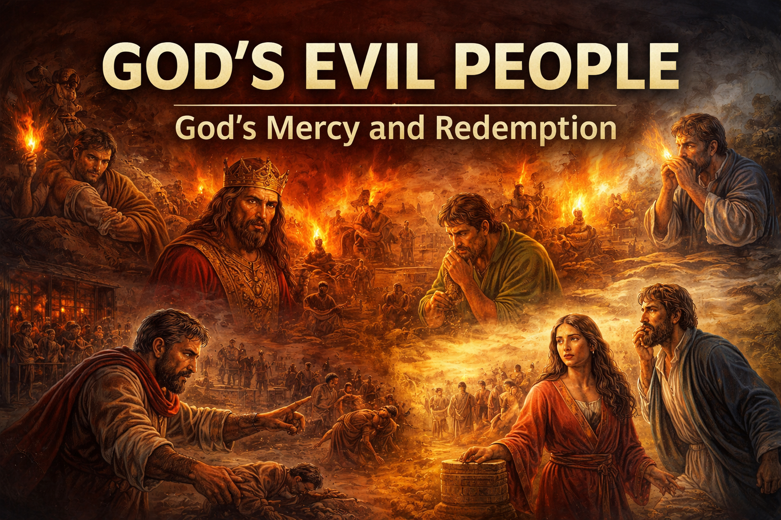
Notes:
God's evil people. I've had the idea for this sermon for a few years now, my younger brother gave a sermon that sparked this idea. Ok, so the Bible is full of people who failed and sinned, people that if we judged them we'd condemn them, yet God forgave and used them in his kingdom. The message this morning is simple, no one is too far gone.

Slide 2
God’s Love
Romans 5:6
⁶ For when we were still without strength, in due time Christ died for the ungodly.
Notes:
Let's look at God's view toward humans (Romans 5:6) God's son died for sinners, the ungodly.

Slide 3
God’s Love
Romans 5:8
⁸ But God demonstrates His own love toward us, in that while we were still sinners, Christ died for us.
Notes:
(verse 8) His son's death shows us his love for us. I'm about to have a son in a couple months and I can say with almost full certainty that I wouldn't willingly have him killed for you, even worse though people that aren't even obedient to me. God has way more love for you than humans do to each other, I don't think it's something we can understand. So let's look at the bad people in God's kingdom

Slide 4
Moses – From Fugitive to Leader
Exodus 2:11-12, 15
¹¹ Now it came to pass in those days, when Moses was grown, that he went out to his brethren and looked at their burdens. And he saw an Egyptian beating a Hebrew, one of his brethren. ¹² So he looked this way and that way, and when he saw no one, he killed the Egyptian and hid him in the sand.
¹⁵ When Pharaoh heard of this matter, he sought to kill Moses. But Moses fled from the face of Pharaoh and dwelt in the land of Midian; and he sat down by a well.
Notes:
Moses, I'm sure we all know Moses and understand that he was a prominent character in the Old Testament. Well, Moses was a murderer, (Exodus 2:11-12, 15) if you read the beginning of this chapter you'll see that Moses was born a Hebrew but adopted by the Pharoah's daughter, the ruler of the Egyptian people, a higher title than our President. This story reminds me of the crime videos on Youtube that I watch where they track down the killer, especially high profile crimes. So I had AI make the youtube thumbnail.

Slide 5
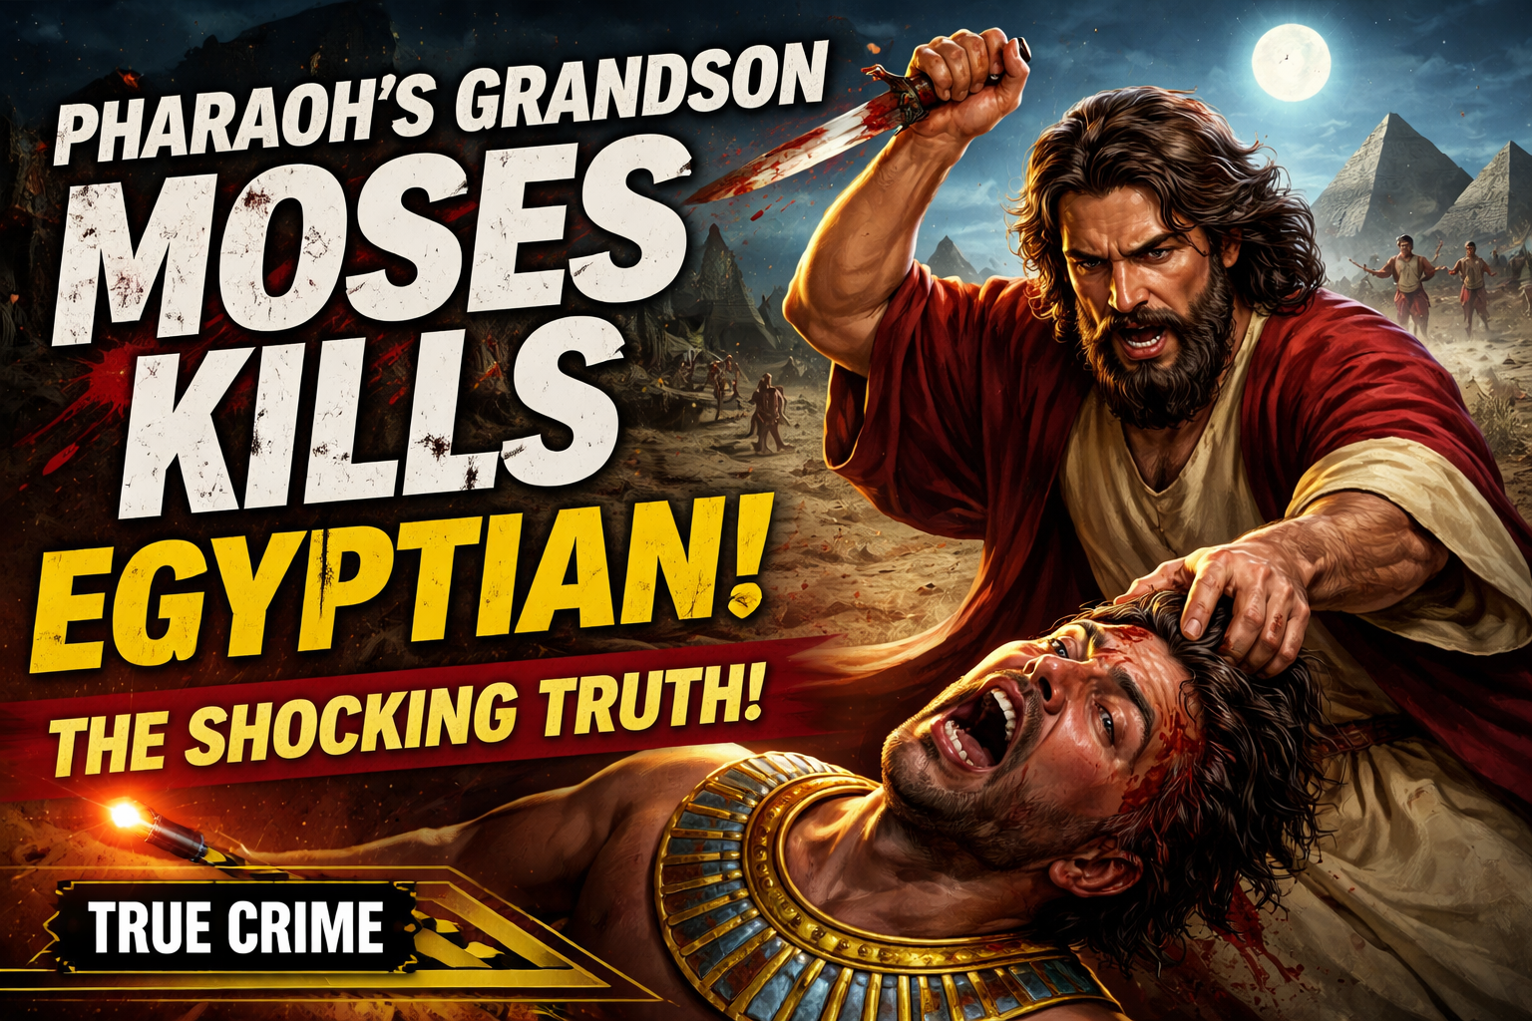
Moses – From Fugitive to Leader
Notes:
Moses looked to see if anyone was watching, killed the Egyptian, buried him, and fled

Slide 6
Moses – From Fugitive to Leader
Exodus 3:10
¹⁰ Come now, therefore, and I will send you to Pharaoh that you may bring My people, the children of Israel, out of Egypt.”
Notes:
Then we go to chapter 3 where God calls out to Moses from the burning bush and instructs him to lead God's people out Egypt (verse 10). This shows that a violent past is not beyond God's purpose and forgiveness.

Slide 7
Manasseh – Radical Forgiveness
2 Kings 21:2, 6, 16
² And he did evil in the sight of the Lord, according to the abominations of the nations whom the Lord had cast out before the children of Israel.
⁶ Also he made his son pass through the fire, practiced soothsaying, used witchcraft, and consulted spiritists and mediums. He did much evil in the sight of the Lord, to provoke Him to anger
¹⁶ Moreover Manasseh shed very much innocent blood, till he had filled Jerusalem from one end to another, besides his sin by which he made Judah sin, in doing evil in the sight of the Lord.
Notes:
Manasseh, the 14th king of Judah, led the nation into idolatry, killed the innocent, and practiced sorcery (2 Kings 21:2,6,16)

Slide 8
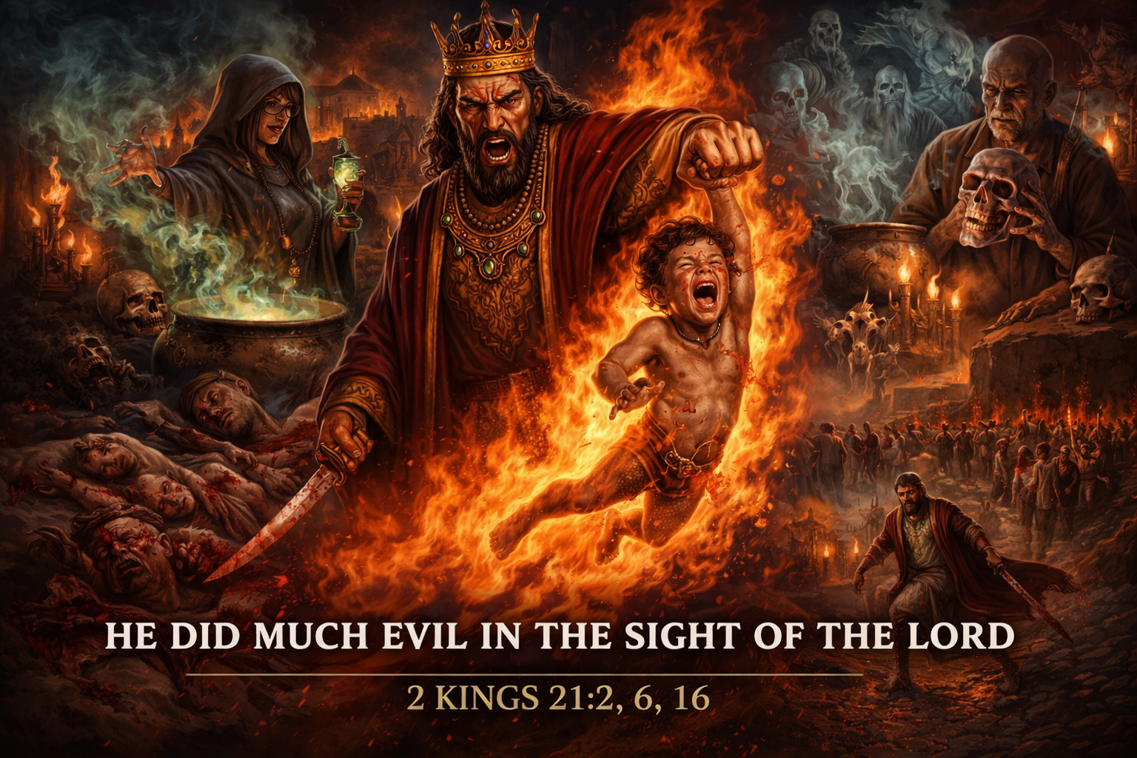
Manasseh – Radical Forgiveness
Notes:
Pretty evil if you ask me, I think all of us here would've said Manasseh is doomed and lost forever. In this photo we can see sorcery, kids being killed, and just evil, not a place that I'd wanna live. Well God brought him down.

Slide 9
Manasseh – Radical Forgiveness
2 Chronicles 33:10-11
¹⁰ And the Lord spoke to Manasseh and his people, but they would not listen. ¹¹ Therefore the Lord brought upon them the captains of the army of the king of Assyria, who took Manasseh with hooks, bound him with bronze fetters, and carried him off to Babylon.
Notes:
(2 chronicles 33:10-11). Hooks would've been actual hooks put thru the nose or lips and attached to a chain. Bronze fetters would be shackles and being bronze they'd be very heavy. very humiliating for a king.

Slide 10
Manasseh – Radical Forgiveness
2 Chronicles 33:12-13
¹² Now when he was in affliction, he implored the Lord his God, and humbled himself greatly before the God of his fathers, ¹³ and prayed to Him; and He received his entreaty, heard his supplication, and brought him back to Jerusalem into his kingdom. Then Manasseh knew that the Lord was God.
Notes:
Then we see Manasseh repent. (verses 12-13)

Slide 11
Manasseh – Radical Forgiveness
2 Chronicles 33:15-16
¹⁵ He took away the foreign gods and the idol from the house of the Lord, and all the altars that he had built in the mount of the house of the Lord and in Jerusalem; and he cast them out of the city. ¹⁶ He also repaired the altar of the Lord, sacrificed peace offerings and thank offerings on it, and commanded Judah to serve the Lord God of Israel.
Notes:
And we can also see evidence of his change (verse 15 and 16). Manasseh was a wicked ruler, led the nation into idolatry, practiced sorcery, sacrificed his own children, and shed innocent blood yet when he humbled himself, God forgave him and accepted his repentance. If God could forgive Manasseh, there is nobody in this room beyond the mercy of God.

Slide 12
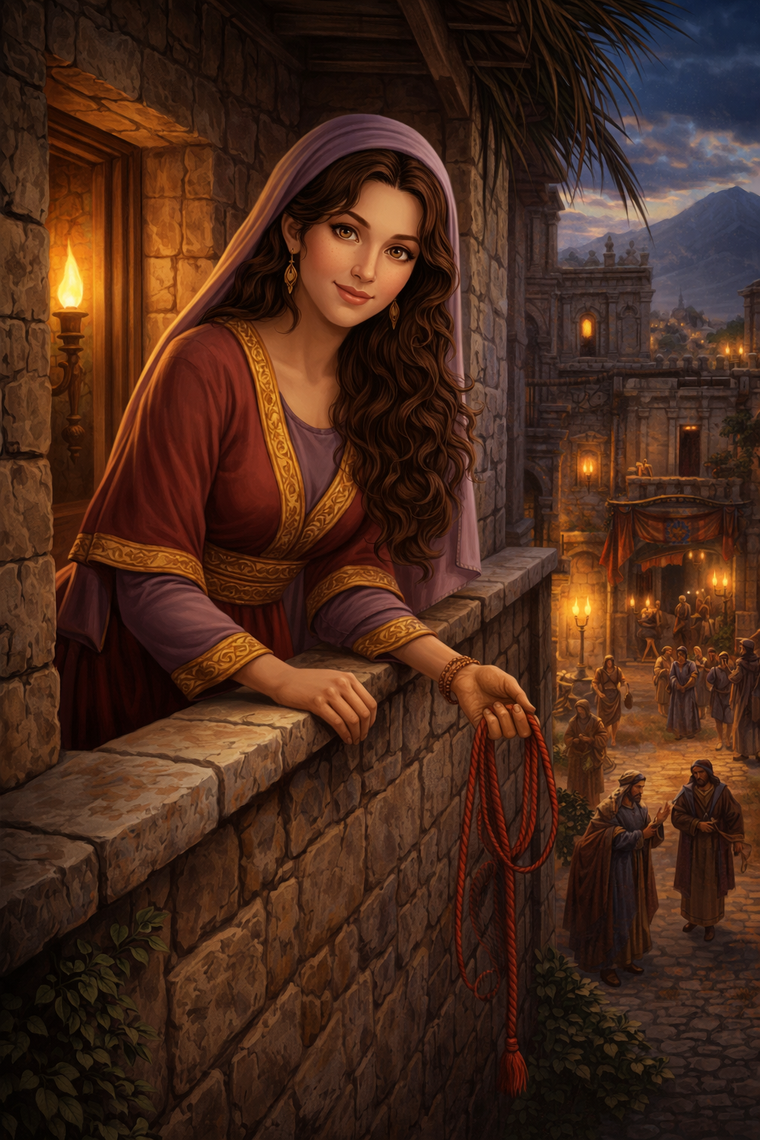
Rahab – From Outsider to Believer
Notes:
Rahab, the prostitute. This is the story about Joshua sending 2 spies out to do some recon on Jericho.

Slide 13
Rahab – From Outsider to Believer
Joshua 2:1
¹Now Joshua the son of Nun sent out two men from Acacia Grove to spy secretly, saying, “Go, view the land, especially Jericho.”
So they went, and came to the house of a harlot named Rahab, and lodged there.
Notes:
(Joshua 2:1). So we are introduced to Rahab, a harlot, also known as a prostitute. So what would a harlot have to do with God,

Slide 14
Rahab – From Outsider to Believer
Joshua 2:8-11
⁸ Now before they lay down, she came up to them on the roof, ⁹ and said to the men: “I know that the Lord has given you the land, that the terror of you has fallen on us, and that all the inhabitants of the land are fainthearted because of you.
Notes:
well she had faith (verses 8-11).

Slide 15
Rahab – From Outsider to Believer
Joshua 2:8-11
¹⁰ For we have heard how the Lord dried up the water of the Red Sea for you when you came out of Egypt, and what you did to the two kings of the Amorites who were on the other side of the Jordan, Sihon and Og, whom you utterly destroyed. ¹¹ And as soon as we heard these things, our hearts melted; neither did there remain any more courage in anyone because of you, for the Lord your God, He is God in heaven above and on earth beneath.
Notes:
(read after verse 11) Rahab believed in the God of Israel before most people in Jericho did.

Slide 16
Rahab – From Outsider to Believer
Joshua 6:25
²⁵ And Joshua spared Rahab the harlot, her father’s household, and all that she had. So she dwells in Israel to this day, because she hid the messengers whom Joshua sent to spy out Jericho.
Notes:
Rahab was spared when Jericho was destroyed (Joshua 6:25)

Slide 17
Rahab – From Outsider to Believer
James 2:25
²⁵ Likewise, was not Rahab the harlot also justified by works when she received the messengers and sent them out another way?
Notes:
Rahab's faith produced action (James 2:25) Rahab, a pagan, a prostitute living in a wicked city was saved because of her faith and action.

Slide 18
Paul – From Persecutor to Apostle
Acts 8:3
³ As for Saul, he made havoc of the church, entering every house, and dragging off men and women, committing them to prison.
Acts 9:1-2
¹Then Saul, still breathing threats and murder against the disciples of the Lord, went to the high priest ² and asked letters from him to the synagogues of Damascus, so that if he found any who were of the Way, whether men or women, he might bring them bound to Jerusalem.
Notes:
Let's move into the New Testament. I think we have to talk about Paul in this lesson. Let's use his original name Saul. Now Saul imprisoned Christians, approved executions (the example we have is the stoning of Stephen), He actively hunted believers and tried to destroy the church (Acts 8:3, Acts 9:1-2, Acts 7:58-8:1)

Slide 19
Paul – From Persecutor to Apostle
Acts 7:58-8:1
⁵⁸ and they cast him out of the city and stoned him. And the witnesses laid down their clothes at the feet of a young man named Saul. ⁵⁹ And they stoned Stephen as he was calling on God and saying, “Lord Jesus, receive my spirit.” ⁶⁰ Then he knelt down and cried out with a loud voice, “Lord, do not charge them with this sin.” And when he had said this, he fell asleep.
¹Now Saul was consenting to his death.

Slide 20
Paul – From Persecutor to Apostle
Acts 26:10-11
¹⁰ This I also did in Jerusalem, and many of the saints I shut up in prison, having received authority from the chief priests; and when they were put to death, I cast my vote against them. ¹¹ And I punished them often in every synagogue and compelled them to blaspheme; and being exceedingly enraged against them, I persecuted them even to foreign cities.
Notes:
Saul didn't even deny any of his actions. (Acts 26:10-11).

Slide 21
Paul – From Persecutor to Apostle
Acts 9:3-6
³ As he journeyed he came near Damascus, and suddenly a light shone around him from heaven. ⁴ Then he fell to the ground, and heard a voice saying to him, “Saul, Saul, why are you persecuting Me?”
⁵ And he said, “Who are You, Lord?”
Then the Lord said, “I am Jesus, whom you are persecuting. It is hard for you to kick against the goads.”
⁶ So he, trembling and astonished, said, “Lord, what do You want me to do?”
Then the Lord said to him, “Arise and go into the city, and you will be told what you must do.”
Notes:
Saul didn't just oppose Christianity, he was trying to wipe it out until he converted. (Acts 9:3-6).

Slide 22
Paul – From Persecutor to Apostle
Acts 9:20
²⁰ Immediately he preached the Christ in the synagogues, that He is the Son of God.
Notes:
He immediately changed when he was convinced that he was wrong (Acts 9:20).

Slide 23
Paul – From Persecutor to Apostle
Acts 13:9
⁹ Then Saul, who also is called Paul, filled with the Holy Spirit, looked intently at him
Notes:
His name changes (Acts 13:9) and he reflects on his transformation

Slide 24
Paul – From Persecutor to Apostle
Galatians 1:13-16
¹³ For you have heard of my former conduct in Judaism, how I persecuted the church of God beyond measure and tried to destroy it. ¹⁴ And I advanced in Judaism beyond many of my contemporaries in my own nation, being more exceedingly zealous for the traditions of my fathers.
¹⁵ But when it pleased God, who separated me from my mother’s womb and called me through His grace, ¹⁶ to reveal His Son in me, that I might preach Him among the Gentiles,

Slide 25
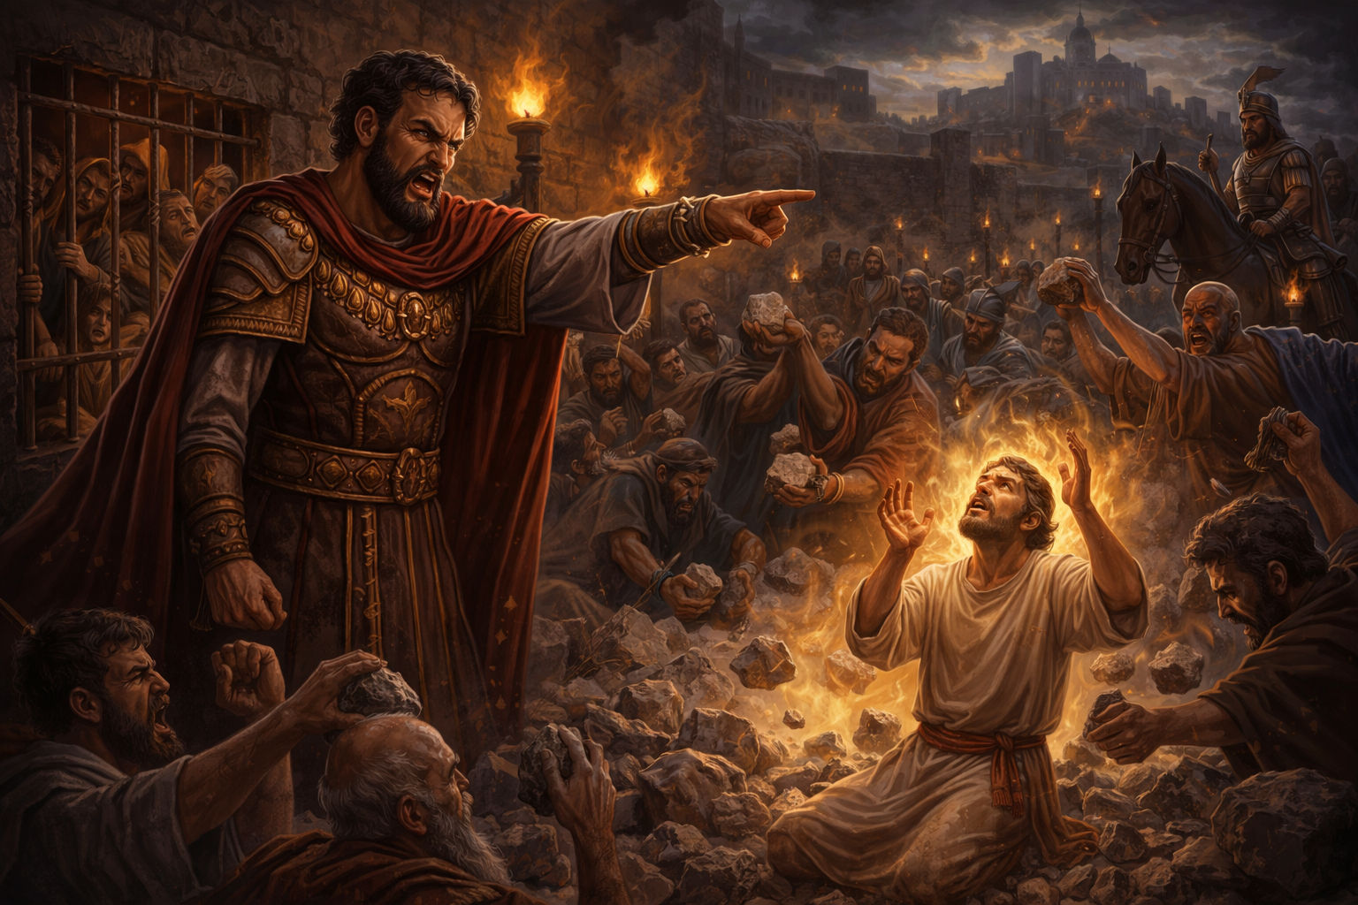
Paul – From Persecutor to Apostle
Notes:
Saul, a violent enemy of Christians, personally confronted by Jesus, to become Paul one of the greatest New Testament characters and writers.

Slide 26
Samaritan Woman – From Shame to Witness
John 4:7-9
⁷ A woman of Samaria came to draw water. Jesus said to her, “Give Me a drink.” ⁸ For His disciples had gone away into the city to buy food.
⁹ Then the woman of Samaria said to Him, “How is it that You, being a Jew, ask a drink from me, a Samaritan woman?” For Jews have no dealings with Samaritans.
Notes:
The Samaritan woman at the well, we aren't gonna read the full passage word for word but we are going to start reading at (John 4:7-9)

Slide 27
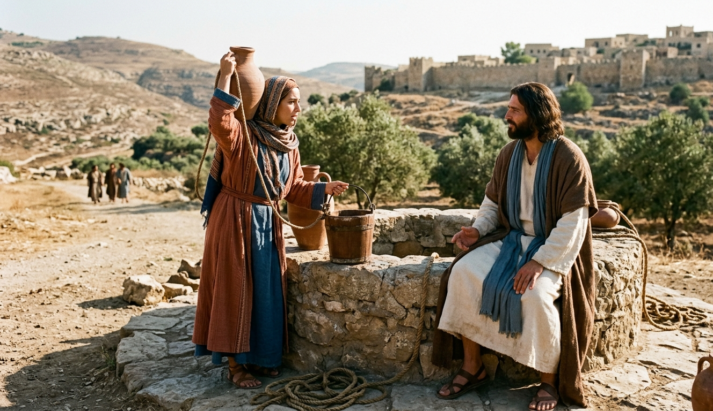
Samaritan Woman – From Shame to Witness
Notes:
This would've been a strange encounter, Jews didn't talk to or like Samaritans. I also believe it would've been against culture for men to openly speak to women like this, 2 boundaries Jesus broke down.

Slide 28
Samaritan Woman – From Shame to Witness
John 4:13-14
¹³ Jesus answered and said to her, “Whoever drinks of this water will thirst again, ¹⁴ but whoever drinks of the water that I shall give him will never thirst. But the water that I shall give him will become in him a fountain of water springing up into everlasting life.”
Notes:
Read on down to (verses 13 and 14). Jesus is talking about spiritual life, not physical water, everlasting life is only available through him.

Slide 29
Samaritan Woman – From Shame to Witness
John 4:16-18
¹⁶ Jesus said to her, “Go, call your husband, and come here.”
¹⁷ The woman answered and said, “I have no husband.”
Jesus said to her, “You have well said, ‘I have no husband,’ ¹⁸ for you have had five husbands, and the one whom you now have is not your husband; in that you spoke truly.”
Notes:
(verses 16-18). Jesus knows her and her past but still engaged with her.

Slide 30
Samaritan Woman – From Shame to Witness
John 4:25-26
²⁵ The woman said to Him, “I know that Messiah is coming” (who is called Christ). “When He comes, He will tell us all things.”
²⁶ Jesus said to her, “I who speak to you am He.”
Notes:
Jesus reveals himself to her (verses 25 and 26).

Slide 31
Samaritan Woman – From Shame to Witness
John 4:28-29
²⁸ The woman then left her waterpot, went her way into the city, and said to the men, ²⁹ “Come, see a Man who told me all things that I ever did. Could this be the Christ?”
Notes:
How does this affect her? She immediately leaves her water jug and tells others about Christ (verses 28 and 29).

Slide 32
Samaritan Woman – From Shame to Witness
John 4:39-42
³⁹ And many of the Samaritans of that city believed in Him because of the word of the woman who testified, “He told me all that I ever did.” ⁴⁰ So when the Samaritans had come to Him, they urged Him to stay with them; and He stayed there two days. ⁴¹ And many more believed because of His own word.
⁴² Then they said to the woman, “Now we believe, not because of what you said, for we ourselves have heard Him and we know that this is indeed the Christ, the Savior of the world.”
Notes:
She had an impact on the town, leading others to Jesus (verses 39-42). Jesus meets people where they are. Did her past disqualify her? No, it did not, she was not too far gone. Her true fulfillment was spiritual, not physical.

Slide 33
Peter – Failure to Restoration
Luke 5:4-11
⁴ When He had stopped speaking, He said to Simon, “Launch out into the deep and let down your nets for a catch.”
⁵ But Simon answered and said to Him, “Master, we have toiled all night and caught nothing; nevertheless at Your word I will let down the net.” ⁶ And when they had done this, they caught a great number of fish, and their net was breaking. ⁷ So they signaled to their partners in the other boat to come and help them. And they came and filled both the boats, so that they began to sink.
Notes:
Peter's failure was different than what we've studied so far. He wasn't an enemy of Jesus or an outcast but a follower who failed. Peter left everything when he first started following Jesus, (Luke 5:4-11). we are just going to touch on the highlighted sections

Slide 34
Peter – Failure to Restoration
Luke 5:4-11
⁸ When Simon Peter saw it, he fell down at Jesus’ knees, saying, “Depart from me, for I am a sinful man, O Lord!”
⁹ For he and all who were with him were astonished at the catch of fish which they had taken; ¹⁰ and so also were James and John, the sons of Zebedee, who were partners with Simon. And Jesus said to Simon, “Do not be afraid. From now on you will catch men.” ¹¹ So when they had brought their boats to land, they forsook all and followed Him.

Slide 35
Peter – Failure to Restoration
Matthew 26:33
³³ Peter answered and said to Him, “Even if all are made to stumble because of You, I will never be made to stumble.”
Notes:
He promised he would never fail (Matt 26:33).

Slide 36
Peter – Failure to Restoration
Matt 26:69-74
⁶⁹ Now Peter sat outside in the courtyard. And a servant girl came to him, saying, “You also were with Jesus of Galilee.”
⁷⁰ But he denied it before them all, saying, “I do not know what you are saying.”
⁷¹ And when he had gone out to the gateway, another girl saw him and said to those who were there, “This fellow also was with Jesus of Nazareth.”
Notes:
Peter genuinely loved Jesus but overestimated himself. After all of this he failed, he denied Jesus 3 times (verses 69-74).

Slide 37
Peter – Failure to Restoration
Matt 26:69-74
⁷² But again he denied with an oath, “I do not know the Man!”
⁷³ And a little later those who stood by came up and said to Peter, “Surely you also are one of them, for your speech betrays you.”
⁷⁴ Then he began to curse and swear, saying, “I do not know the Man!”
Immediately a rooster crowed.

Slide 38
Peter – Failure to Restoration
Matt 26:34
³⁴ Jesus said to him, “Assuredly, I say to you that this night, before the rooster crows, you will deny Me three times.”
Notes:
But even worse, Jesus predicted that Peter would deny him that night, the very next verse after Peter said he'd never stumble (verse 34).

Slide 39
Peter – Failure to Restoration
John 21:15-17
¹⁵ So when they had eaten breakfast, Jesus said to Simon Peter, “Simon, son of Jonah, do you love Me more than these?”
He said to Him, “Yes, Lord; You know that I love You.”
He said to him, “Feed My lambs.”
¹⁶ He said to him again a second time, “Simon, son of Jonah, do you love Me?”
He said to Him, “Yes, Lord; You know that I love You.”
He said to him, “Tend My sheep.”
Notes:
Jesus personally restored him (John 21:15-17).

Slide 40
Peter – Failure to Restoration
John 21:15-17
¹⁷ He said to him the third time, “Simon, son of Jonah, do you love Me?” Peter was grieved because He said to him the third time, “Do you love Me?”
And he said to Him, “Lord, You know all things; You know that I love You.”
Jesus said to him, “Feed My sheep.

Slide 41
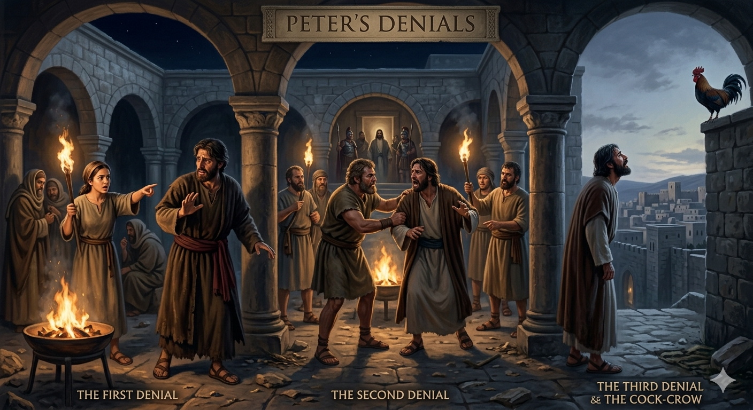
Peter – Failure to Restoration
Notes:
Did Jesus just forgive him? no, he went farther than that and recommissioned him. The man that denied Jesus went and publicly preached him and lead the early church.

Slide 42
The Pattern of Redemption
1 John 1:9
⁹ If we confess our sins, He is faithful and just to forgive us our sins and to cleanse us from all unrighteousness.
Notes:
There's a similar pattern that we see. Action, that action was confessing their sins and repenting. We can read (1 John 1:9). Redemption and restoration isn't something that just happens, it requires action on our part.

Slide 43
Call to Respond
Acts 3:19
¹⁹ Repent therefore and be converted, that your sins may be blotted out, so that times of refreshing may come from the presence of the Lord,
Notes:
I invite you to respond to God's message, to repent and be made whole in God's kingdom (Acts 3:19)

Slide 44
You are not too far gone
You’re not too hostile toward God (Saul)
Not too ashamed of your past (Samaritan woman, Rahab)
Not too weak or inconsistent (Peter)
Not too far gone after failure (Moses)
Not too deep in sin or corruption (Manasseh)
Notes:
I want you to look at how you’re living your life. You've heard his word, do you believe it? Have you been baptized? Are you living in and flourishing in his kingdom? If you answered no to any of these questions then I request you to come forward now as we stand and sing because

Slide 45
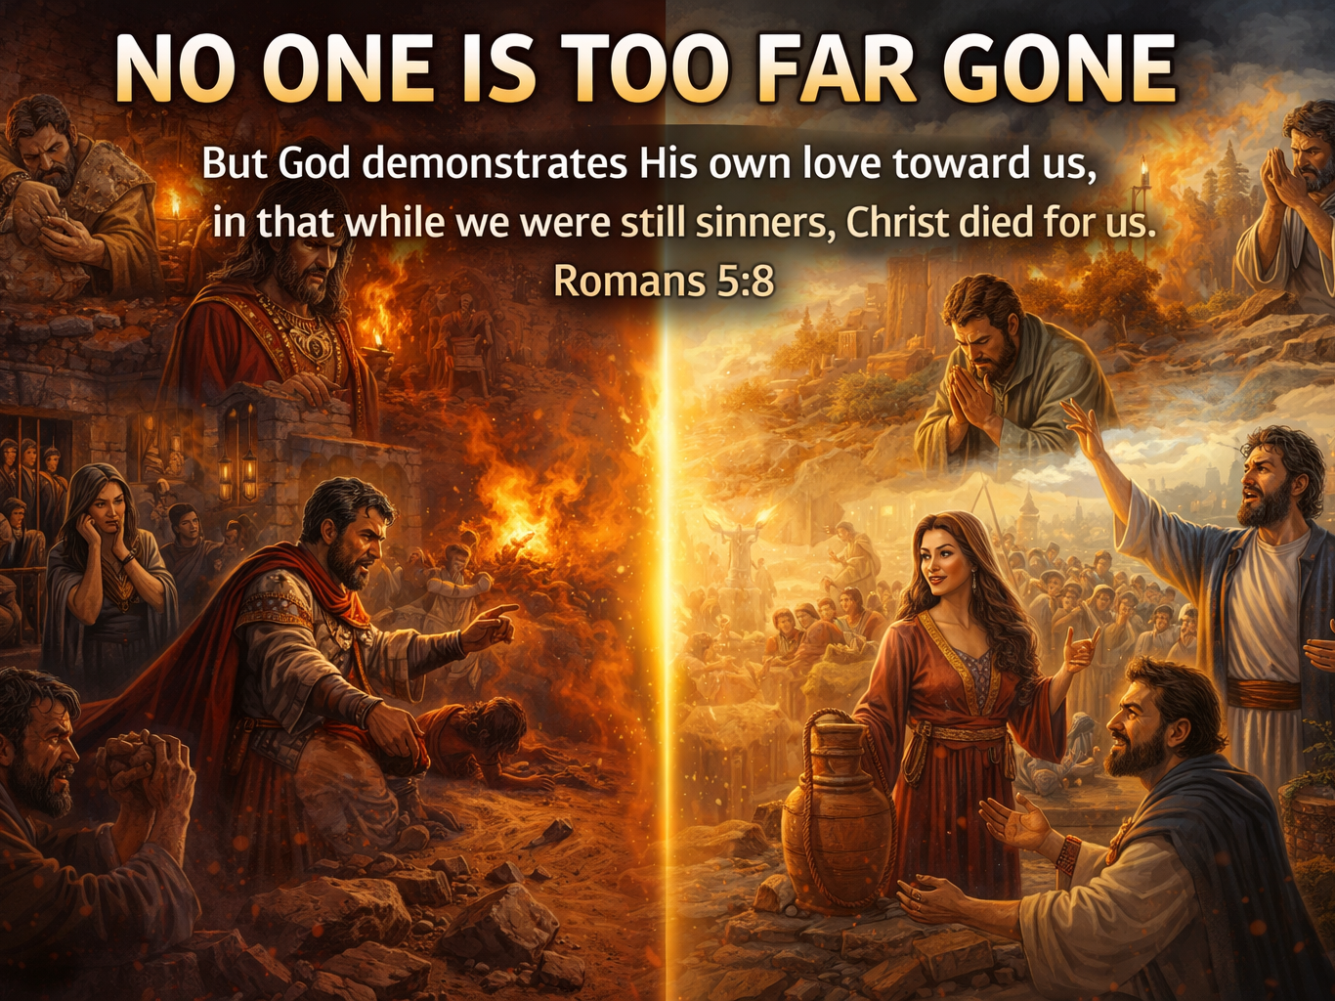
Notes:
no one is too far gone.

